Slide 1


Monday 8th February 2021
L.O To label a picture

Slide 2
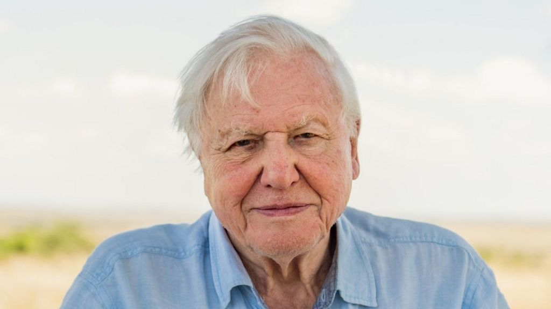
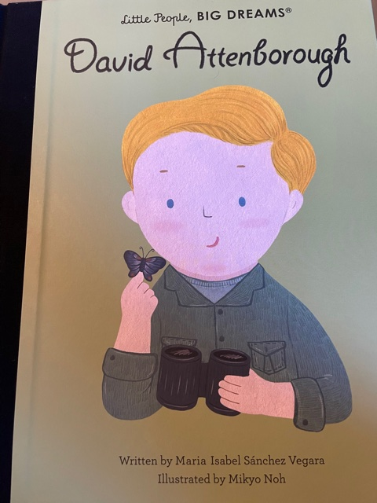
This week we are learning about a real life superhero called Sir David Attenborough. He has helped us to understand how to save after our planet and the animals on it.

Slide 3
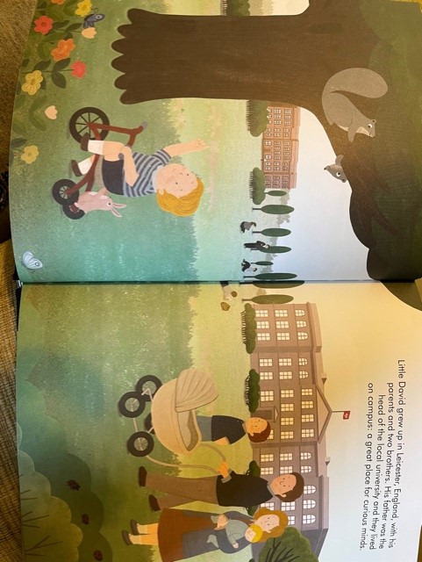

Slide 4
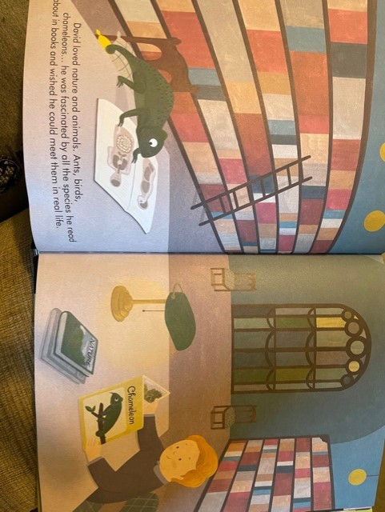

Slide 5
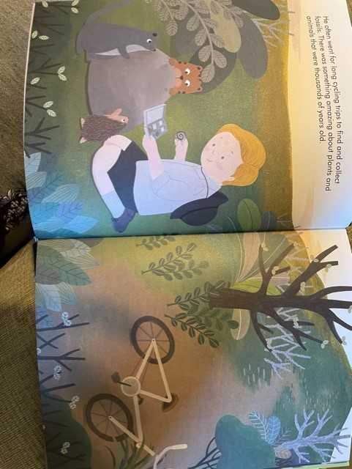

Slide 6
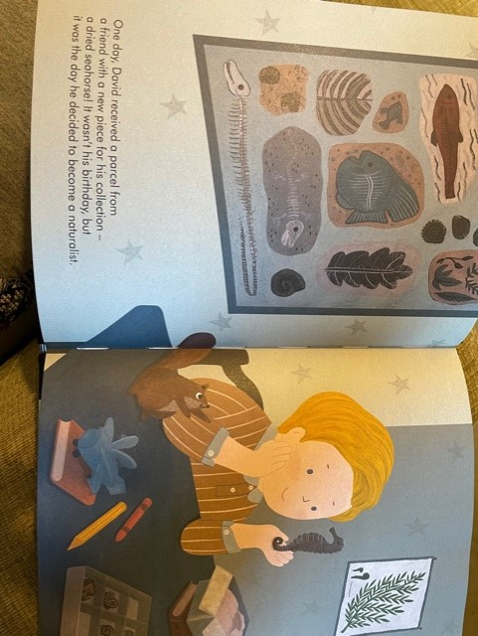

Slide 7
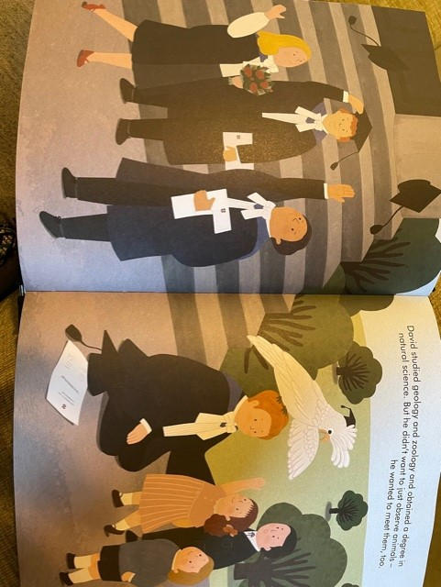

Slide 8
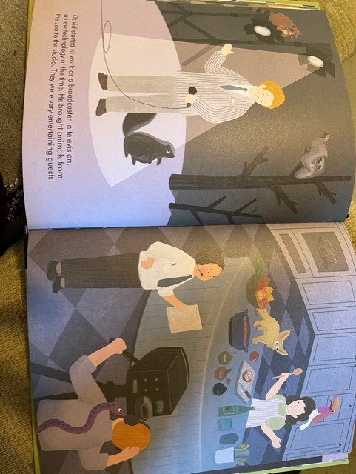

Slide 9
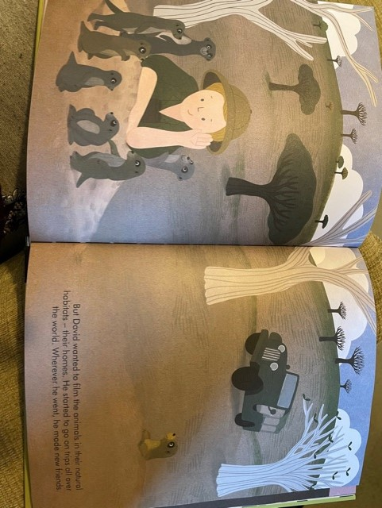

Slide 10
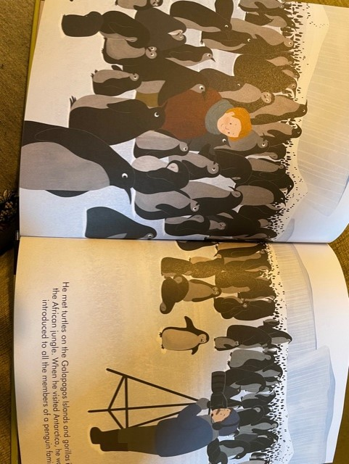

Slide 11
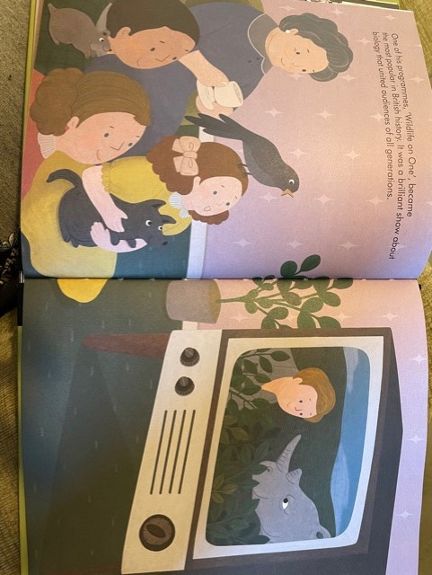

Slide 12
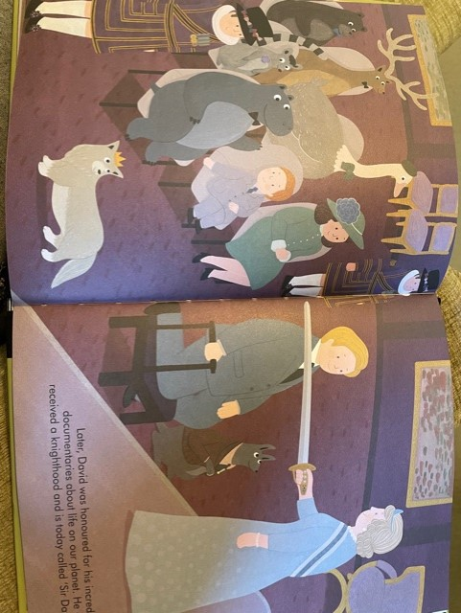

Slide 13
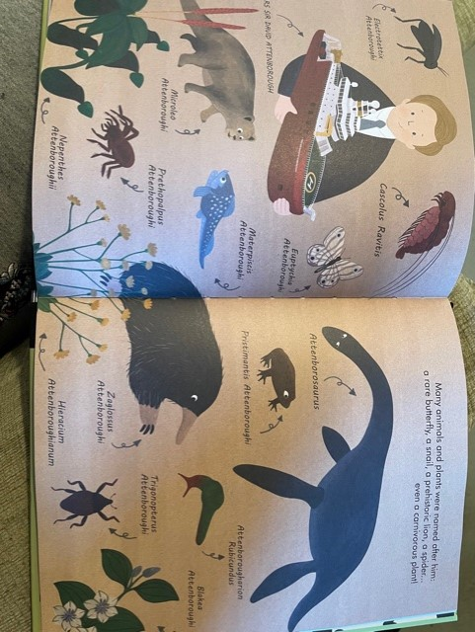

Slide 14
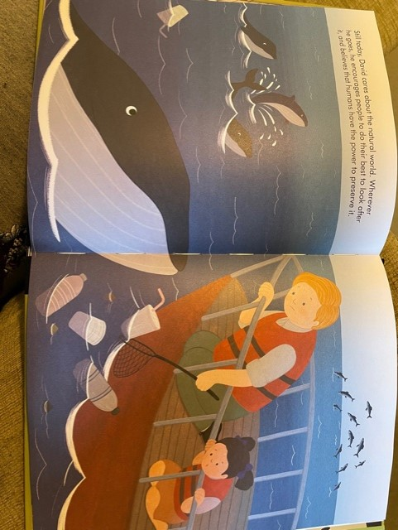

Slide 15
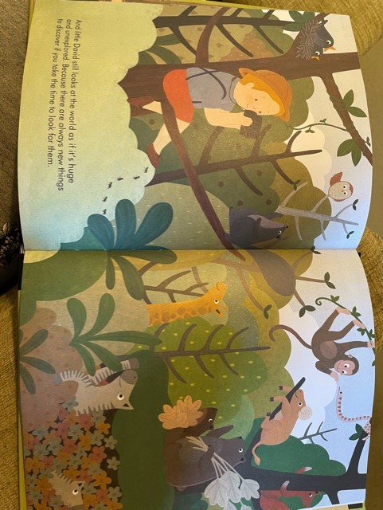

Slide 16
Sir David Attenborough
Enjoys learning about animals
Made documentaries on the TV all about animals
Tells us how to save our planet and look after the animals
He is a real life superhero, trying to help us all look after our planet!

Slide 17
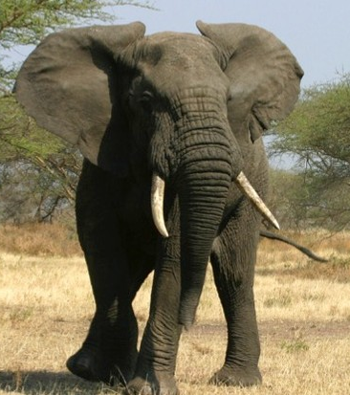
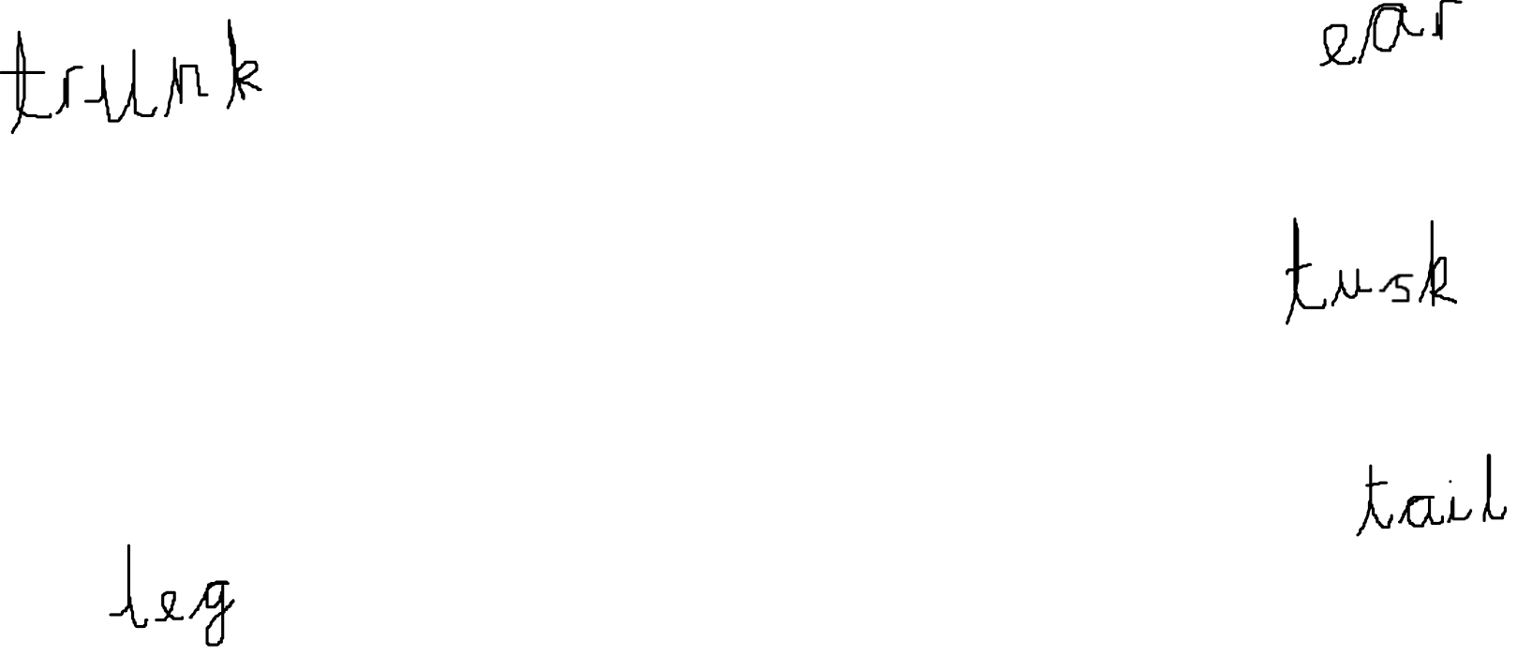
Labelling a Picture

Slide 18

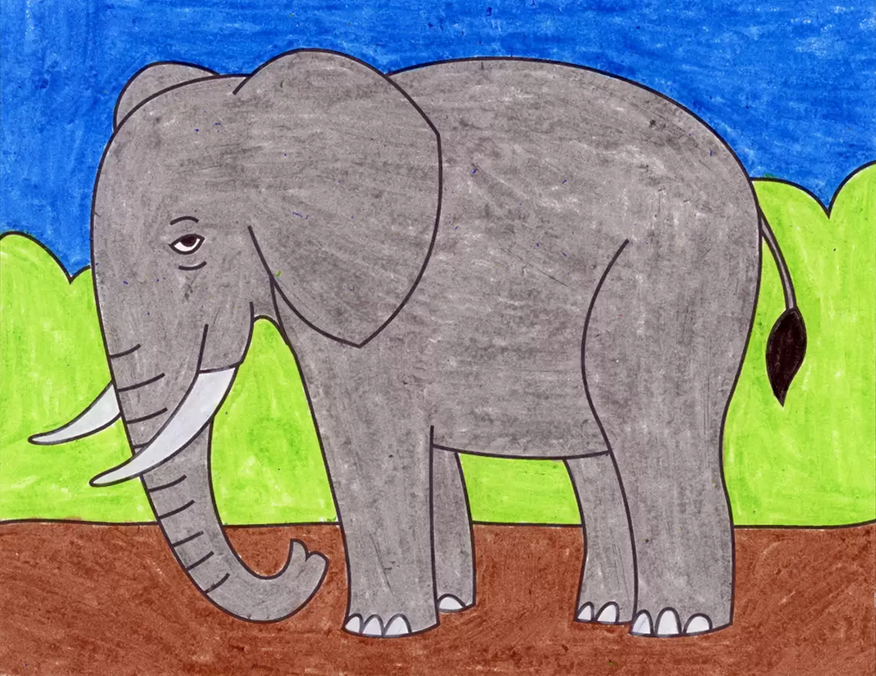





Today’s Activity
Draw a picture of your favourite animal
Label your picture
Extension
https://www.bbc.co.uk/cbeebies/puzzles/sir-david-attenboroughs-guess-the-wild-animal-quiz

