Slide 1


Slide 2
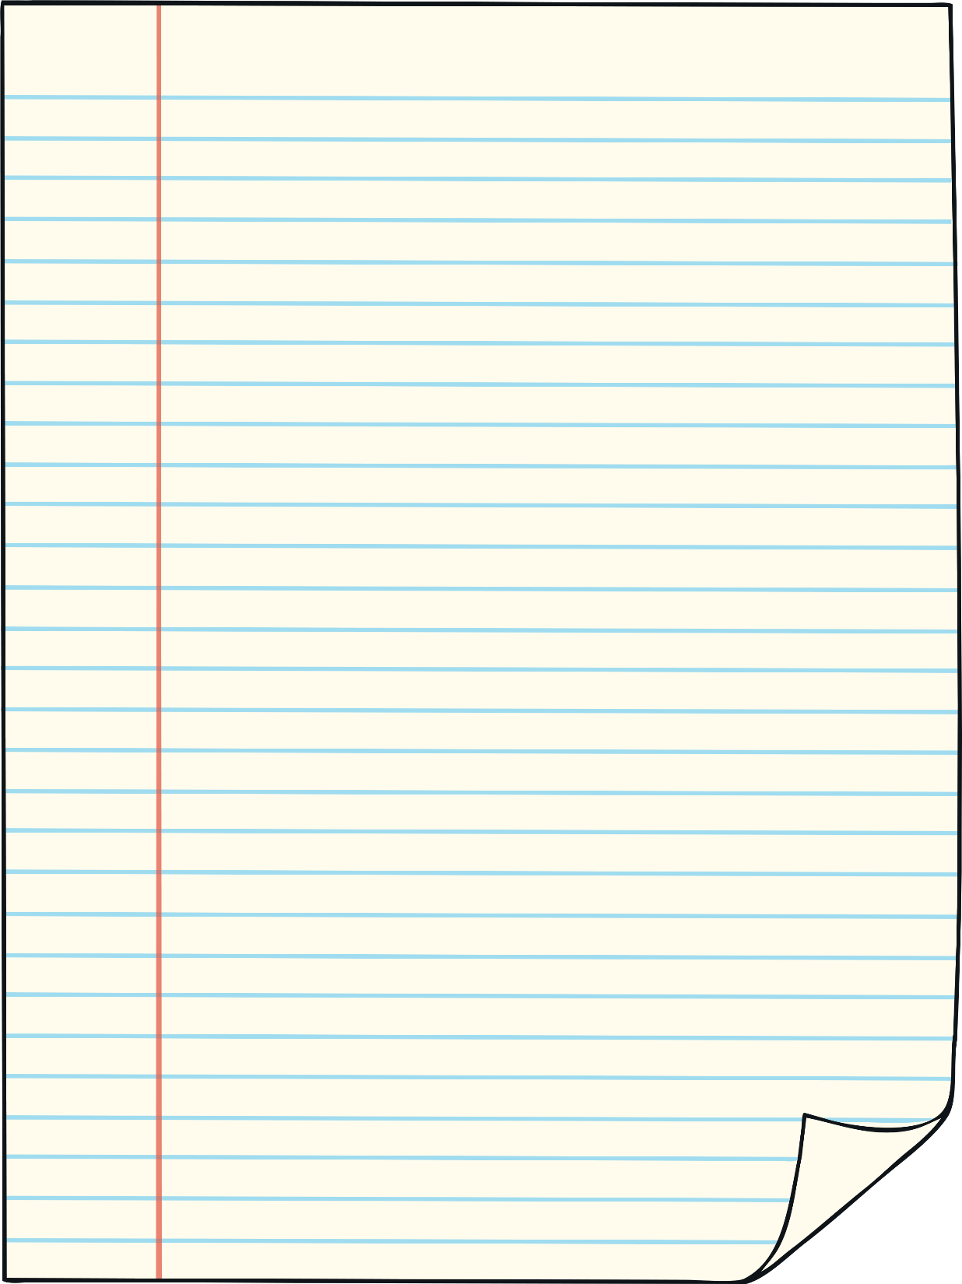



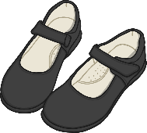


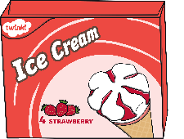
Off to the shops!
What will you buy first?
crayons
apples
sweets
shoes
carrots
ice creams

Slide 3
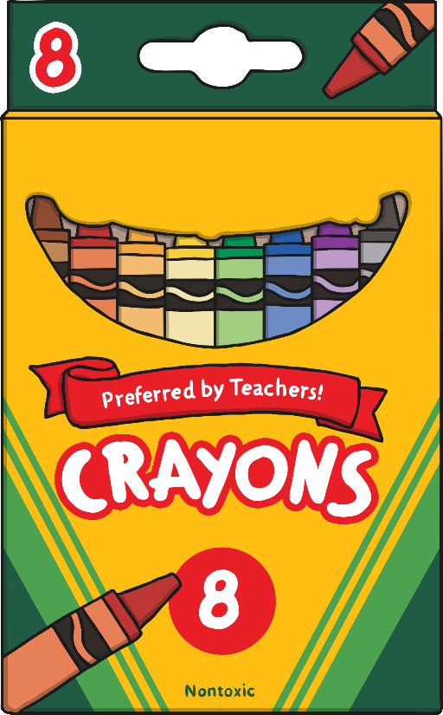
How many crayons have you bought?
back
+
=
10
0
1
2
3
4
5
6
7
8
9
10

Slide 4


How many apples have you bought?
back
+
=
5
7
0
1
2
3
4
5
6
7
8
9
10

Slide 5
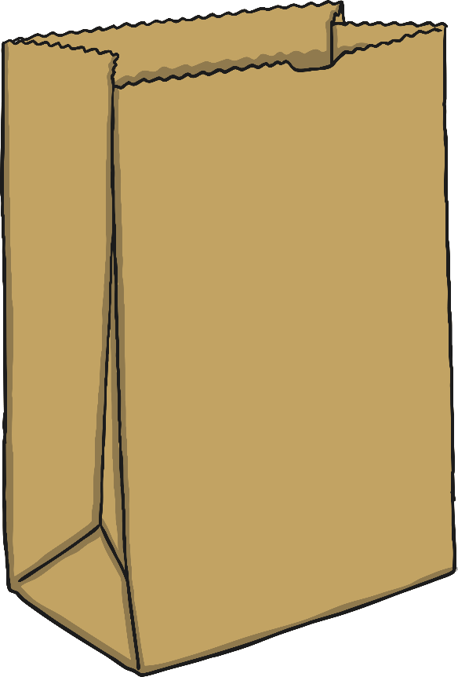



How many sweets have you bought?
back
6
+
=
9
0
1
2
3
4
5
6
7
8
9
10

Slide 6
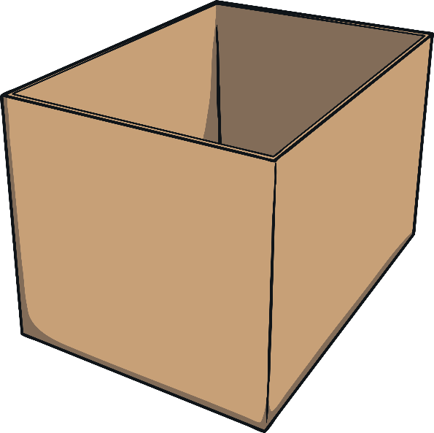

How many shoes have you bought?
back
2
+
=
4
0
1
2
3
4
5
6
7
8
9
10

Slide 7



How many carrots have you bought?
back
+
=
3
8
0
1
2
3
4
5
6
7
8
9
10

Slide 8

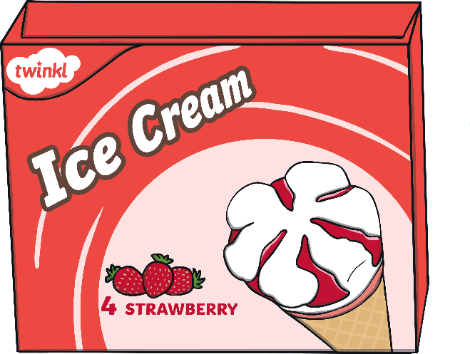
How many ice creams have you bought?
back
+
=
7
0
1
2
3
4
5
6
7
8
9
10

