Slide 1
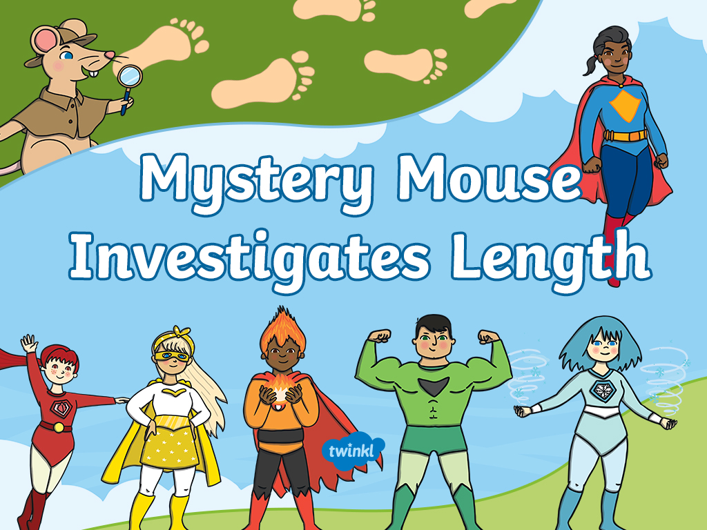

Slide 2
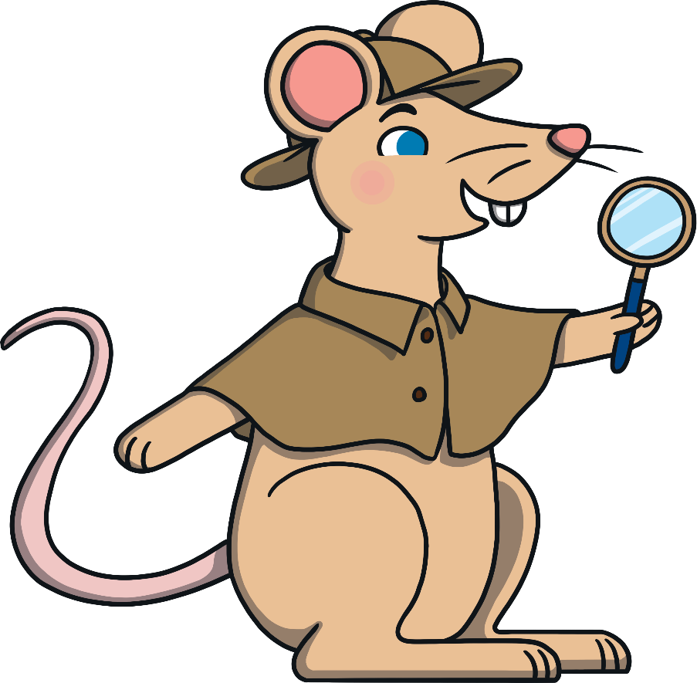
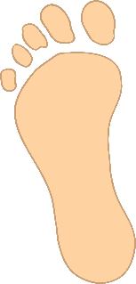
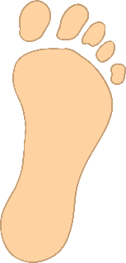

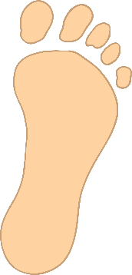
Mystery Mouse loves superheroes! He likes to track their footprints
to find out which superheroes have completed their missions.
Can you help Mystery Mouse to work out which superheroes
have been leaving their footprints behind?

Slide 3




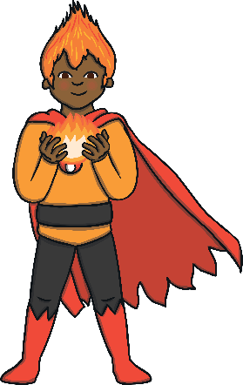
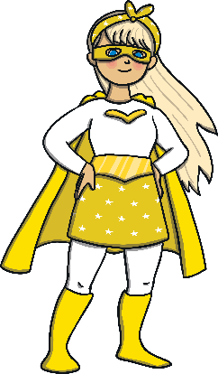
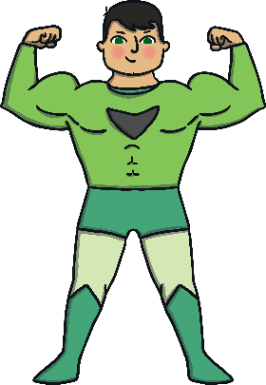
Which superhero left this footprint? How do you know?
It wasn’t me!
Try again.
It wasn’t me!
Try again.

Slide 4


Correct!
How many cubes long do you think my footprint is?
Click it to find out.
Next

Slide 5
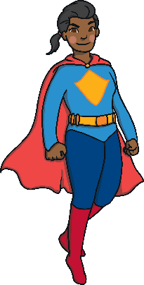
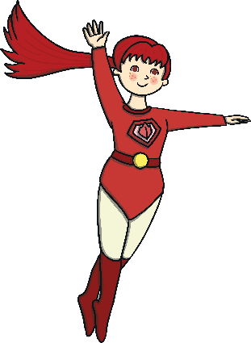
Which superhero left this footprint? How do you know?
It wasn’t me!
Try again.
It wasn’t me!
Try again.

Slide 6


Correct!
How many cubes long do you think my footprint is?
Click it to find out.
Next

Slide 7
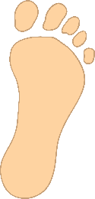
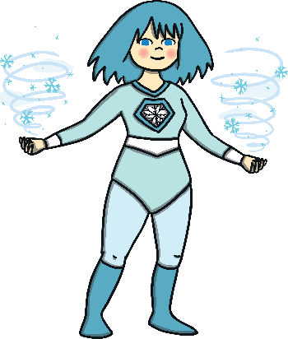
Which superhero left this footprint? How do you know?
It wasn’t me!
Try again.
It wasn’t me!
Try again.

Slide 8

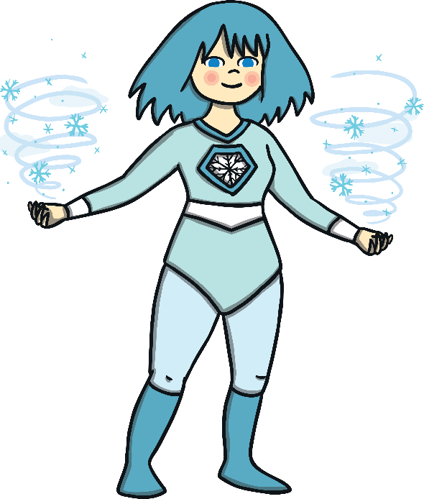
Correct!
How many cubes long do you think my footprint is?
Click it to find out.
Next

Slide 9




I found a footprint that is 6 cubes long.
Who does it belong to? How can you work it out?
That’s right!
My footprint is 6 cubes long.
It wasn’t me, my footprint is 4 cubes long. Try again.
It wasn’t me, my footprint is 7 cubes long. Try again.
Next

Slide 10


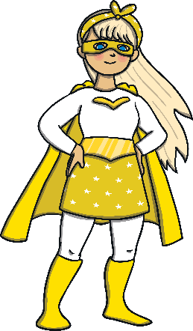


I found a footprint that is 3 cubes long.
Who does it belong to? How can you work it out?
That’s right!
My footprint is 3 cubes long.
It wasn’t me, my footprint is 4 cubes long. Try again.
It wasn’t me, my footprint is 2 cubes long. Try again.
Next

Slide 11


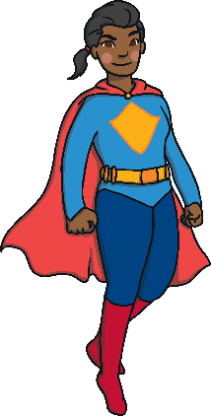

I found a footprint that is 8 cubes long.
Who does it belong to? How can you work it out?
That’s right!
My footprint is 8 cubes long.
It wasn’t me, my footprint is 7 cubes long. Try again.
It wasn’t me, my footprint is 5 cubes long. Try again.
Next

Slide 12


Can you help me work out whose footprint this is?
Can you estimate how many cubes long the footprint might be? Click on the footprint to count the cubes.
That’s right!
My footprint is 9 cubes long.
My footprint is 9 cubes long.
It wasn’t me! My footprint is 11 cubes long. Try again.
My footprint is 11 cubes long.
Next

Slide 13


Can you help me work out whose footprint this is?
Can you estimate how many cubes long the footprint might be? Click on the footprint to count the cubes.
That’s right!
My footprint is 12 cubes long.
My footprint is 12 cubes long.
It wasn’t me! My footprint is 10 cubes long. Try again.
My footprint is 10 cubes long.
Next

Slide 14


Can you help me work out whose footprint this is?
Can you estimate how many cubes long the footprint might be? Click on the footprint to count the cubes.
That’s right!
My footprint is 7 cubes long.
It wasn’t me! My footprint is 8 cubes long. Try again.
My footprint is 8 cubes long.
My footprint is 7 cubes long.
End

Slide 15
Thank you for helping me
to solve the mysteries!

Slide 16
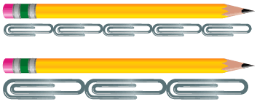
Today’s Activity
You will need:
Different objects
A group of the same sized objects to measure with (lego bricks, paper clips etc)
Estimate how many lego bricks (or items you have chosen) long the object is. Write your estimation down on the sheet. Use the object measure each item. Count how many objects long the item is. Was your estimate close?

Slide 17


