Slide 2
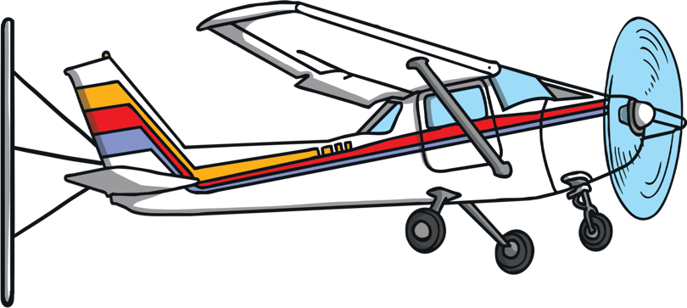

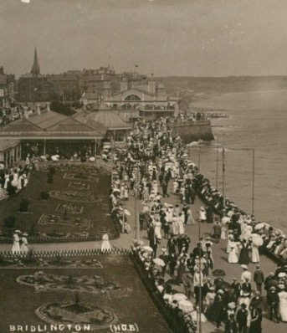
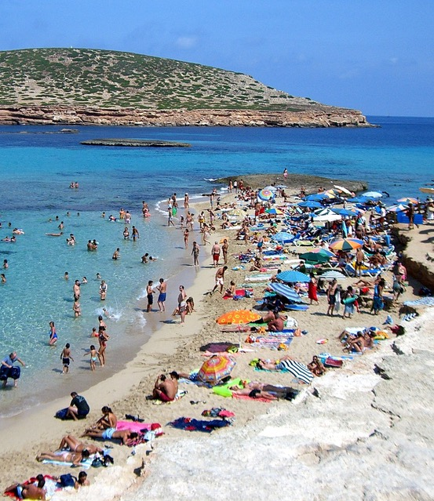
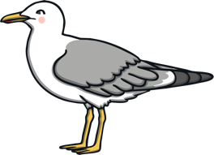
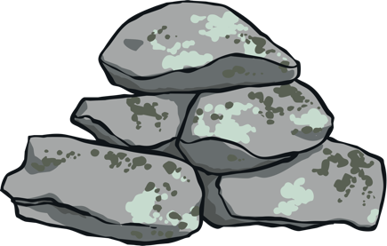

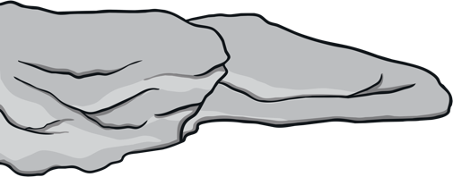
Exploring Seaside Holidays
Past and Present
What is different?
What is the same?

Slide 3
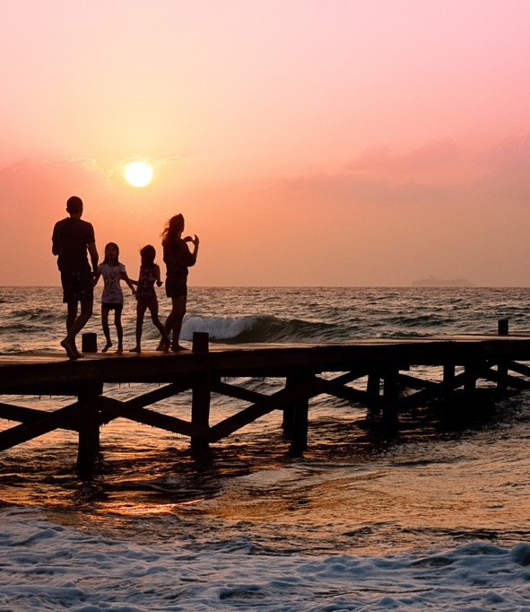
People have been going on holiday to the seaside for hundreds of years, which is a very long time.
When something happened a long time ago, you can say that it happened in the past.
When something is still happening today, you can say it is happening in the present.
There are lots of similarities and differences between seaside holidays in the past and seaside holidays in the present.

Slide 4
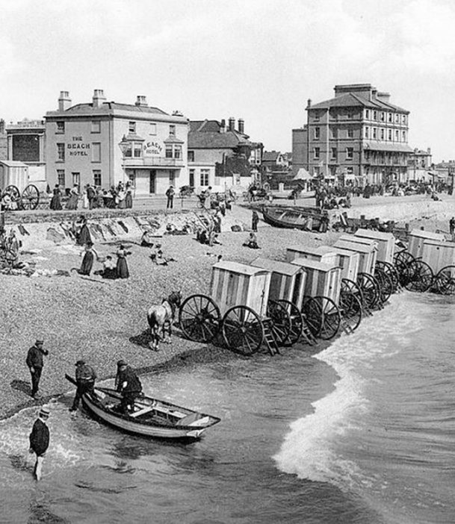
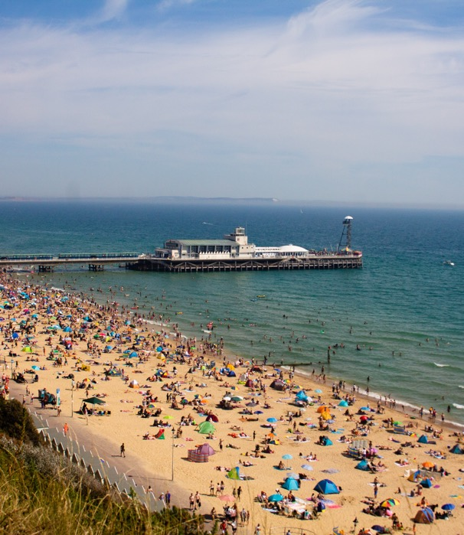
Look carefully at the photographs.
I wonder which photograph shows a seaside holiday from the past…
What do you notice about the two photographs?

Slide 5
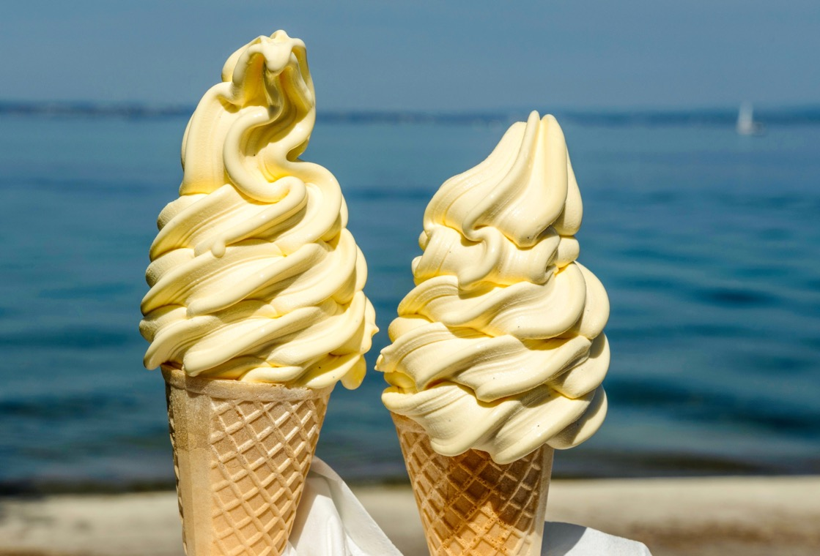
Ice Creams
It is a similarity between seaside holidays in the past and in the present.
I wonder if people in the past used to like eating ice creams when they went to the seaside.
What do you think?
Eating ice creams at the seaside is something that people have done for a very long time.

Slide 6
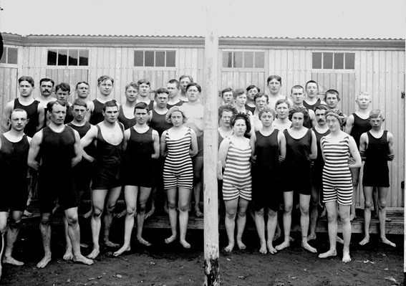
Swimwear
In the past, people often wore swimwear that covered most of their body when swimming in the sea.
Do you think the swimwear they wore in the past to swim in the sea is the same as people wear today?
What swimwear do people wear today when they swim
in the sea?
In the past, just like today, people liked to go swimming when they went to the seaside.

Slide 7
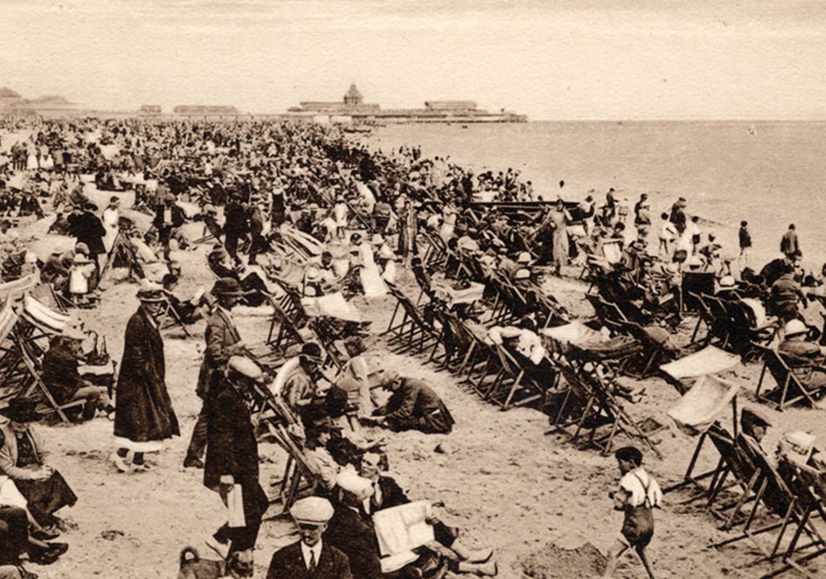
Building Sandcastles
This photograph shows a seaside holiday from the past. Can you spot the sandcastle?
Building sandcastles is something children often do on seaside holidays today and something they also used to do in the past.
What else do you notice about this photograph from the past?
Have you ever been to the beach and built a sandcastle?
In the past, do you think children used to build sandcastles at the seaside?

Slide 8
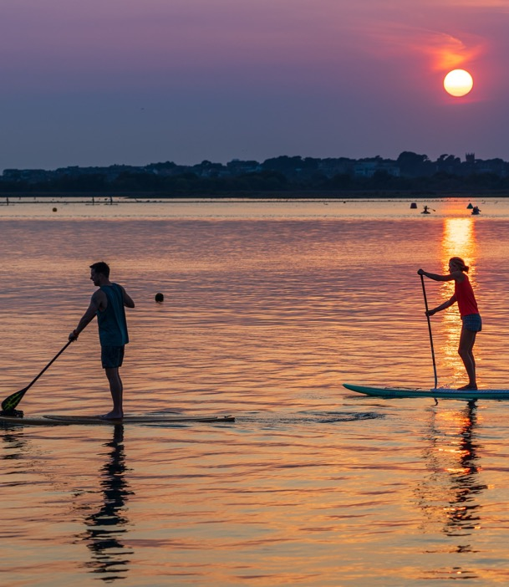
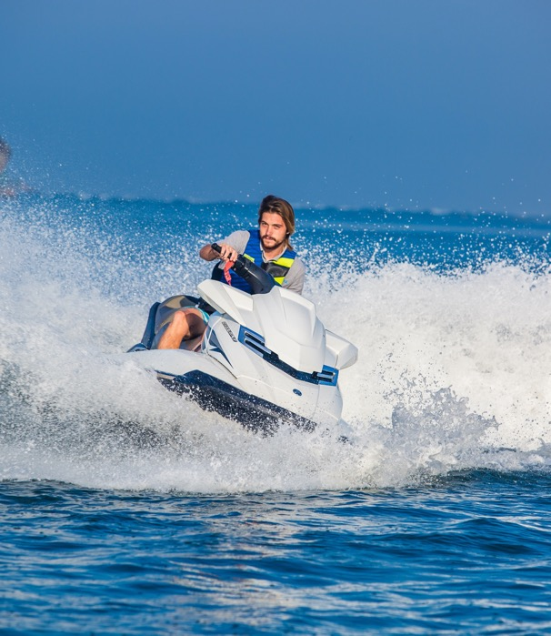
Activities in the Sea
This is a difference between seaside holidays in the past and the present, people didn’t do these activities at the seaside in the past.
Swimming and paddling in the sea, on a seaside holiday, is something people have done for hundreds of years!
There are other activities you can do in the sea today, such as paddle boarding or going on a jet ski.
Do you think people in the past did these activities at the seaside?

Slide 9
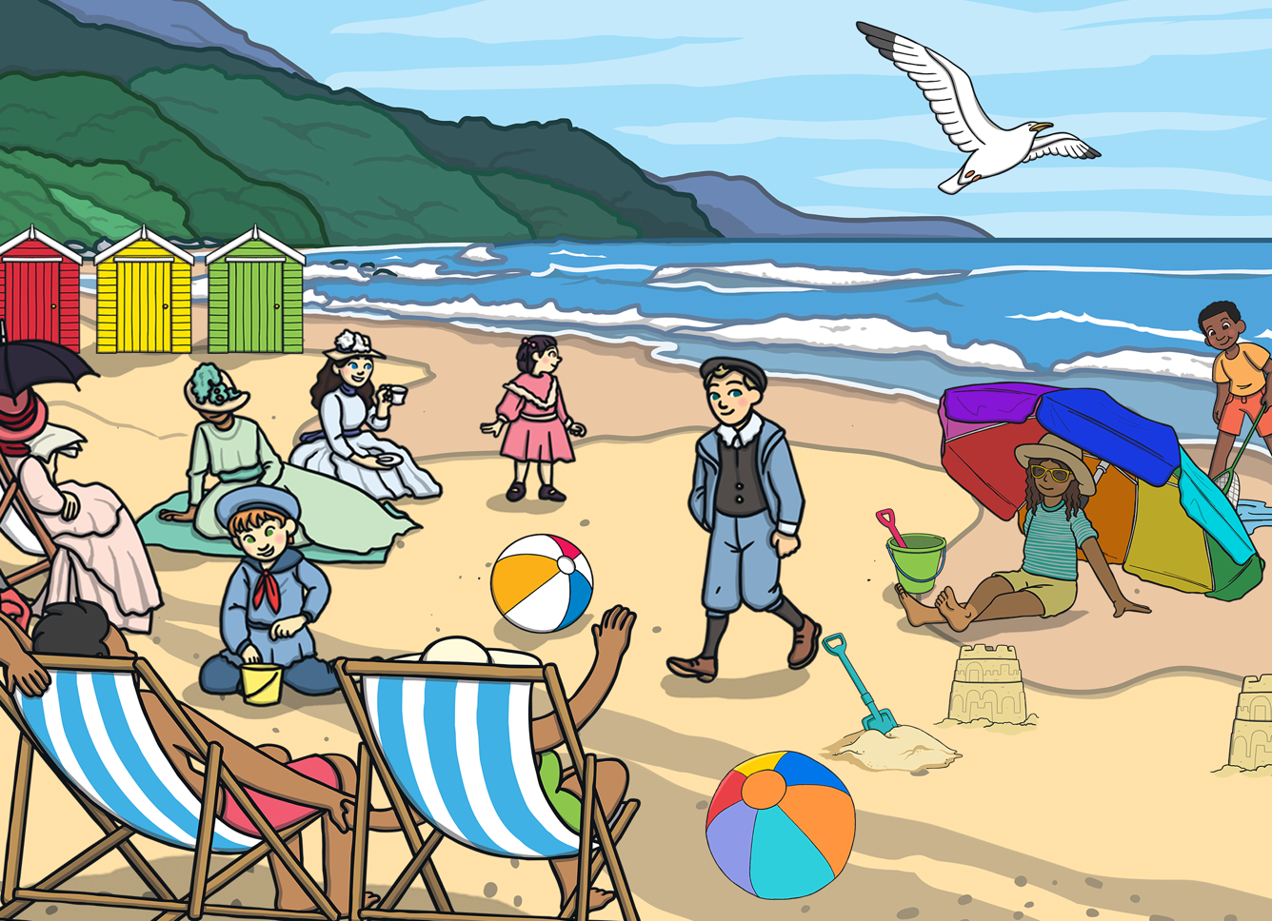
Can you think of anything else that might be different when you go on a seaside holiday today, compared to in the past?
Can you think of any other similarities between seaside holidays in the past and seaside holidays people go on today?

