Slide 1
Year 2 curriculum presentation for parents

Slide 2
English
The National Curriculum for English consists of -
Reading
Writing
Spelling
Speaking and Listening
Handwriting
Vocabulary, Grammar & Punctuation

Slide 3
Handwriting
The children practise continuous cursive handwriting first thing in the morning and are encouraged to use this throughout all of their writing.
They should continue to ‘lead’ in every letter from the writing line.

Slide 4
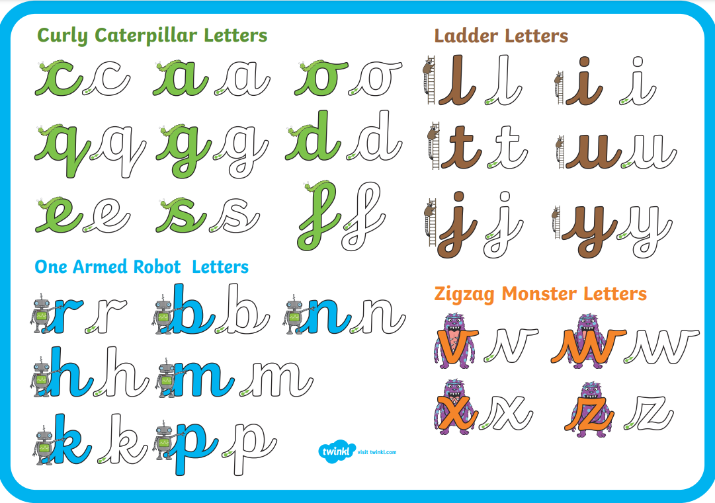

Slide 5

Phonics
Phonics is taught for 20-25 minutes every morning.
The children will be reviewing the Phase 5 sounds they learned in Year 1, for five weeks.
After the review we will move onto Little Wandle ‘Bridge to Spelling’ for five weeks. They will be learning foundational skills for spelling.
For the rest of the year we will teach Little Wandle Spelling Units to complete the coverage of the Year 2 National Curriculum requirements.

Slide 6
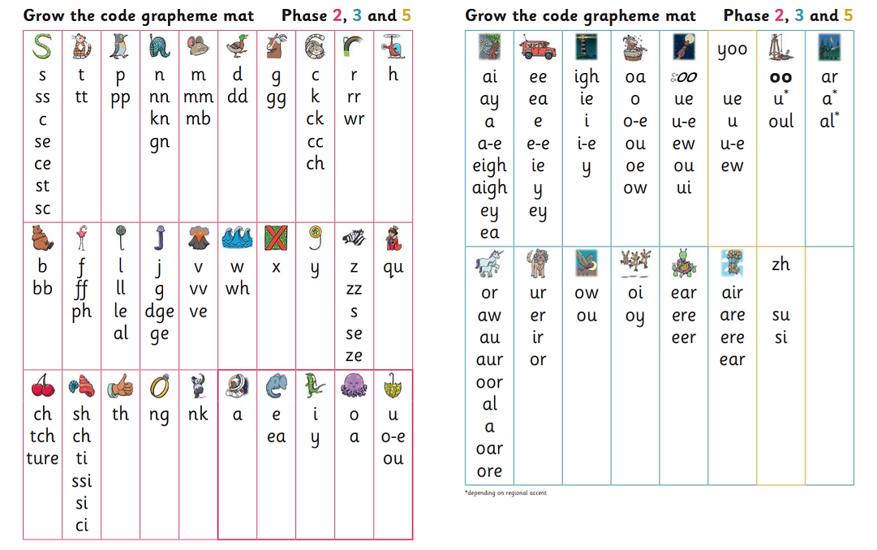

Slide 7

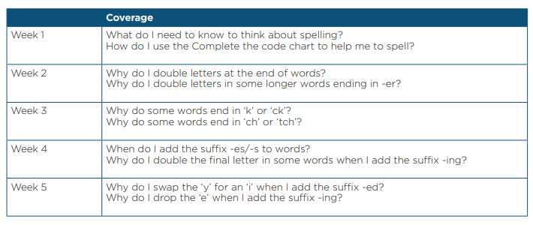
Bridge to Spelling

Slide 8
Little Wandle Spelling Units
Homophones
Prefixes –un/dis
Suffixes – ed/ing
Compound words – strawberry/playground
Past and present tense
Contracted words – don’t/I’m

Slide 9
Spelling
Every Friday the children will bring home spellings based on the graphemes learnt in Phonics that week. We shall also be learning to spell the Year 2 common exception words.
They will be tested the following Friday.
The children will be expected to spell the Year 2 common exception words by the end of the academic year. These will assessed throughout the year.

Slide 10
Reading
We strive to hear the children read as much as possible through a variety of activities.
This can be done through;
Little Wandle Reading groups
Individual reading
Reading questions or extracts and texts
Written and spoken comprehension activities
We cannot emphasise enough the importance of you listening to your child read as much as possible. If your child reads at home, at least 3 times a week, they will earn a sticker for their chart.

Slide 11
Reading
In Year Two, there is a higher emphasis on not just being able to decode and read the text but also –
Read with understanding
Read with fluency and pace
Predict what might happen
Correctly sequence events
Identify and discuss main characters
Suggest alternatives or extensions to plot
Comments on how the book is written and presented
Make inferences on the basis of what is said and done

Slide 12
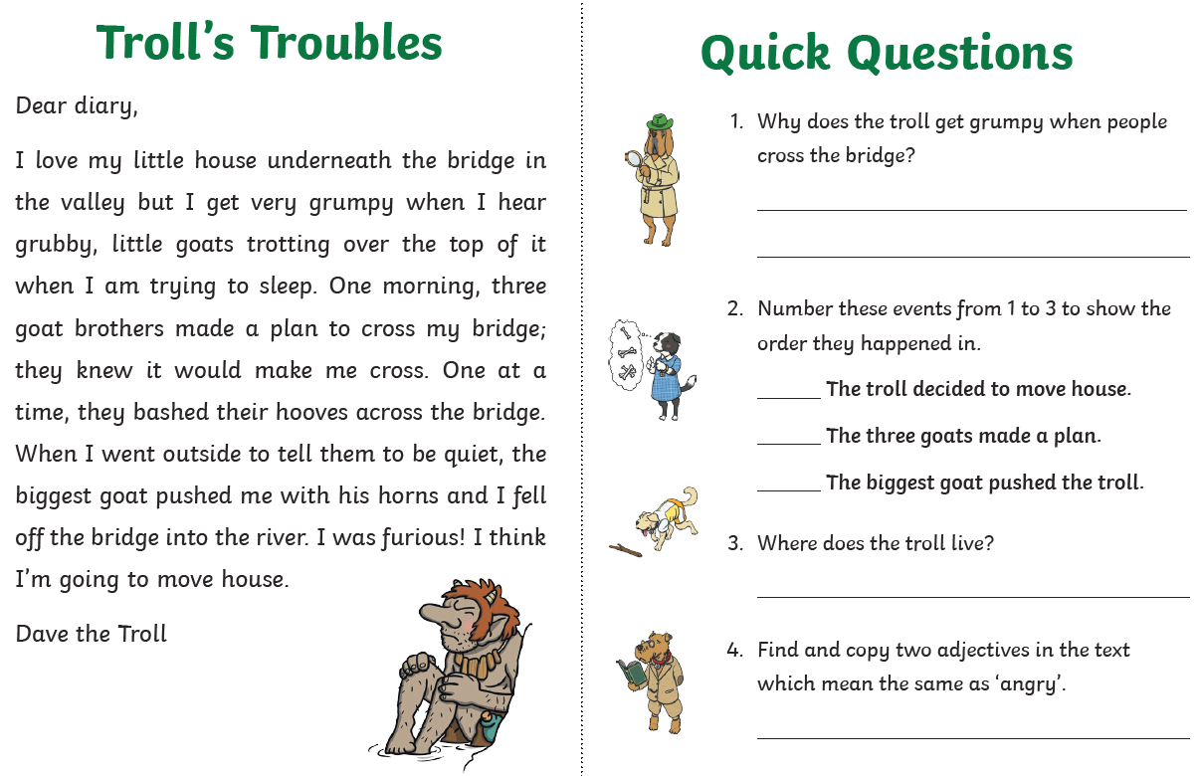
Reading Comprehension

Slide 13
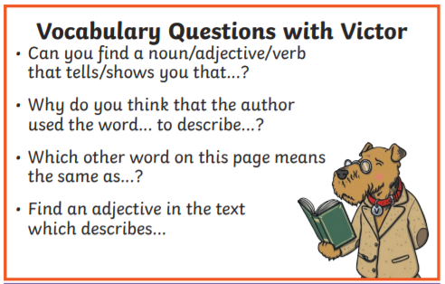
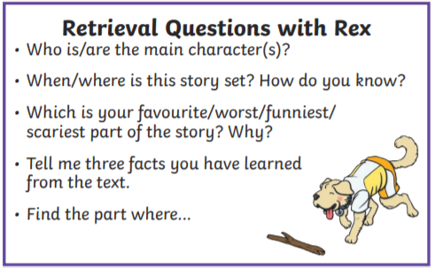
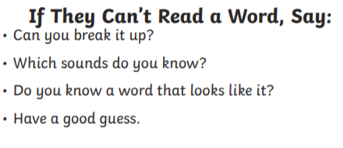
Examples of the types of questions you can ask your child when listening to them read.

Slide 14
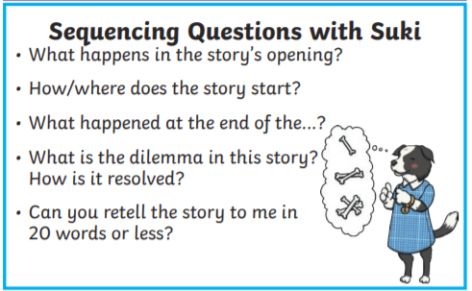
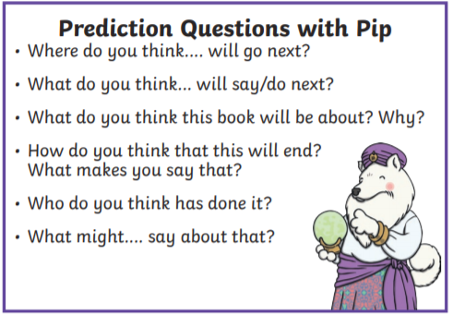

Slide 15
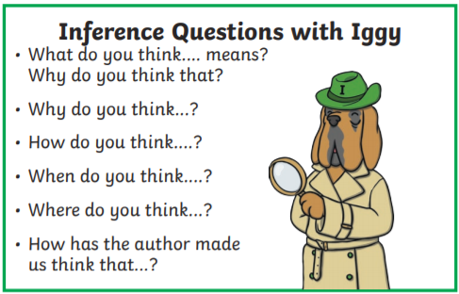
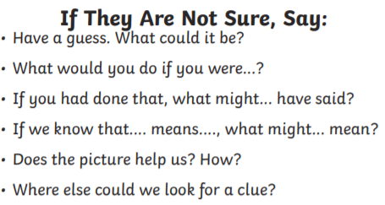
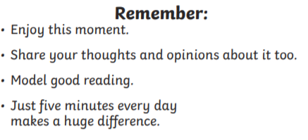

Slide 16
Reading
There is a wide range of information and support for reading on our class webpages including -
Links to online resources
Books suggestions for Year 2 readers
Book band information
Virtual school library
Reading for pleasure

Slide 17
Writing
This year we will provide the children with a range of Writing opportunities -
narratives about personal experiences and those of others (real and fictional)
about real events
poetry
writing for different purposes

Slide 18
Writing
We aim for the children to develop positive attitudes and stamina for writing.
They will now be expected to work with increasing independence.
They will be expected to work more quickly and write for extended periods.
Their work will become more accurate and will use a wider vocabulary and more ambitious word choices.
The children will be taught to make simple additions, revisions and corrections by proof reading their work.

Slide 19
Vocabulary, Grammar & Punctuation
As the year progresses we expect to see correct & consistent use of:
Capital letters
Full stops
Question marks
Exclamation marks
Commas in a list
Apostrophes for contracted forms and the possessive (singular)

Slide 20
Vocabulary, Grammar & Punctuation
The children will learn to use –
Expanded noun phrases to describe and specify e.g. The large grey shark with sharp pointy teeth.
Present and past tenses correctly and consistently Identifying a sentence as a statement, question, command or exclamation
Identifying and using nouns, adjectives, verbs and adverbs

Slide 21
Vocabulary, Grammar & Punctuation
Conjunctions to extend sentences (when, if, that, because, or, and, but)
Words with contracted forms e.g. I’m, don’t we’ve.
Suffixes to spell some longer words, including –ment, –ness, –ful, –less, –ly

Slide 22

Maths
The National Curriculum for Maths consists of -
Number: Number & Place Value
Number: Addition & Subtraction
Number: Multiplication & Division
Number: Fractions
Geometry: Properties of shape
Geometry: Position & Direction
Measurement
Statistics

Slide 23
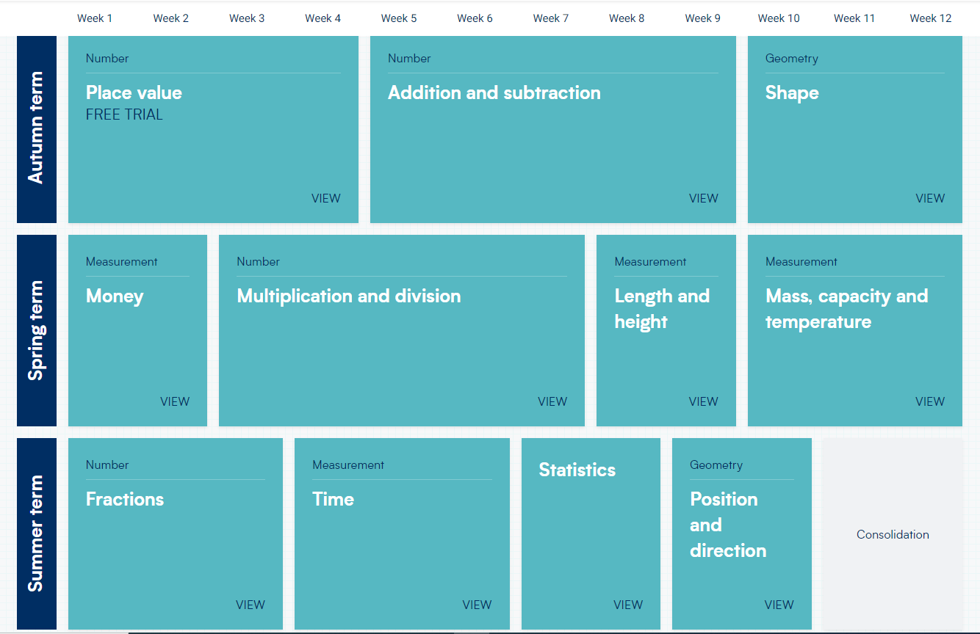


Slide 24
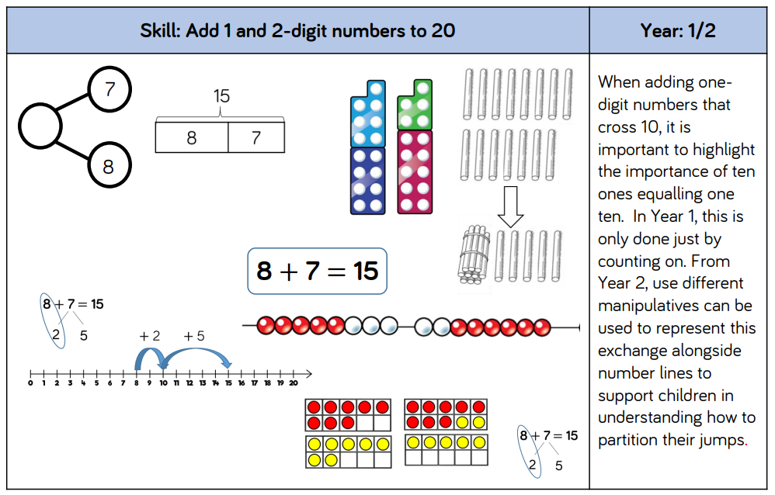
Addition – Models & Images to support teaching of concepts

Slide 25
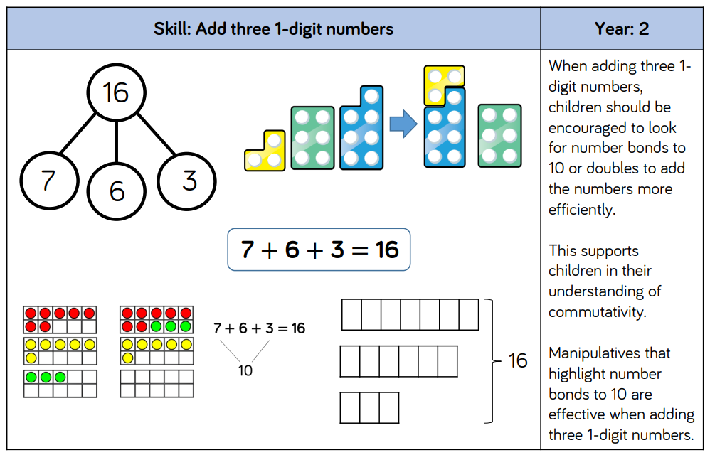
Addition – Models & Images to support teaching of concepts

Slide 26
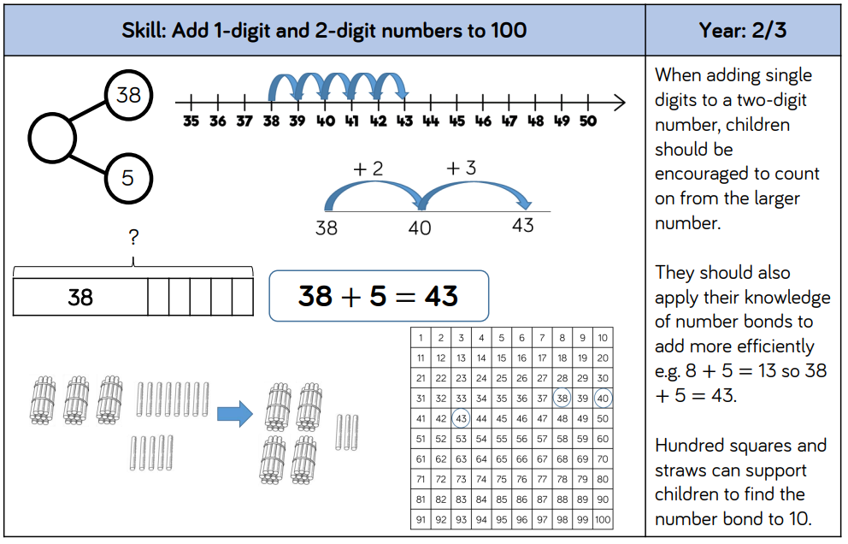
Addition – Models & Images to support teaching of concepts

Slide 27
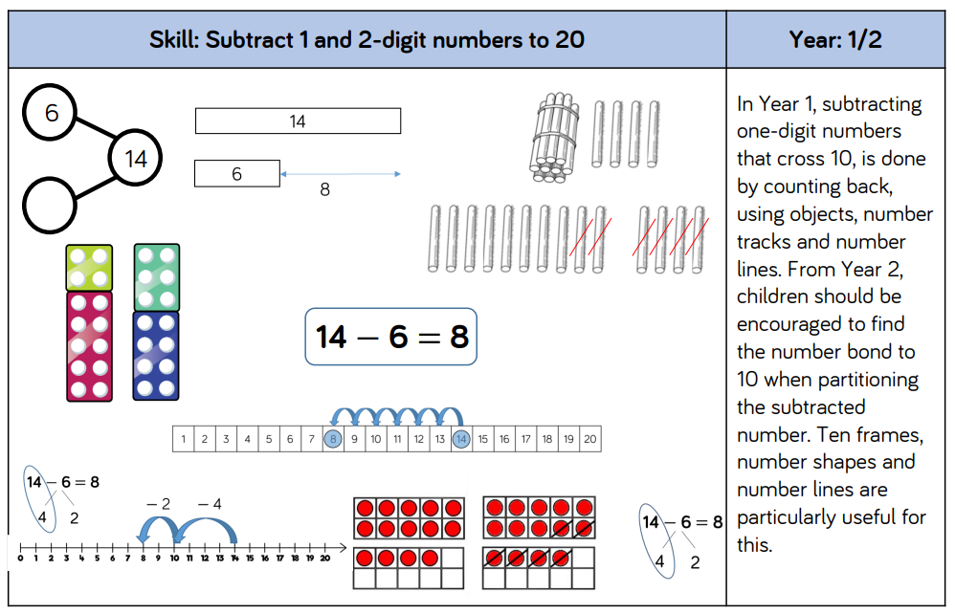
Subtraction – Models & Images to support teaching of concepts

Slide 28
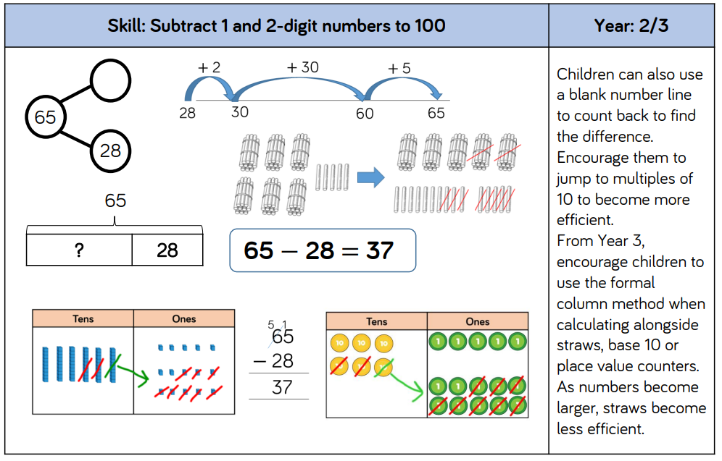
Subtraction – Models & Images to support teaching of concepts

Slide 29
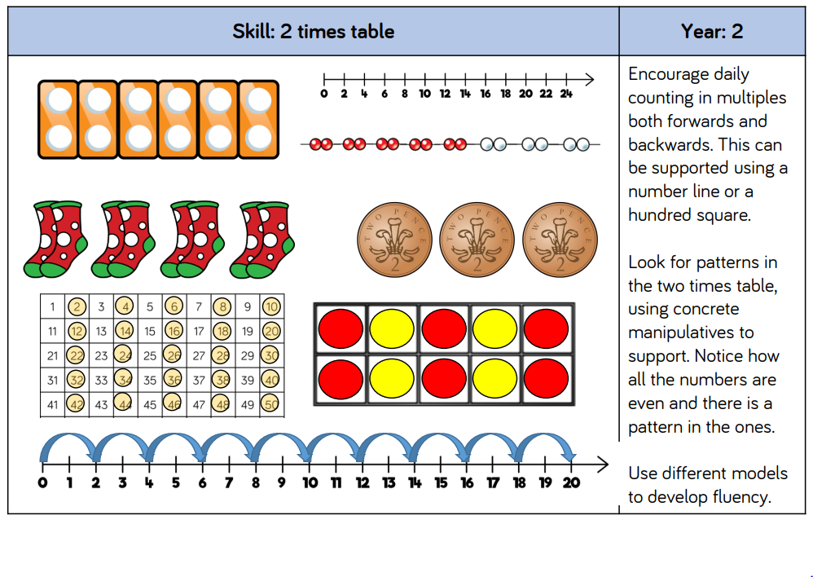
Multiplication – Models & Images to support teaching of concepts

Slide 30
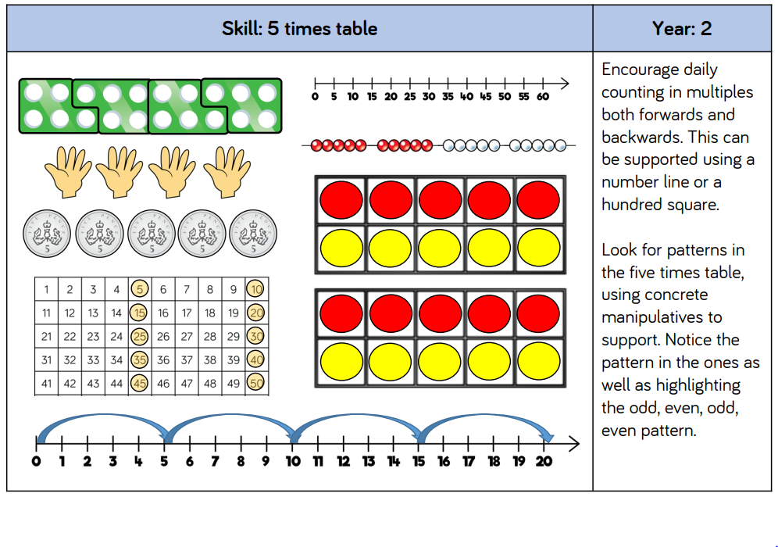
Multiplication – Models & Images to support teaching of concepts

Slide 31
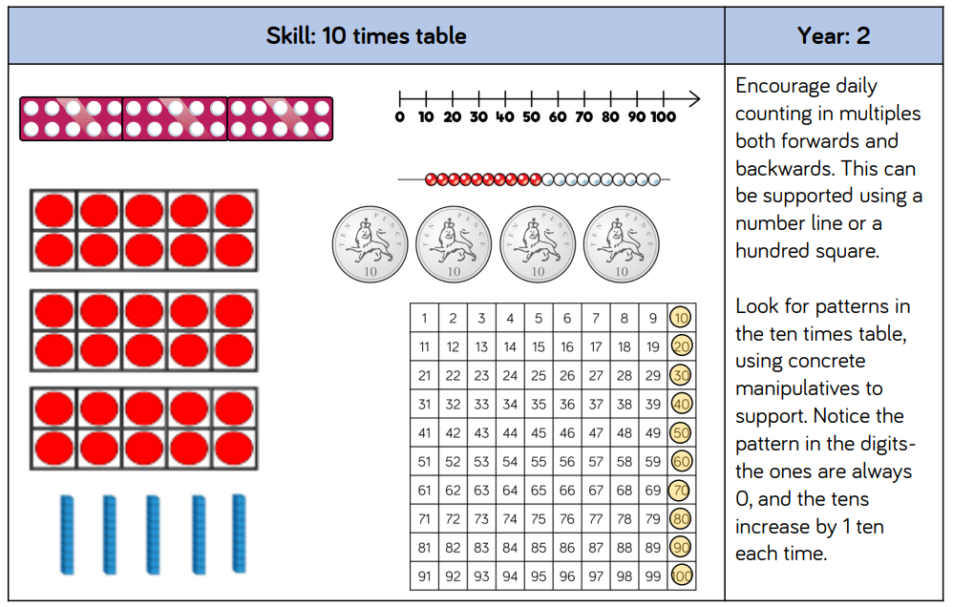
Multiplication – Models & Images to support teaching of concepts

Slide 32
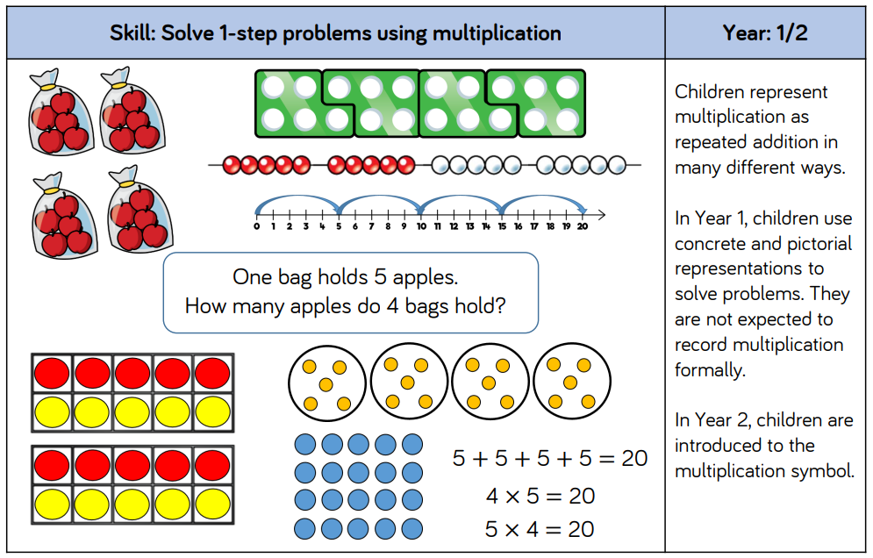
Multiplication – Models & Images to support teaching of concepts

Slide 33
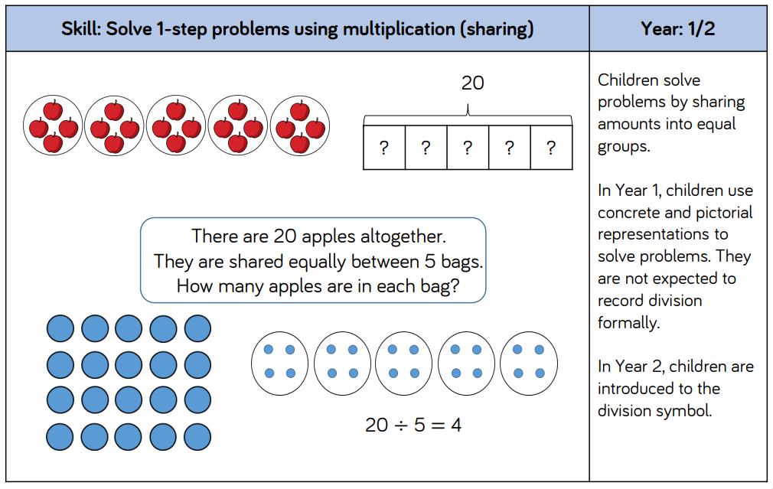
Division – Models & Images to support teaching of concepts

Slide 34
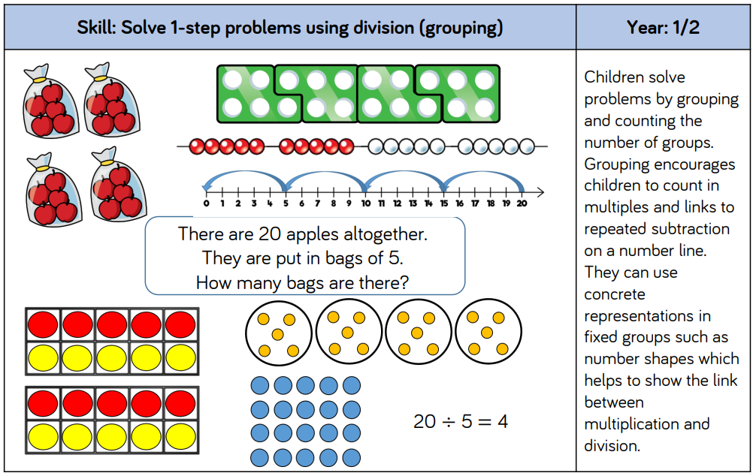
Division – Models & Images to support teaching of concepts

Slide 35
Science:
Animals including humans- Basic needs for survival, animals and their babies, exercise, hygiene and healthy eating
Working Scientifically- Performing simple tests, making observations, recording information
Uses of everyday materials- Identifying and comparing everyday materials, changing the shape of materials
Plants- Growing seeds and bulbs, conditions for growth
Living things and their habitats – Comparing living/non-living things, identify and name a variety of plants and animals, comparing habitats

Slide 36
Computing:
Word processing and animation
Graphics and artwork
Programing using Pro-bots, 2Control and Music software
Digital imagery
E-safety and emailing
Coding and debugging

Slide 37
History:
Time Travellers - Remembrance, Gunpowder Plot & Victorian Schooling
Nurturing Nurses - Florence Nightingale, Mary Seacole & Edith Cavell
Trailblazers – Ludwig Guttmann, Amelia Earhart & Ernest Shackleton

Slide 38
Geography:
All about the UK
  UK countries and surrounding seas
  Capital cities, Famous landmarks, Flags, National Flower, patron saints
Commotion in the oceans
  Continents, seas and oceans of the world
Comparing the U.K. to Kenya
  Human and physical features
  Rural and Urban comparisons

Slide 39
Art and D&T
Creating our own lighthouses with moving mechanisms.
Art skills – colour mixing, observational drawing
Sewing puppets
African Art – making masks, jewellery and printing
Investigating and preparing party food

Slide 40
Religious Education
Focus on the Jewish faith –
All about me
Important places and things
Special stories and people
Our world
Belonging

Slide 41
PSHE
VIP’s – importance of family, what makes a good friend, solving arguments, co-operation, showing you care
Safety first – identifying dangers in the home and outside, following rules to keep safe, e-safety, keeping privates private, emergency numbers,
Aiming high – star qualities, jobs they can do as a grown up and the skills needed, hopes for the future
Digital wellbeing – using the internet in a safe and responsible way
Growing up – differences and similarities, growing and changing
One world – different homes and environments, natural resources

Slide 42
Physical Education
Ball skills
Dance
Gymnastics
Sending and receiving
Team building
Invasion games
Athletics
Striking and fielding

Slide 43
How can you help your child at home?
English:
By listening to your child read every day and asking questions to check their understanding
Practice spelling regularly
Reading to your child
Supporting with homework

Slide 44
How can you help your child at home? continued
Maths:
Counting accurately and being confident with numbers up to 100.
Counting on and back in steps of 2, 10 and 5, starting from any given number.
By making sure the children are confident of their number bonds to 10, 20 and 100.
Working with them to improve their accuracy in adding and subtracting one and 2 digit numbers in their heads and on a number line.

Slide 45
How can you help your child at home?
Maths:
Understanding about numbers being greater than or less than other numbers.
Learning the 2, 5 and 10 times tables.
Identify simple fractions in shapes and numbers
Completing the Maths home learning sent home on a Friday

Slide 46
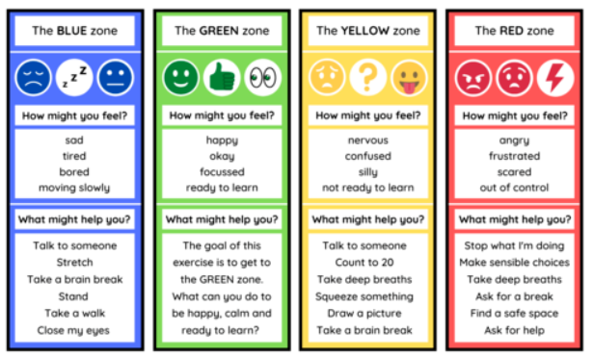
Self Regulation
We use Zones of Regulation to support the development of self-regulation. The children are encouraged to identify their feelings and use the taught methods to be in the appropriate zone.

Slide 47
Reading Folders
Please ensure that reading folders and books are brought to school every day. Children will change their books every Monday and Wednesday if they have finished them.
Include a list of adults who may collect your child in the inside cover.

