Slide 1
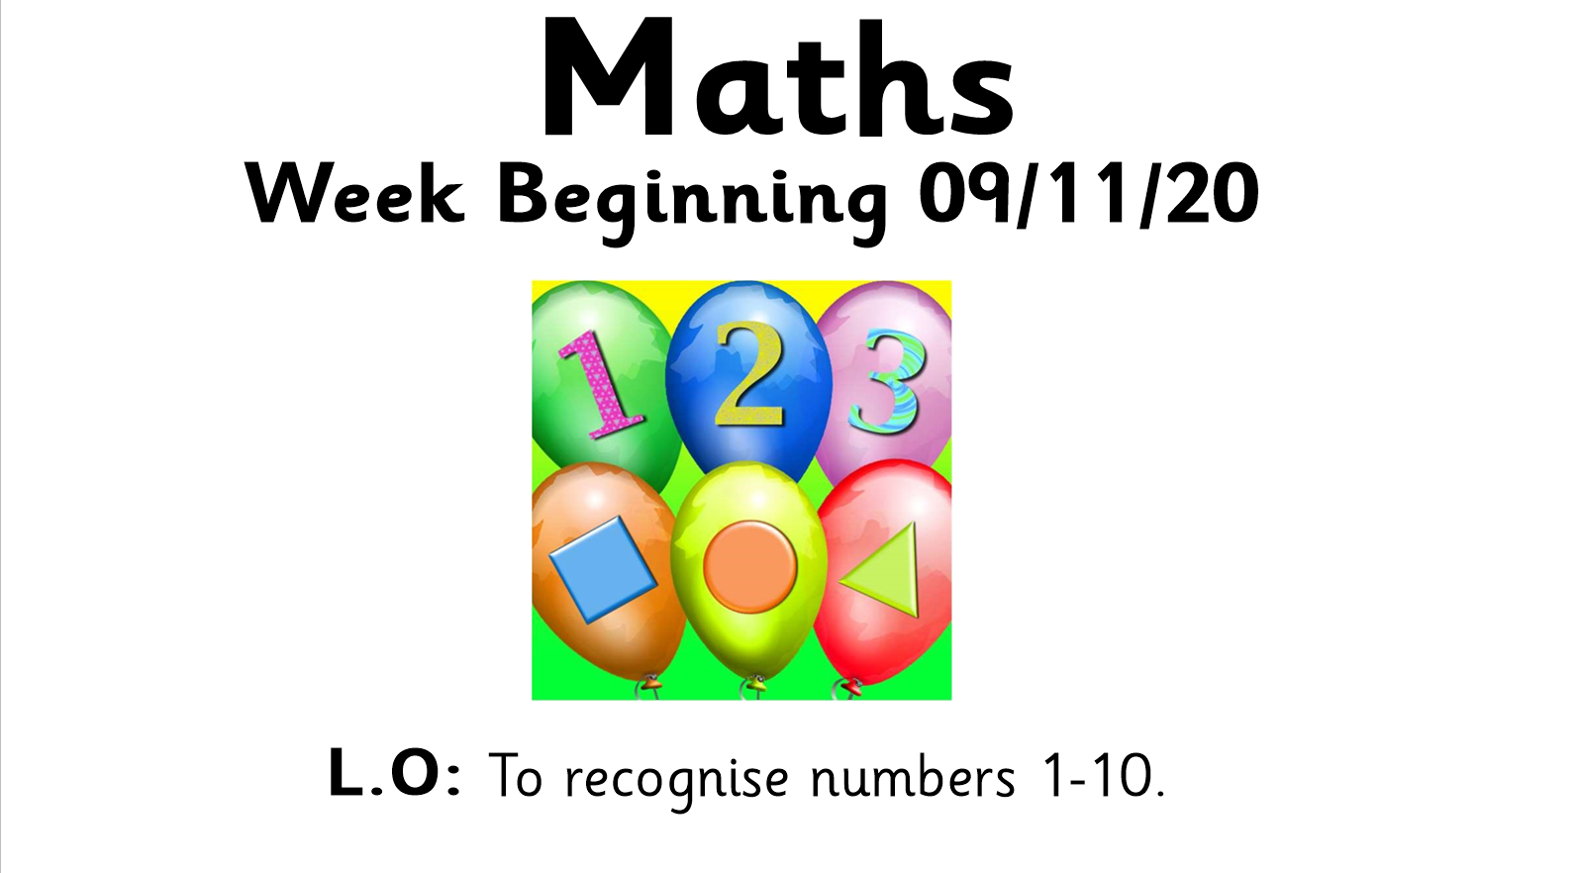

Slide 2

https://www.youtube.com/watch?v=3txltaYkTyE

Slide 3
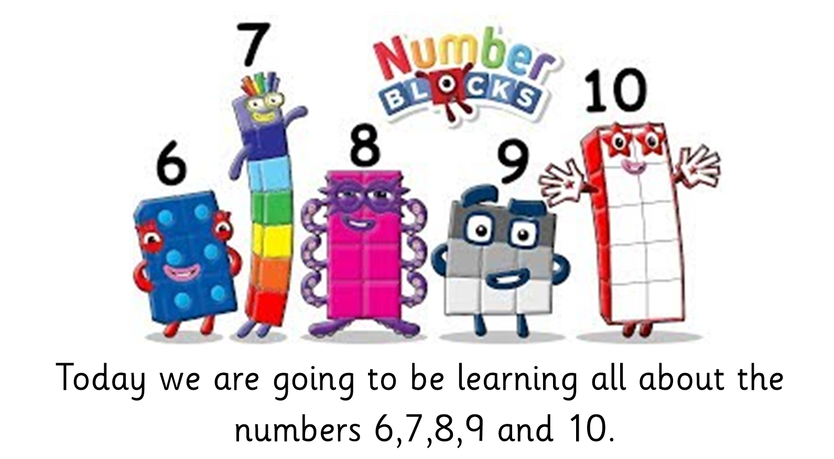

Slide 4
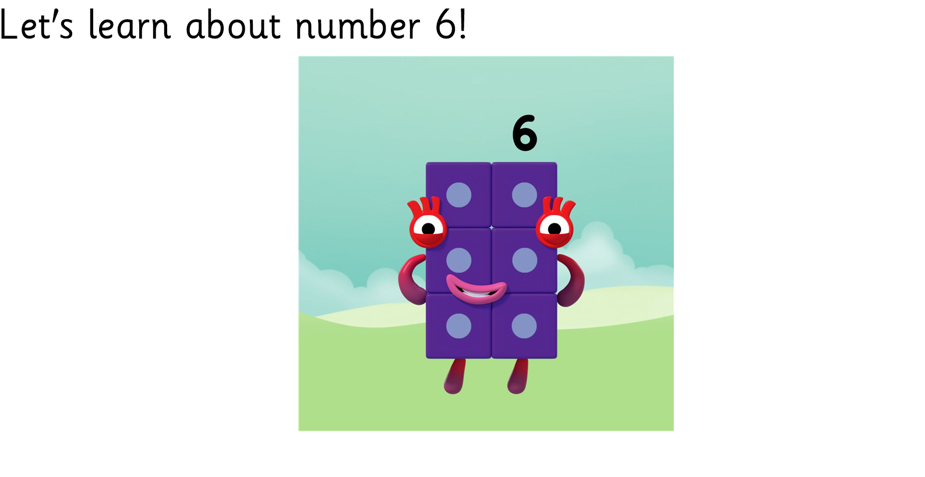
https://www.bbc.co.uk/cbeebies/watch/playlist-numberblocks-songs#playlist

Slide 5
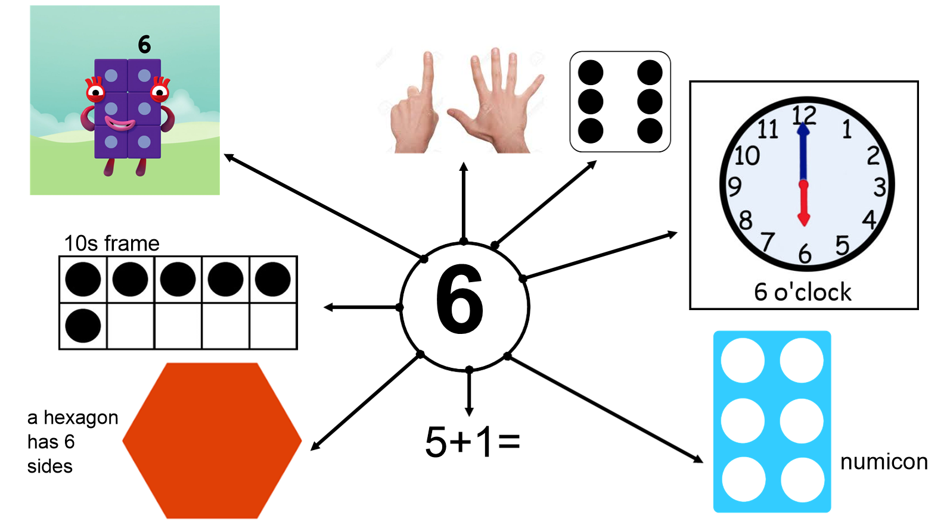

Slide 6
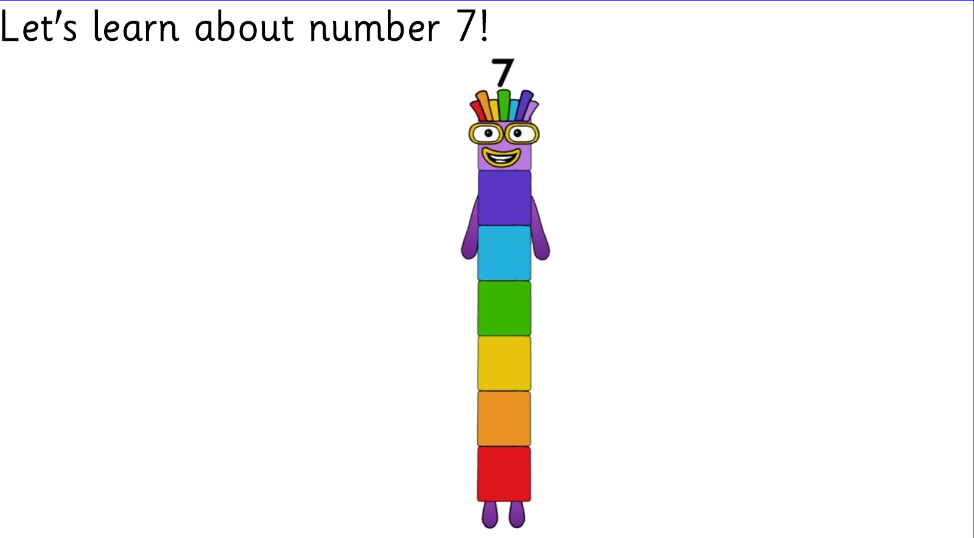
https://www.bbc.co.uk/cbeebies/watch/playlist-numberblocks-songs#playlist

Slide 7
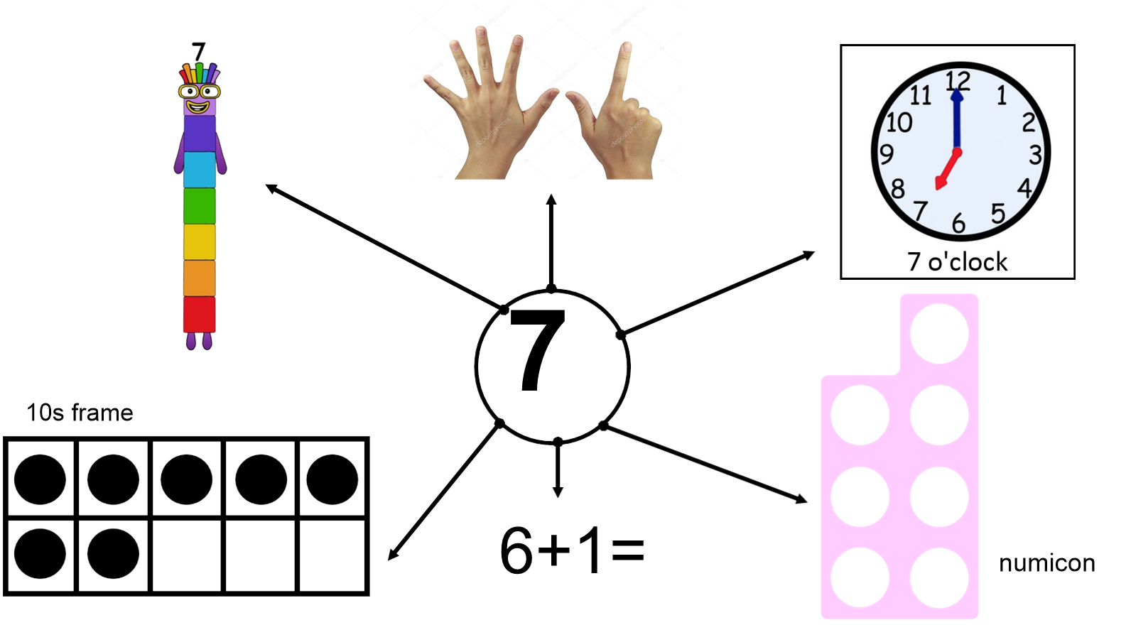

Slide 8
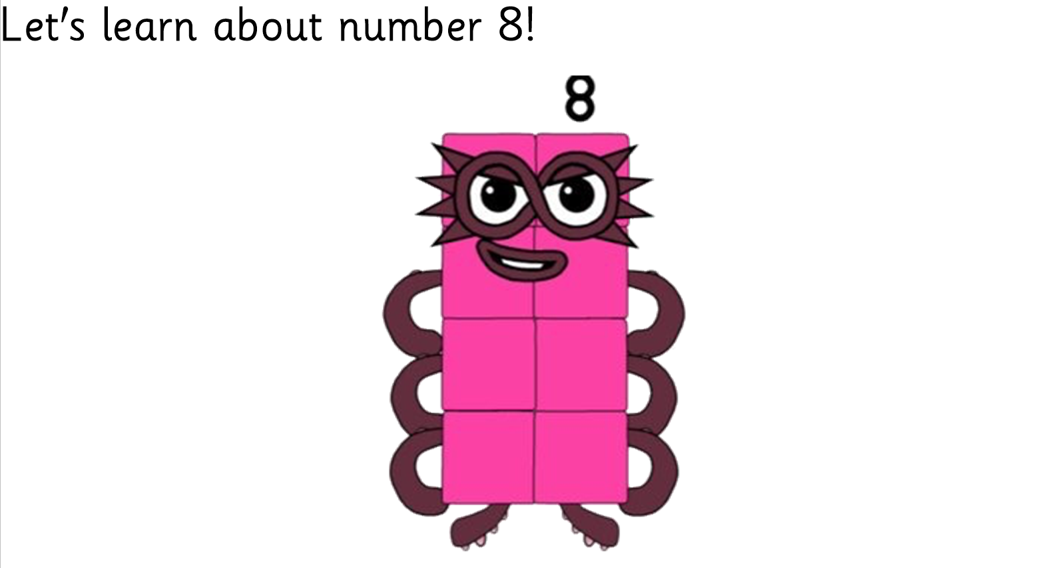
https://www.bbc.co.uk/cbeebies/watch/playlist-numberblocks-songs#playlist

Slide 9
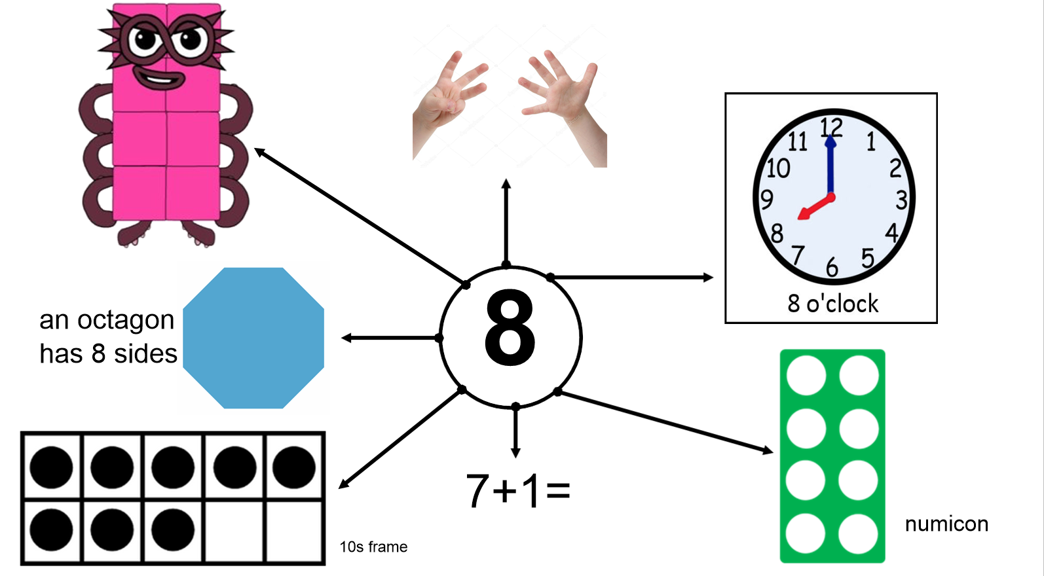

Slide 10
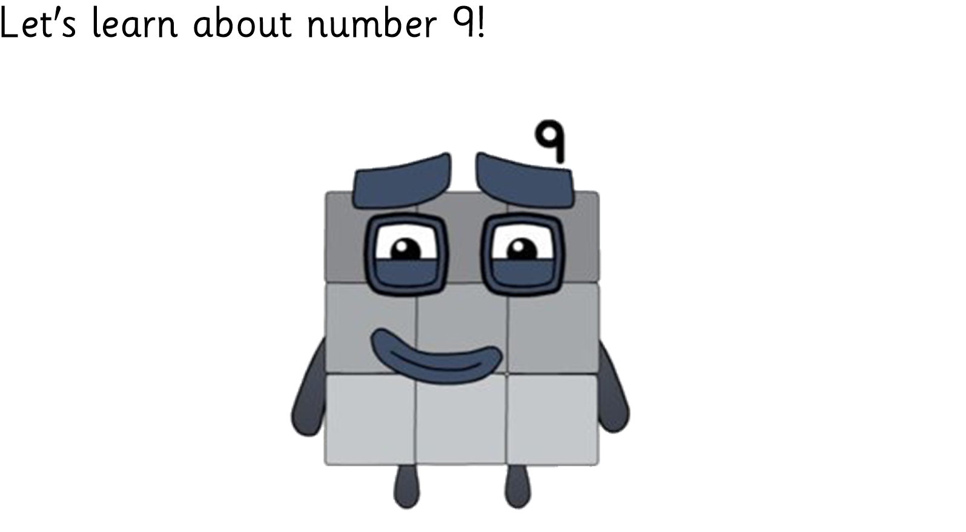
https://www.bbc.co.uk/cbeebies/watch/playlist-numberblocks-songs#playlist

Slide 11
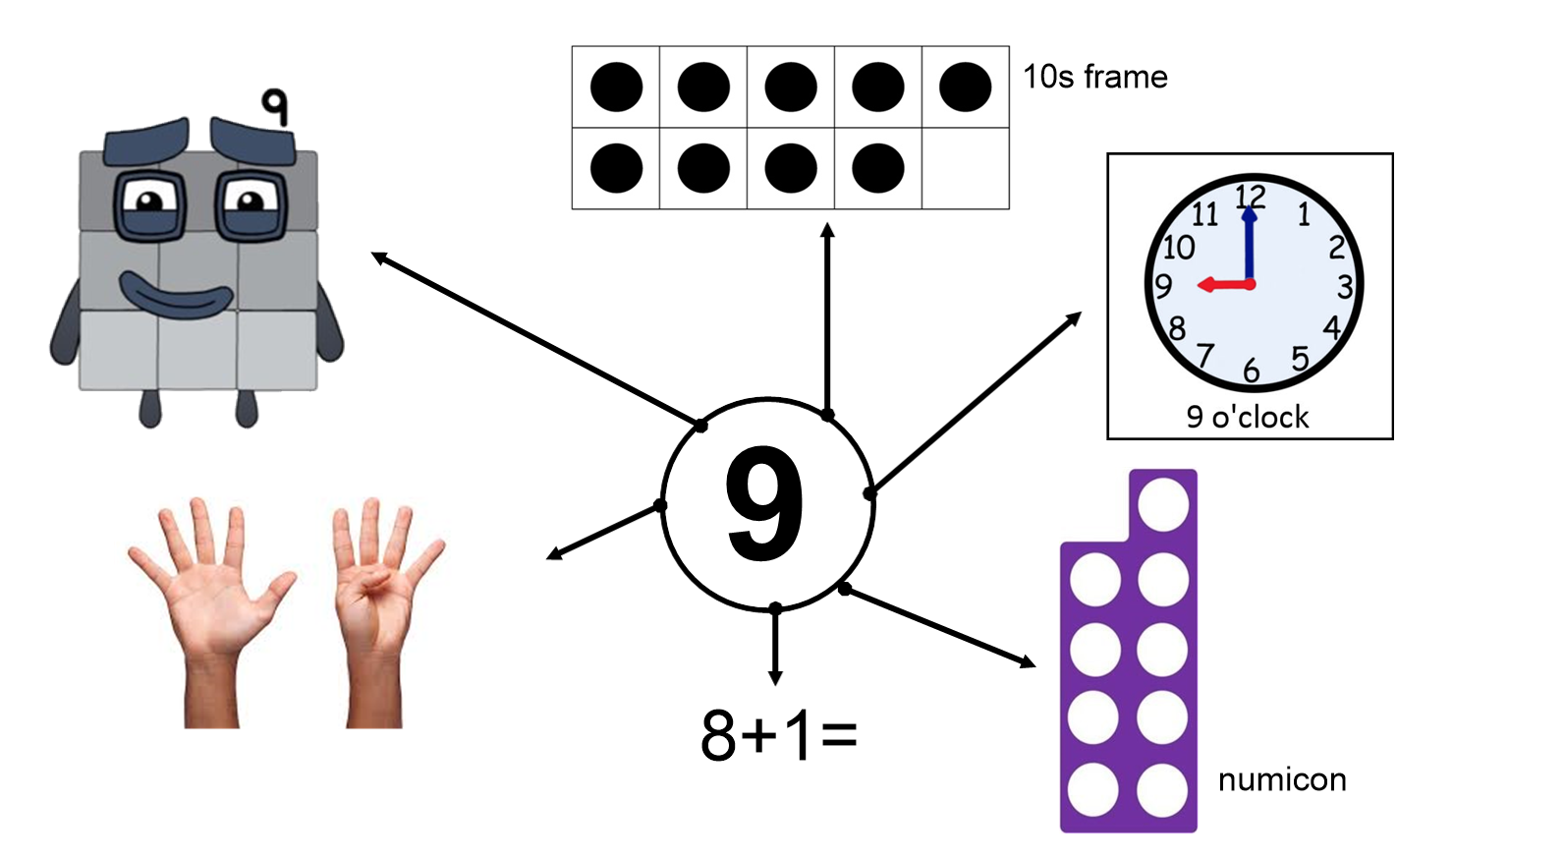

Slide 12
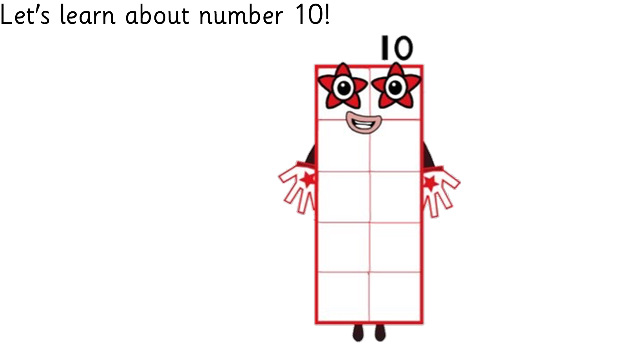
https://www.bbc.co.uk/cbeebies/watch/playlist-numberblocks-songs#playlist

Slide 13


