Slide 1


Slide 2
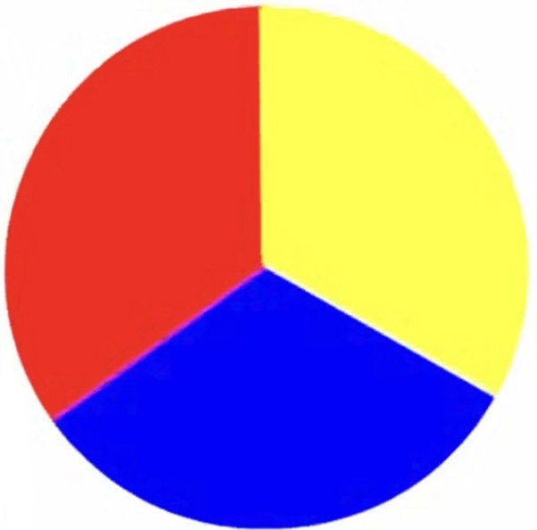
Today we are going to be learning 3 colours in French! Listen to each colour and repeat the word.

Slide 3

bleu

Slide 4

rouge

Slide 5

jaune

Slide 6
Let’s practise again! Listen carefully there will be a quiz at the end!

Slide 7
bleu

Slide 8
rouge

Slide 9
jaune

Slide 10
QUIZ TIME!
Listen to the colour and point to the colour you hear!

Slide 11
Oú est jaune?

Slide 12
Oú est bleu?

Slide 13
Oú est rouge?

