Slide 1
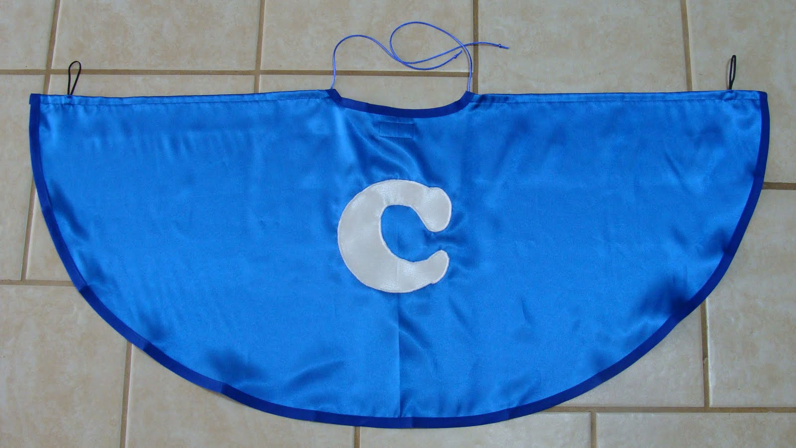
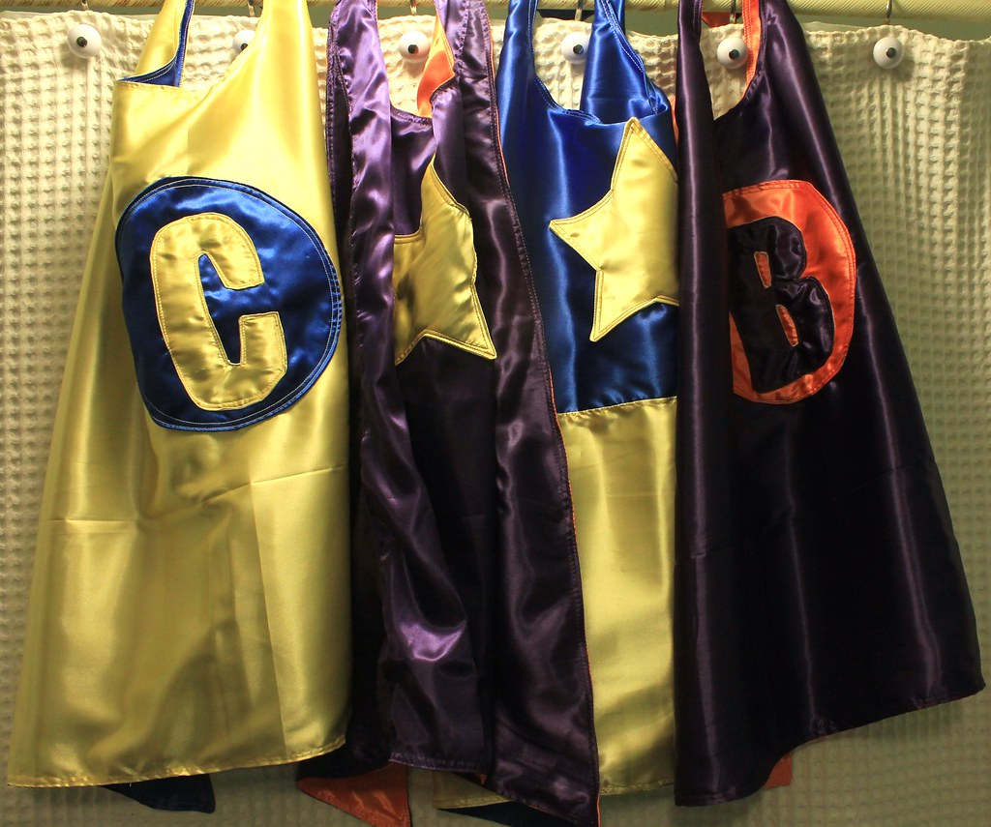
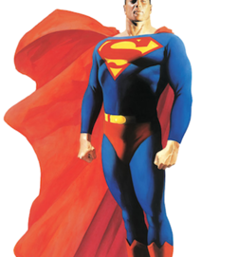
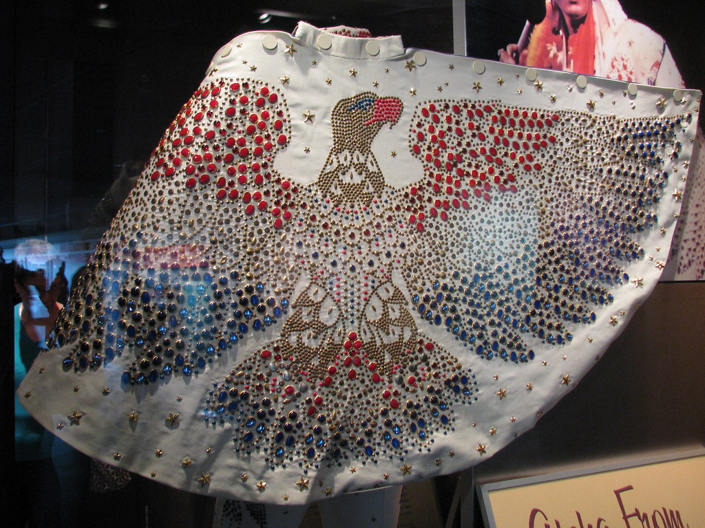
Design a Superhero Cape!
Friday 29th January 2021

Slide 2
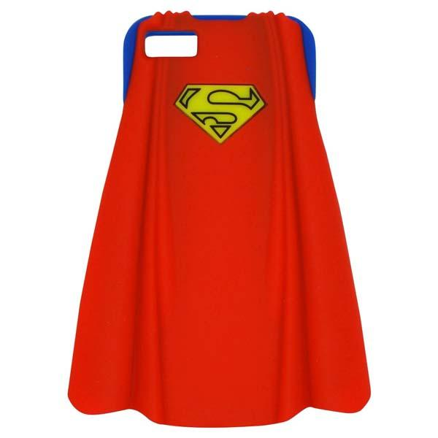
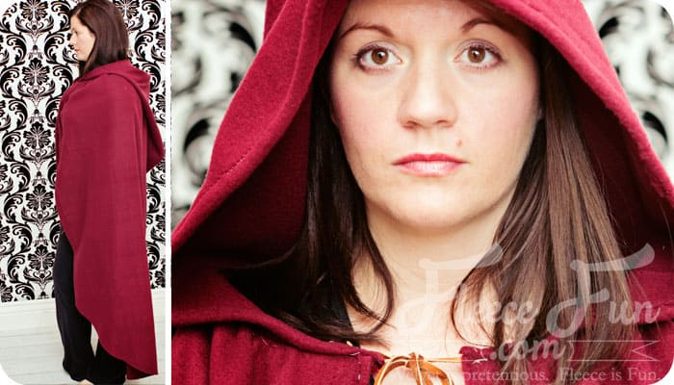
What is a Cape?
A cape is like a coat but it does not have sleeves. It is usually quite short. Some capes have hoods.

Slide 3
Design your own Superhero Cape!
We would like you to design a cape for your superhero. Think about the fabric you would like it to be made out of and the colours you will use to decorate it with. We would like you to consider these points as well before you design your cape.
Will you use bright or dark colours?
Will your cape have a logo on it?
Will it have a hood on it?
Does your cape have special powers? If so what does it do?

Slide 4
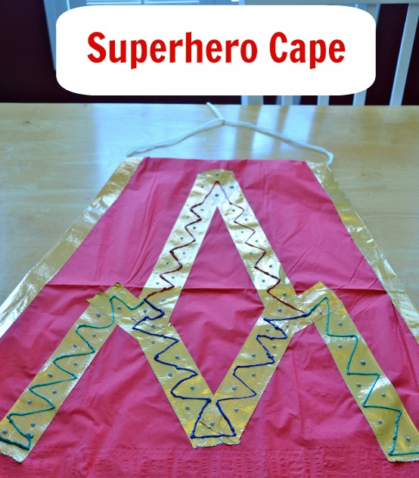
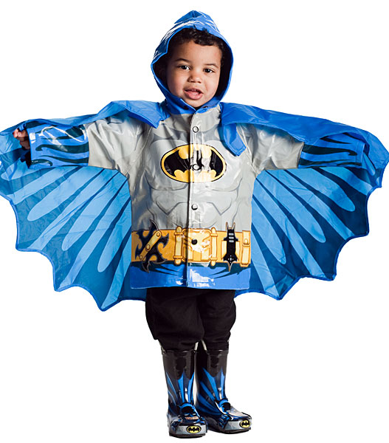
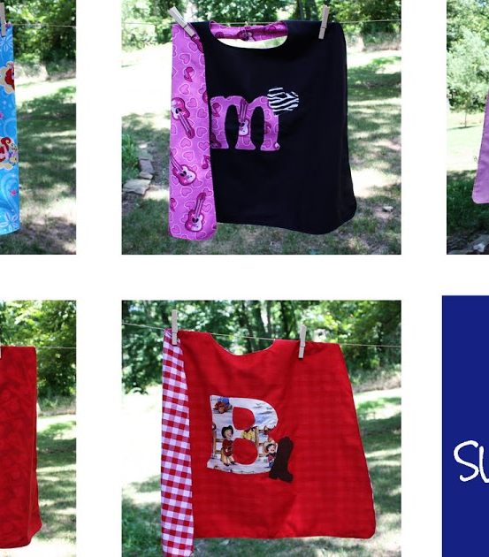

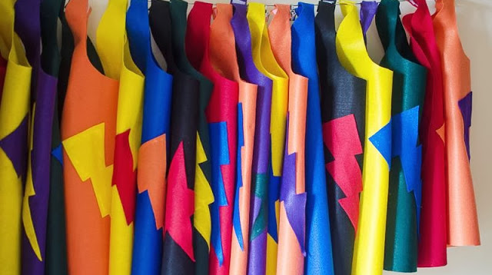
Some ideas for your Superheroes Cape!
Begin by drawing a design for your cape. Here are some ideas you can use to help you. Once you have designed your cape, make you cape. You could use fabric, paper or old materials you have. We are looking forward to seeing your capes. Once you have finished your cape, talk about what you like about it and would you change anything.

