Slide 1
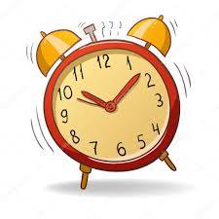

Time
Monday 25th January 2021

Slide 2
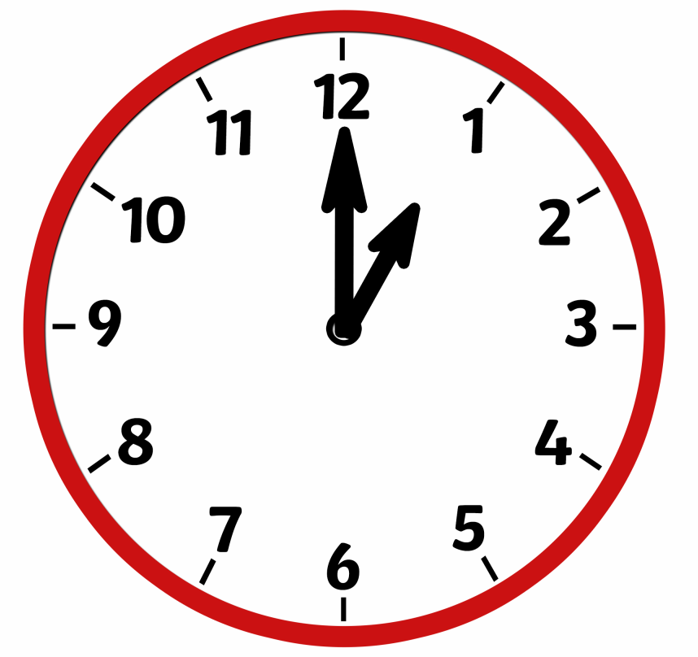
Recognising O’Clock
Minute Hand
Hour Hand

Slide 3
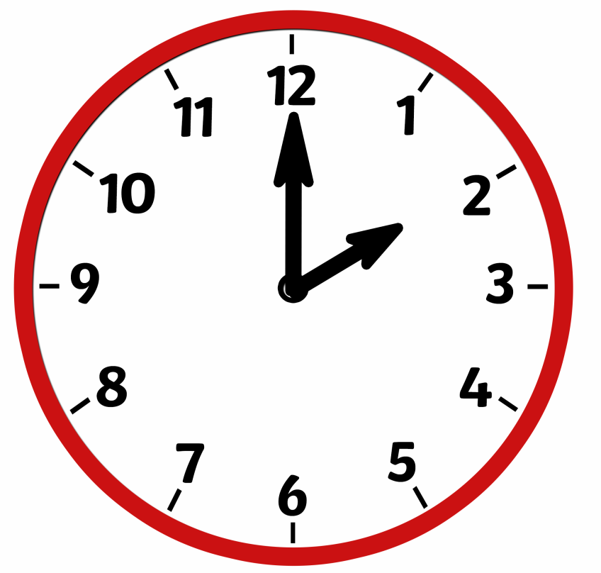

Slide 4
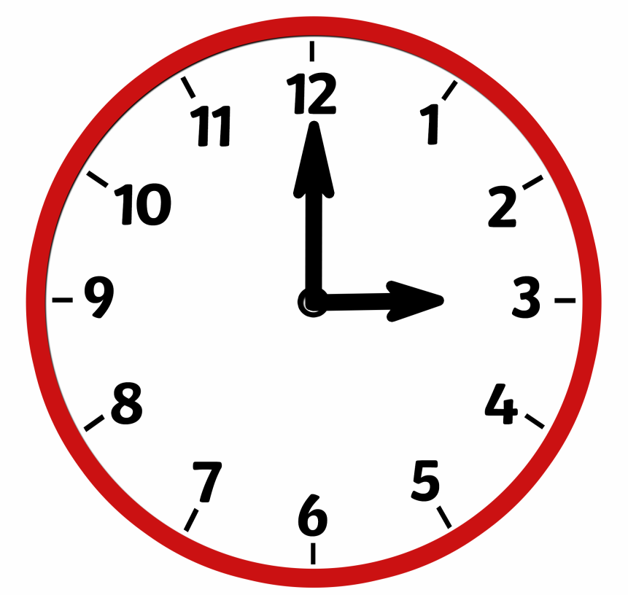

Slide 5
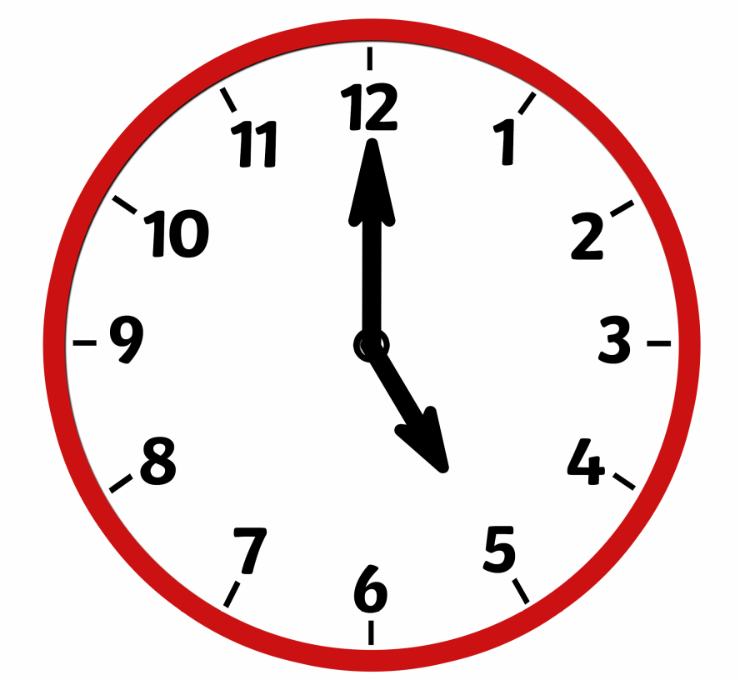

Slide 6
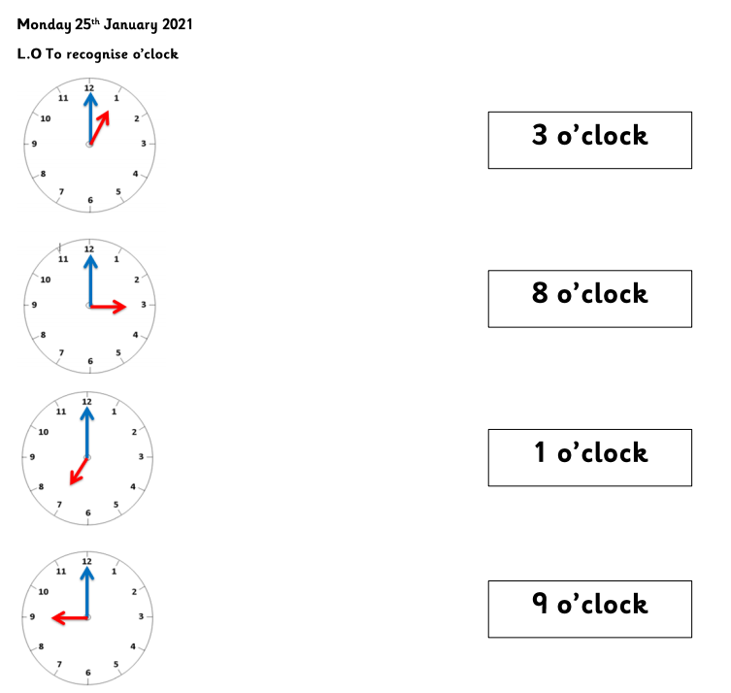
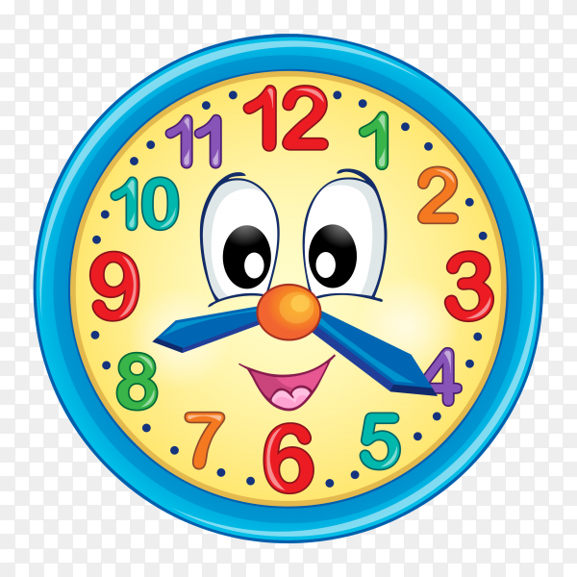
Your turn!
Can you match the time to the clock on the worksheet?
If you haven’t got a printer could you find a clock and change the time on it?

