Slide 1


Slide 2
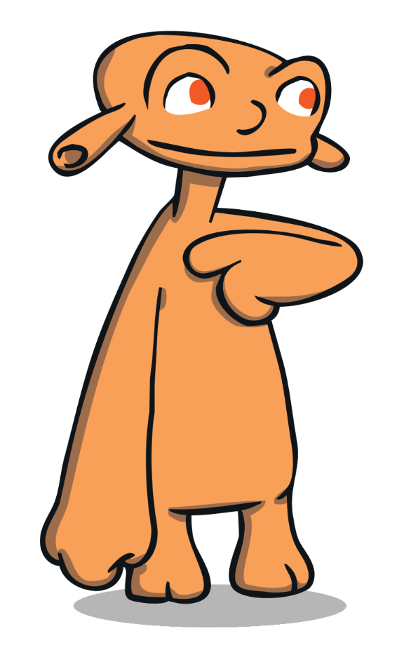
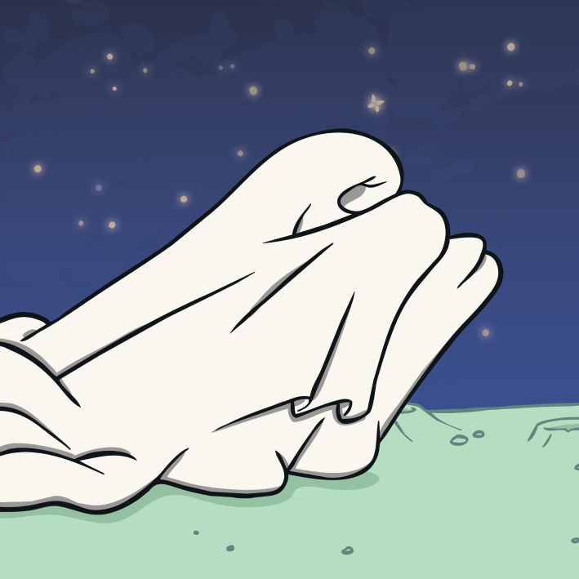
Zid’s Dress
Zid has an idea. Zid wants to make a dress.
Zid doesn’t get it
quite right first time.
What does Zid do next? Who helps Zid?

Slide 3


Zid’s Dress
Zid’s friends, Yoff and Mab, give Zid lots of support.
It might be better if you could see.
When Zid shows them the
dress, Mab suggests ways
to make it better.
What does Zid do when Mab makes suggestions?

Slide 4
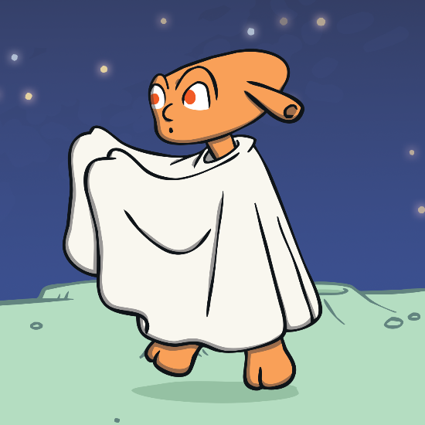
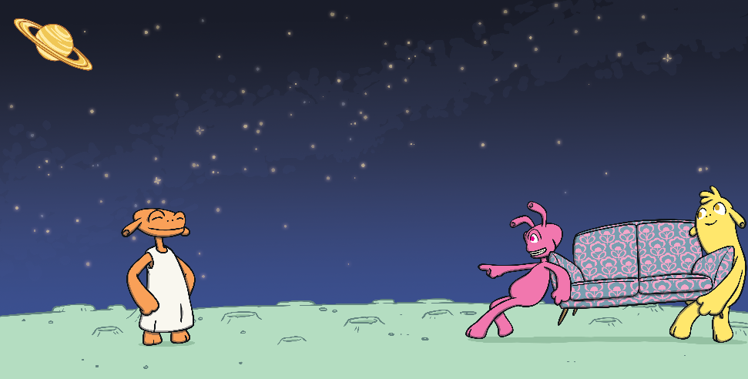
Zid’s Dress
When Mab makes suggestions, Zid goes off to do more work on the dress. Zid wants to make the best dress ever.
If you add some decorations, it will be really special.
Mab wants to help Zid make the best dress ever. Mab keeps giving Zid ideas to make the dress better.
What happens to Zid’s dress?

Slide 5

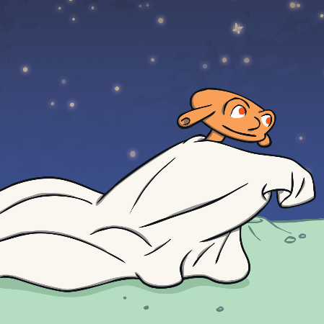
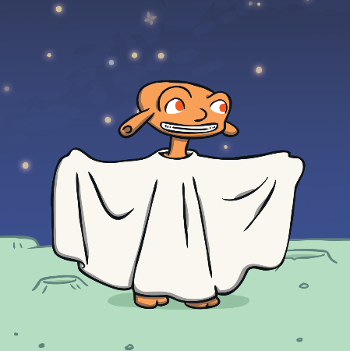

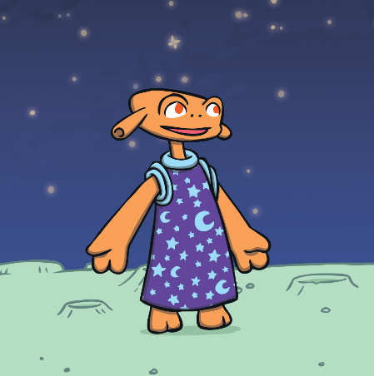
Zid’s Dress
Zid uses each of the ideas to make improvements to the dress.
Zid’s dress gets better and better.

Slide 6
Zid’s Dress
Think about Zid’s attitude to learning in the story.
What makes Zid a super learner?
Zid never gives up.
Zid doesn’t say, ‘I can’t do it.’
Zid listens to ideas to help improve the dress.
Zid is keen to make the best dress, not just an OK dress.
Zid puts lots of time and effort into the dress.
Zid is happy to make changes to the dress.
Zid learns from Mab.
Zid is proud of the dress.

Slide 7
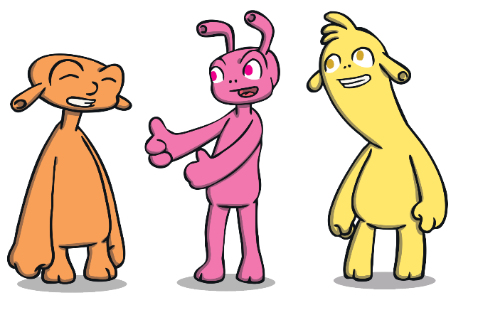
Mab’s Ideas
Think about what Yoff and Mab do in the story.
How do they help Zid?
Yoff and Mab are both supportive of Zid.
Yoff and Mab both believe in Zid.
Mab helps Zid to improve.
Mab makes suggestions in a kind and helpful way.
Mab doesn’t let Zid give up.
Mab shares ideas and knowledge to help Zid.
Mab helps Zid to make the best dress ever.
Yoff and Mab are both proud of their friend.

Slide 8
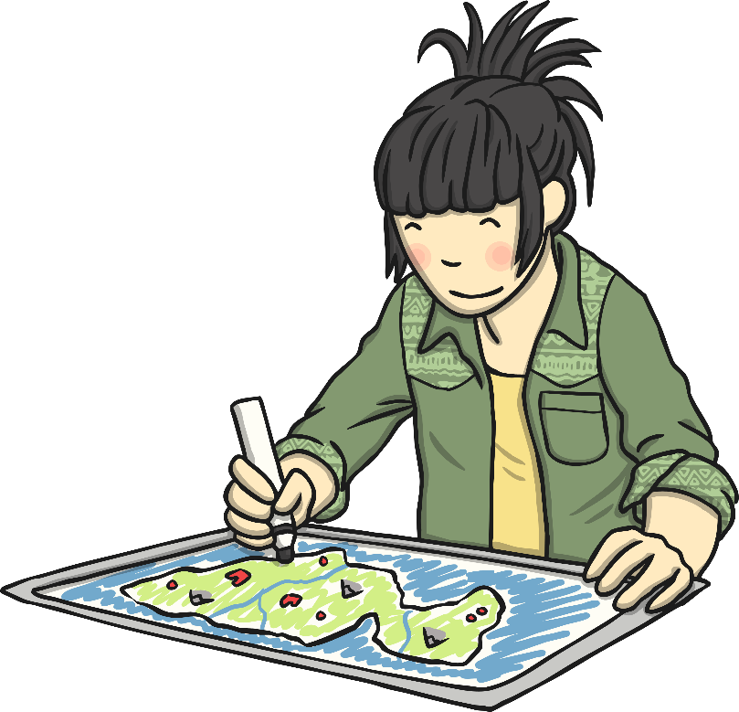
What Would Zid Say?
Joy says:
What would Zid say?
It’s good enough.
Is it my best work yet?
Joy has finished a drawing.

Slide 9
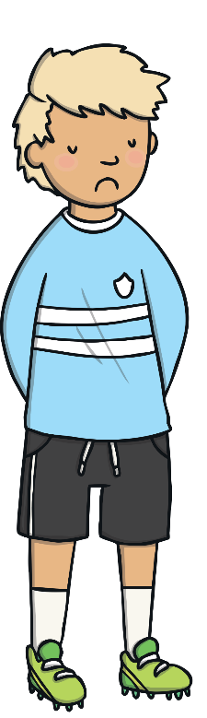

What Would Zid Say?
Alby says:
I’m no good at football.
What would Zid say?
I’m going to practise and learn how to play.
Alby is in a PE lesson.

Slide 10
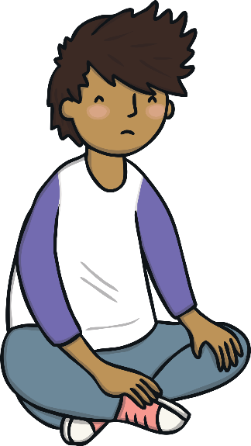
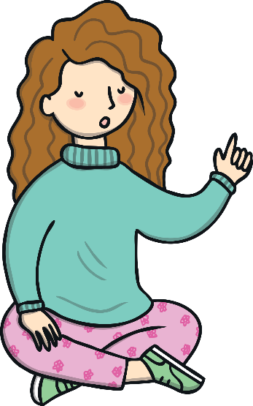
What Would Zid Say?
Dylan says:
I’ll never be as clever as Alannah.
What would Zid say?
I’m going to find out how Alannah does that.
Alannah solves a
tricky maths problem.

Slide 11
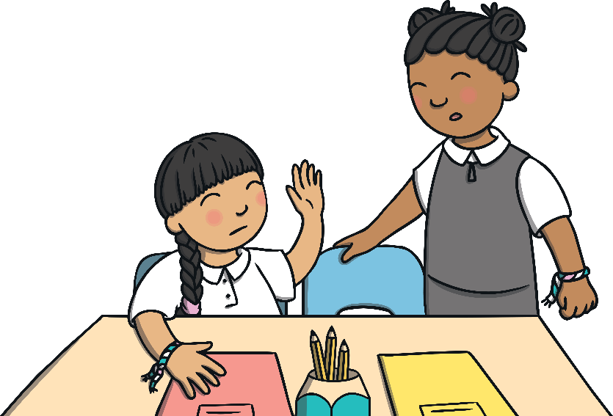
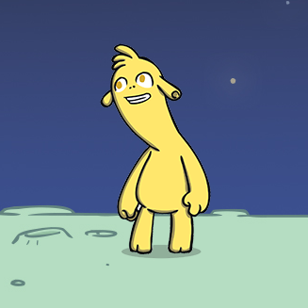
What Would Mab Say?
Tia says:
Lin can’t do it.
What would Mab say?
Let’s give Lin some ideas and help her understand.
In an English lesson, Lin is
not sure how to write a story.

Slide 12
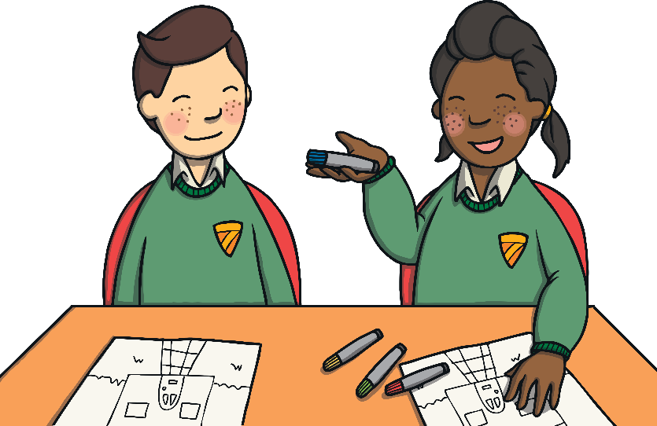
What Would Mab Say?
Josh says:
It’s good enough.
What would Mab say?
Great start.
How could you make it better?
Kaitlyn shows Josh her drawing.

Slide 13
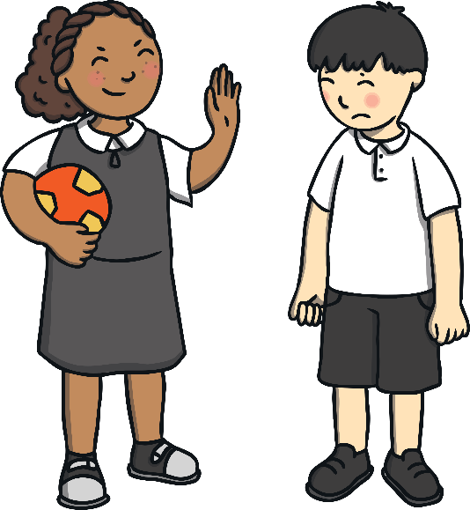
What Would Mab Say?
Patty says:
Next time, let me take the shot.
What would Mab say?
Keep practising! I’ll help you, if you like.
At playtime, Jack misses a goal.

Slide 14

Be Super Learners!
How could you be more like Zid today?

