Slide 1


Tuesday 26th January 2021
L.O To sequence the day

Slide 2
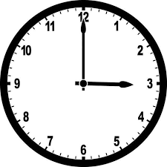
What time is it?

Slide 3
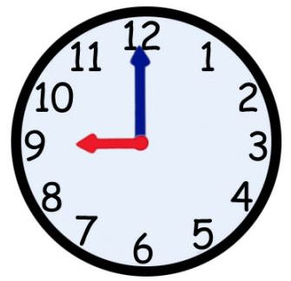
What time is it?

Slide 4
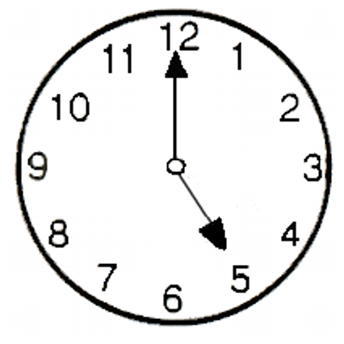
What time is it?

Slide 5
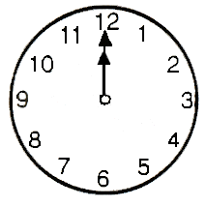
What time is it?

Slide 6
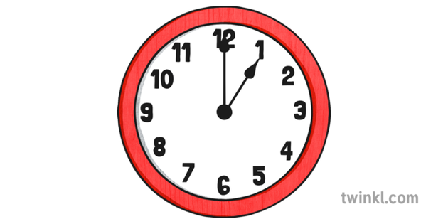
What time is it?

Slide 7
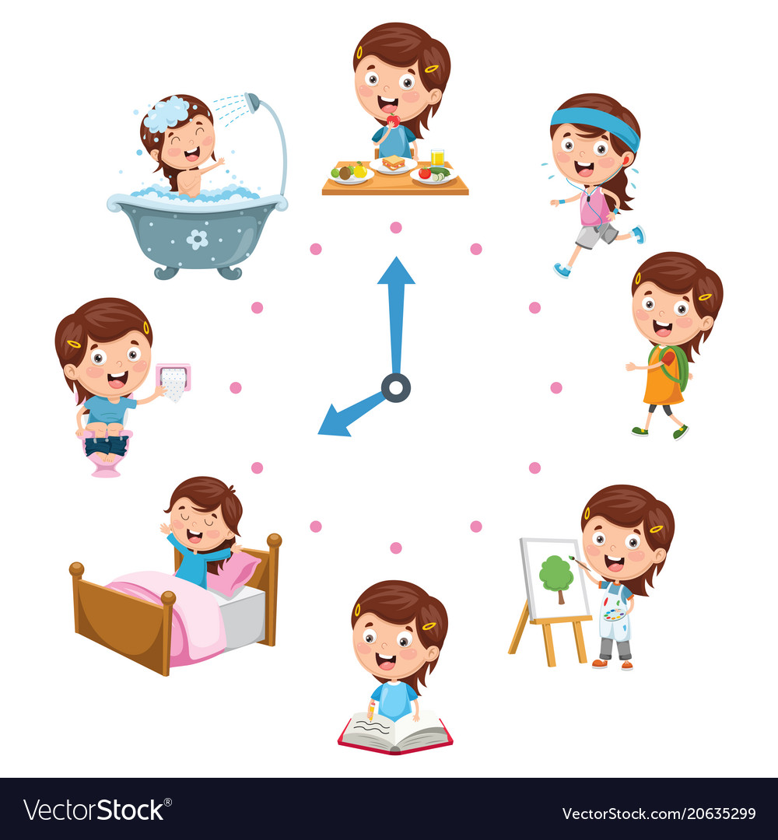
Today we are going to be scheduling the day. We will be thinking about what time we do different things throughout the day.

Slide 8

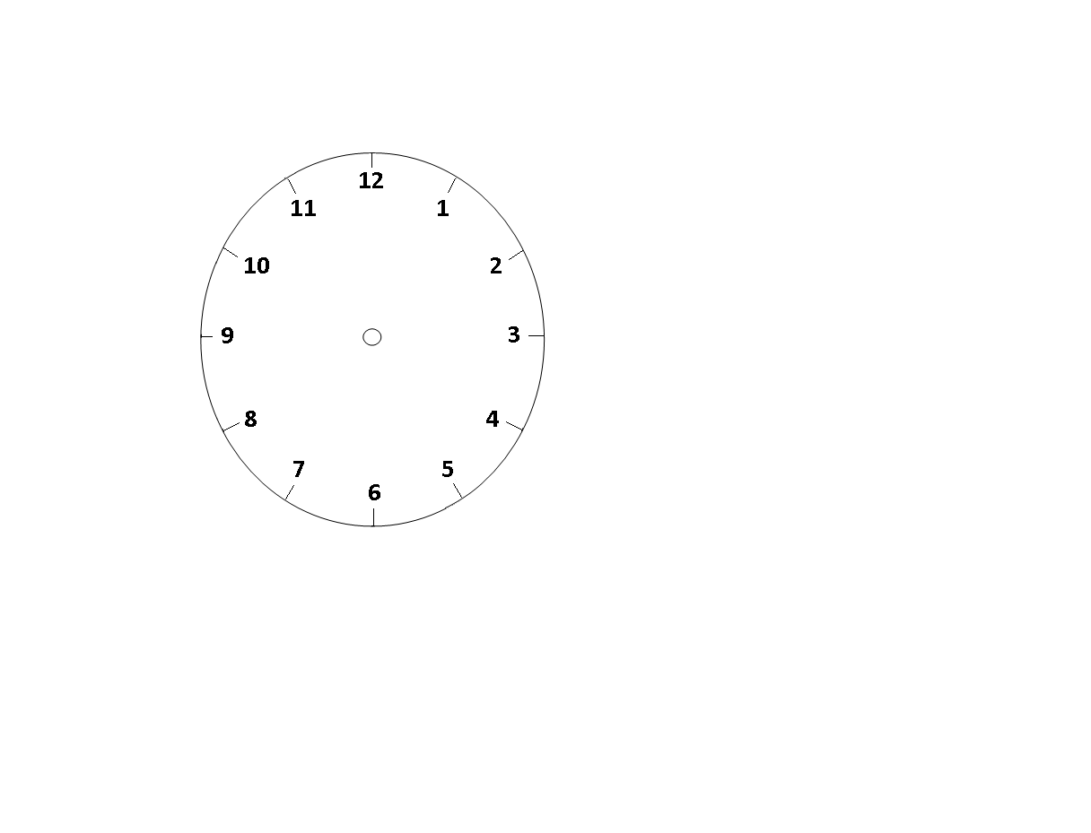

Wake up

Slide 9
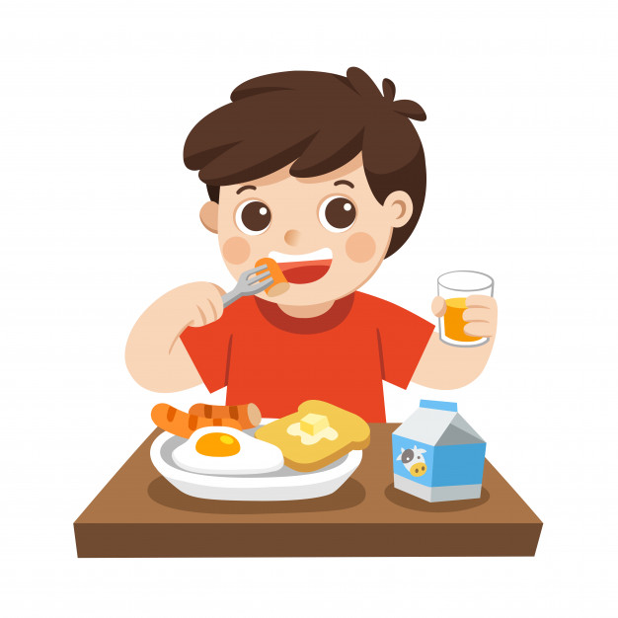

Eat Breakfast

Slide 10


Lunch Time

Slide 11
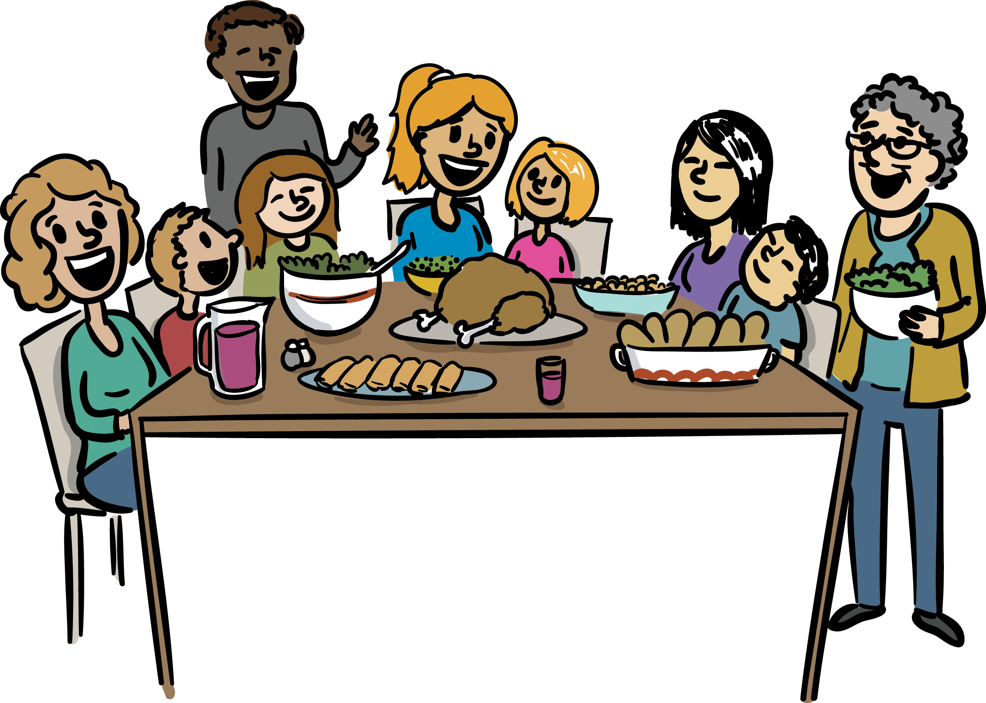

Dinner Time

Slide 12
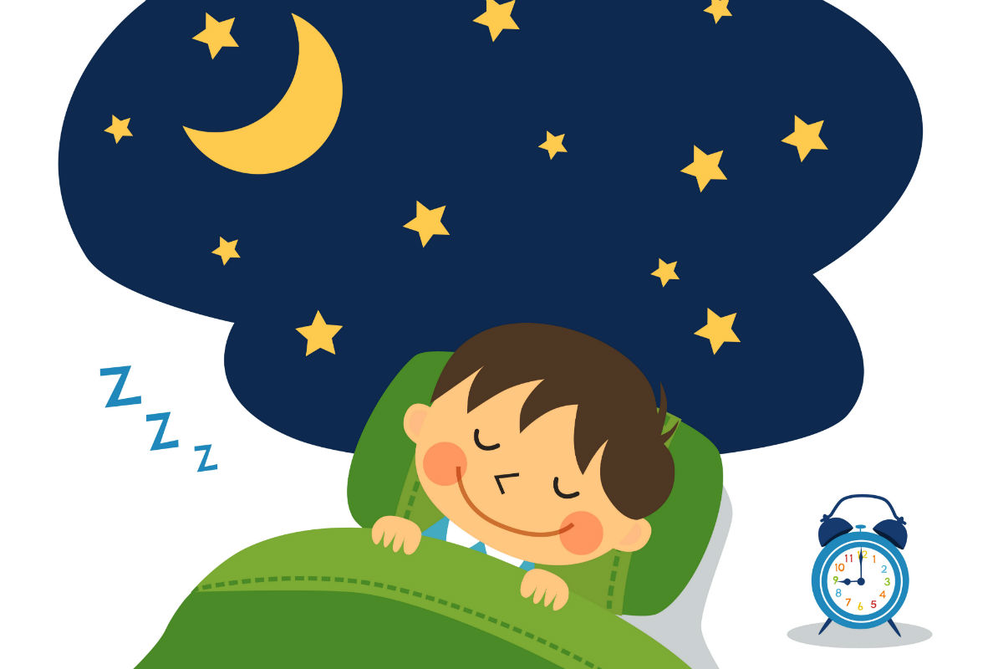

Bedtime

Slide 13
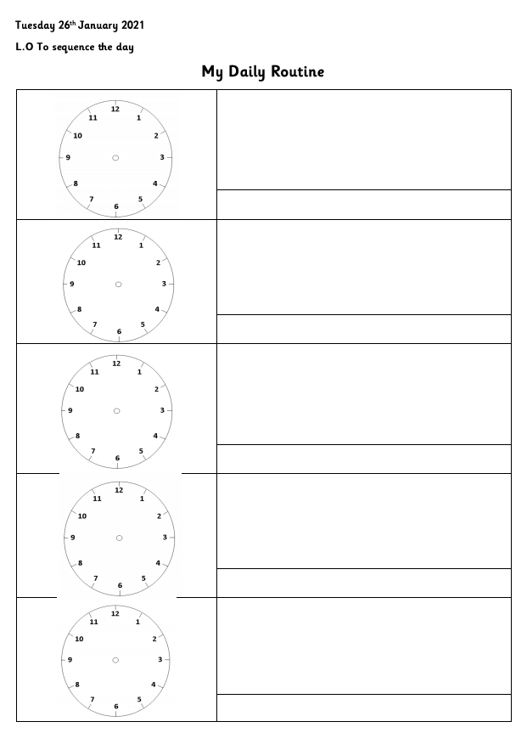

Todays Activity
Draw the time on the clock
Draw what you do at that time
Extension
Label your picture
Further Extension
Measuring time challenges

