Slide 1
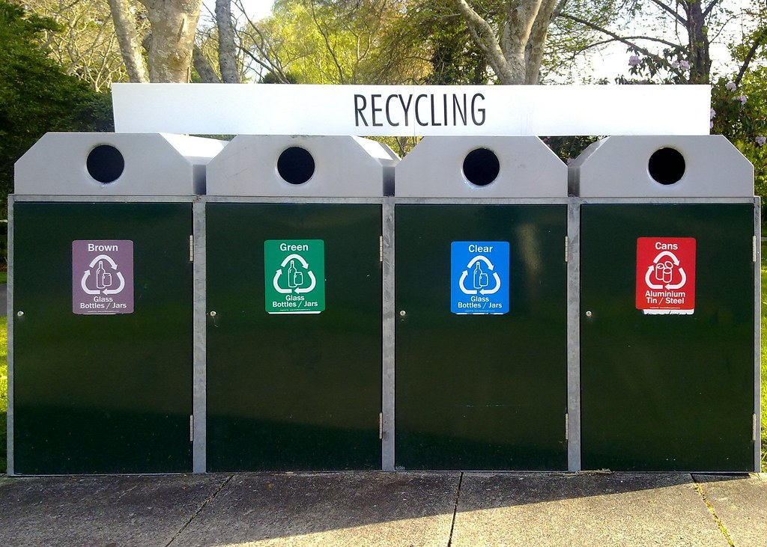

Reduce, Reuse and Recycle!
This Photo by Unknown Author is licensed under CC BY-SA-NC

Slide 2

Who is this character?
Why is he a crusader?
This Photo by Unknown Author is licensed under CC BY-NC-ND

Slide 3
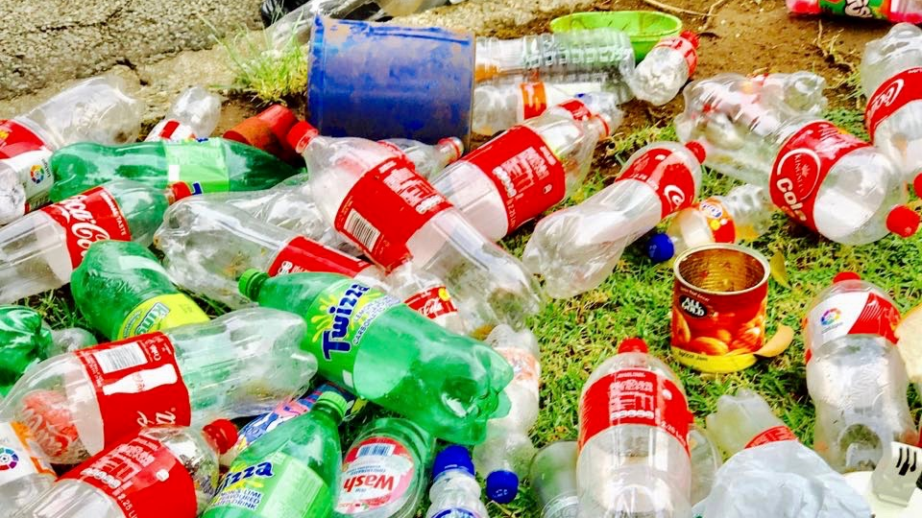
Recycled materials
This Photo by Unknown Author is licensed under CC BY-ND

Slide 4
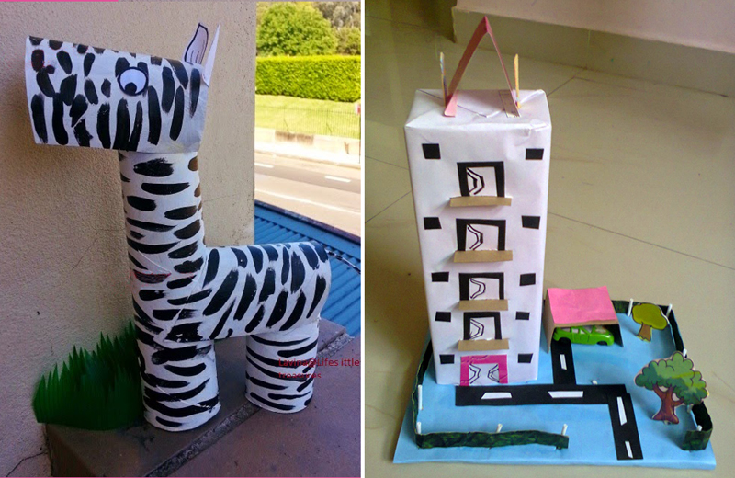
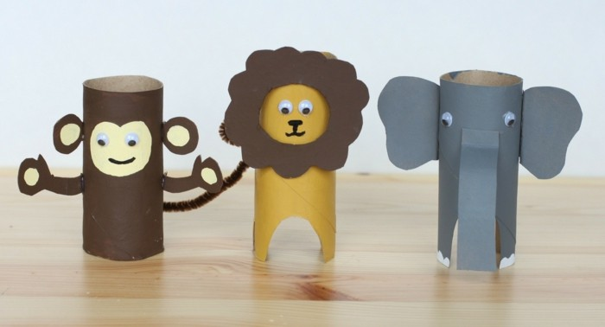
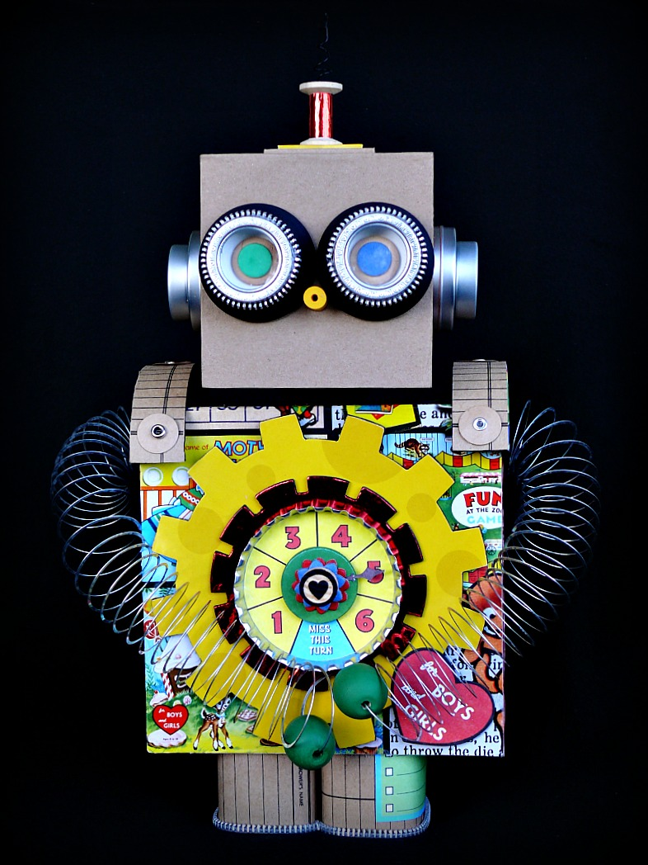
What characters can you create out of different containers?
This Photo by Unknown Author is licensed under CC BY-ND
This Photo by Unknown Author is licensed under CC BY
This Photo by Unknown Author is licensed under CC BY-NC

Slide 5

Superheroes!
This Photo by Unknown Author is licensed under CC BY-NC

