Slide 1



Slide 2


Slide 3
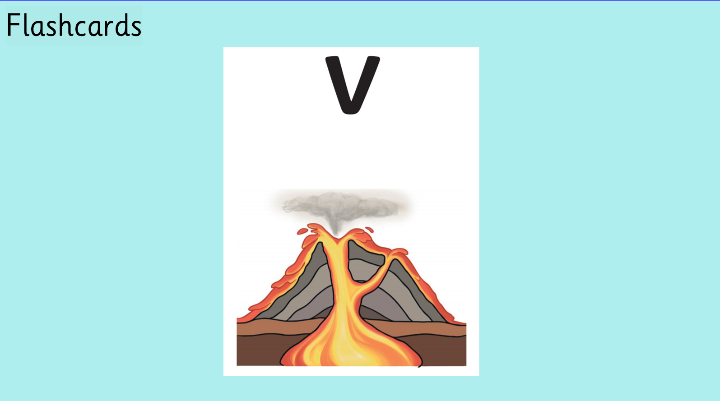

Slide 4
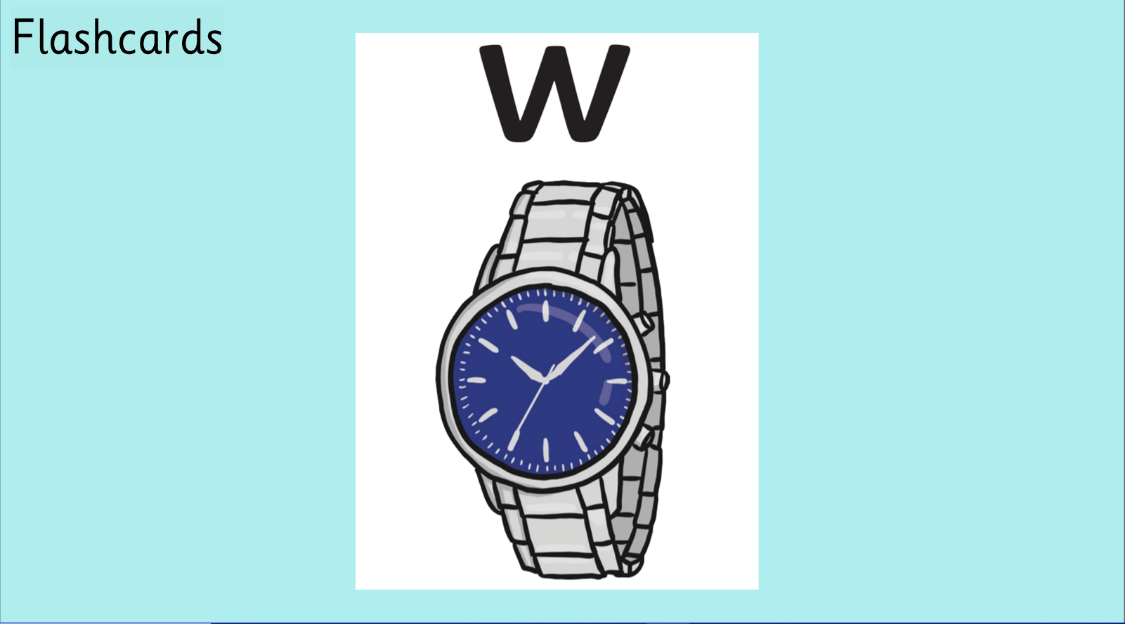

Slide 5


Slide 6
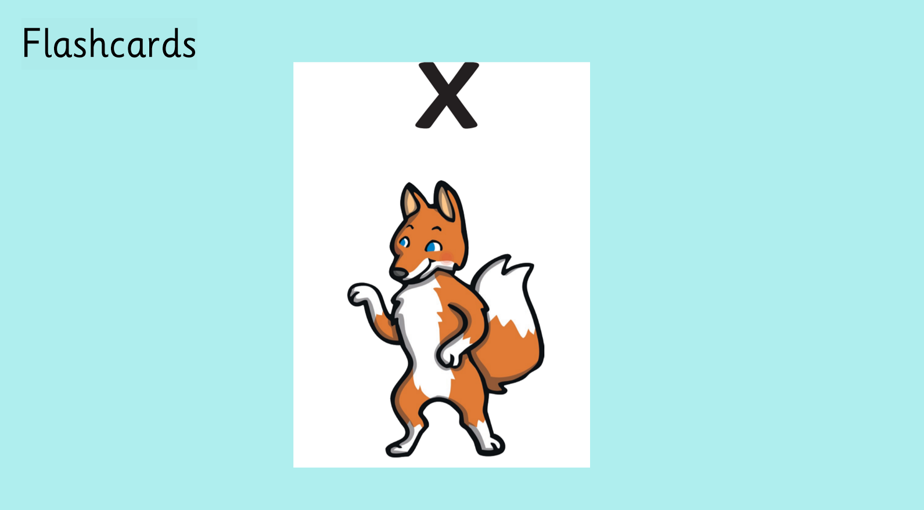

Slide 7
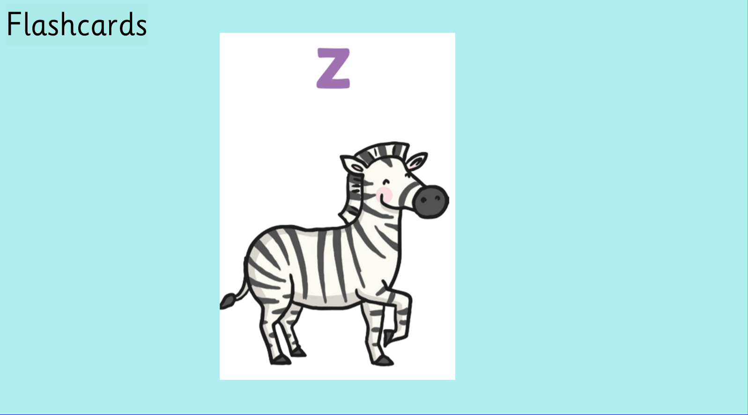

Slide 8
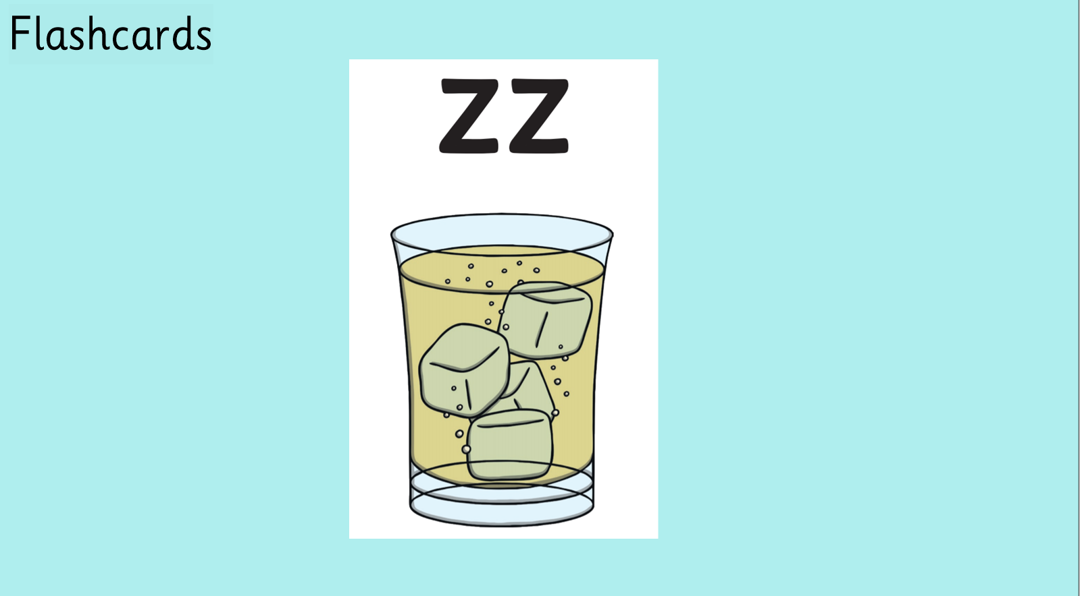

Slide 9


Slide 10


Slide 11


Slide 12


Slide 13


Slide 14


Slide 15


Slide 16


Slide 17
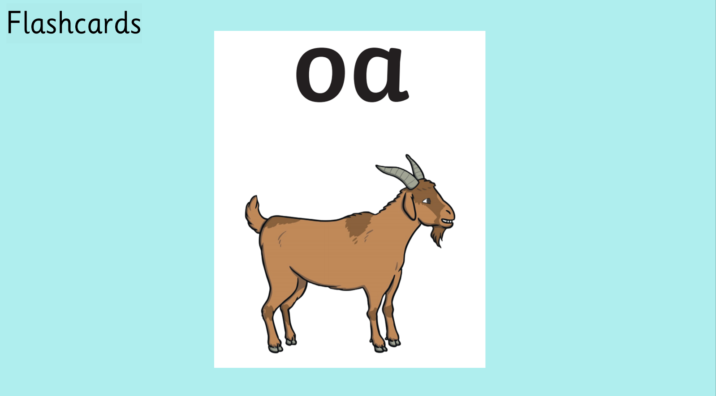

Slide 18



Slide 19



Slide 20



Slide 21


Slide 22


Slide 23


Slide 24


Slide 25


Slide 26


Slide 27


Slide 28


Slide 29


Slide 30


Slide 31


Slide 32



Slide 33
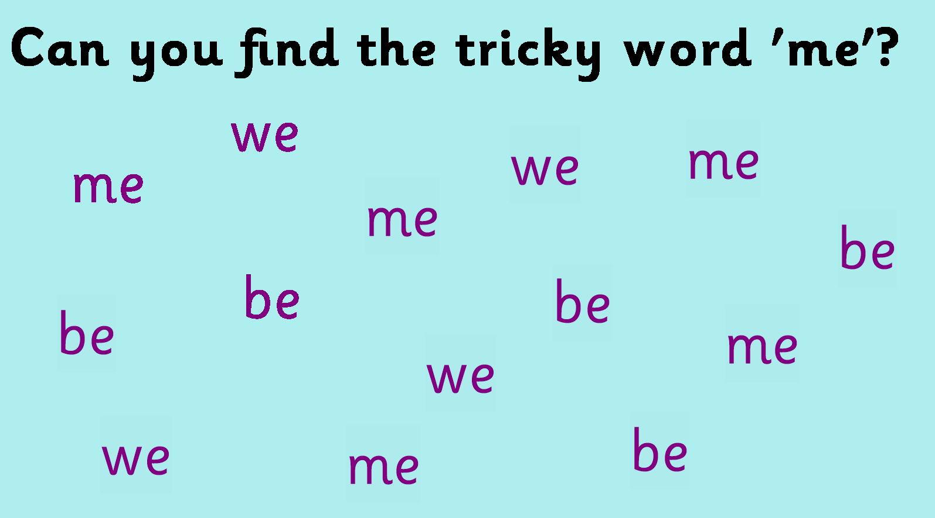


Slide 34


https://www.youtube.com/watch?v=TvMyssfAUx0&t=4s

Slide 35


https://www.youtube.com/watch?v=R087lYrRpgY

Slide 36
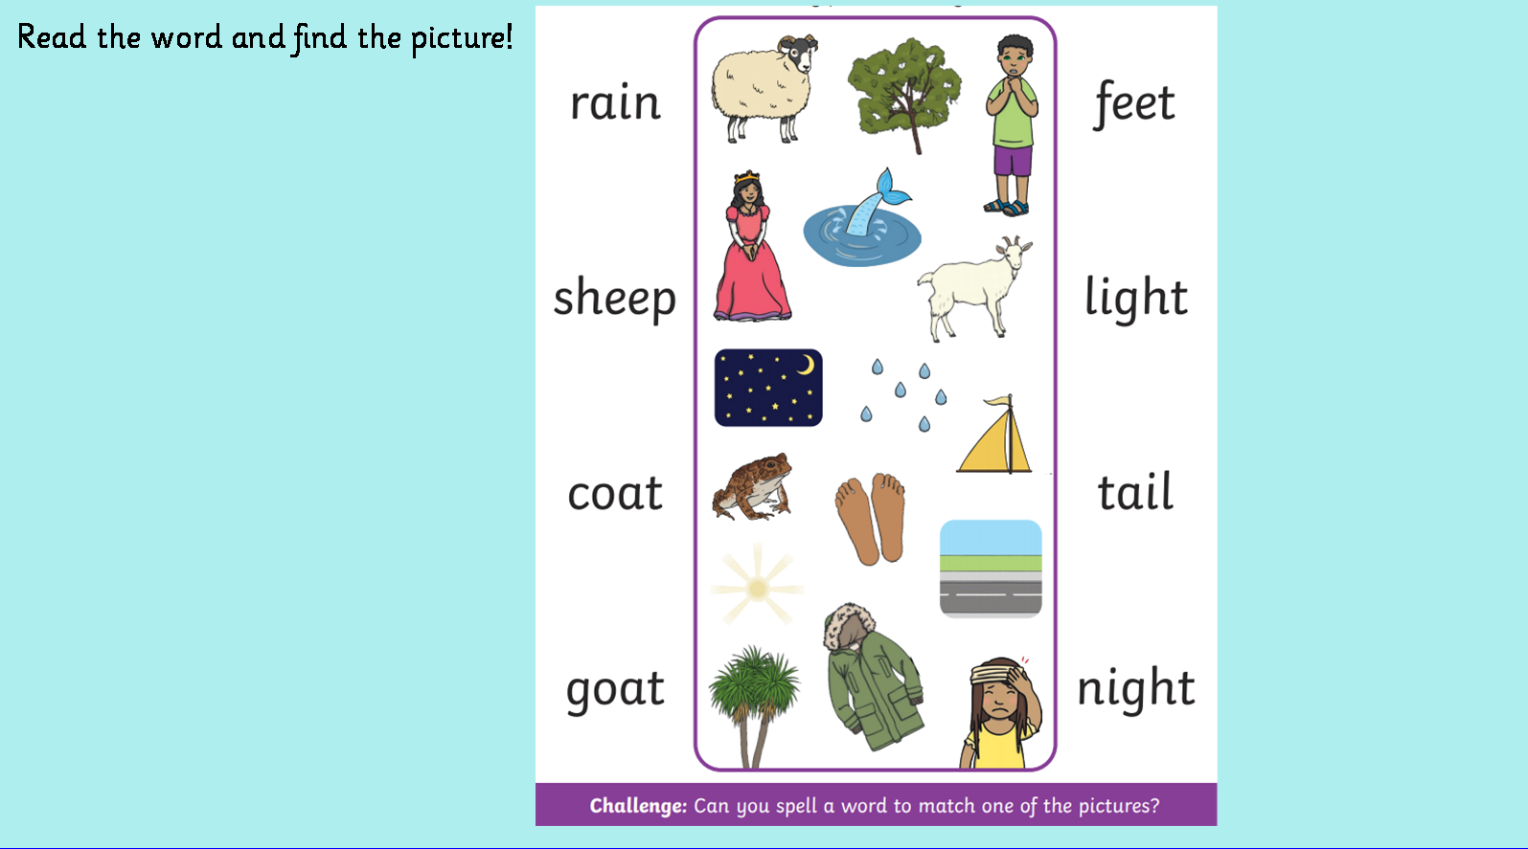


Slide 37
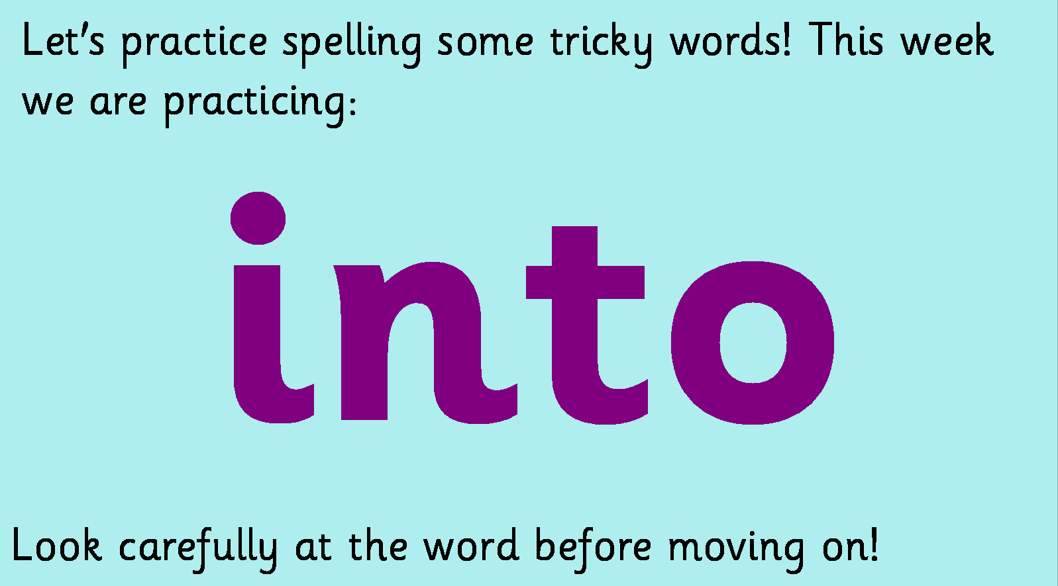

Slide 38


Slide 39


