Slide 1
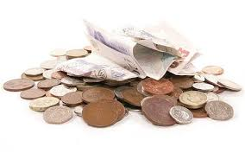

Week Beginning 18/01/2021
Learning Objective: To recognise UK coins.

Slide 2
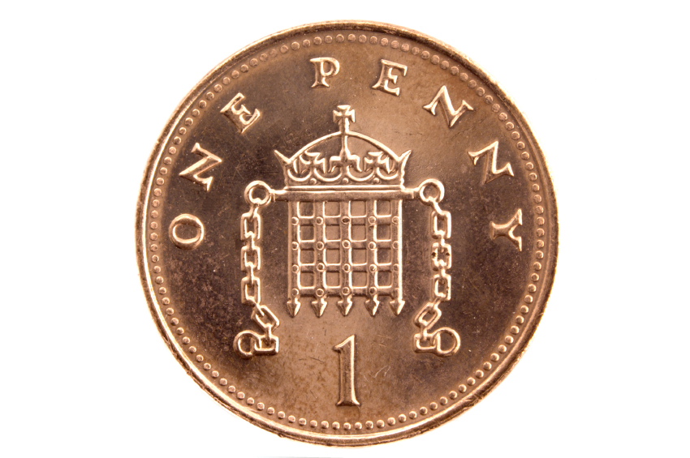


Slide 3
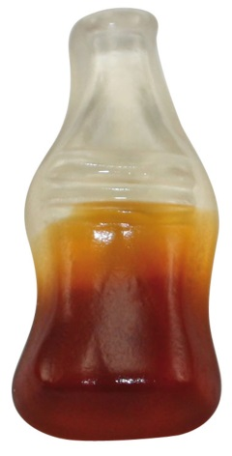

1 sweet

Slide 4
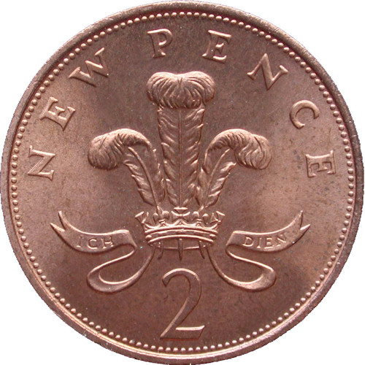


Slide 5
2 sweets

Slide 6
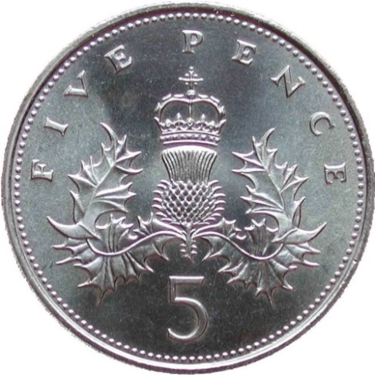


Slide 7

5 sweets

Slide 8
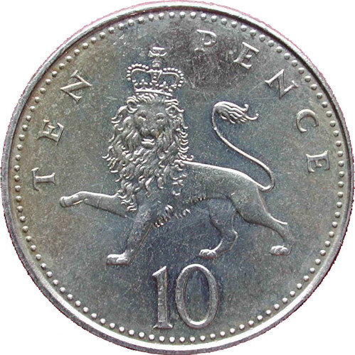


Slide 9
10 sweets

Slide 10
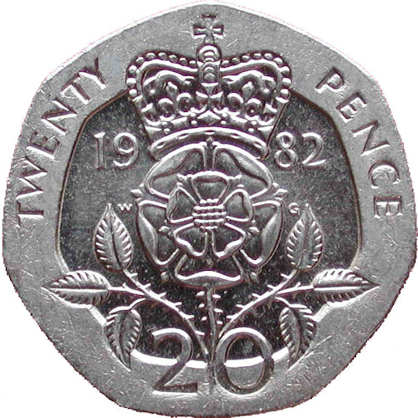
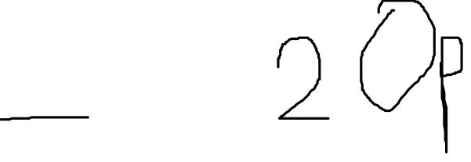

Slide 11

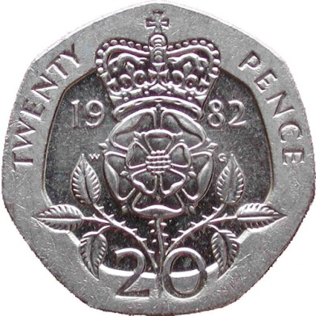

20 sweets

Slide 12
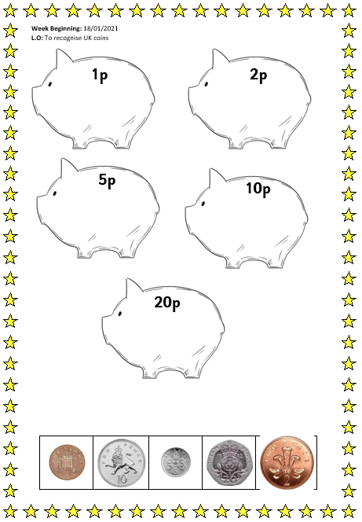

Today’s activity!

