Slide 1


Slide 2
There’s a magic word…

Slide 3
…it’s not very big…

Slide 4
…but it is very important…

Slide 5
…because it has special powers.

Slide 6
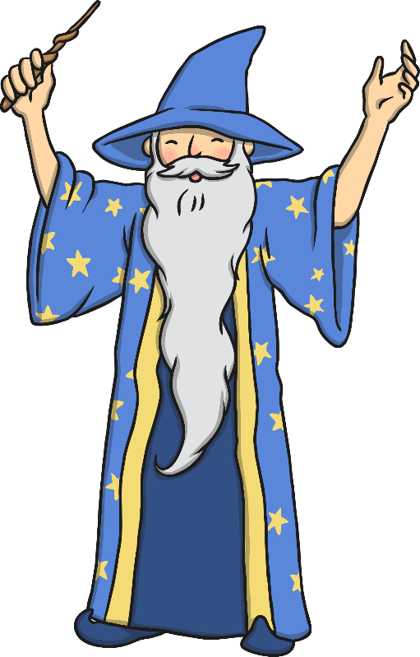
Look at these sentences
I can’t run very far.
I haven’t got good handwriting.
I can’t swim.
Think About It
Can you imagine the people who said these?
Can you think of a sentence like these that you might say about yourself?

Slide 7
Now for the magic word…

Slide 8
…what could it be?

Slide 9
Not long now…

Slide 10
…just a bit longer…

Slide 11
…no really, it’s coming soon…

Slide 12
…the word is…

Slide 13
Yet!

Slide 14

Seriously, this is what it does…
Click here
I can’t run very far yet.
I haven’t got good handwriting yet.
I can’t swim yet.
Click here
Click here
How has that little, tiny word totally changed these sentences?

Slide 15
You Can Do It!
Adding the word 'yet’ to anything makes it possible.
but I can work hard to make it
possible.
It might not be easy,
All we have to do now is think about how we might achieve it.
What can we do?

Slide 16
What Can We Do?
Now try adding your own 'but I can' statements to transform something you thought you couldn't do into something that is possible.
  I can’t run very far
  but I can try to run a bit further every day.
  I haven’t got good handwriting
  but I can practise for five minutes every day.
  I can’t read
  but I can practise my sounds each day.

Slide 17

Now You…
Talk about things you can do.
Talk about things you can’t do yet.
Now add what you can do to work towards achieving your goals by adding, ‘but I can…’
Remember the power of yet when completing your home learning tasks!

