Slide 1


Monday 1st February 2021
L.O To recognise numbers to 20.

Slide 2

https://www.youtube.com/watch?v=_MVzXKfr6e8

Slide 3
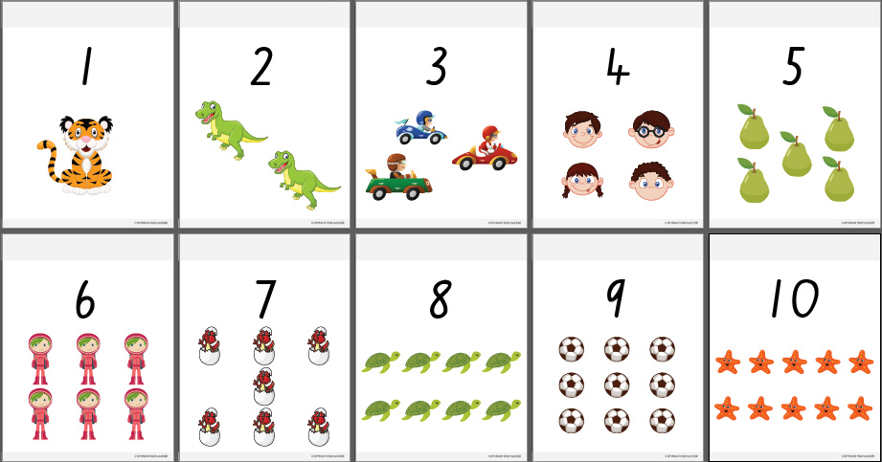

Last term we learnt all about numbers 1-10. We learnt to count, recognise and order the numbers.
Let’s recap numbers 1-10!

Slide 4

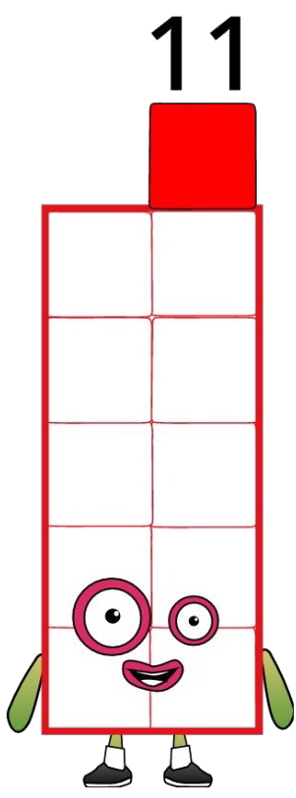

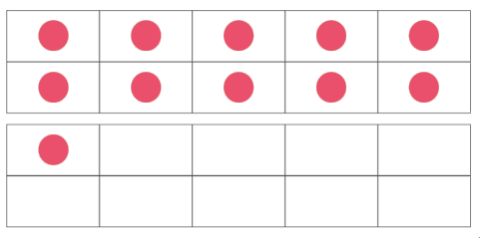


11
Challenge:
Can you blink 11 times?

Slide 5

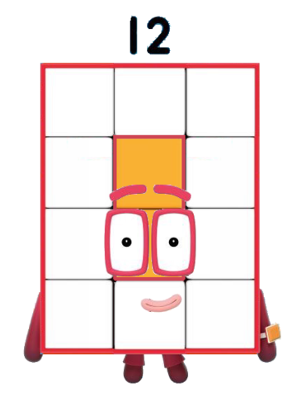
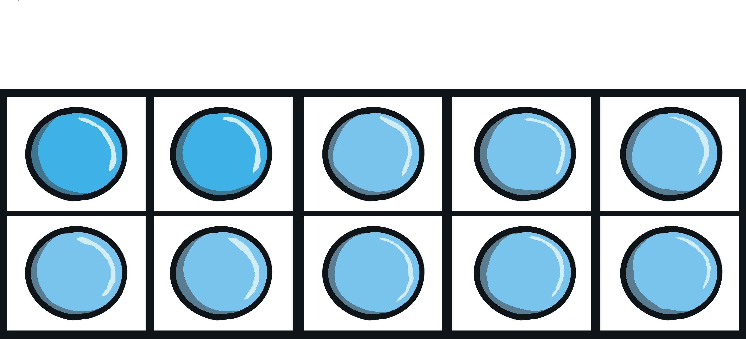




12
Challenge:
Can you clap 12 times?

Slide 6
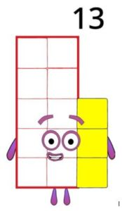




13
Challenge:
Can you jump 13 times?

Slide 7
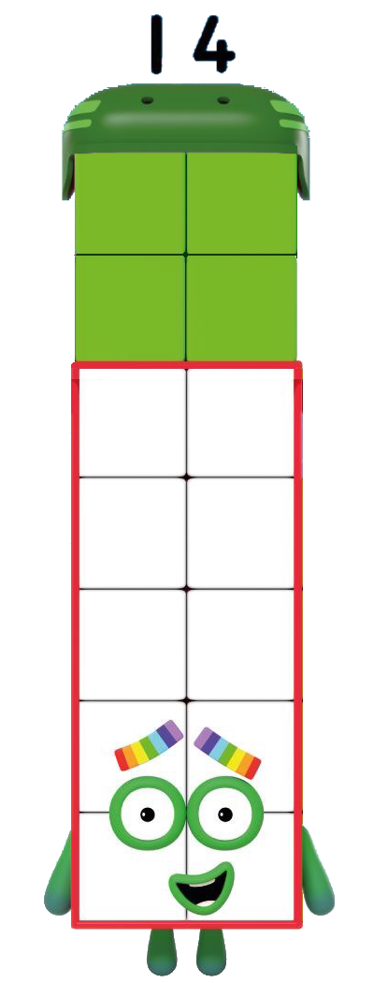

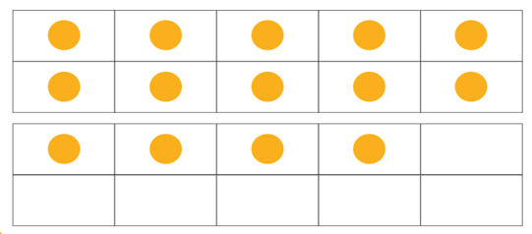


14
Challenge:
Can you tap your knees 14 times?

Slide 8


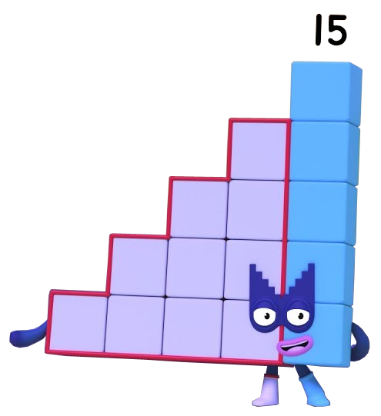
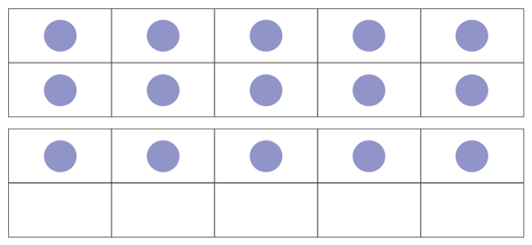

15
Challenge:
Can you hop 15 times?

Slide 9

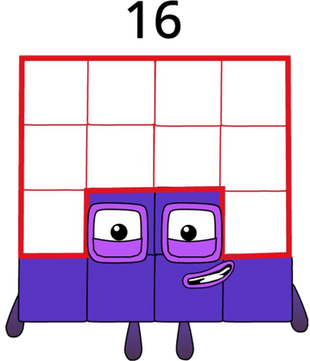
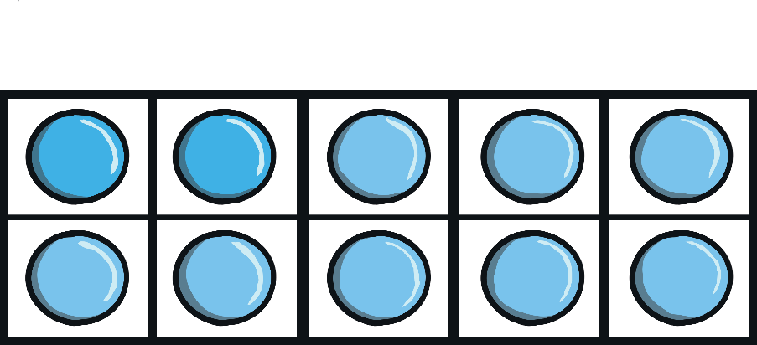

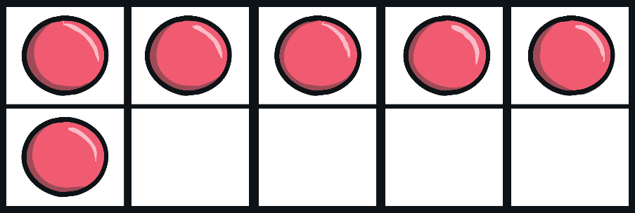

16
Challenge:
Can you pat your head 16 times?

Slide 10
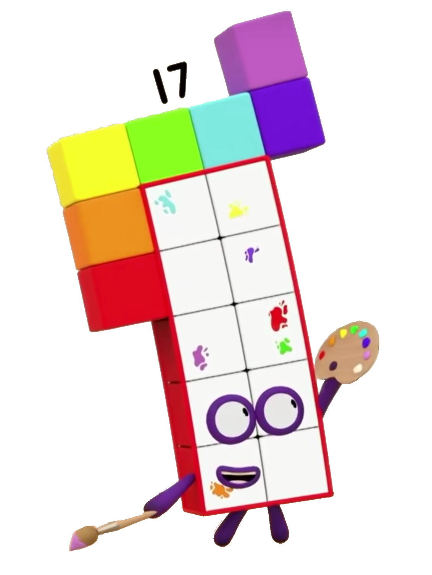





17
Challenge:
Can you bunny hop 17 times?

Slide 11

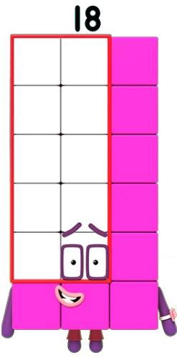

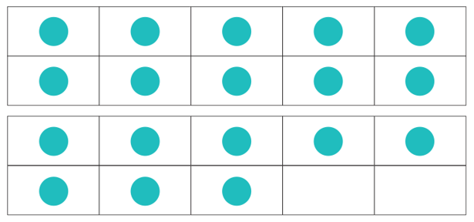

18
Challenge:
Can you bend your knees 18 times?

Slide 12
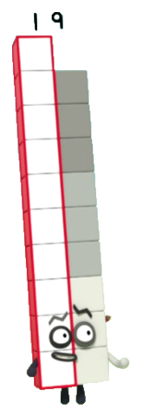


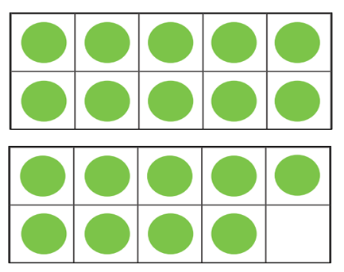

19
Challenge:
Can you touch your toes 19 times?

Slide 13
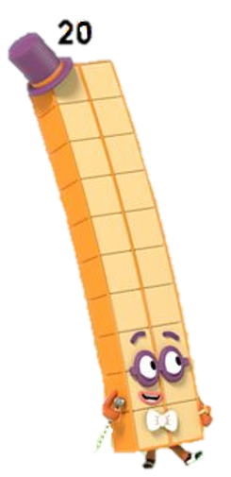

20
Challenge:
Can you stamp your feet 20 times?

Slide 14
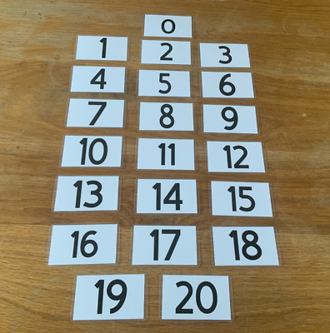
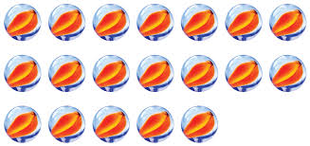
Today’s Activity
Write numbers 1-20 on bits of paper
Muddle them all up
Choose a card
Say the number
Count that number of objects (you could use Lego, pencils, beads)
Repeat with the other numbers
Extension
https://www.twinkl.co.uk/go
PIN IP8973

Slide 15
Numberblocks Numbers 1-20 Clips
Numbers 1-10 https://www.youtube.com/watch?v=Wbh1vOwI2Yo
Number 11 https://www.youtube.com/watch?v=0VLuYTztH-c
Number 12 https://www.youtube.com/watch?v=ZVy7g8jCwa4
Number 13 https://www.youtube.com/watch?v=ka8Dkgc1Heg
Number 14 https://www.youtube.com/watch?v=f6DrklyS8dM
Number 15 https://www.youtube.com/watch?v=W6i-11Flmnw
Number 16 https://www.youtube.com/watch?v=5HmusXTjN6w
Number 17 https://www.youtube.com/watch?v=n83v2kWUC9M
Number 18 https://www.youtube.com/watch?v=WqJ5oYeh7PM
Number 19 https://www.youtube.com/watch?v=NdChW87VJNw
Number 20 https://www.youtube.com/watch?v=4az0yAwmUH4

