Slide 1
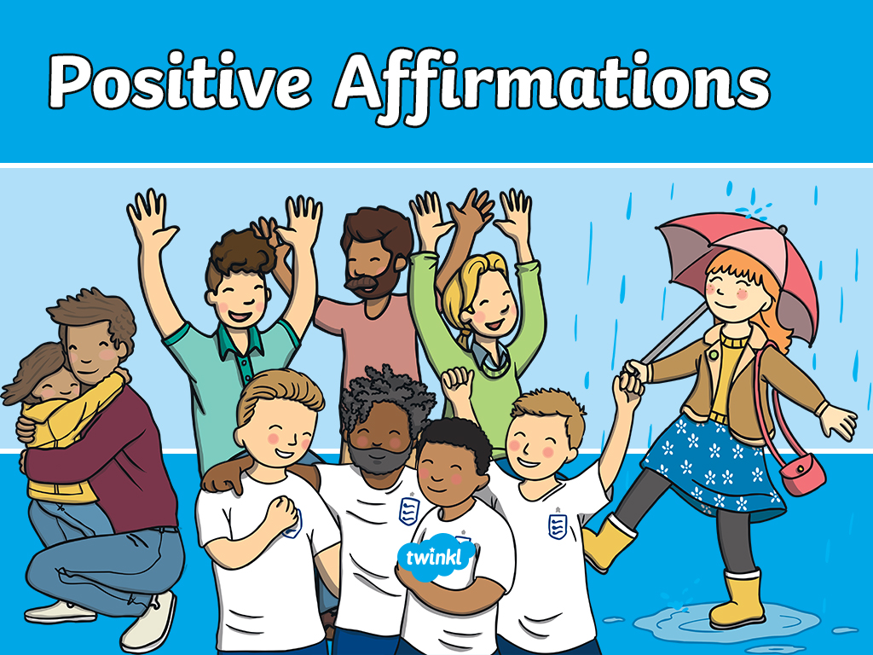


Slide 2
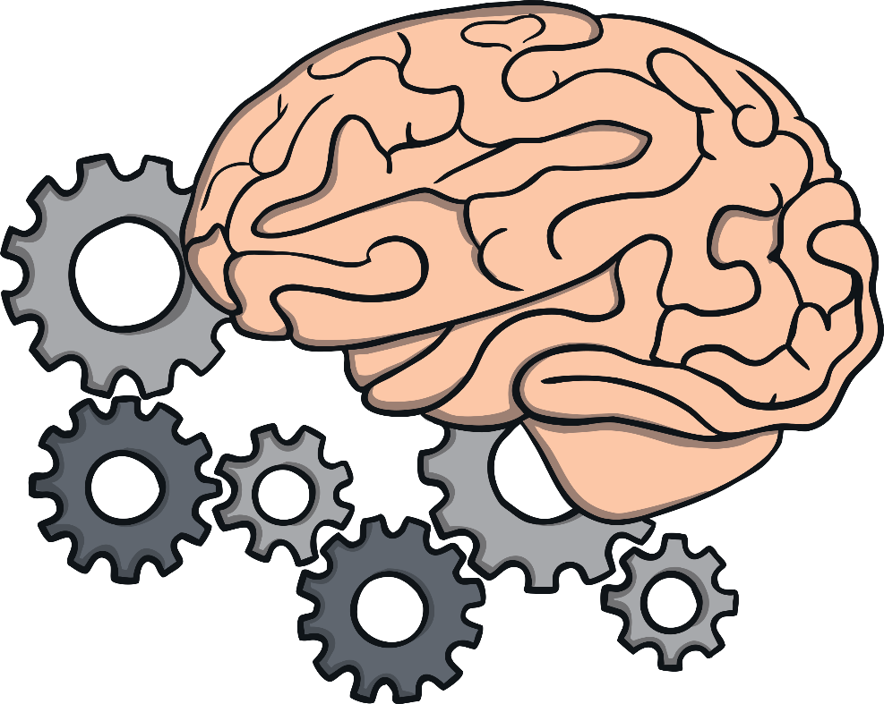
It is important to start each day with a positive thought, as this thought can stay with you for the rest of the day.
Focussing on a positive thought can help you to feel happier and calmer. You can also share this positive thought with others, helping to make their day a little brighter too!

Slide 3
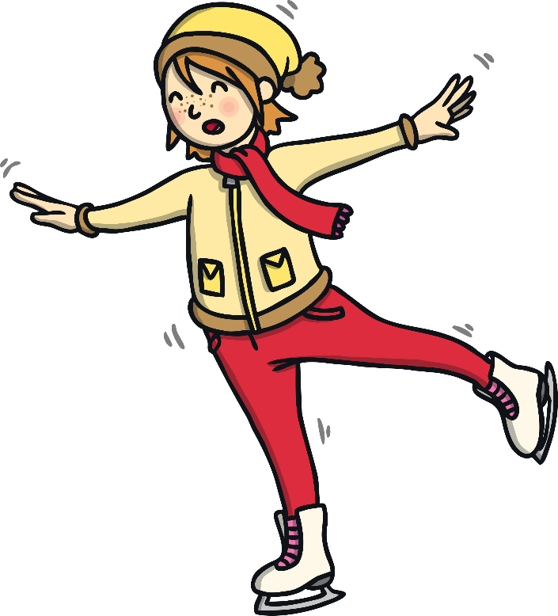
I will learn to do the things I find tricky.

Slide 4
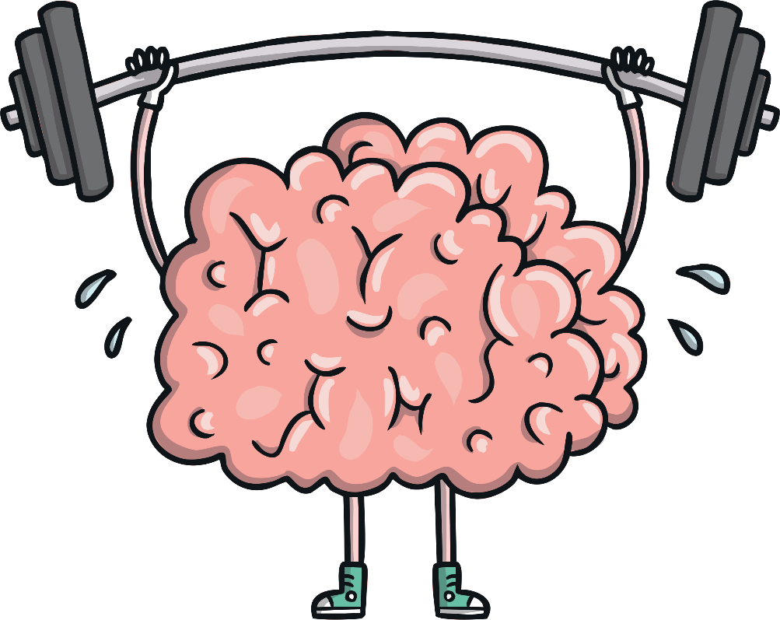
I have a great thinking brain.

Slide 5

I am loved.

Slide 6




I am unique.

Slide 7
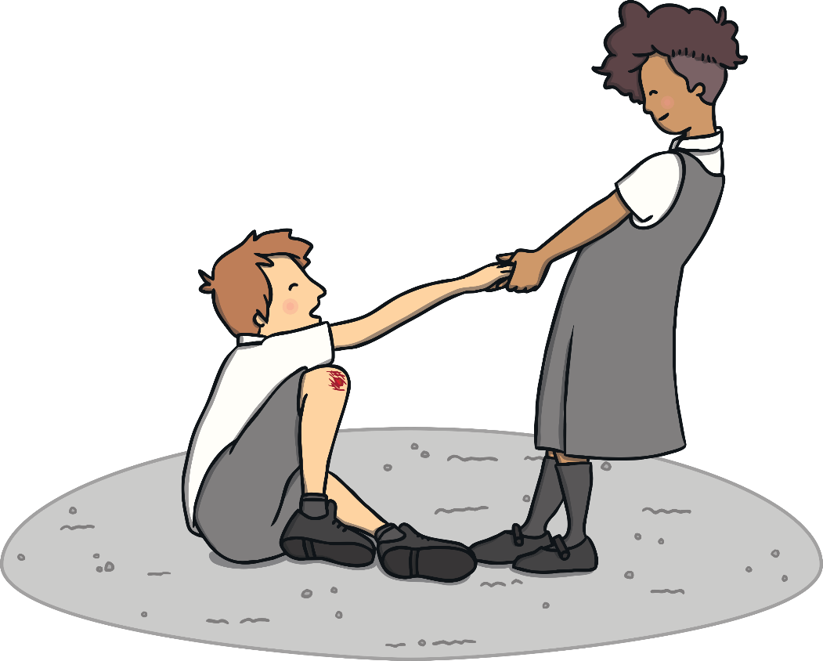
I can be helpful.

Slide 8
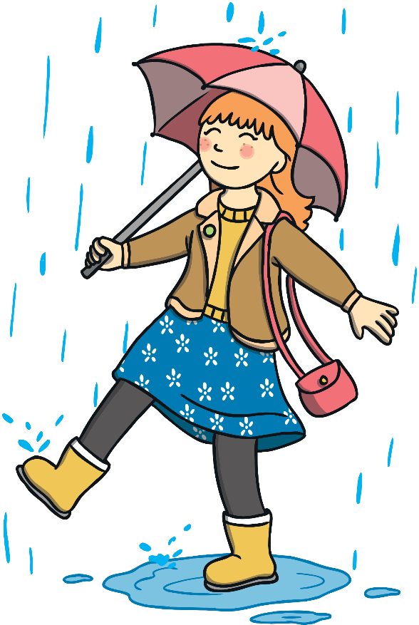
I have a positive attitude.

Slide 9
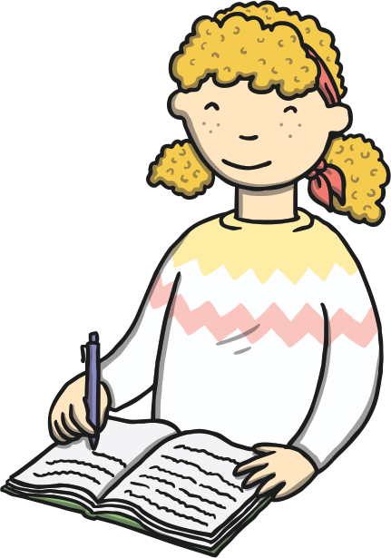
I try my hardest.

Slide 10

I can achieve my dreams.

Slide 11
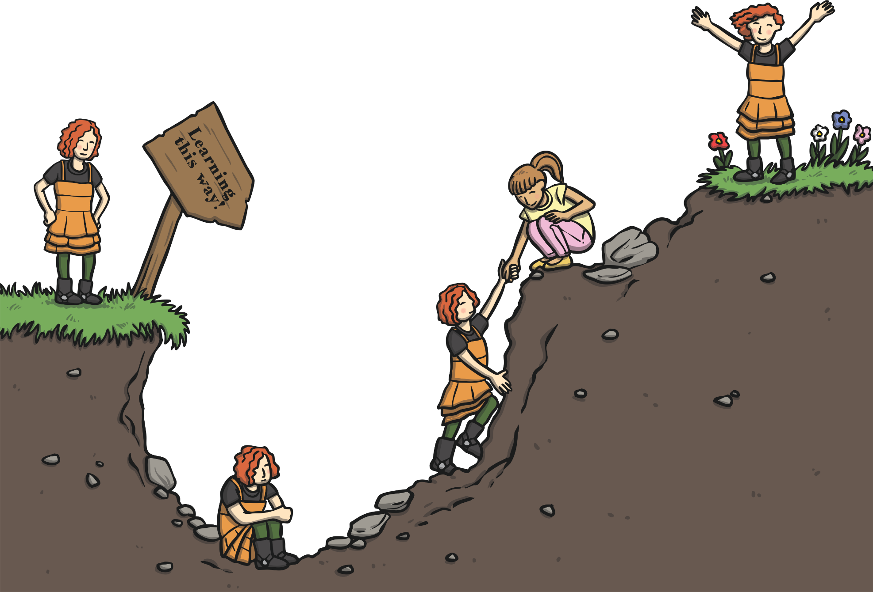
I learn and grow every day.

Slide 12
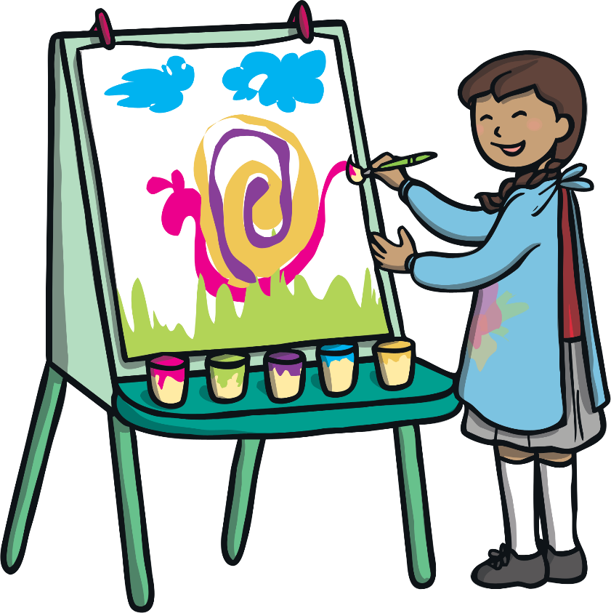
I am talented.

Slide 13
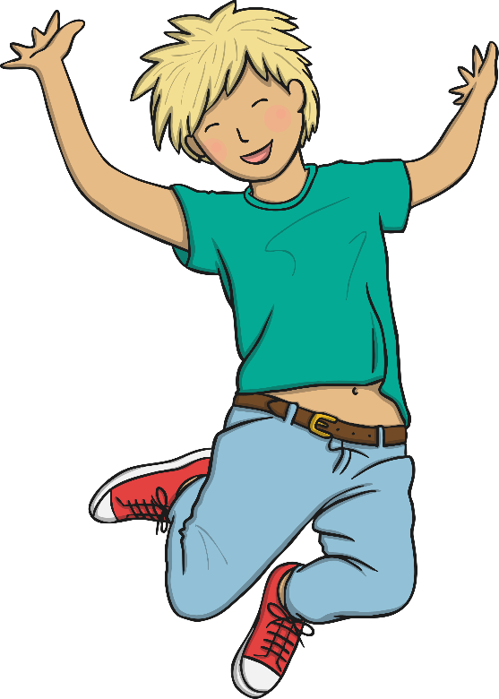
I can reach for the stars!

Slide 14

Challenges help me learn and grow.

Slide 15


I am great, just the way I am.

Slide 16
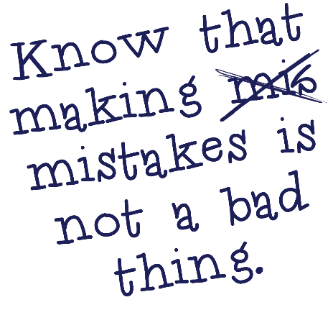

My mistakes help me learn and grow.

Slide 17
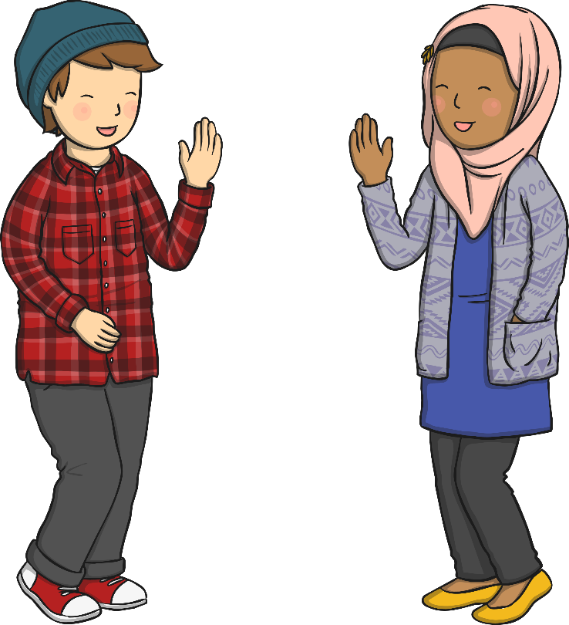
Today is going to be a great day!

Slide 18
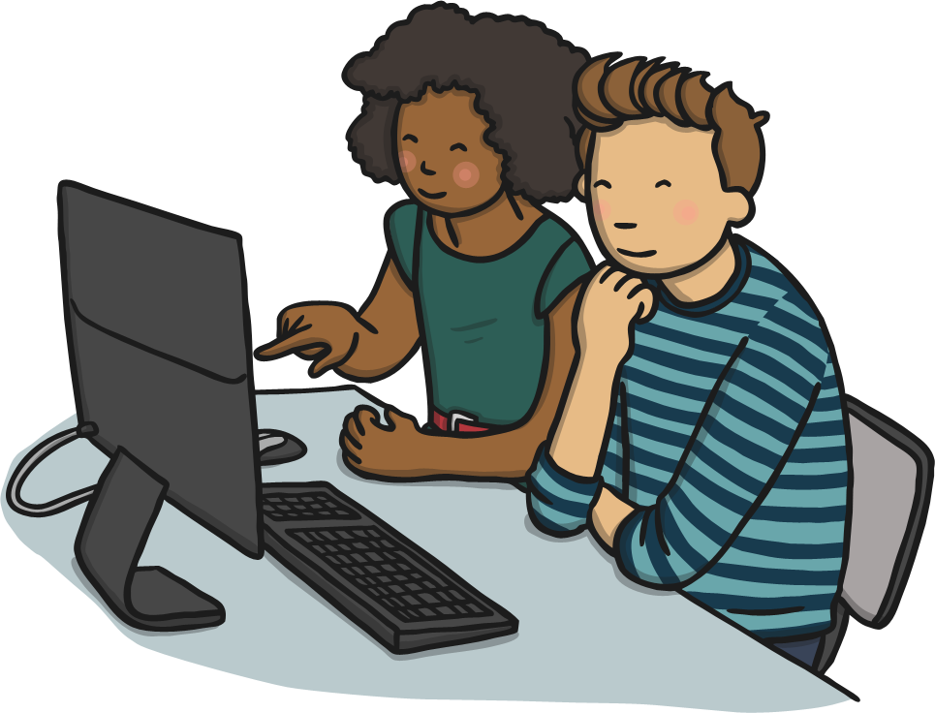
I am a hard worker.

Slide 19
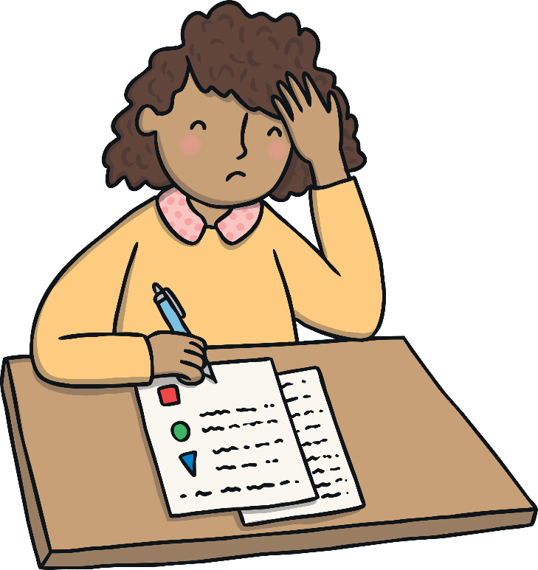

I can do anything I put my mind to.

Slide 20

I have good listening ears.

Slide 21
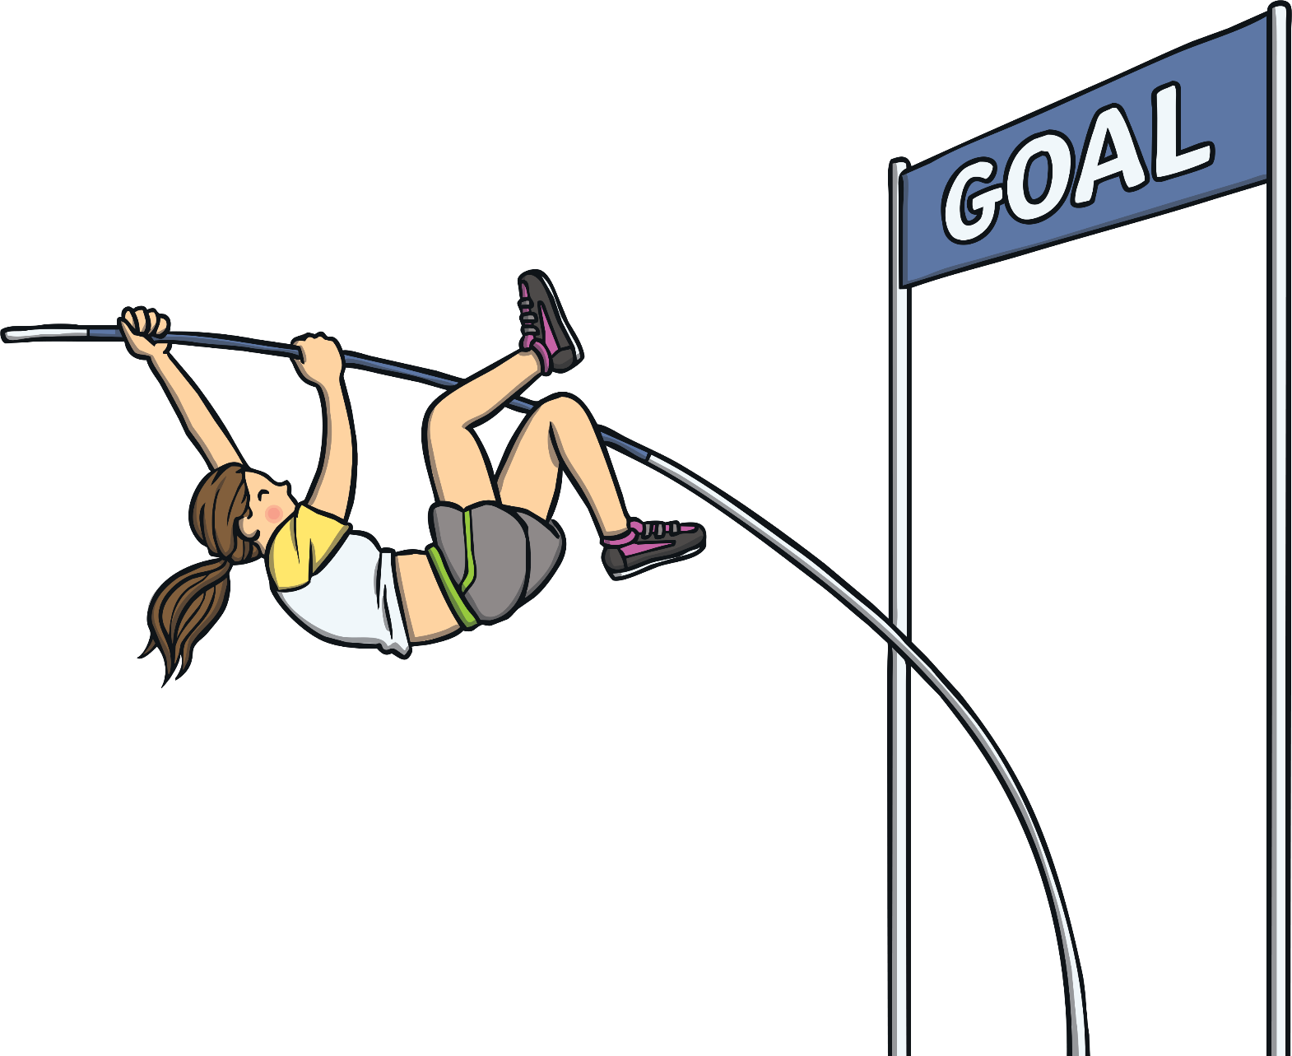
I can do it!

Slide 22
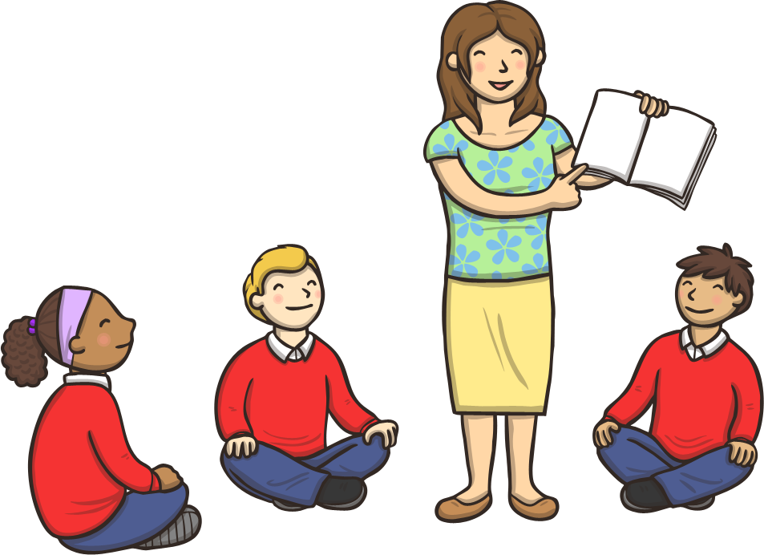
I am ready to learn.

Slide 23
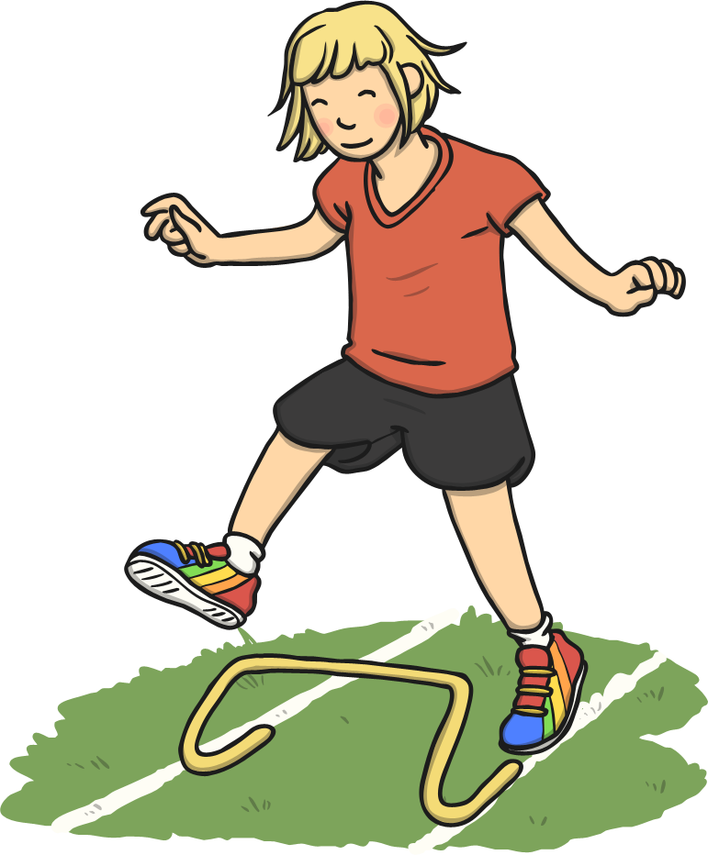
I always try my best.

Slide 24


