Slide 1

Role Play
Let’s create a role play area!

Slide 2
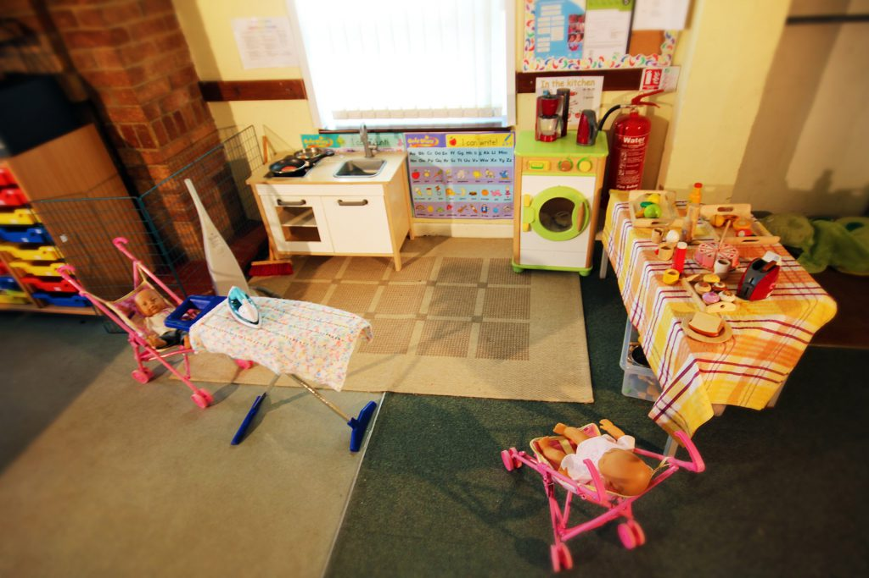
What is a role play area?
A role play area is a place which helps you to act out different situations.
In school you have had shop role play and a space role play area.

Slide 3
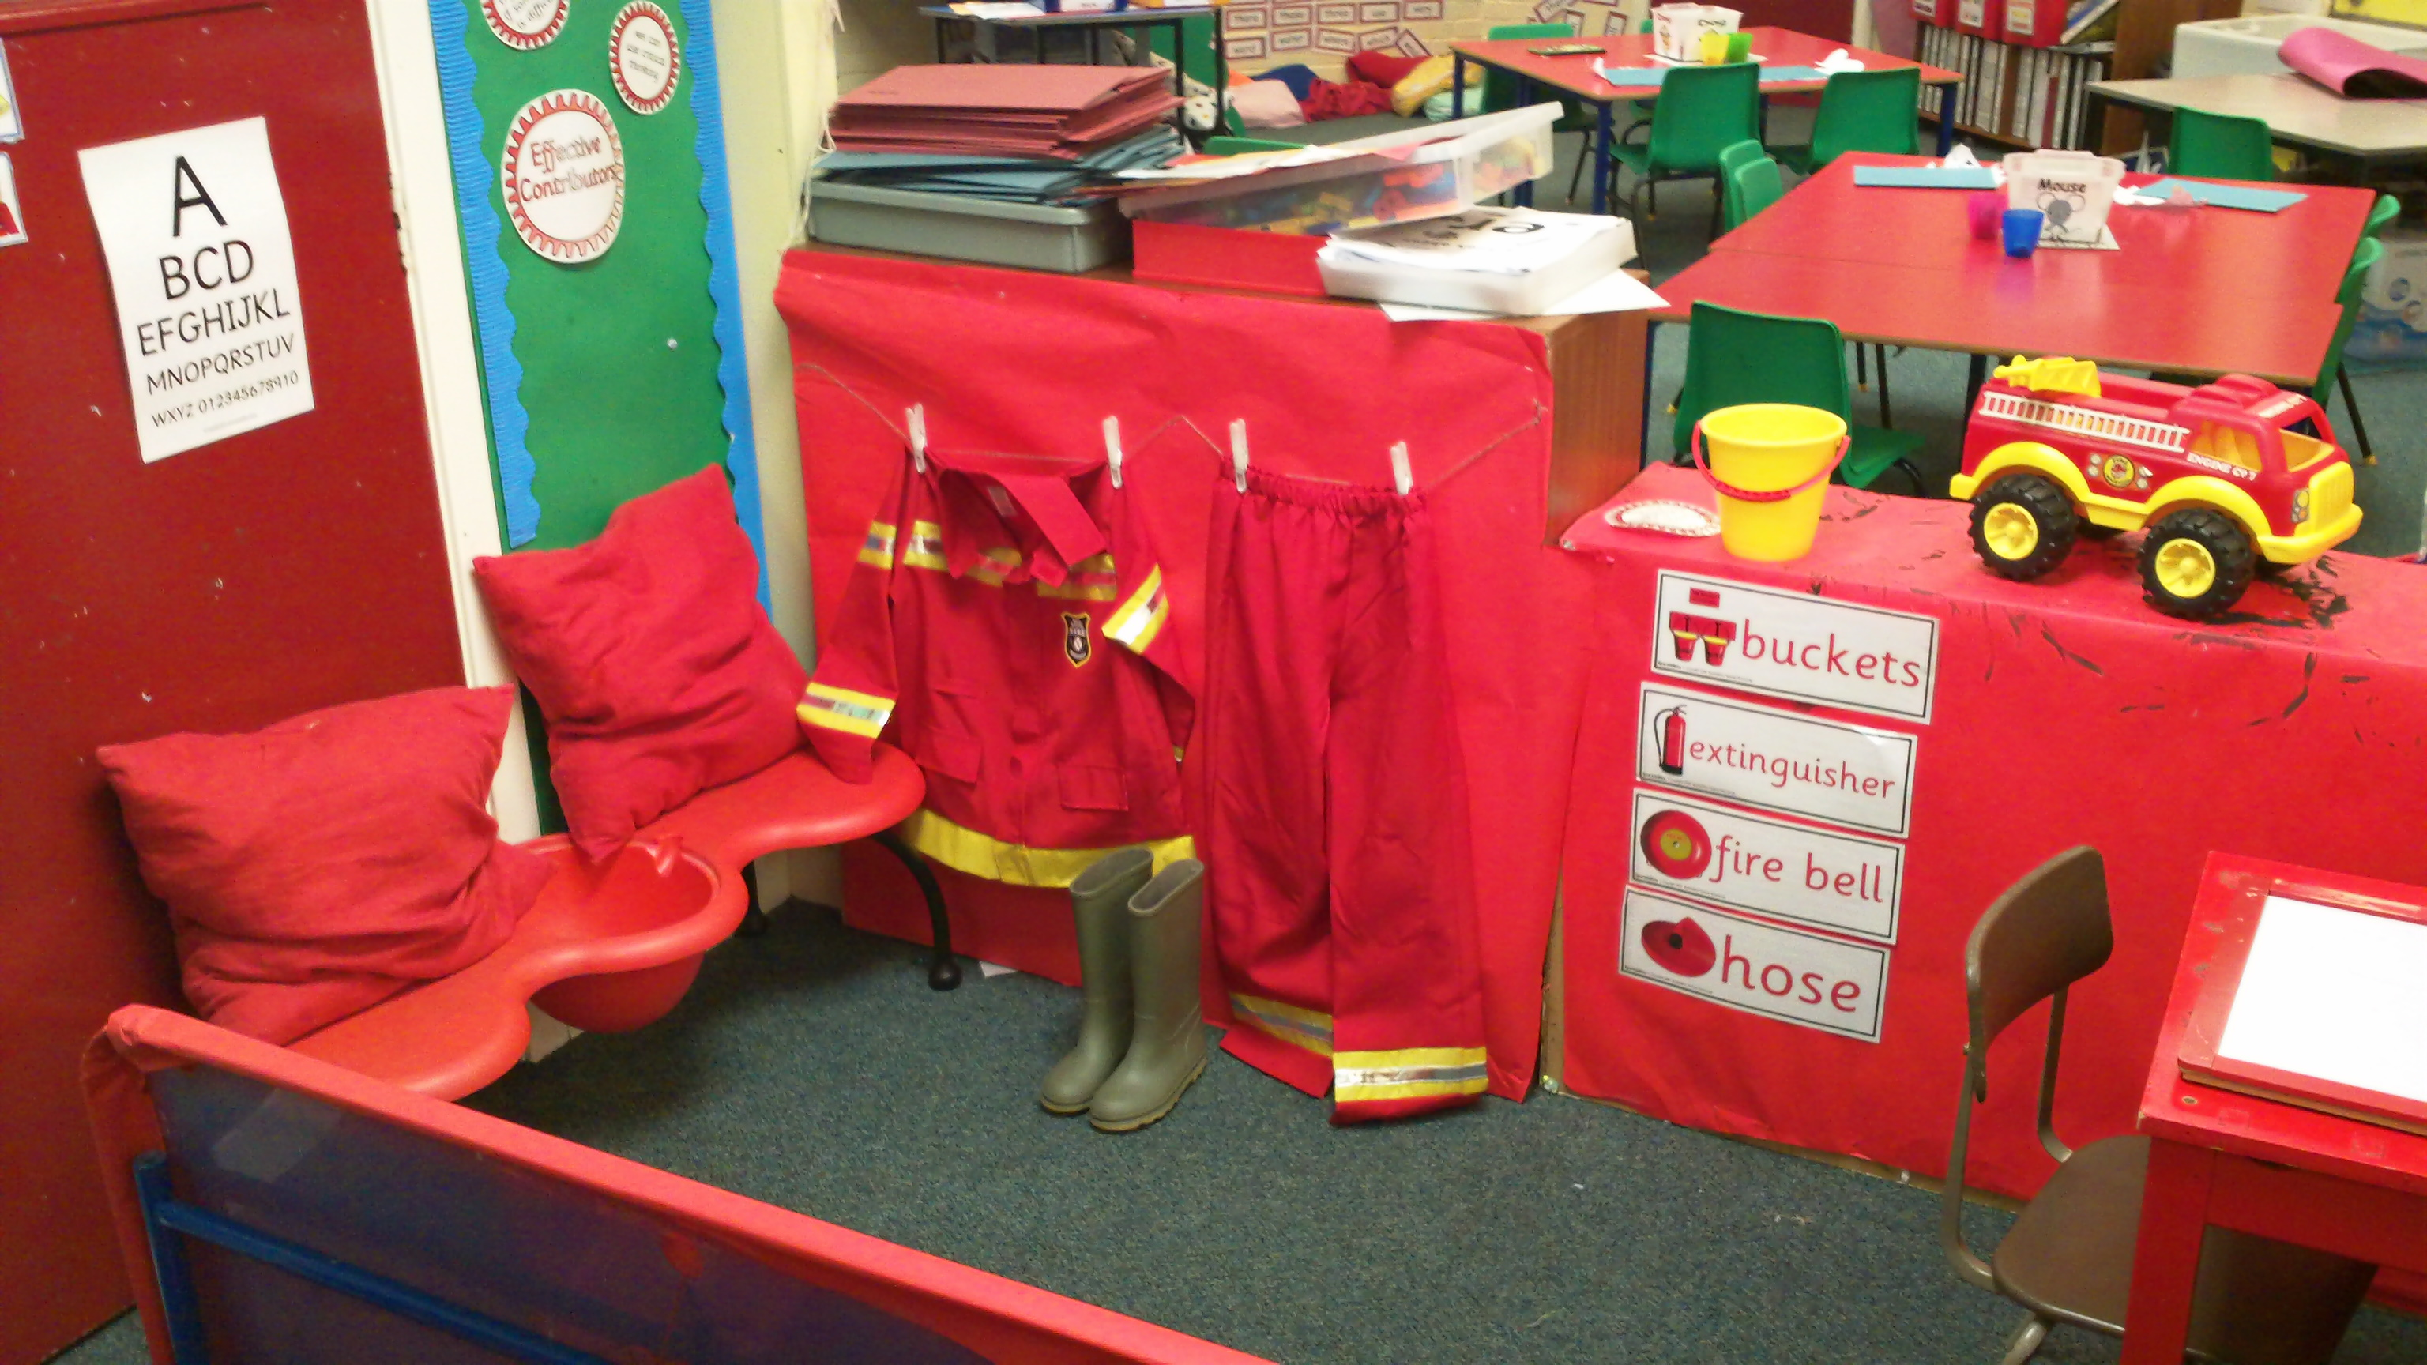
Today’s Activity
You will make a role play area for one of the real life superheroes you learnt about this week.
You could make a:
Hospital
Doctors
Police Station
School
Vets
Fire Station

Slide 4
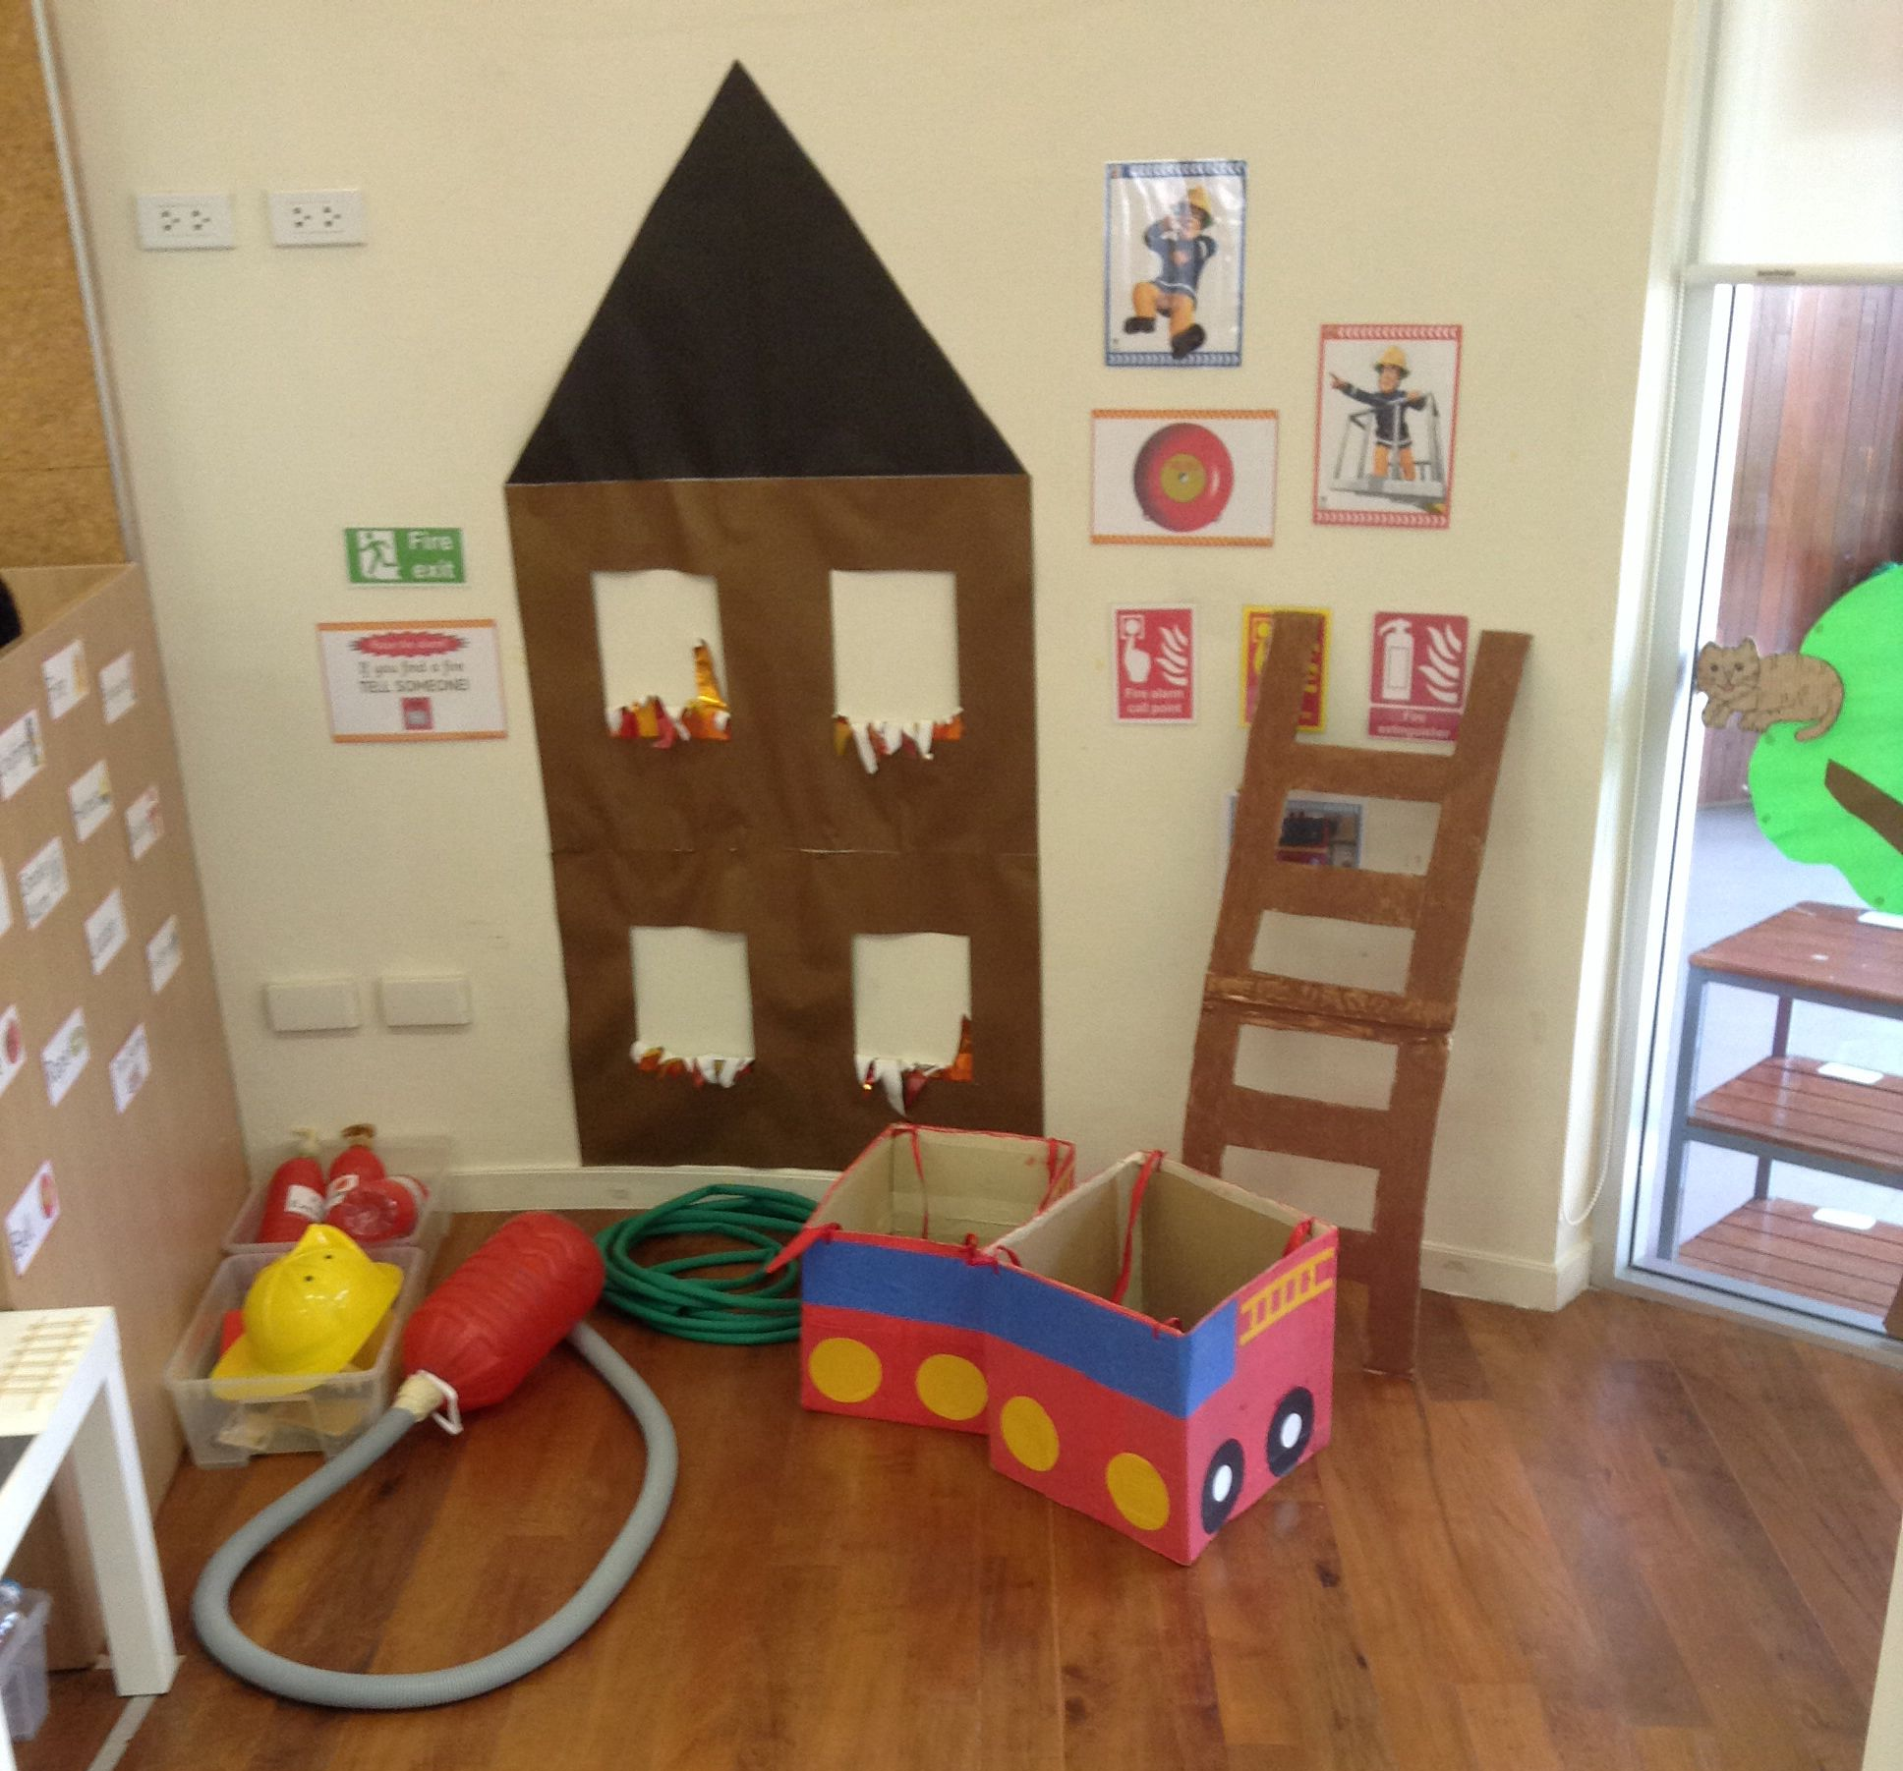
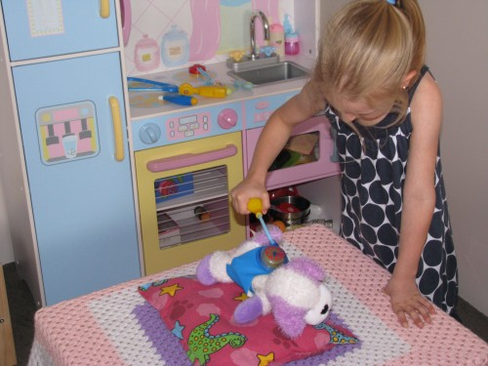
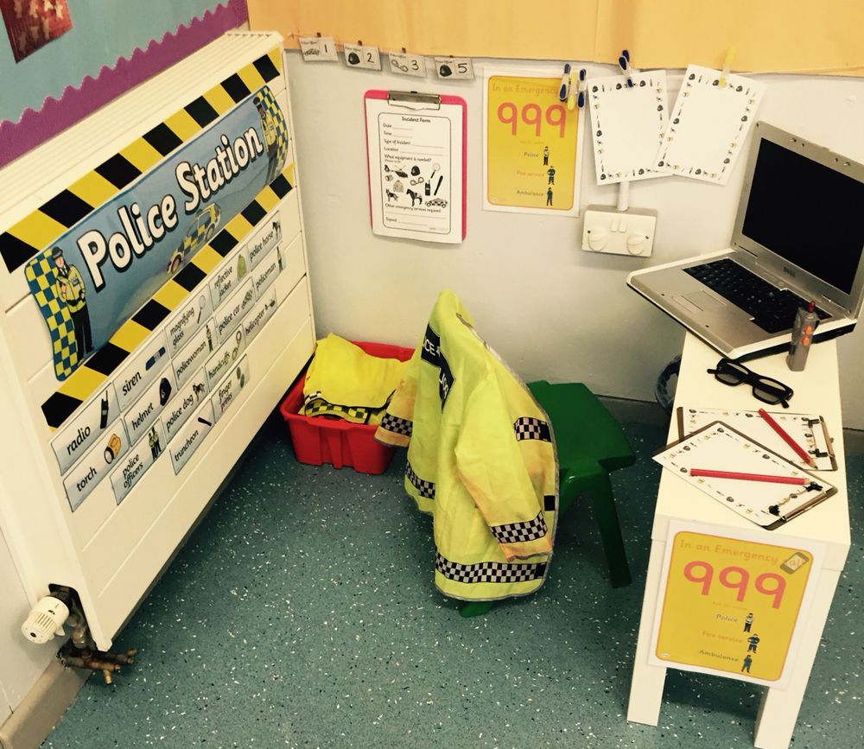
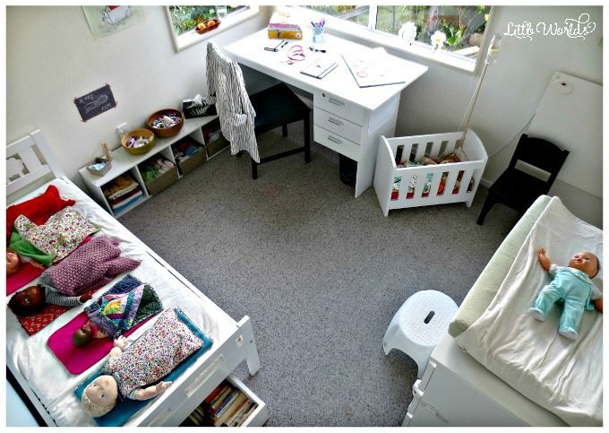
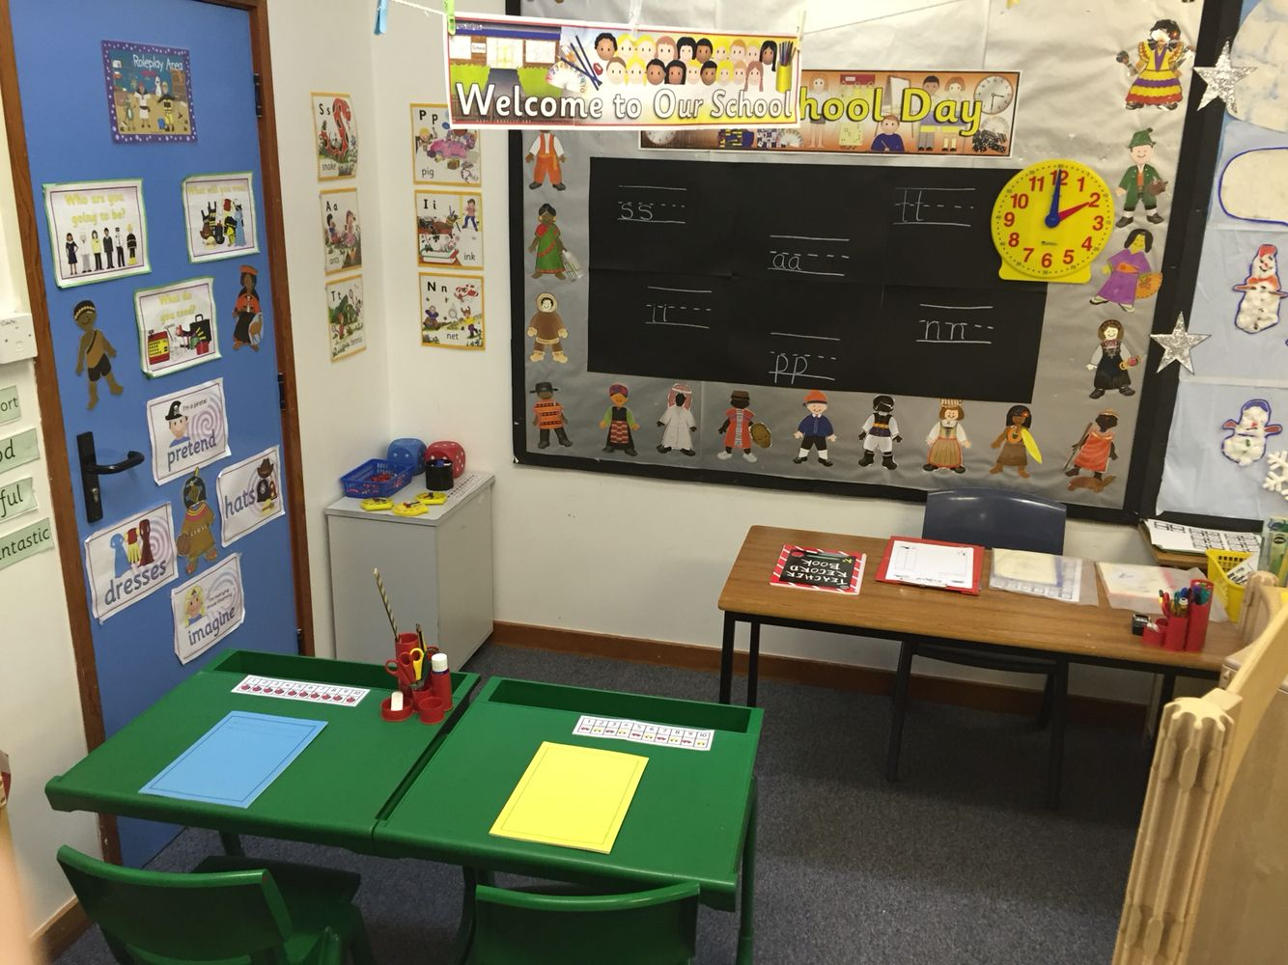
Here are some examples!

Slide 5
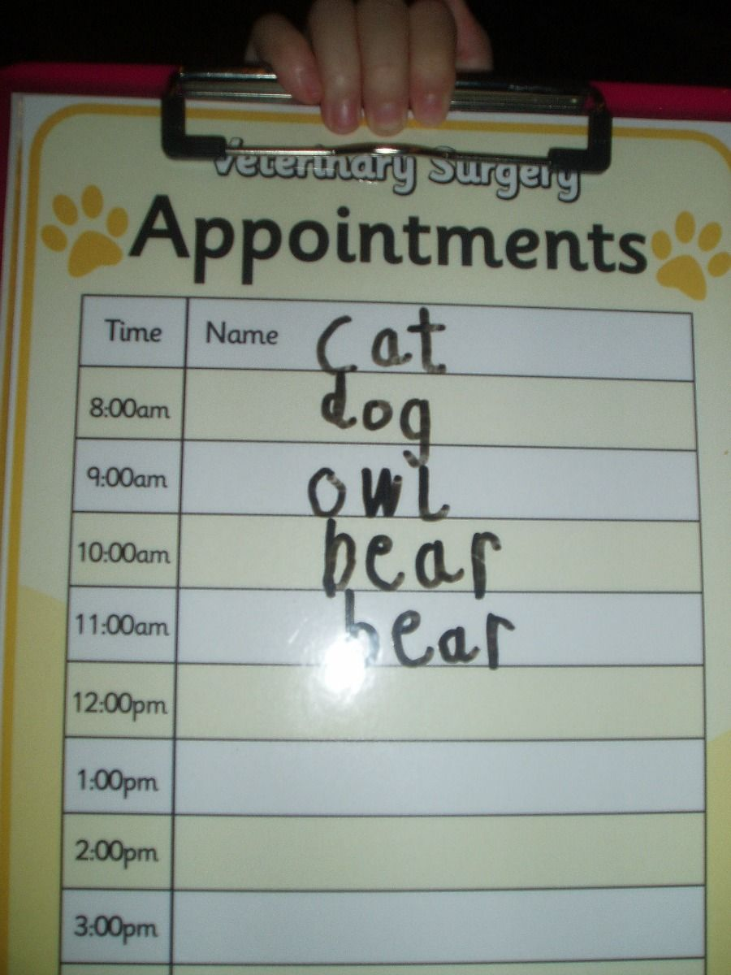
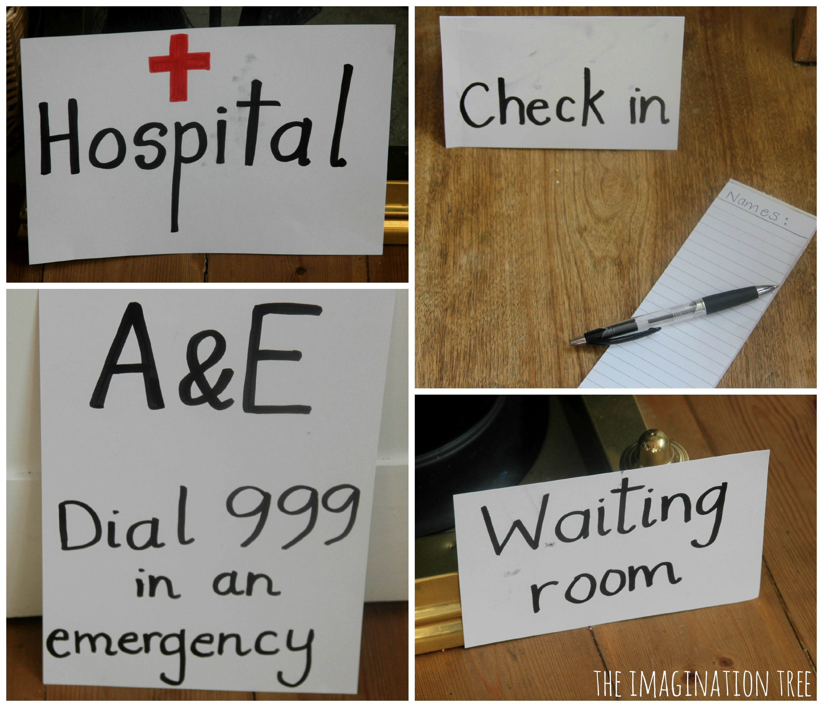
How do you make a role play area?
Decide what you want to make.
Make some signs and labels for your role play area
Find any resources you may need.
Set the area up and add the labels.
Enjoy playing in your role play area!

