Slide 1


Slide 2
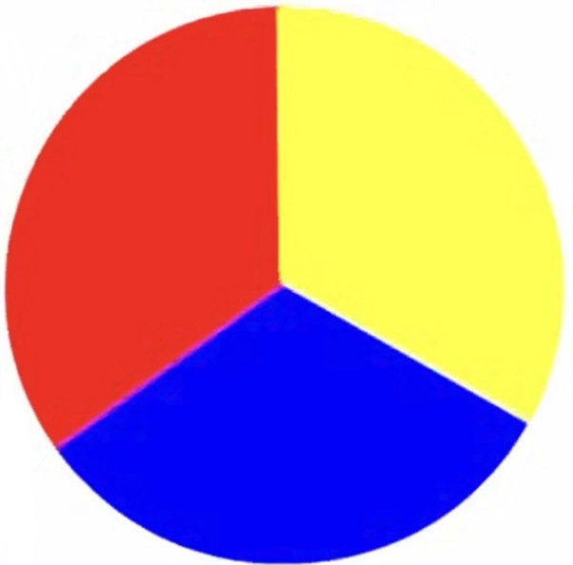
Let’s recap the colours we learnt last week!

Slide 3

bleu

Slide 4

rouge

Slide 5

jaune

Slide 6

Let’s learn 4 new colours! Today we are going to learn how to say orange, green, pink and purple in French!

Slide 7

orange

Slide 8

violet

Slide 9

vert

Slide 10

rose

Slide 11
Let’s practise all our colours again!

Slide 12
orange

Slide 13
violet

Slide 14
vert

Slide 15
rose

Slide 16
bleu

Slide 17
rouge

Slide 18
jaune

Slide 19
CHALLENGE TIME!
Can you make a picture of a rainbow and say each colour in French?

