Slide 1

Maths -Capacity
Friday 15th January 2021

Slide 2
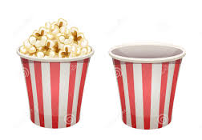
Can you have a go at ordering these from most full to least full?

Slide 3
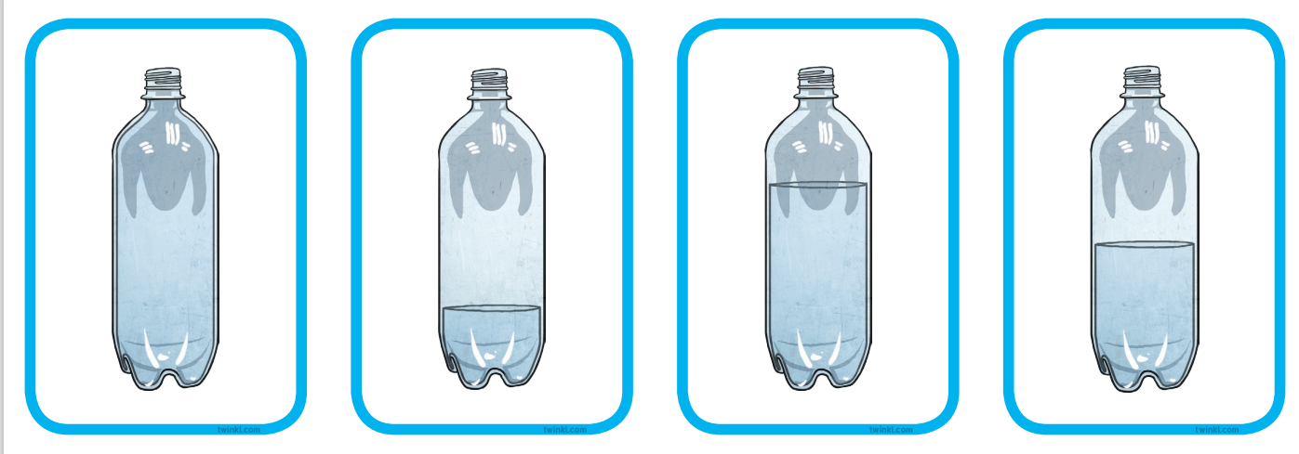
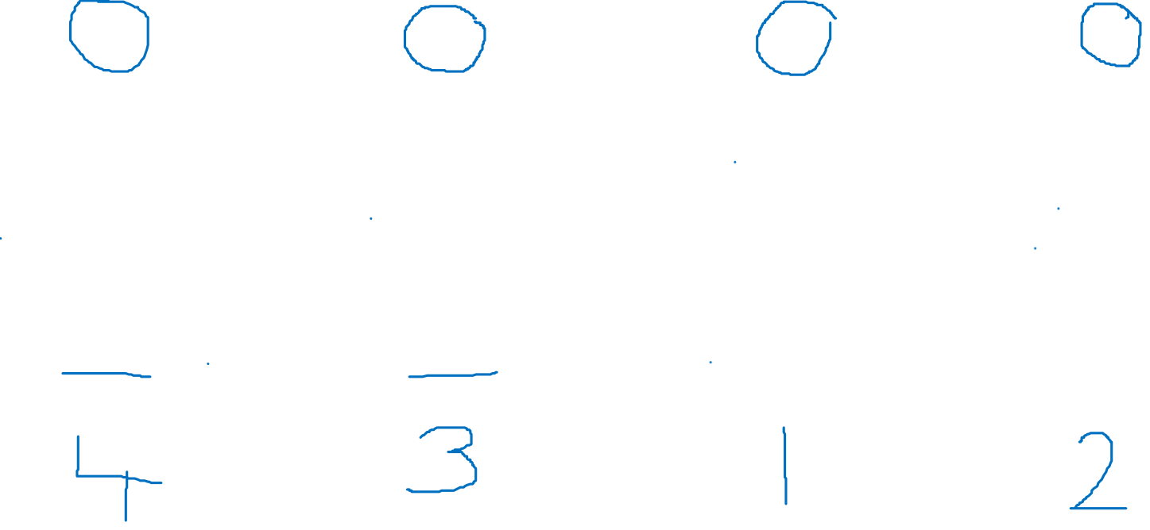

Slide 4
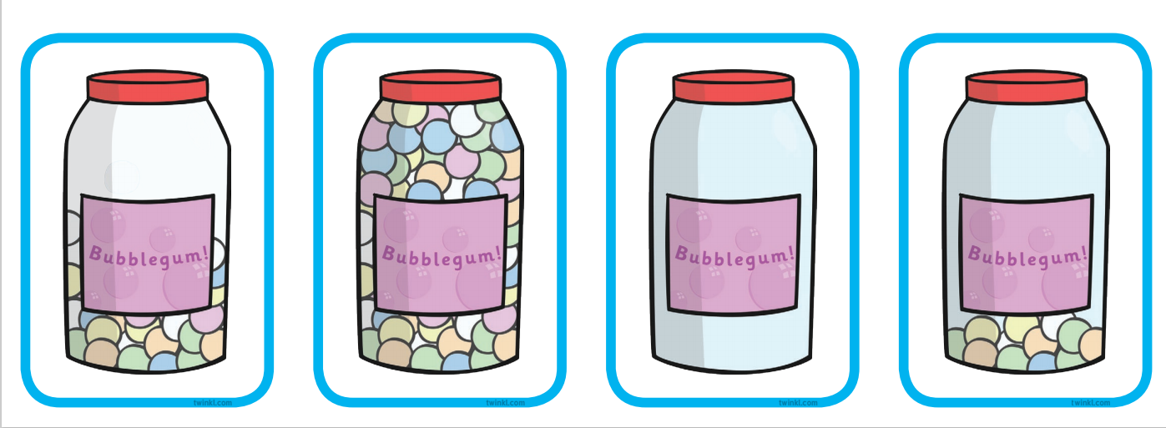
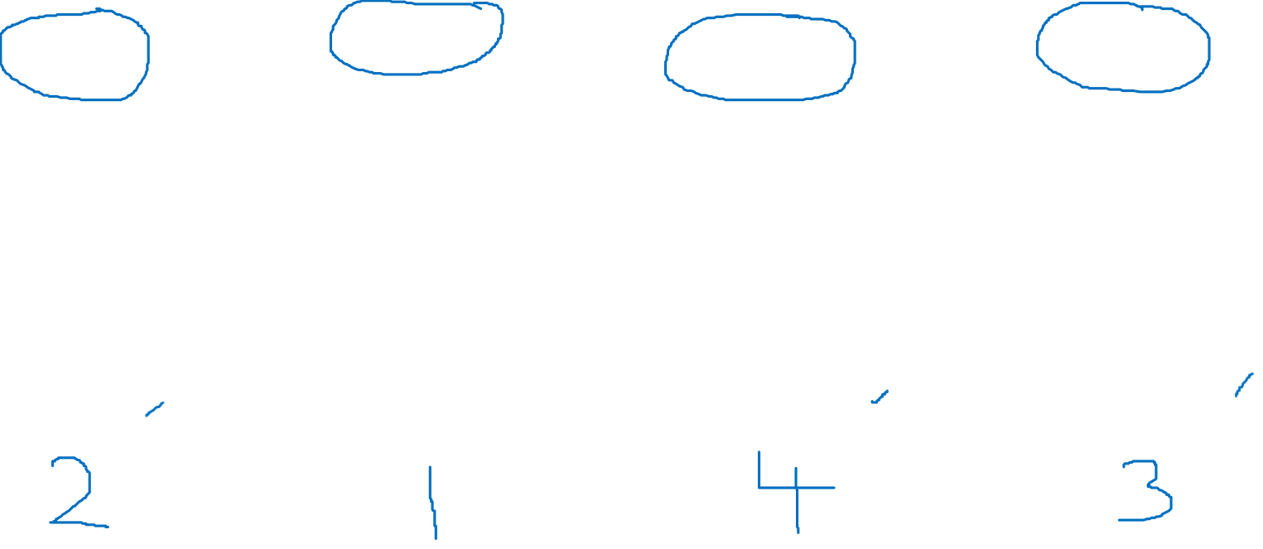

Slide 5
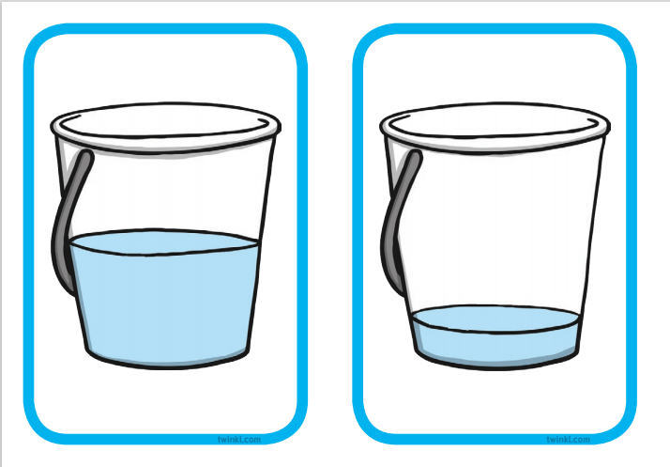
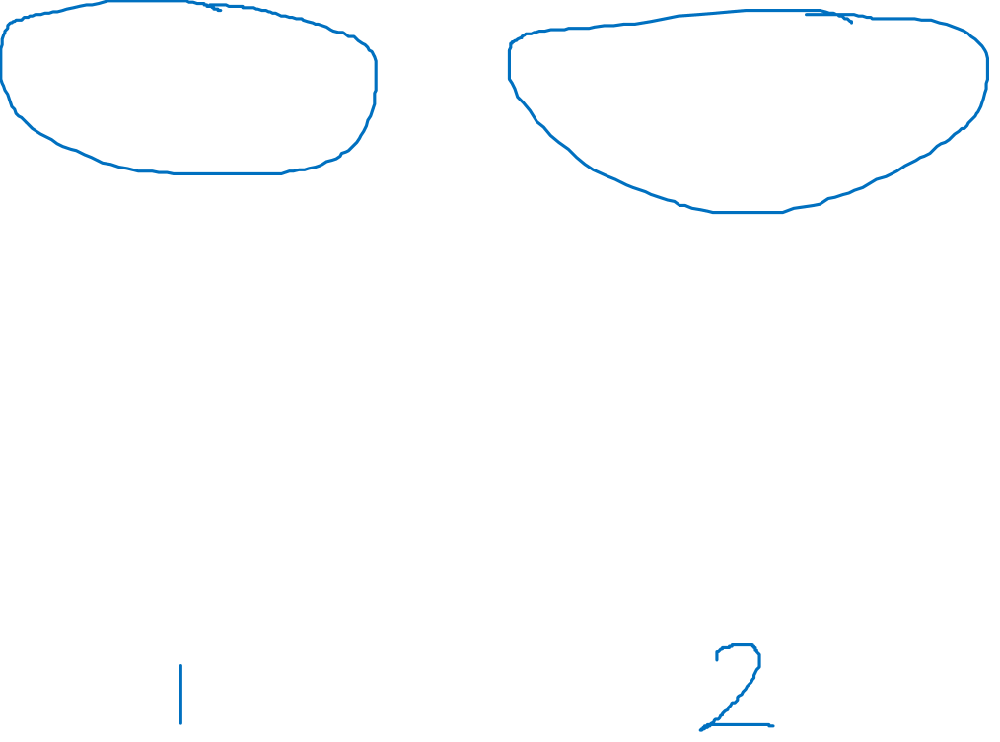

Slide 6
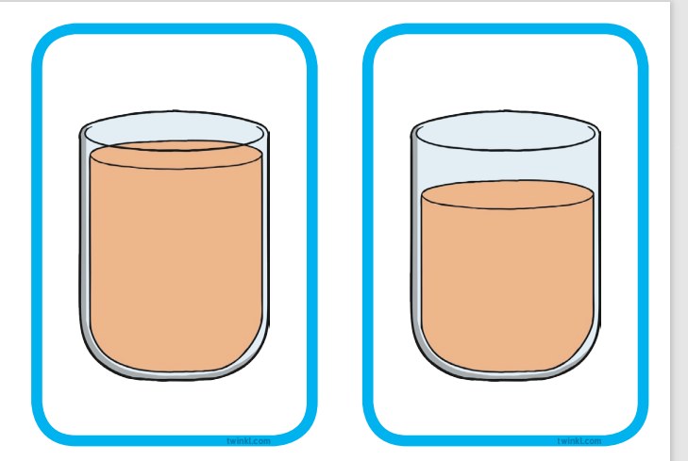
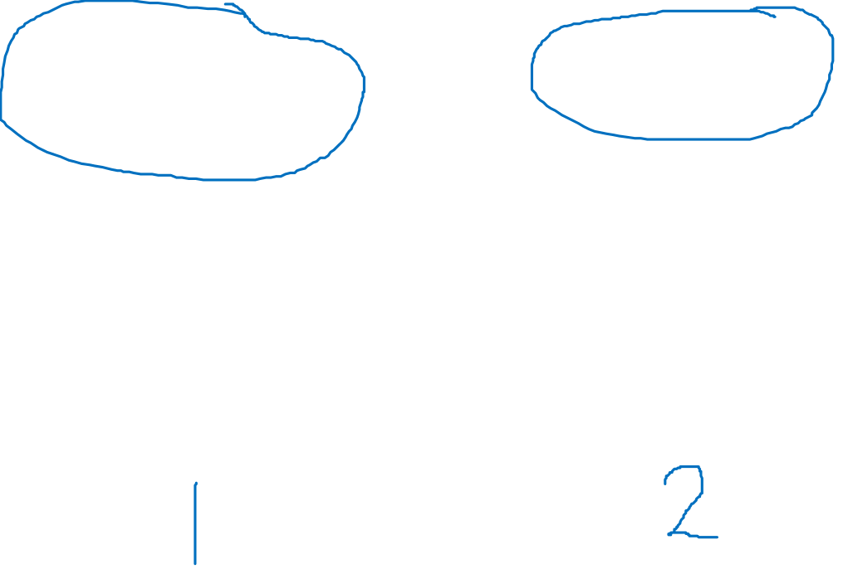

Slide 7
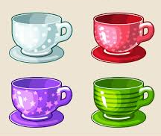
Now it’s your turn to have a go!
Can you find 3 cups the same size, fill them one to full, one to half full and one empty. Can you place them in order from fullest to emptiest? Repeat with 5 cups and add nearly full and nearly empty and place them in order

