Slide 1



Slide 2


Slide 3


Slide 4


Slide 5
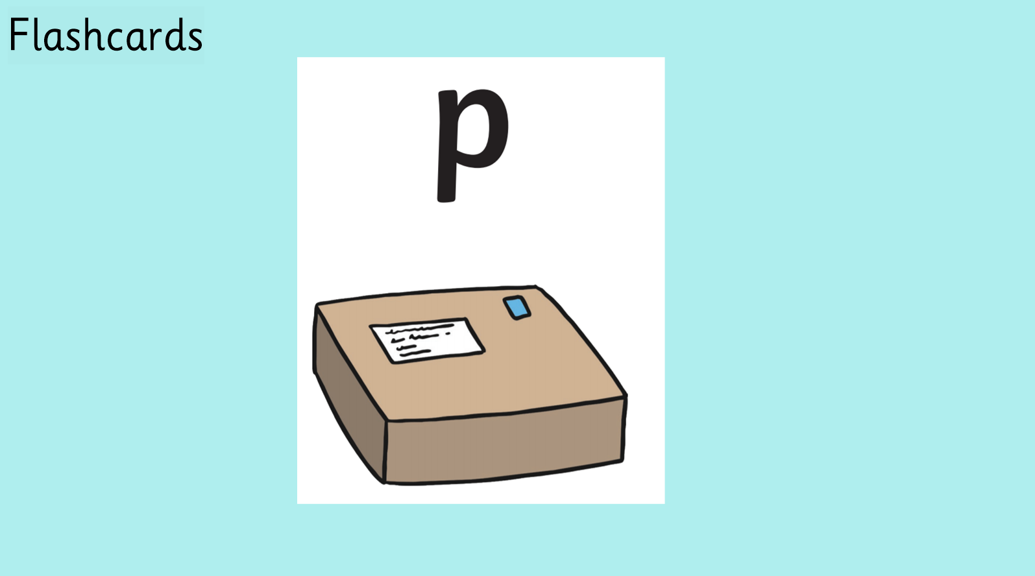

Slide 6


Slide 7


Slide 8


Slide 9


Slide 10
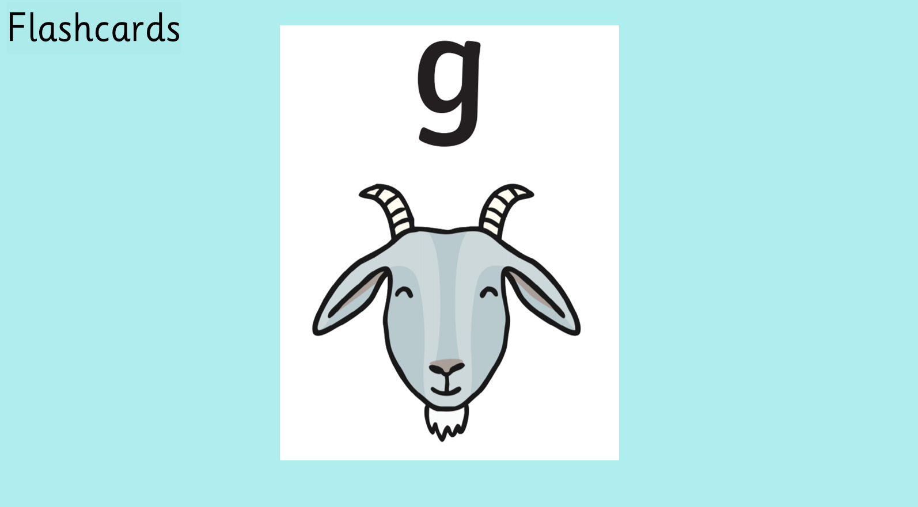

Slide 11


Slide 12


Slide 13


Slide 14


Slide 15


Slide 16


Slide 17


Slide 18


Slide 19


Slide 20


Slide 21


Slide 22


Slide 23


Slide 24
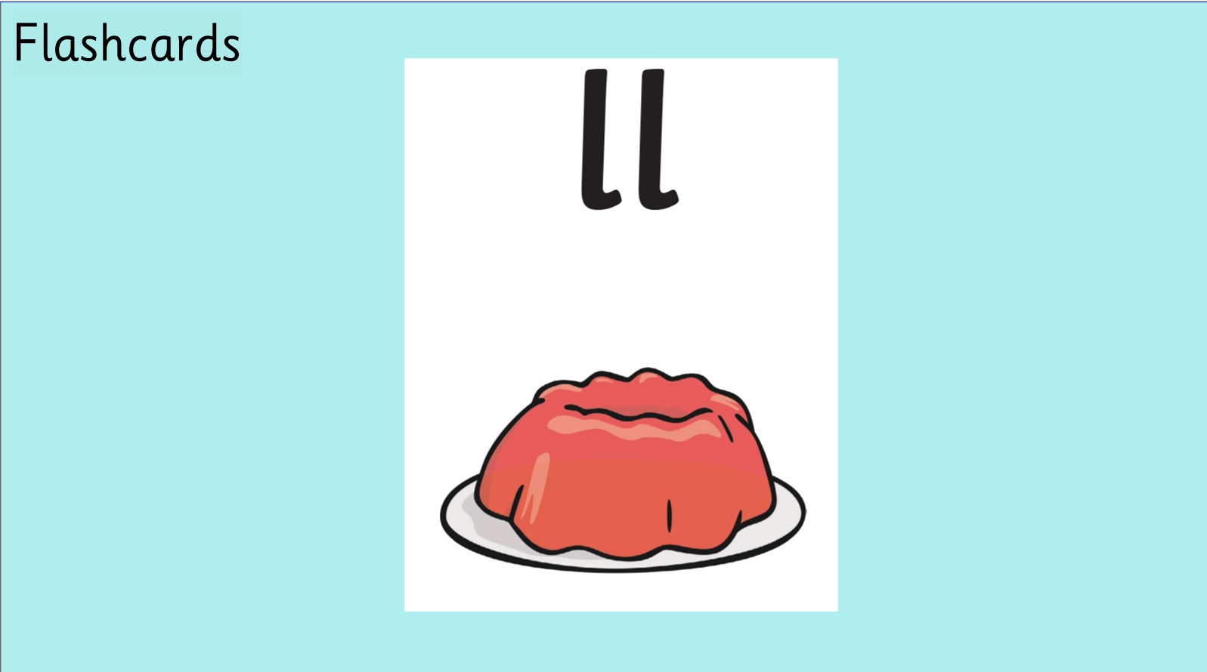

Slide 25


Slide 26


Slide 27


Slide 28


Slide 29


Slide 30



Slide 31


Slide 32


Slide 33


Slide 34


Slide 35


Slide 36


Slide 37
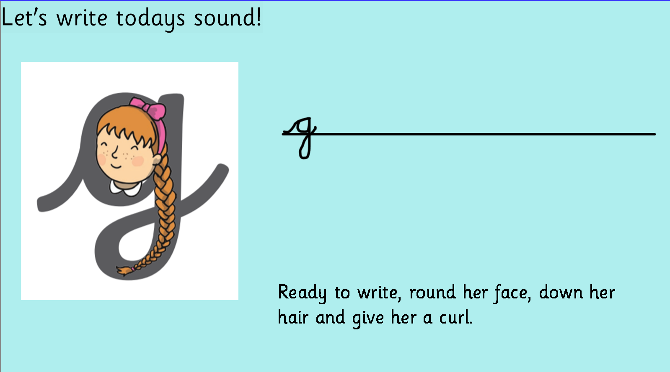


Slide 38



Slide 39
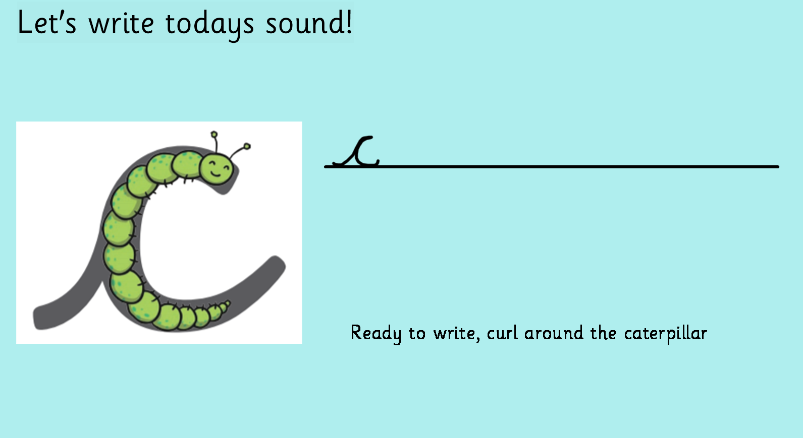


Slide 40
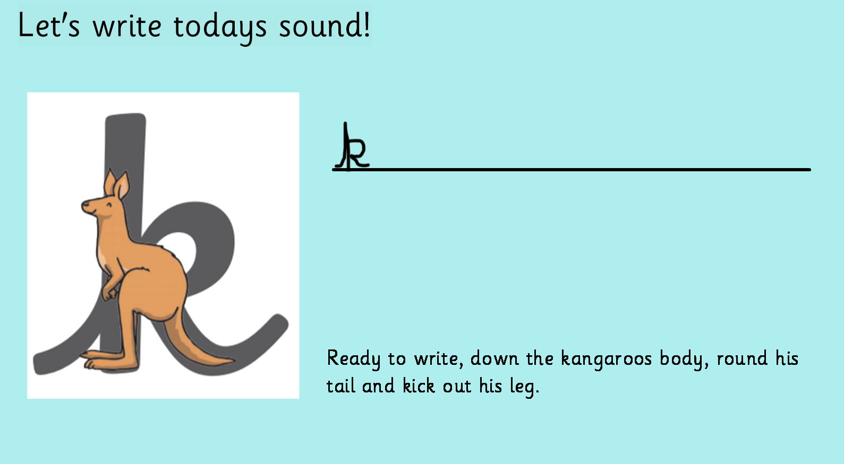


Slide 41


Slide 42









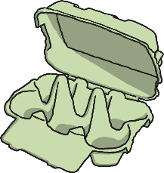

Make the Cake
Can you help Mrs Claus to make the Christmas cake?
The ingredients for the cake have real words on. Can you find them?
Click the ingredients to check if you are right.
dack
kiss
cop
pit
pell
fip
bug
ticket
sog
nap
pog

Slide 43


