Slide 1



Slide 2
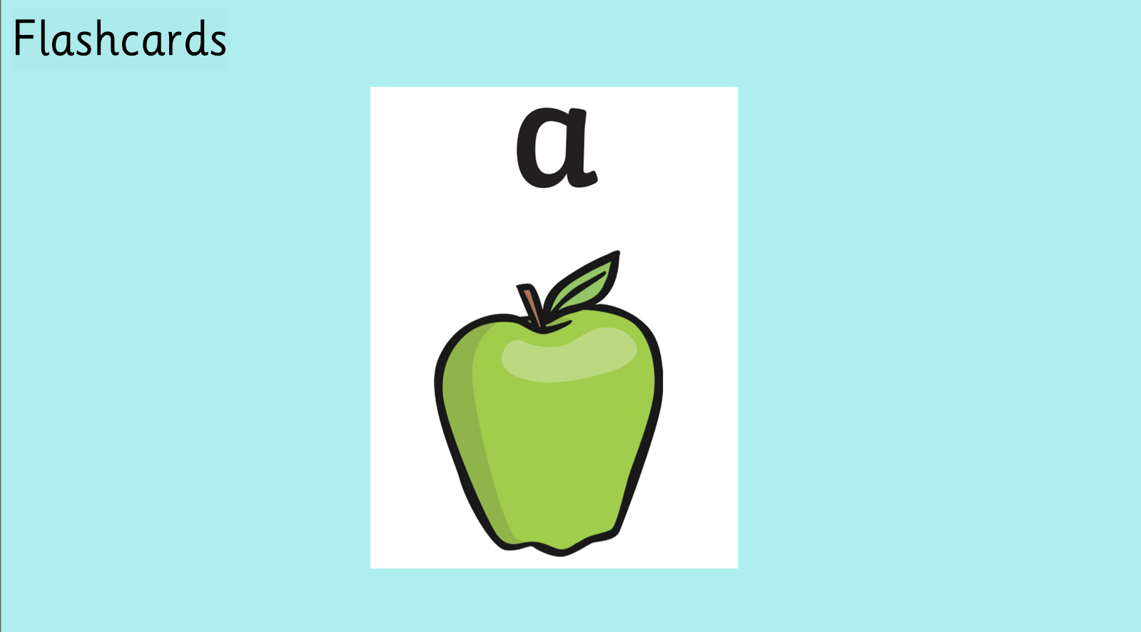

Slide 3
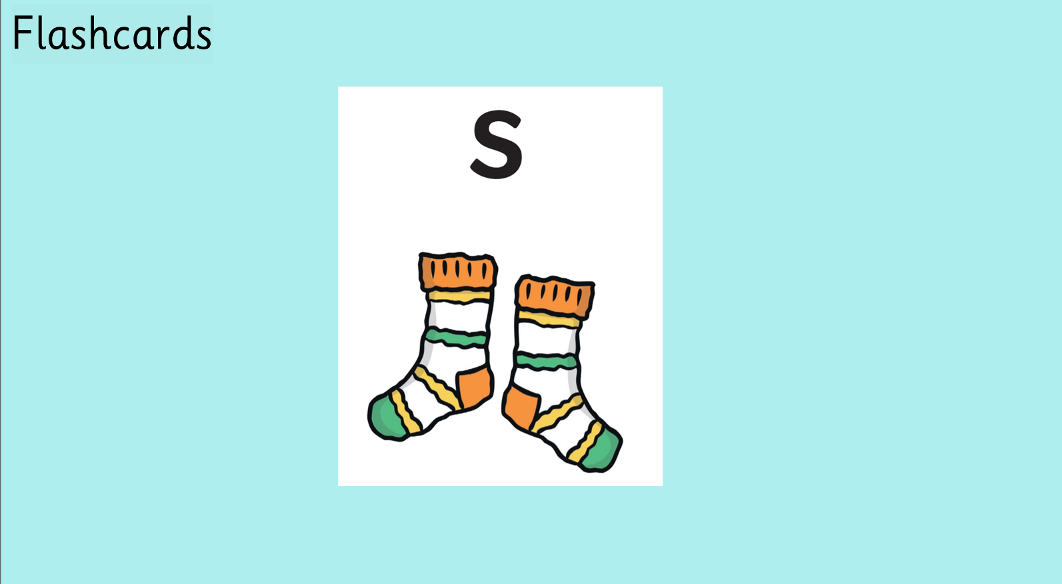

Slide 4


Slide 5
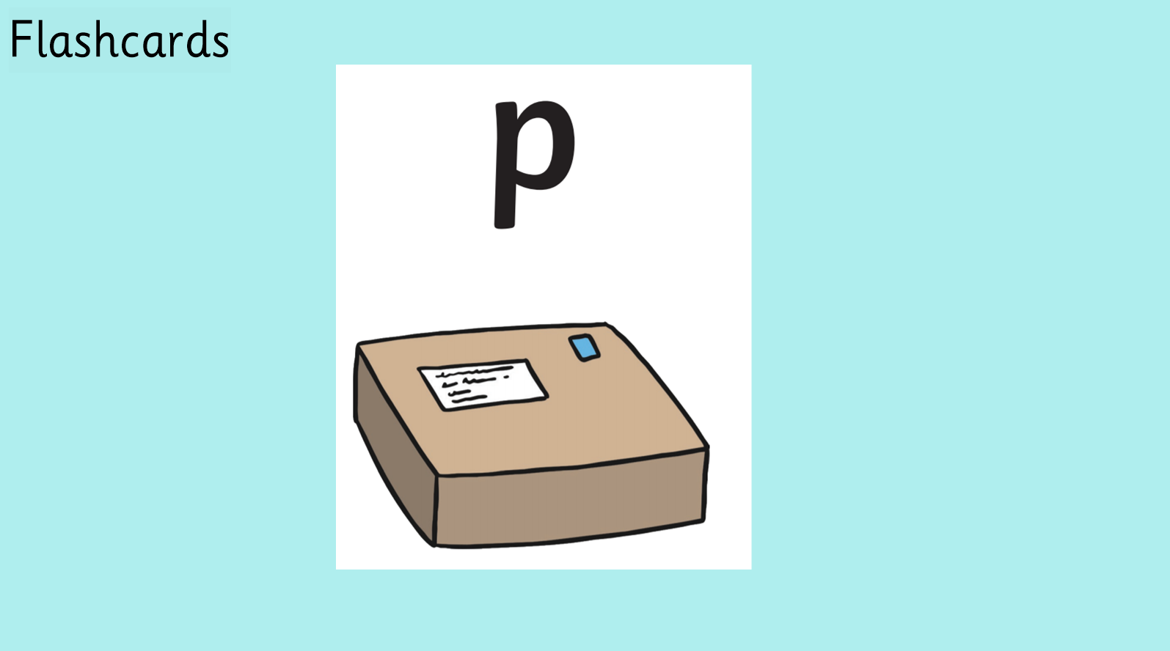

Slide 6
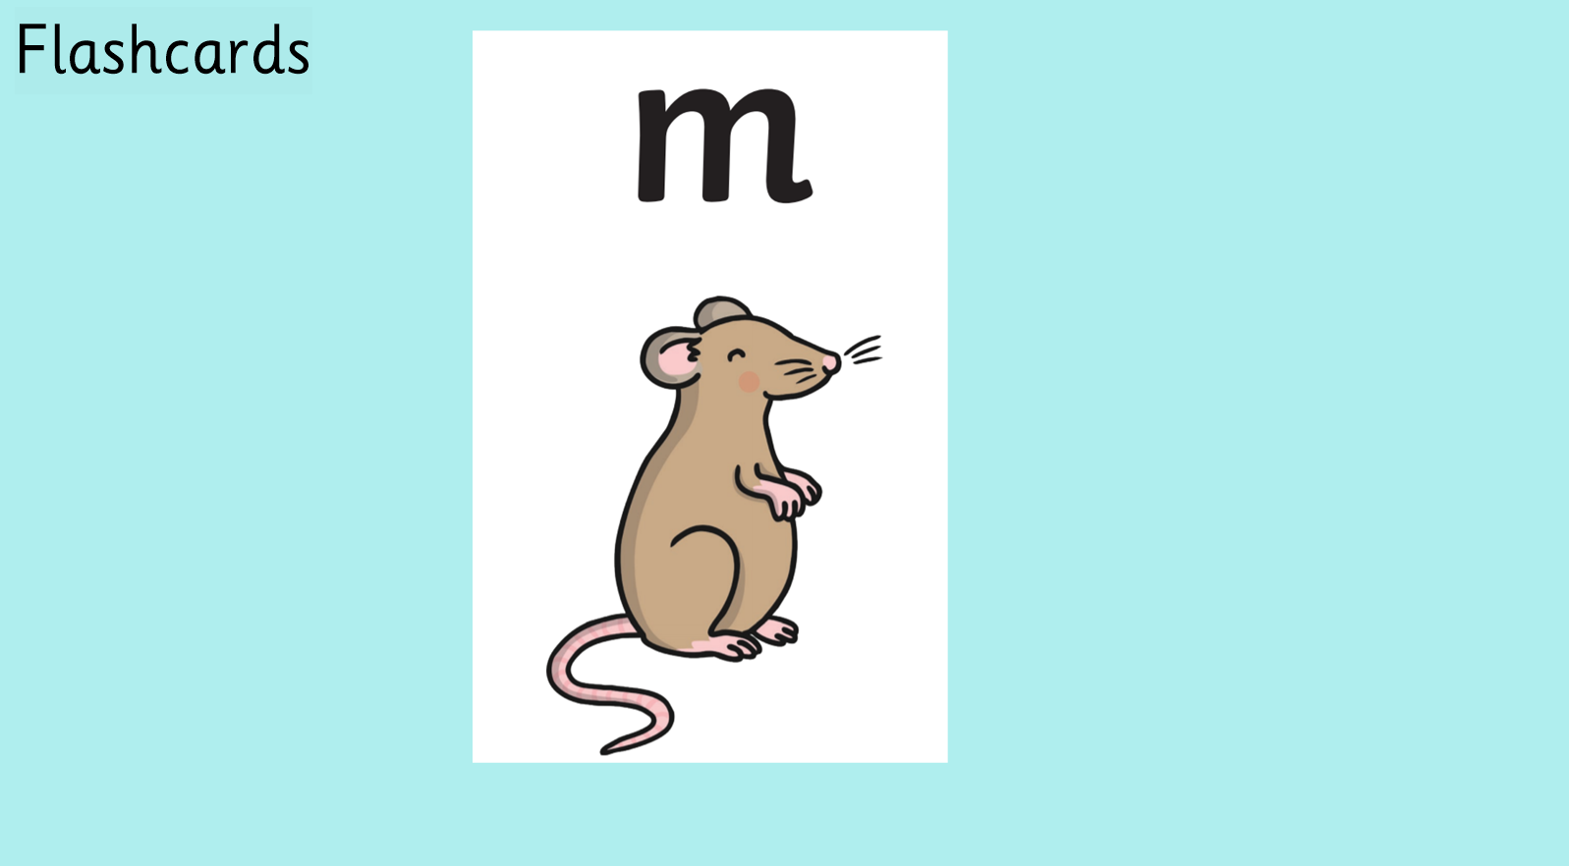

Slide 7


Slide 8
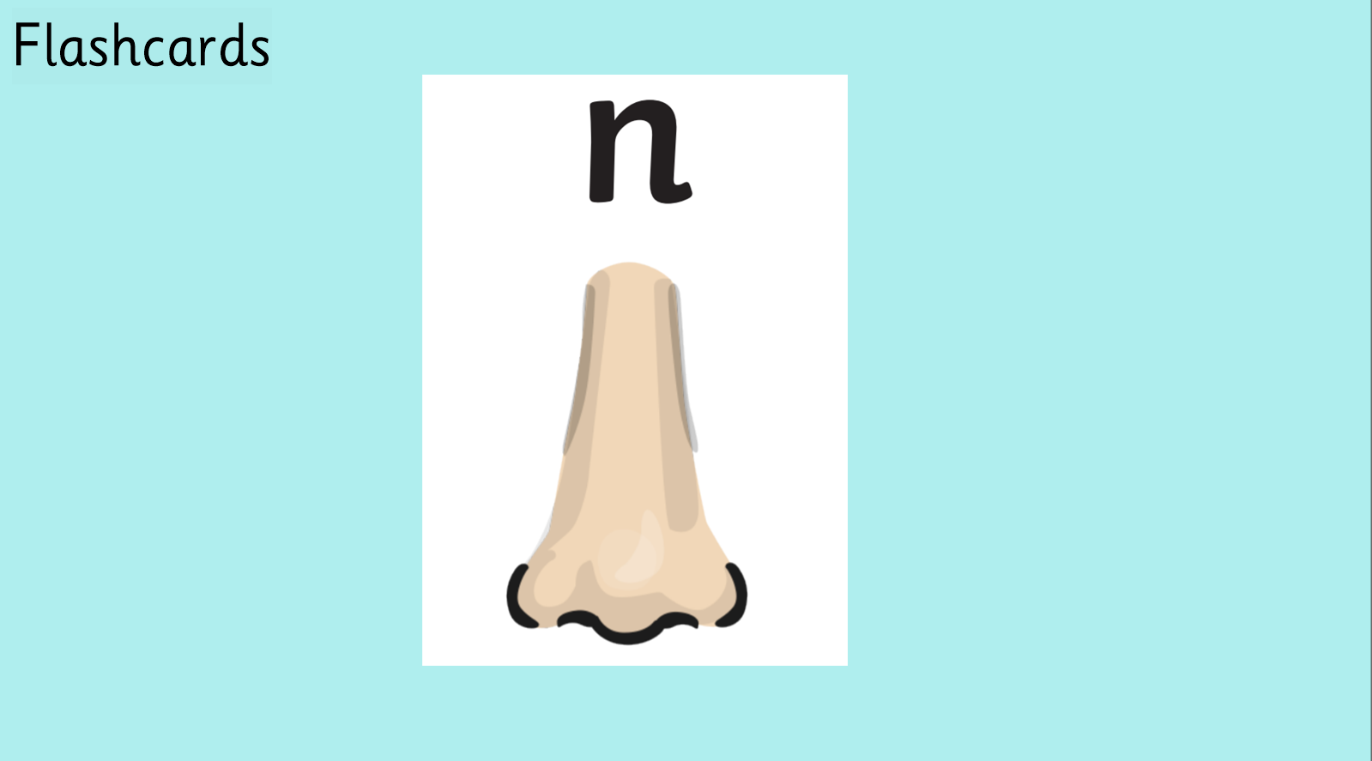

Slide 9
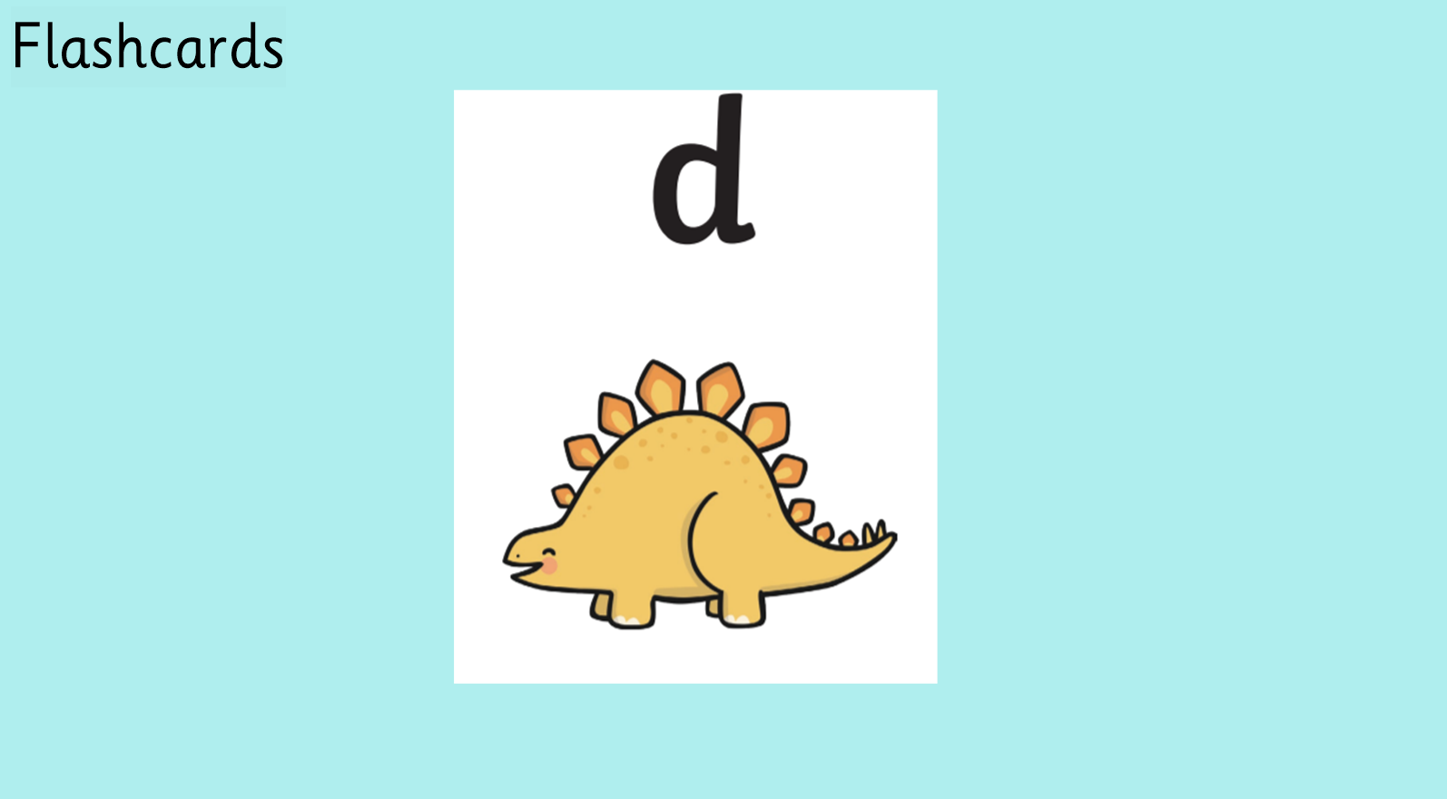

Slide 10
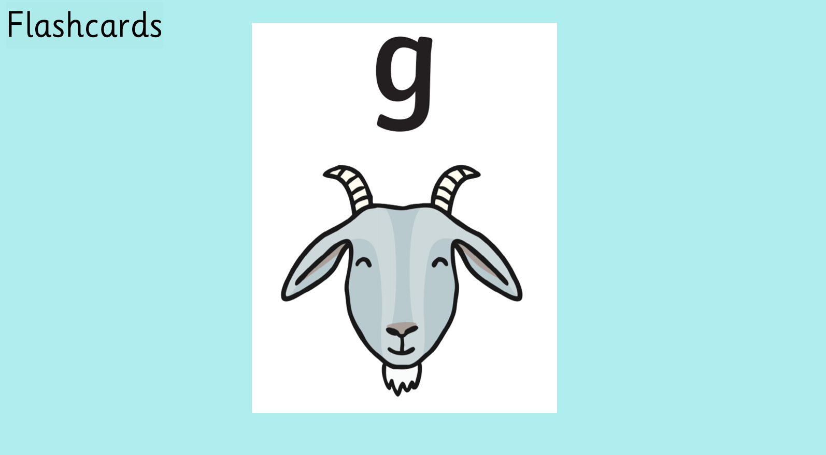

Slide 11


Slide 12


Slide 13


Slide 14


Slide 15


Slide 16


Slide 17


Slide 18


Slide 19
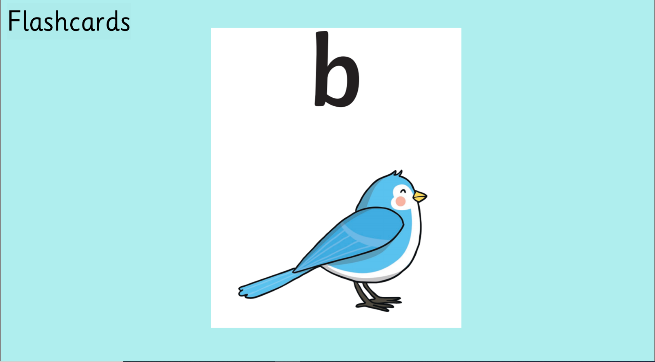

Slide 20


Slide 21


Slide 22


Slide 23


Slide 24


Slide 25



Slide 26



Slide 27



Slide 28



Slide 29


Slide 30


Slide 31


Slide 32


Slide 33


Slide 34


Slide 35
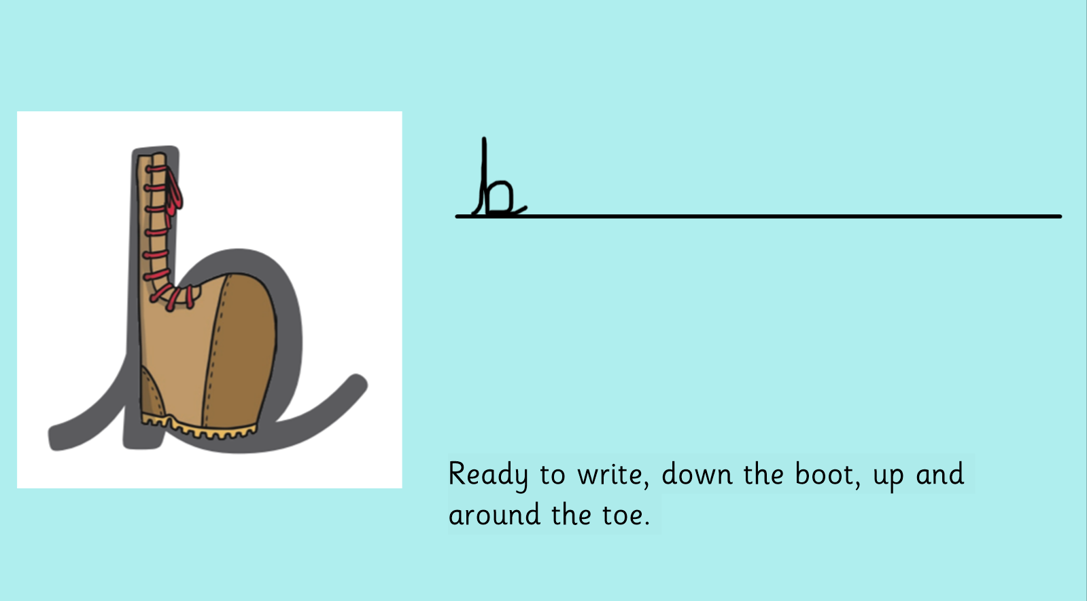


Slide 36
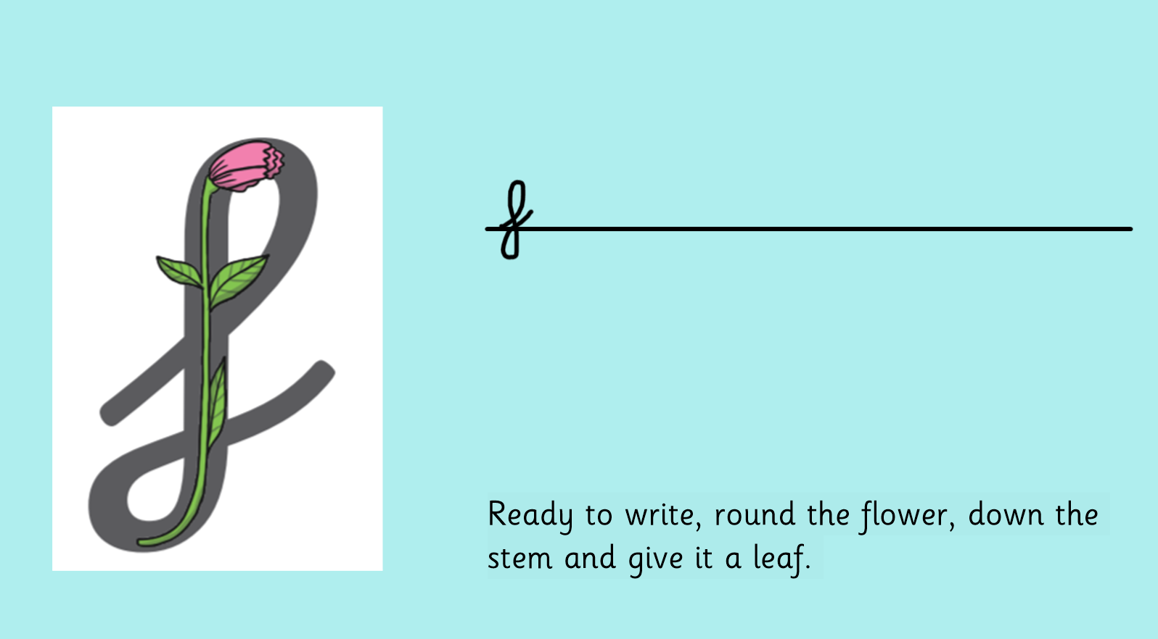


Slide 37
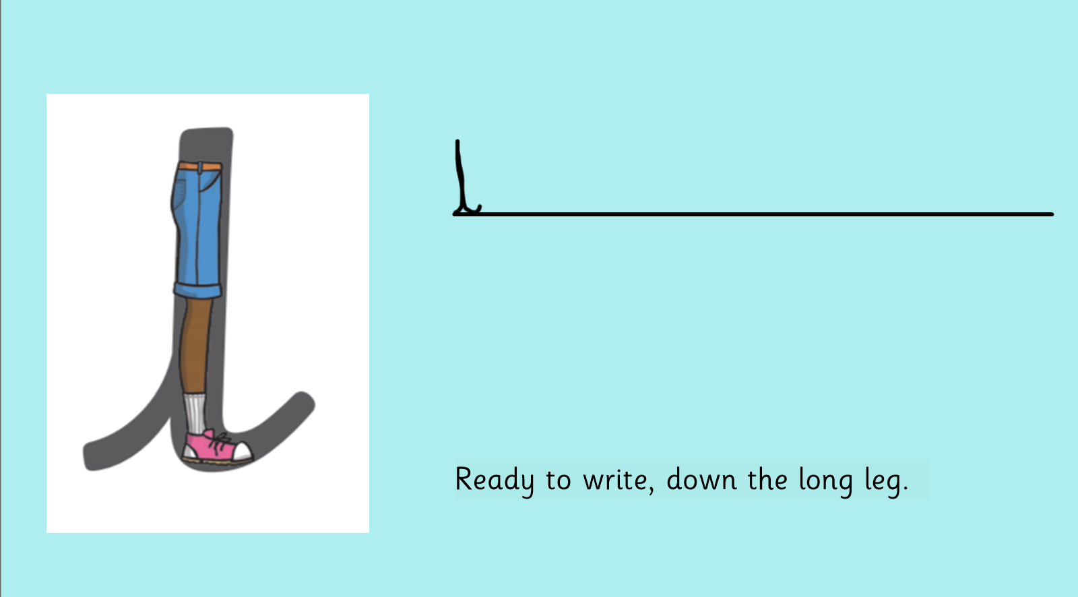
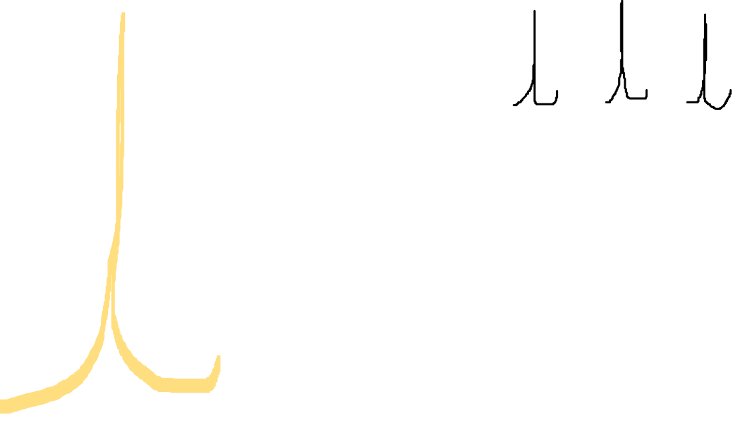

Slide 38
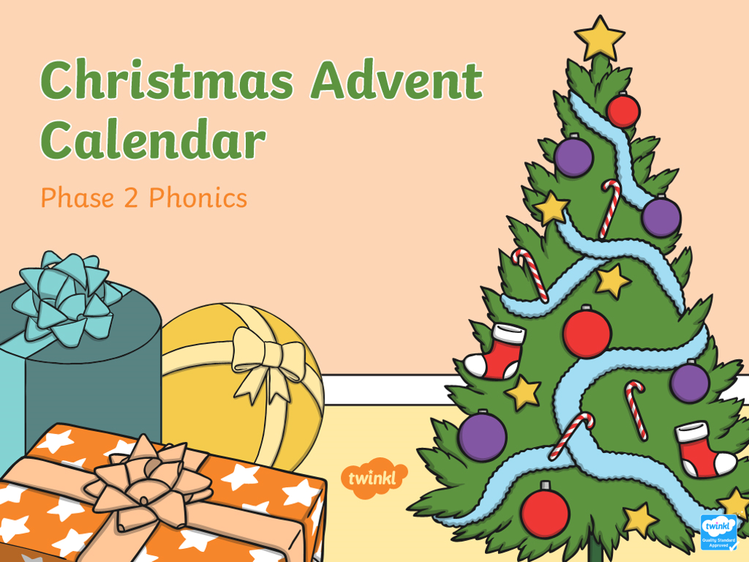

Slide 39
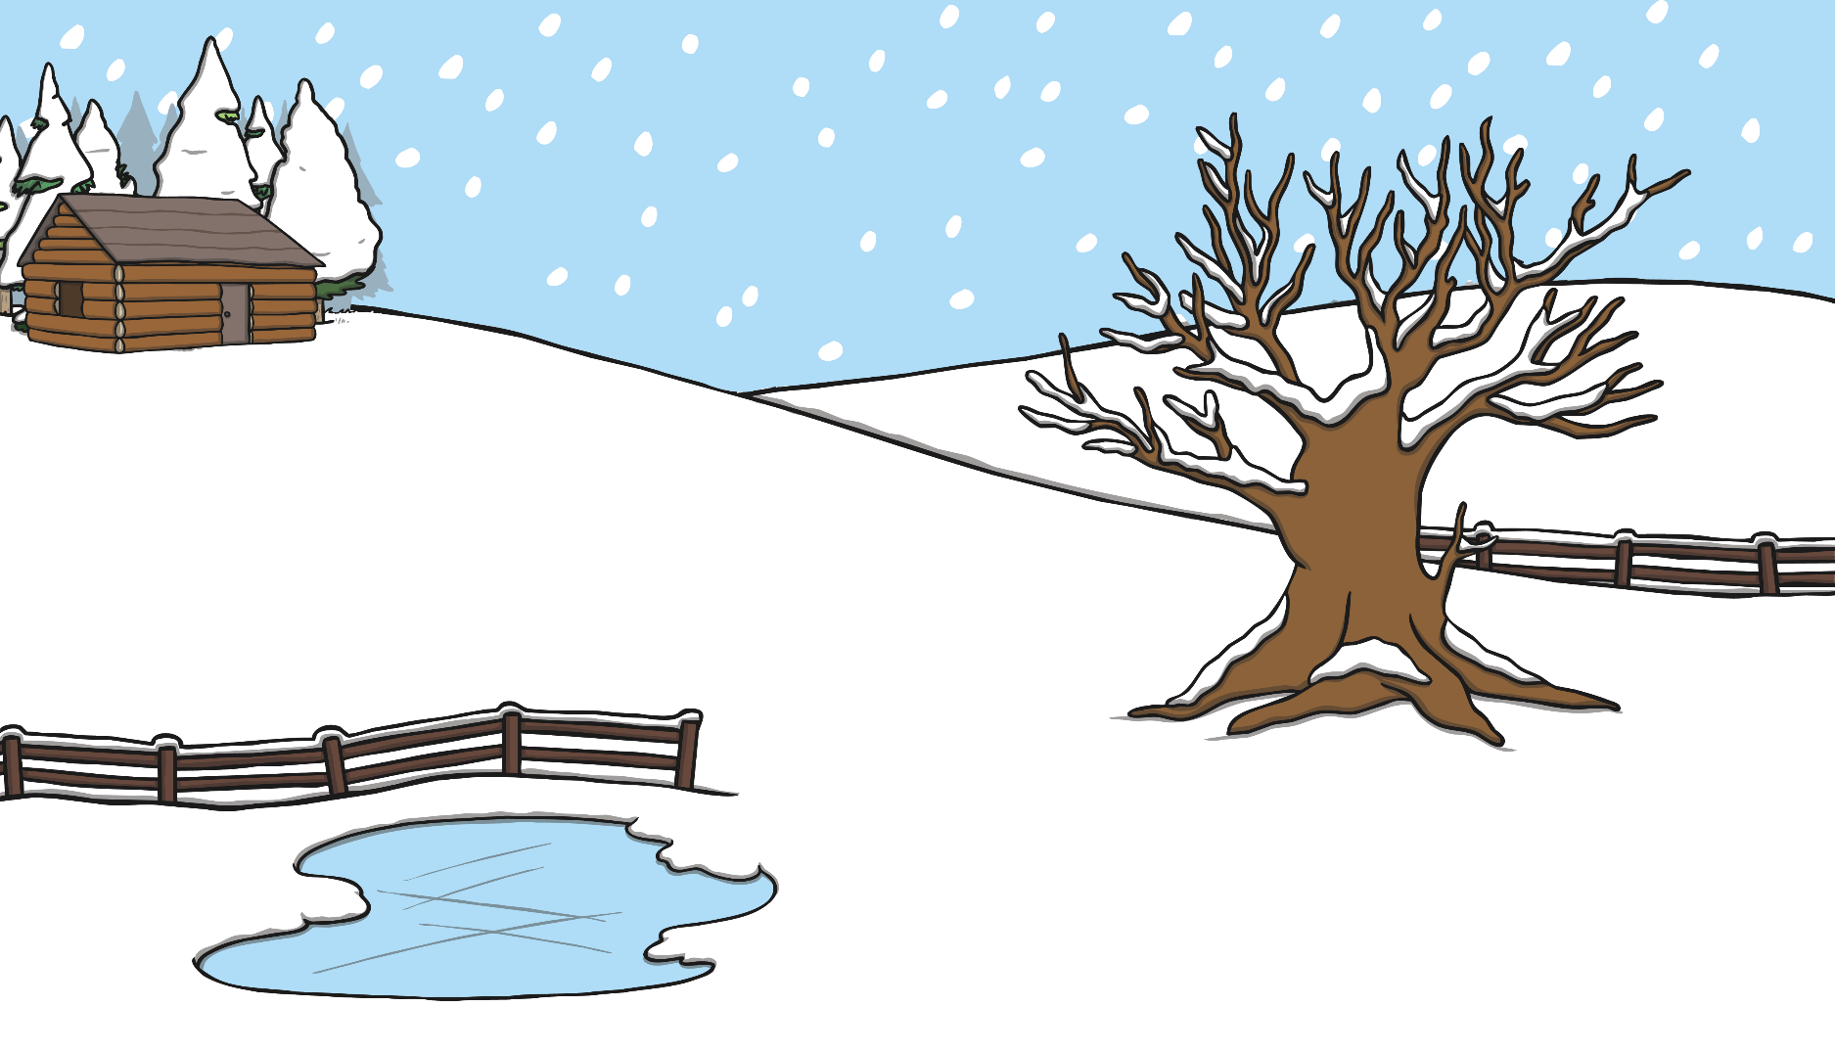





Can you help Santa find his way?
back
Can you read the signs to help Santa find his way to the cabin?
Go to the log cabin
Get to the top
Go up the hill

Slide 40


