Slide 1
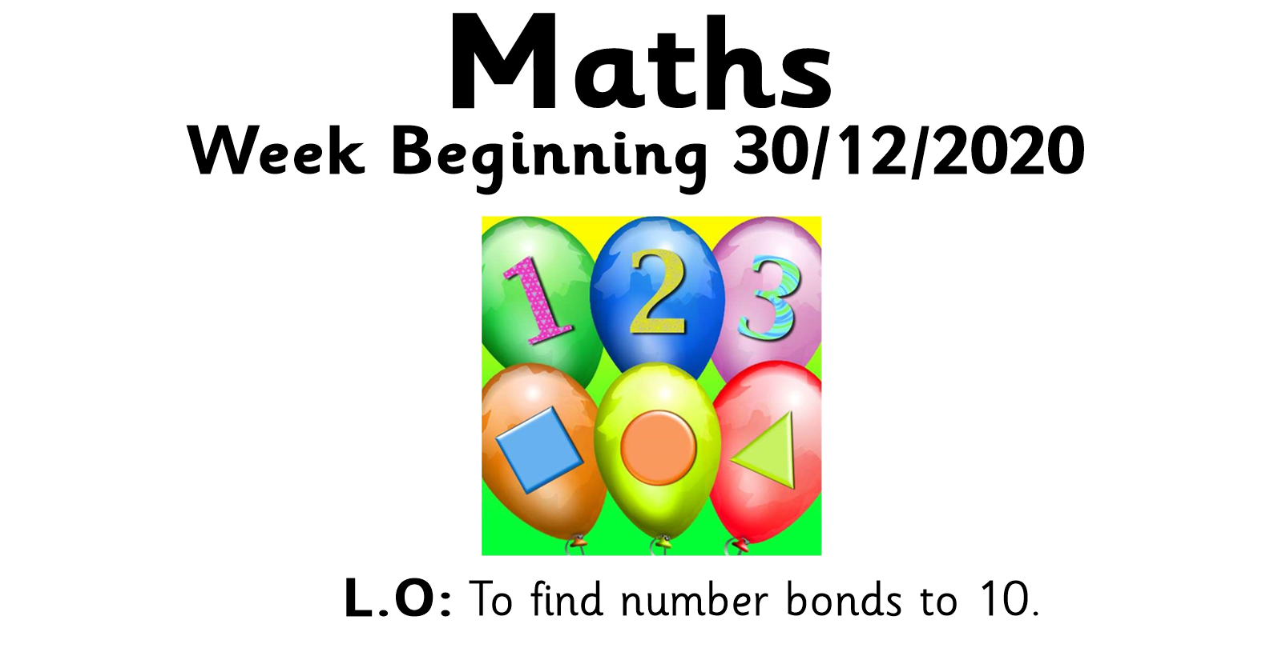


Slide 2
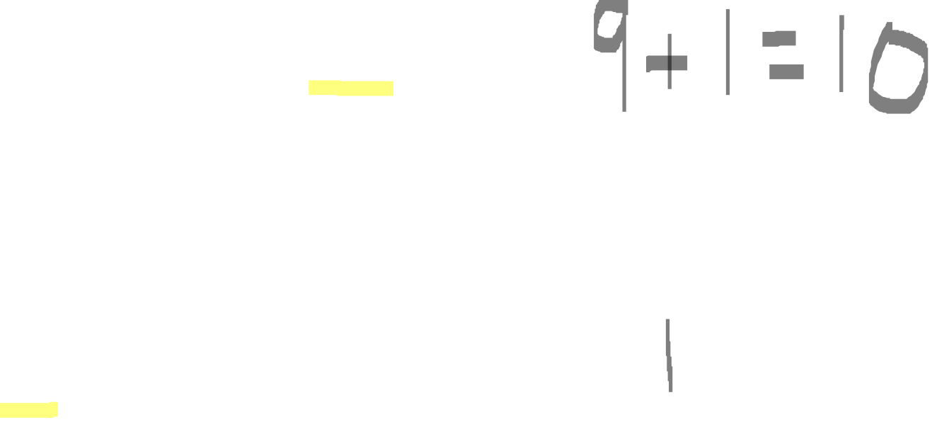
10
9

Slide 3
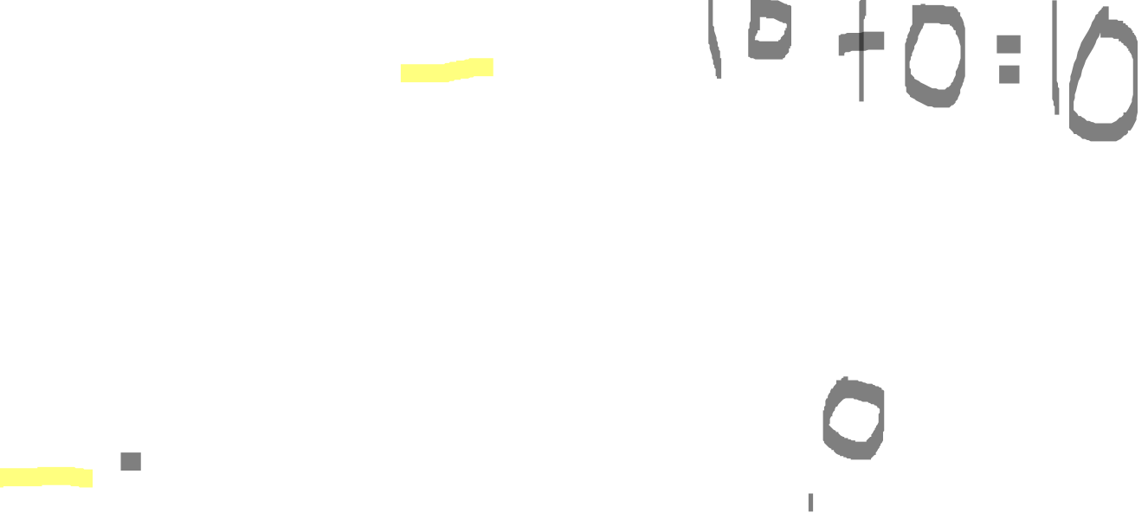
10
10

Slide 4
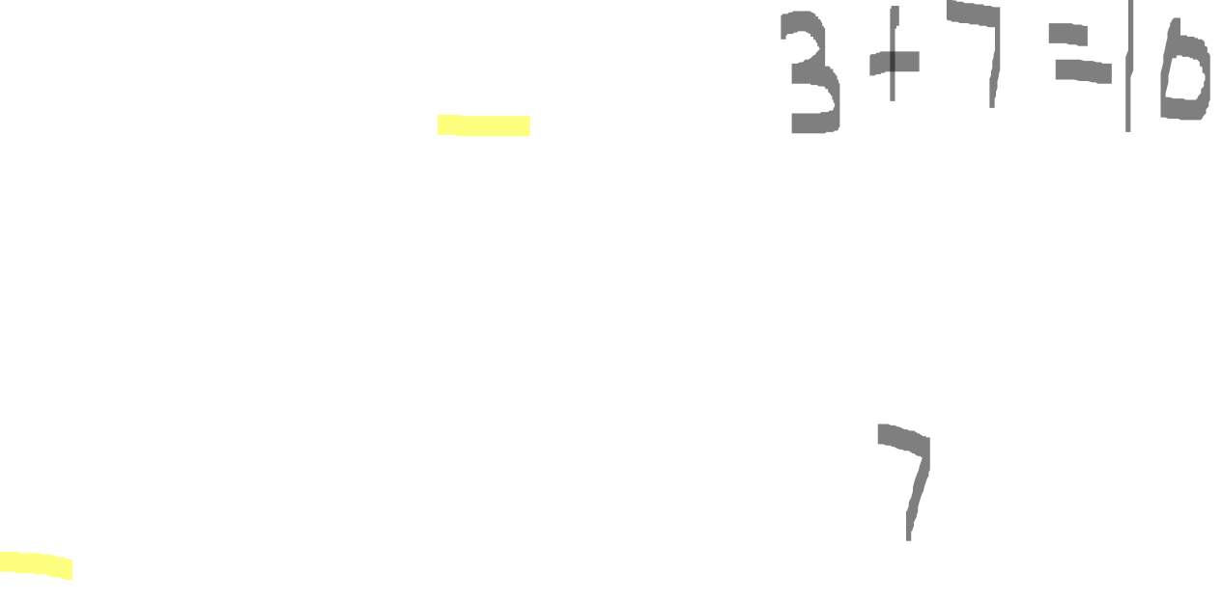
10
3

Slide 5
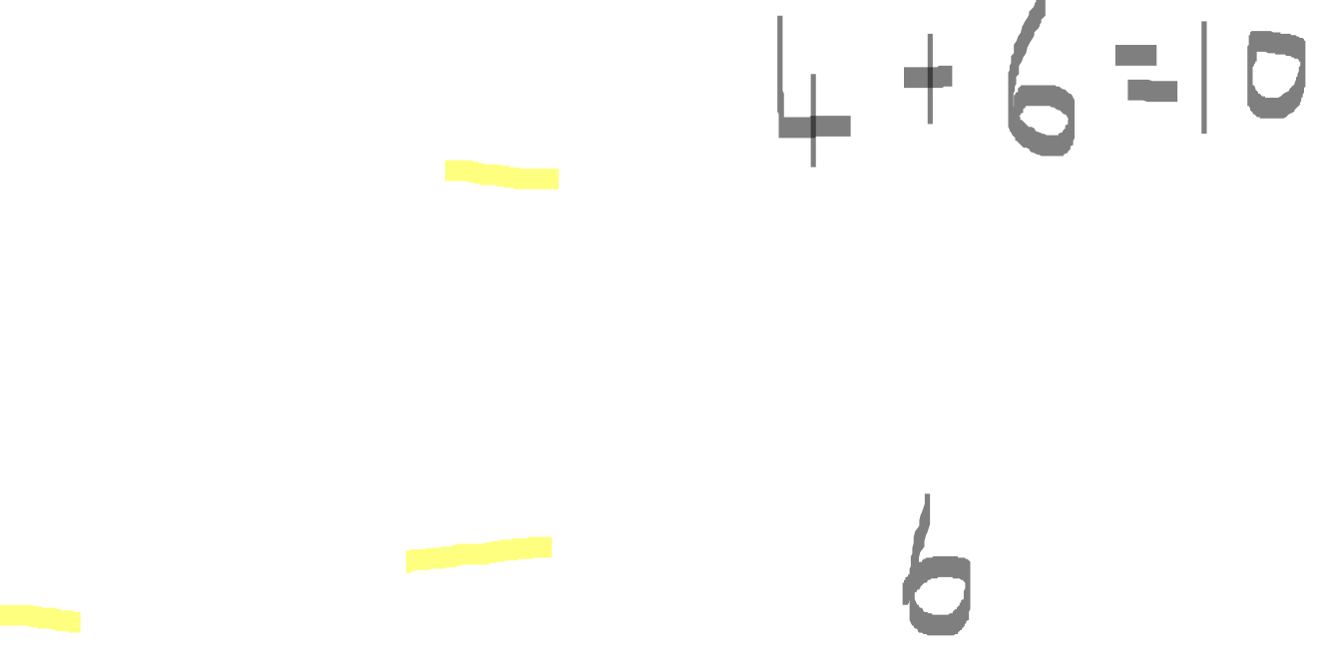
10
4

Slide 6
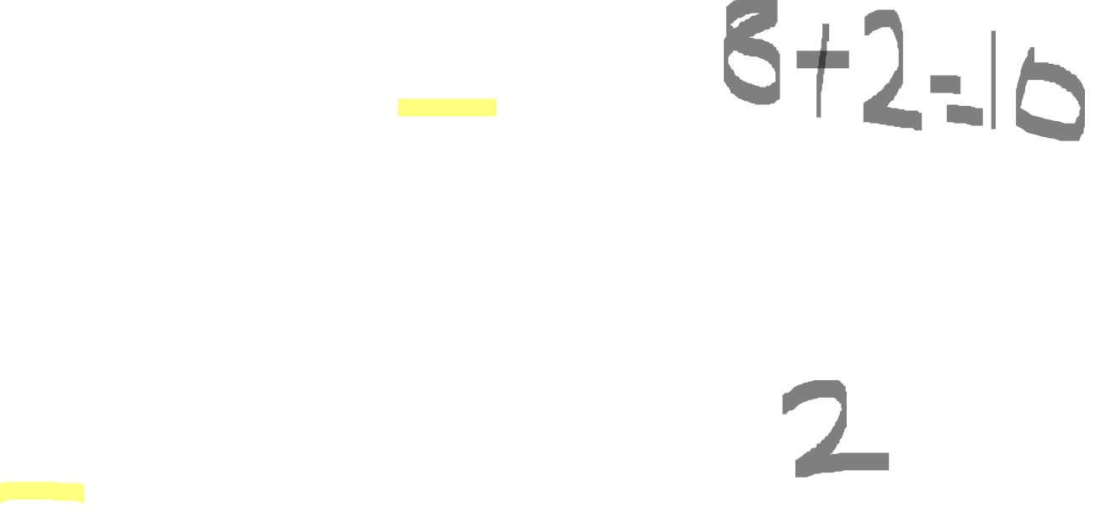
10
8

Slide 7
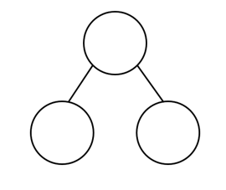
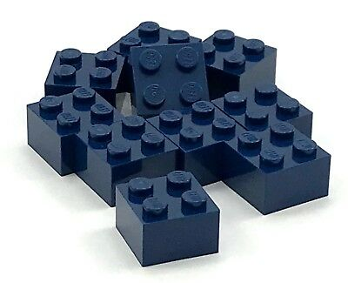
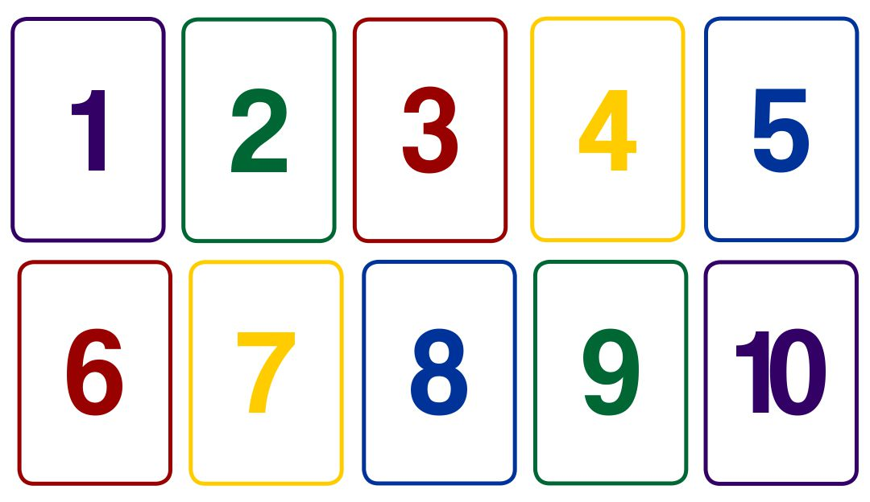
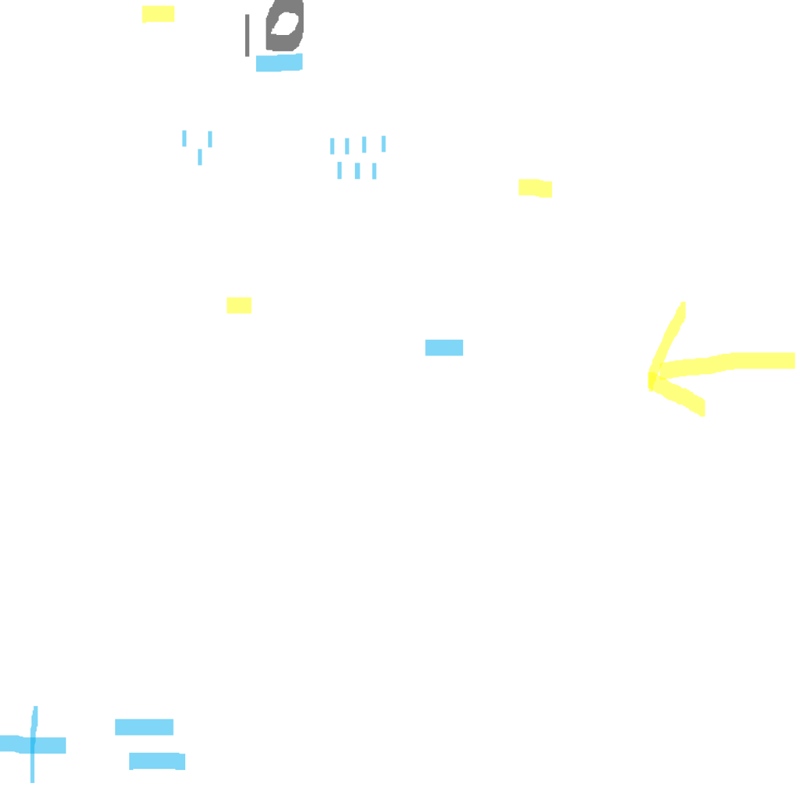
Activity
You will need:
  A part whole model
  Number cards to 10
  10 objects
  Turn your number cards over so you can’t see the number. Place 10 items in your top circle. Choose a card. Count that number of objects into one of the smaller circles and move the rest to the other circle. Can you say the number sentence? Can you write the number sentence?

