Slide 1


Slide 2
Starter
https://www.youtube.com/watch?v=tLzOkpH2zyM
Flashback 4

Slide 3
Complete the number track.
2) What is 1 more than 19?
3) What is 1 less than fifteen?
4) What is 1 more than 17?
10 |  | 12 |  | 14 |  | 16 | 17 |  |  | 20

Slide 4
Complete the number track.
2) What is 1 more than 19?
3) What is 1 less than fifteen?
4) What is 1 more than 17?
15
10 |  | 12 |  | 14 |  | 16 | 17 |  |  | 20
11
13
18
19
20
14
18

Slide 6

What numbers are the arrows pointing to?
1
8
0
9
10
How did you work them out?
Have a think

Slide 7
What numbers are the arrows pointing to?
1
8
0
10
11
18
10
20
How did you work them out?
Have a think

Slide 8
The number line
10
11
12
13
14
15
16
17
18
19
20
Circle the number twelve.

Slide 9
The number line
Have a think
10
11
12
13
14
15
16
17
18
19
20
What is 1 more than 12?
13

Slide 10
The number line
Have a think
10
11
12
13
14
15
16
17
18
19
20
What is 1 less than 12?
11

Slide 11

Kim counts from 8 to 15
0
1
2
3
4
5
6
7
8
9
10
11
12
13
14
15
16
17
18
19
20
Circle all of the numbers that she will say.

Slide 12
The number line
0
1
2
3
4
5
6
7
8
9
10
11
12
13
14
15
16
17
18
19
20
Have a think
Underline all the numbers that are greater than 11

Slide 13
The number line
0
1
2
3
4
5
6
7
8
9
10
11
12
13
14
15
16
17
18
19
20
Have a think
Underline all the numbers that are less than 7

Slide 14
The number line
0
9
10
12
15
18
20
Have a think
Label 9, 12, 15 and 18 on the number line.

Slide 15

Pick a number on the
number line
0
1
2
3
4
5
6
7
8
9
10
11
12
13
14
15
16
17
18
19
20
How many jumps are there from your number to zero?
9

Slide 16
Pick a number on the
number line
0
1
2
3
4
5
6
7
8
9
10
11
12
13
14
15
16
17
18
19
20
How many jumps are there from your
number to 20?
11
Is your number closer to 0 or 20?

Slide 17
Which numbers are hidden?
10
11
12
13
14
15
16
17
18
19
20
Have a think
15, 16 and 17

Slide 18
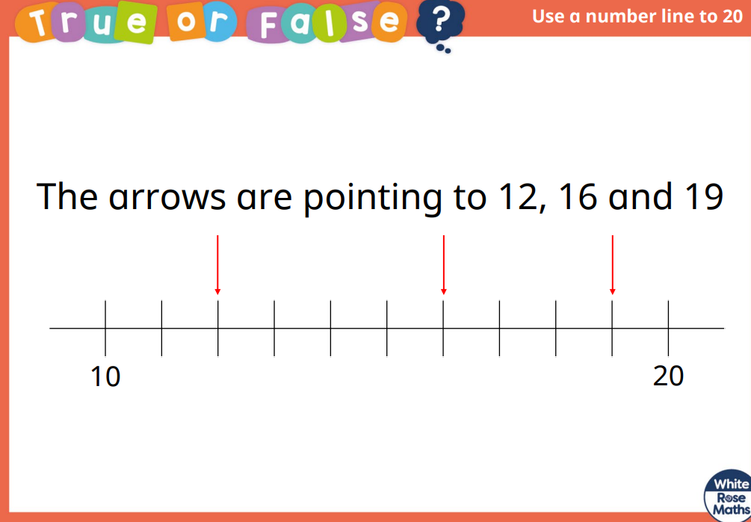

Slide 19


