Slide 1


Slide 3
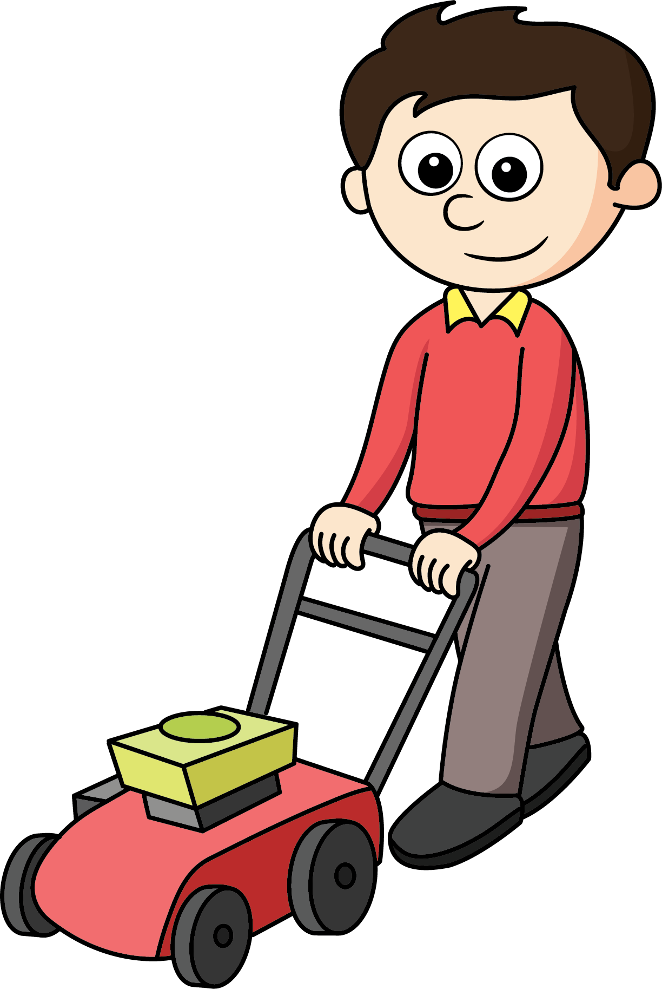
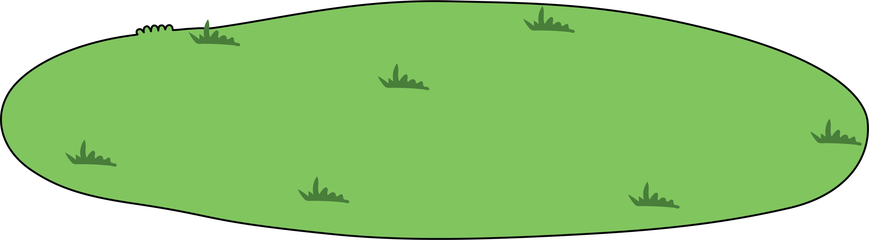

How many men are there?

Slide 4
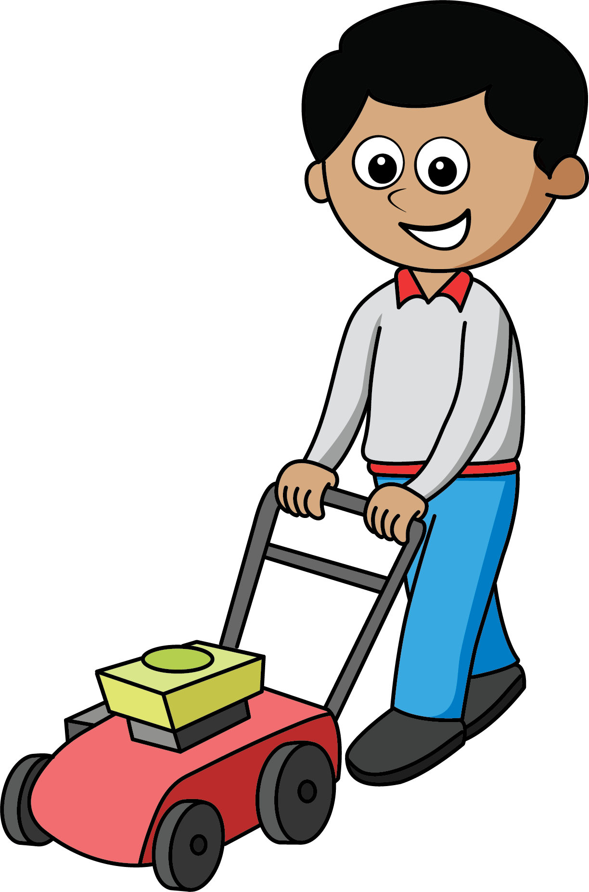
How many are there now?
2
1 more than __ is __
1

Slide 5
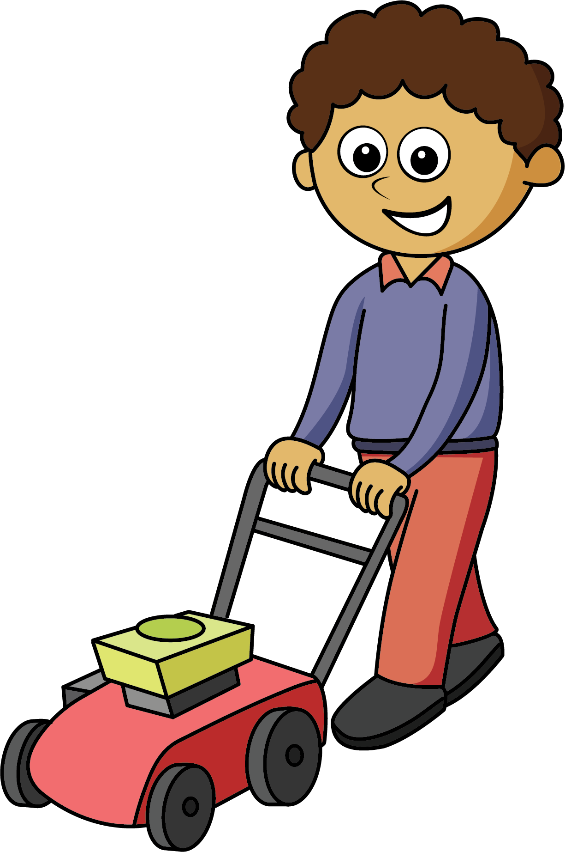
How many are there now?
3
1 more than __ is __
2

Slide 6
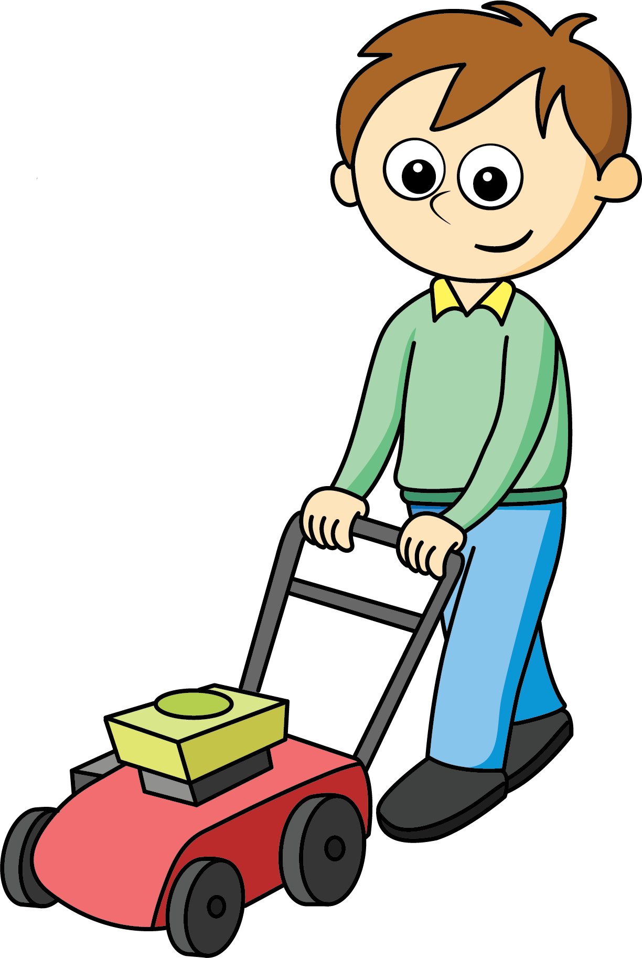
How many are there now?
4
1 more than __ is __
3

Slide 7
How many are there now?
5
1 more than __ is __
4

Slide 8
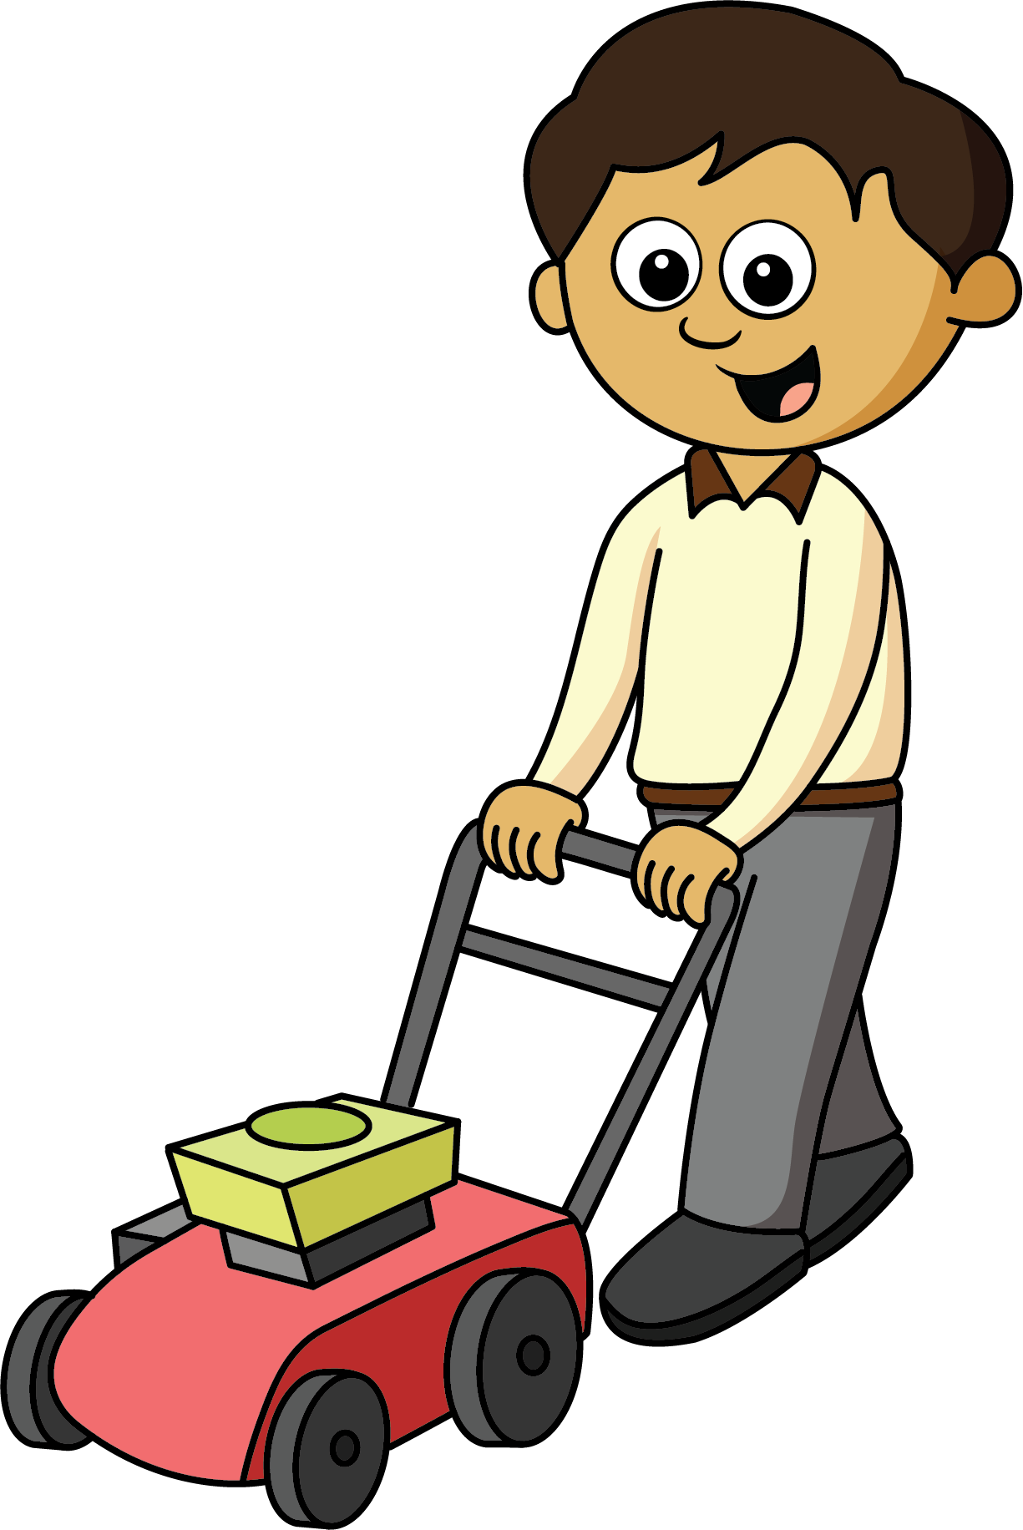
How many are there now?
6
1 more than __ is __
5

Slide 9
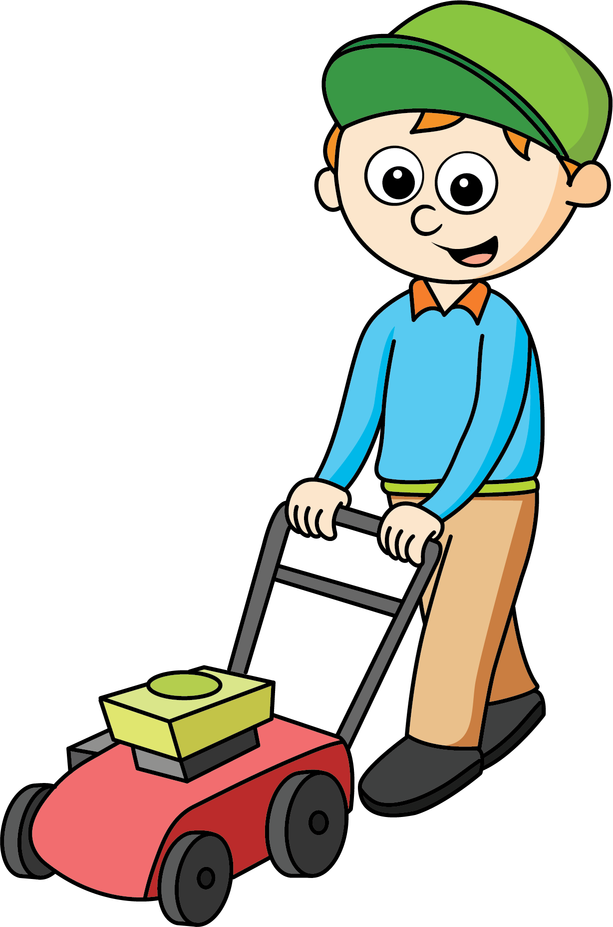
How many are there now?
7
1 more than __ is __
6

Slide 10
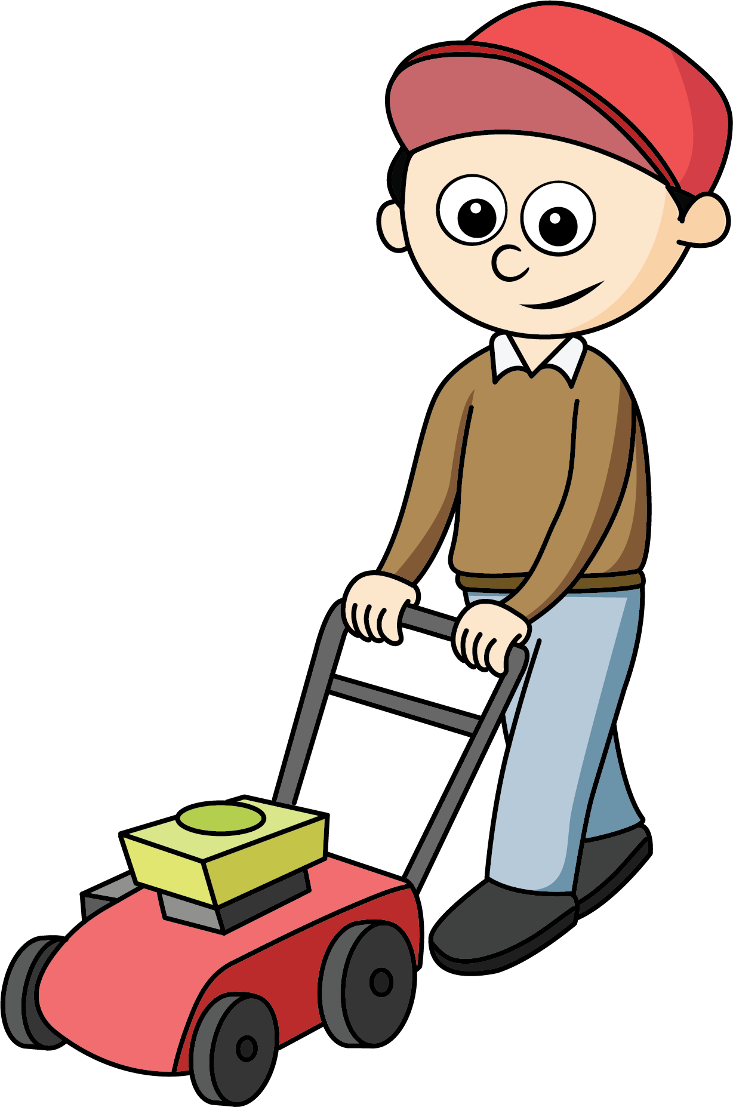
How many are there now?
8
1 more than __ is __
7

Slide 11
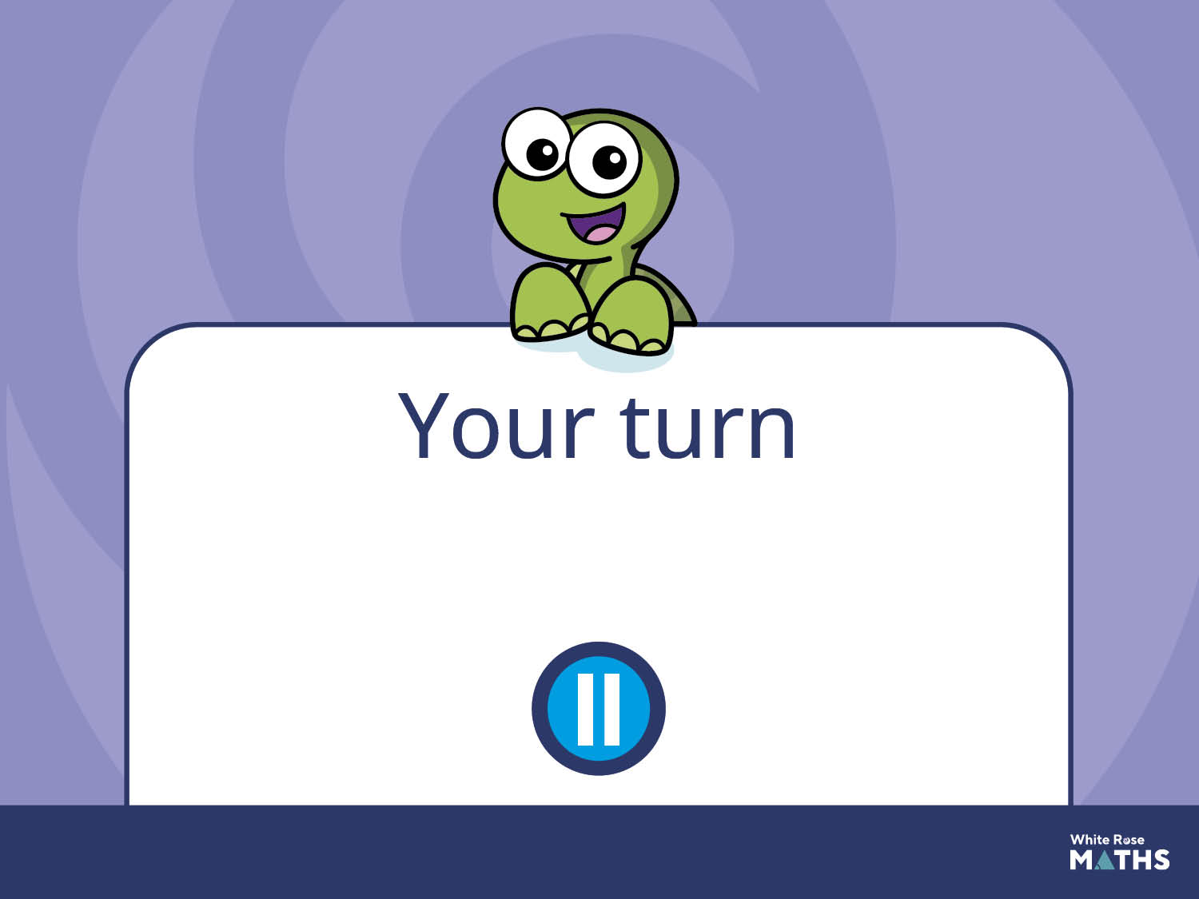
Have a go at the next activity.

