Slide 1


Lesson 4
Step: Select money

Slide 2
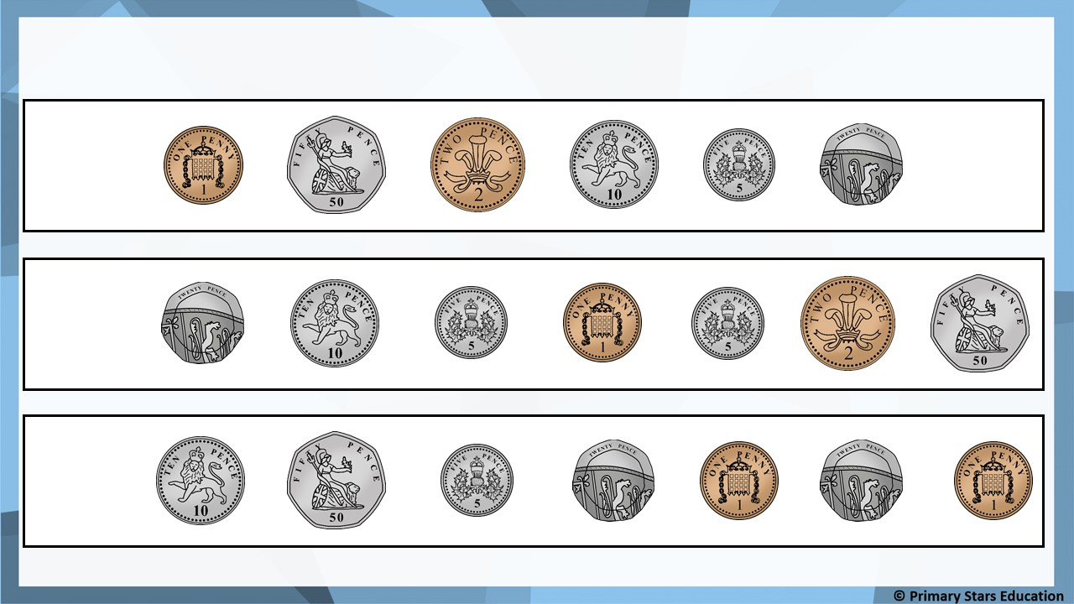
Fluency
Which coins would make the following amounts?
a) 73p
b) 82p
c) 96p

Slide 3
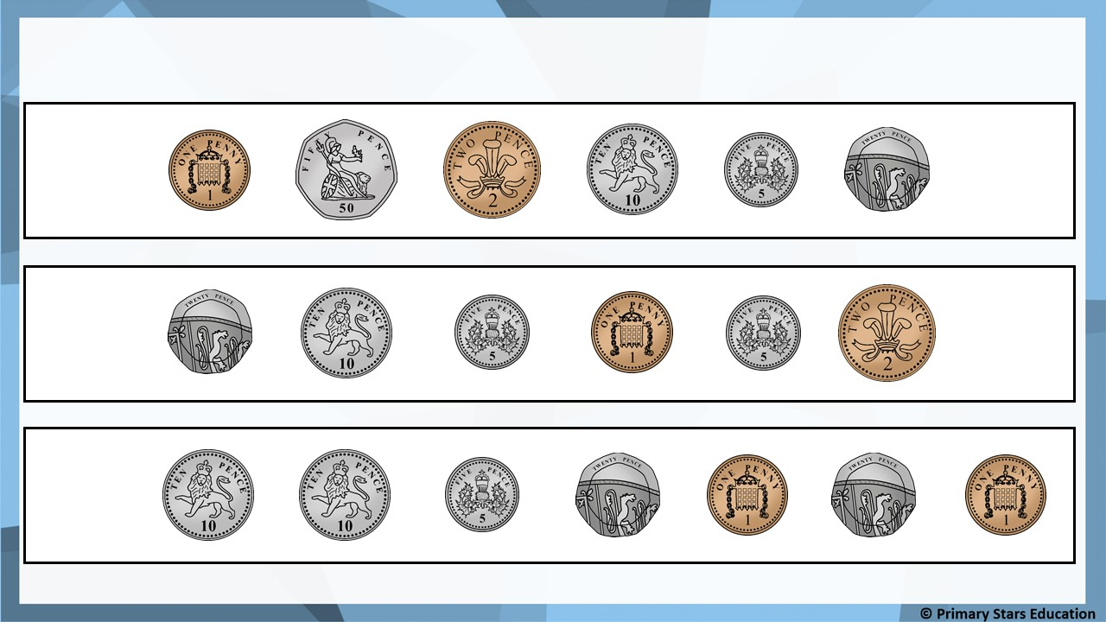
Fluency
Which coins would make the following amounts?
a) 18p
b) 26p
c) 37p

Slide 4
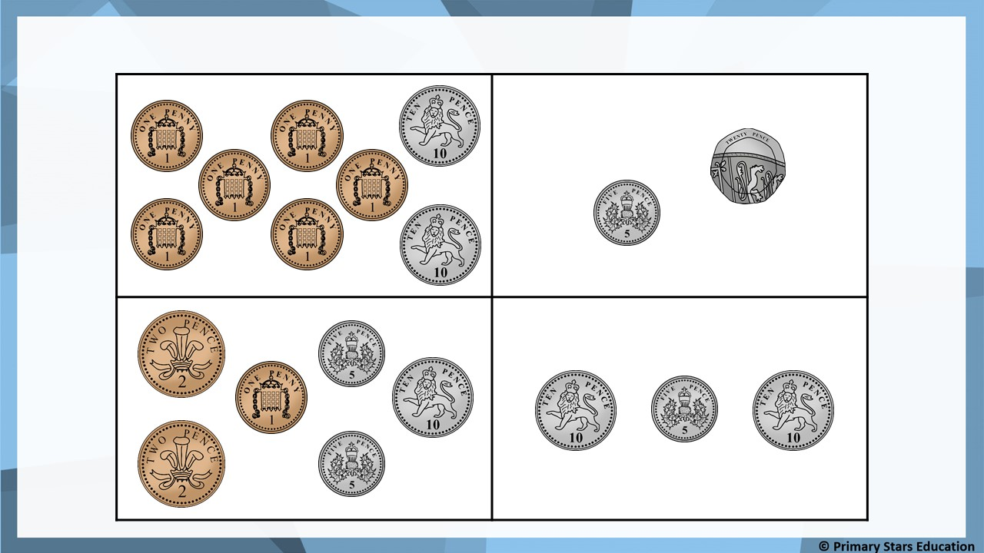
Fluency
Which amount does not show 25p?

Slide 5
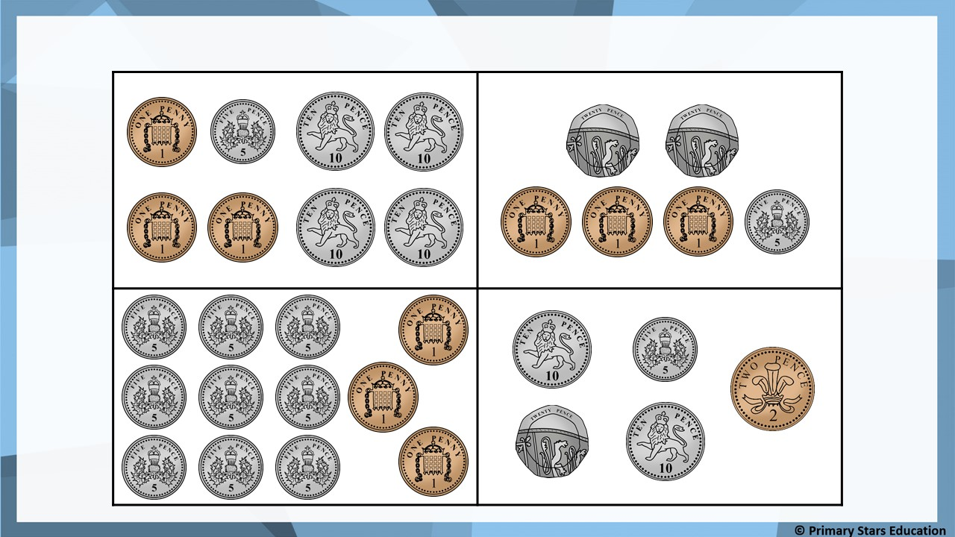
Fluency
Which amount does not show 48p?

Slide 6
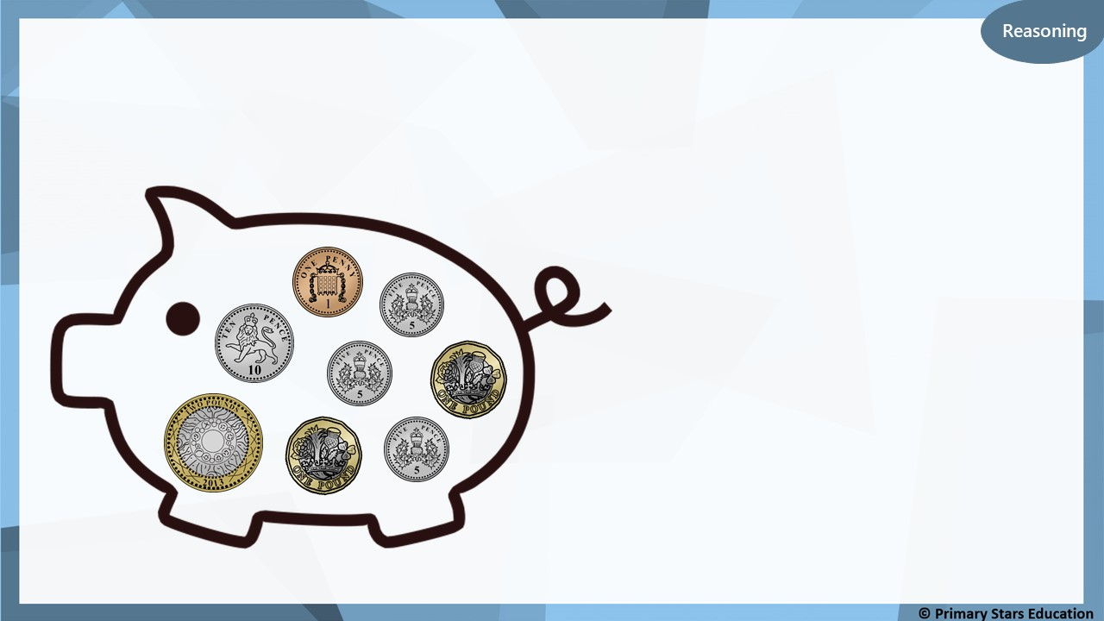
The piggy bank shows £5 and 26p.
True or false? Explain how you know.
False.
The piggy bank shows
£4 and 26p.

Slide 7
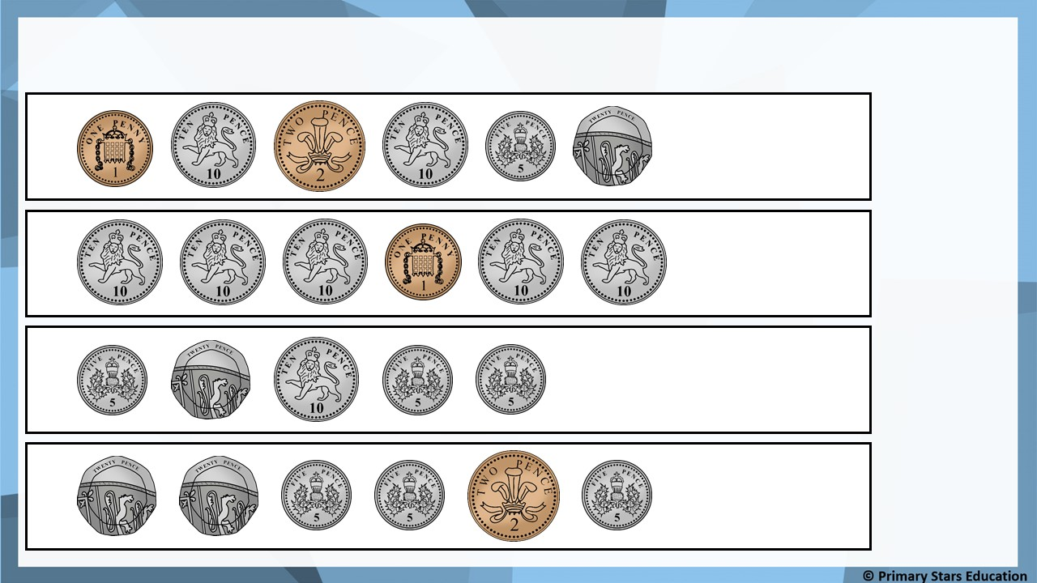
Problem solving
Put a tick (✓) next to the amounts that show more than 50p.
a)
b)
✓
c)
d)
✓

