Slide 1
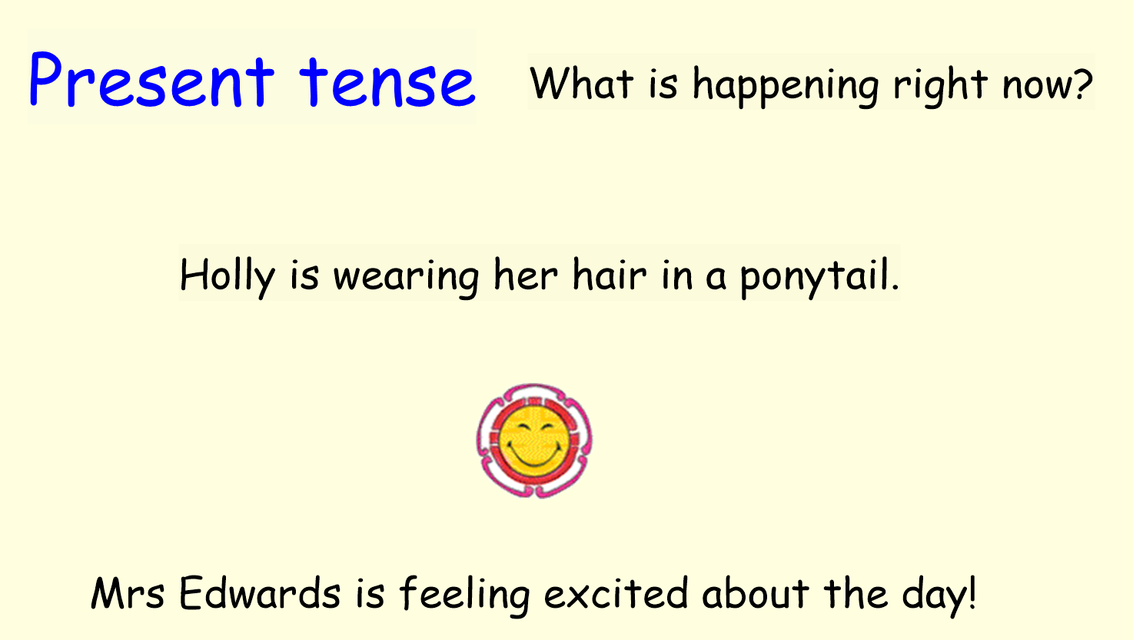

Slide 2
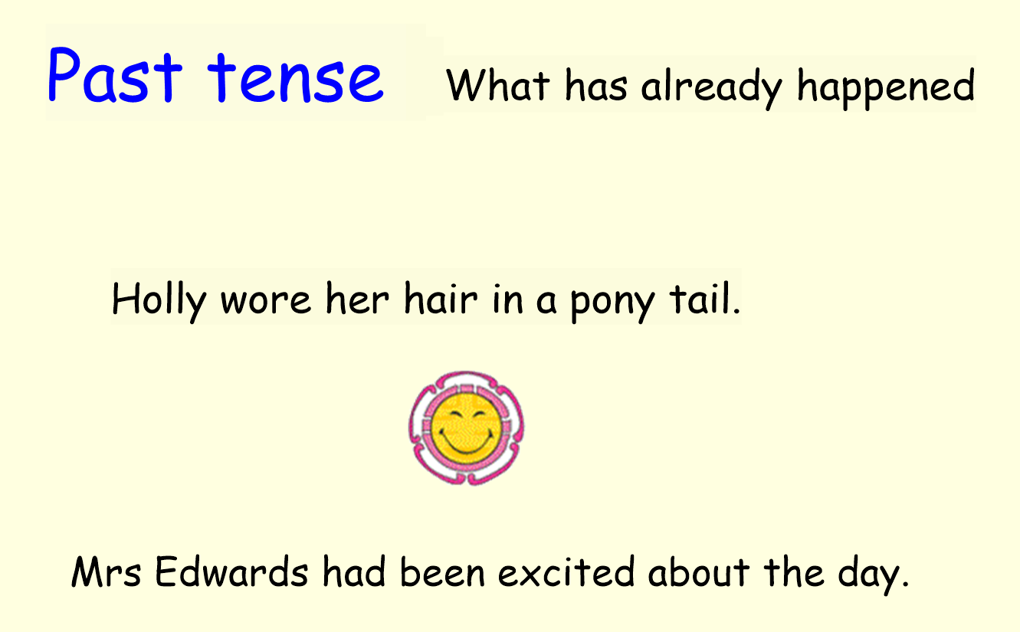

Slide 3

What’s the difference between past and present tense?

Slide 4


