Slide 1
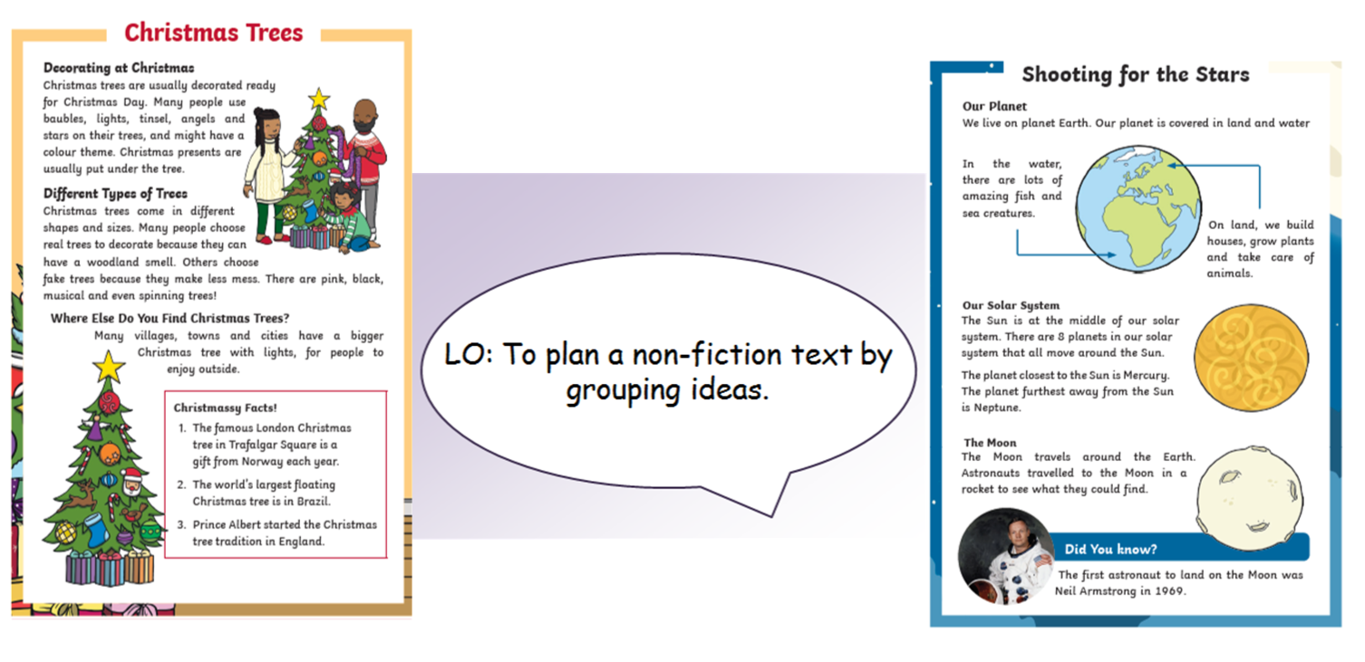

Slide 2


Slide 3
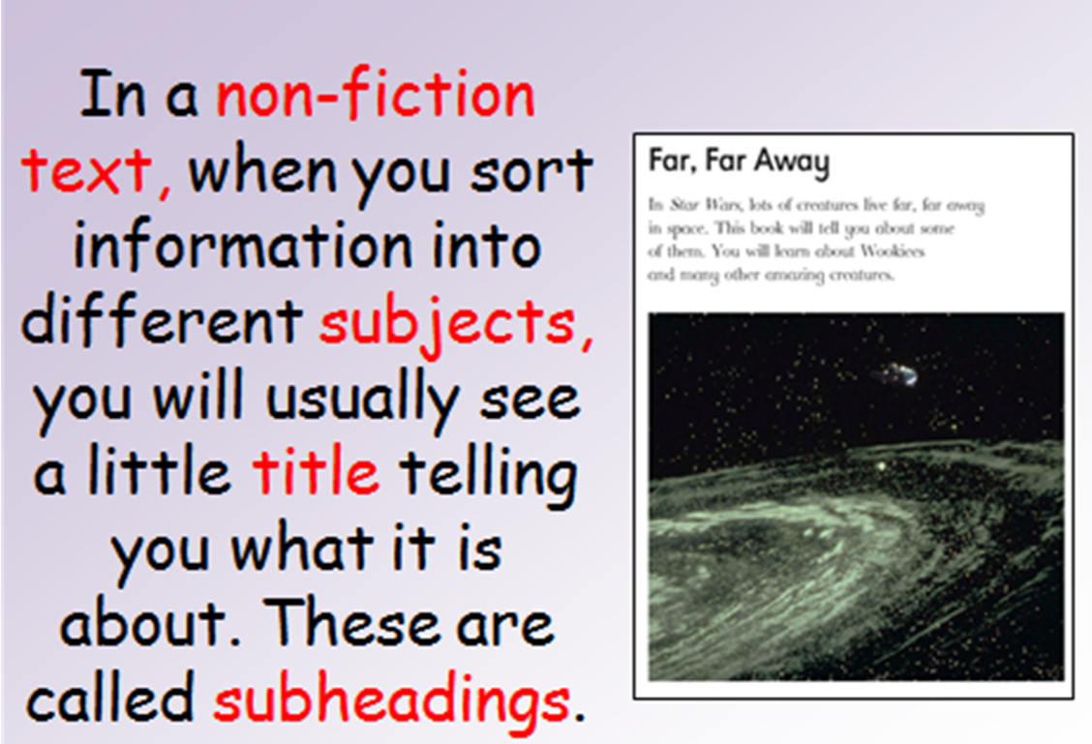

Slide 4
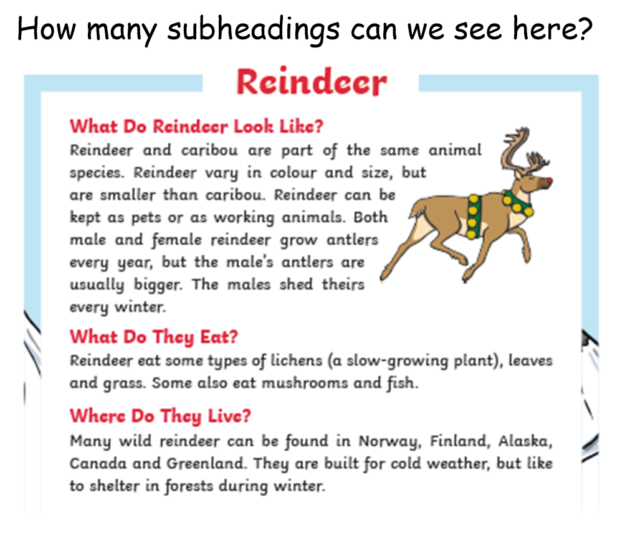

Slide 5

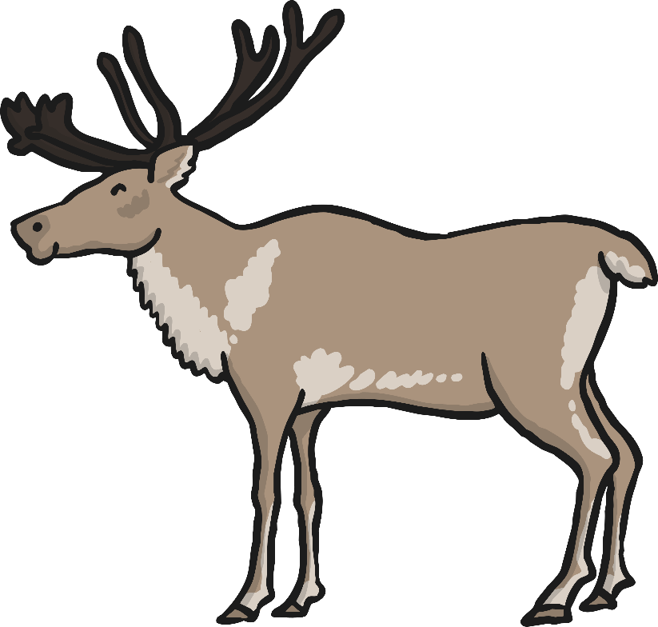

Slide 7
What Are Reindeer?
Reindeer are a type of that live in very cold places.
mammal
They are , which means they eat plants.
herbivores
People often think of Christmas, Santa and Rudolph when they think of reindeer, but there are lots more things you can learn about them!

Slide 8

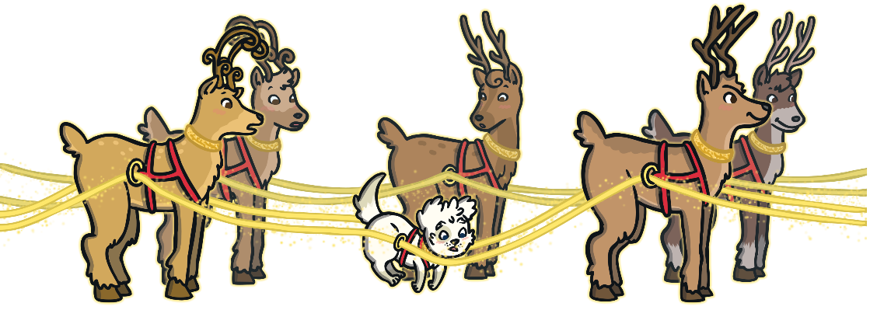
Where Do Reindeer Live?
Reindeer can be found in some of the coldest places on earth. These include northern China, Russia, Scandinavia, North America, Canada, Greenland and Iceland. Many people don’t know that there is also a herd of wild reindeer which can be found in the United Kingdom. These reindeer live in the Cairngorms mountain range in Scotland.
Can you find Scotland on the map?
Greenland
Iceland
Canada
Russia
Scotland
Scandinavia
China
North America

Slide 9
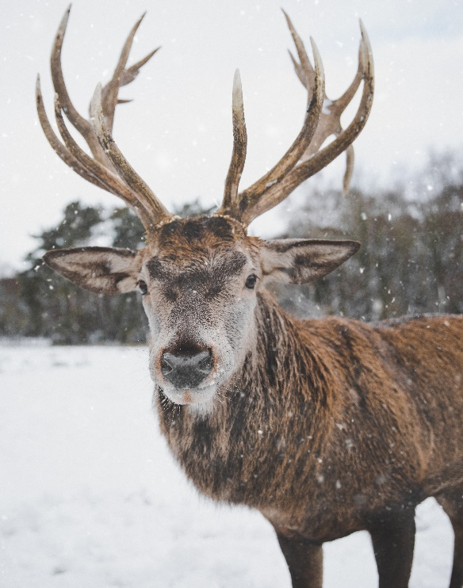
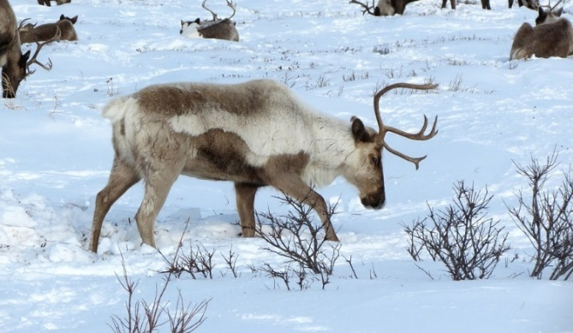
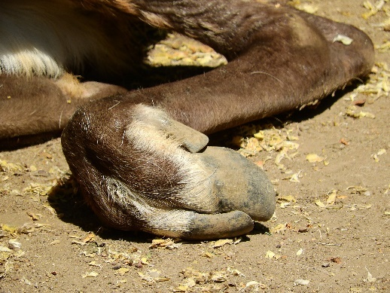
How Do Reindeer Live in Such Cold Places?
Reindeer mostly live in very cold places, such as the Arctic.
They have special features which allow them to live in such cold temperatures. Their coats are very good . This means they keep them warm. In fact, if a reindeer lies down in the snow, the snow underneath it won’t even melt! Their noses also warm the air as they breathe in to help keep their bodies warm.
adapted
insulators
Reindeer also have special hooves. Their hooves have fur on the bottom, which helps to stop them from slipping on the ice and rocks. Reindeer hooves are also very sharp. This helps them to dig in the snow to find food.

Slide 10
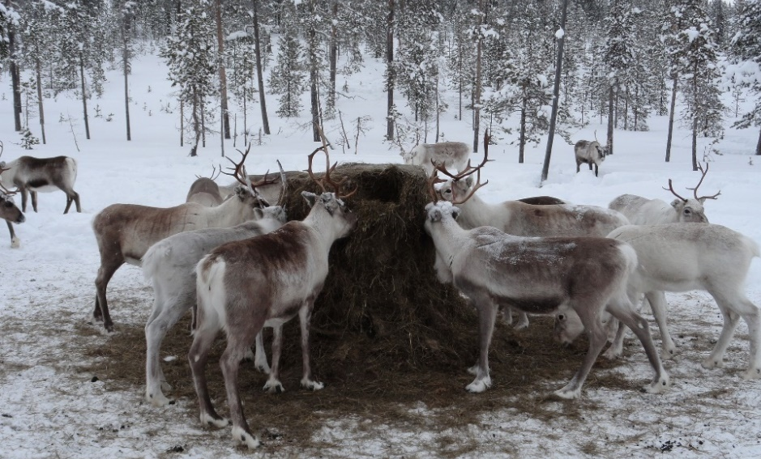
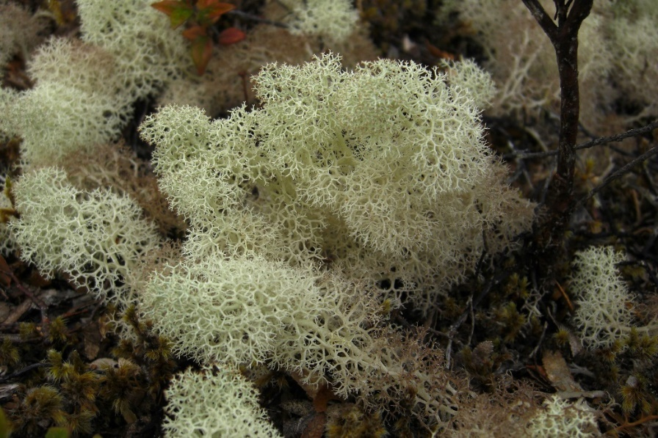
What Do Reindeer Eat?
Reindeer are mostly . This means that they eat plants.
herbivores
They mostly like leaves but they will eat some types of fungi (like mushrooms) and lichens (a type of plant).
Reindeer are the only large mammal able to eat a certain type of moss (called ‘reindeer moss’) because they have a special bacteria in their bodies which helps them to break it down.
“Reindeer Moss” by [Jason Hollinger] is licensed under CC BY 2.0

Slide 11
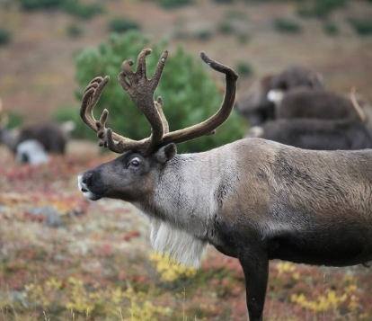
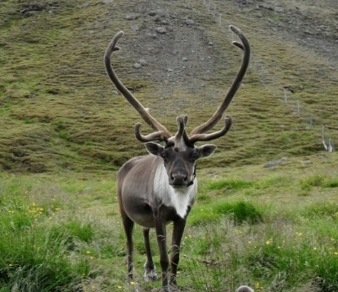
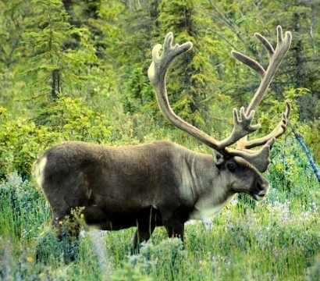
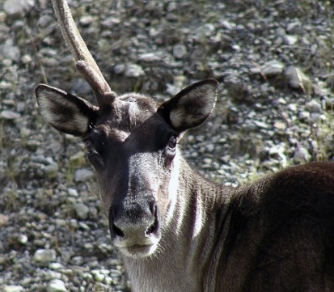
A Special Accessory
Reindeer grow their first set of antlers when they are about two years old.
Reindeer lose their antlers every year. Their antlers grow back larger each time. Male reindeer lose their antlers in the winter and female reindeer lose theirs in the summer. Female reindeer are the only type of deer that grow antlers.
A male reindeer’s antlers can grow as big as 130 centimetres!
No two reindeer have the same antlers. Just like a person’s fingerprints, a reindeer’s antlers are completely !
unique

Slide 12
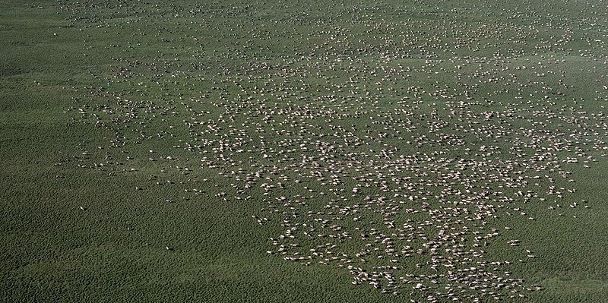
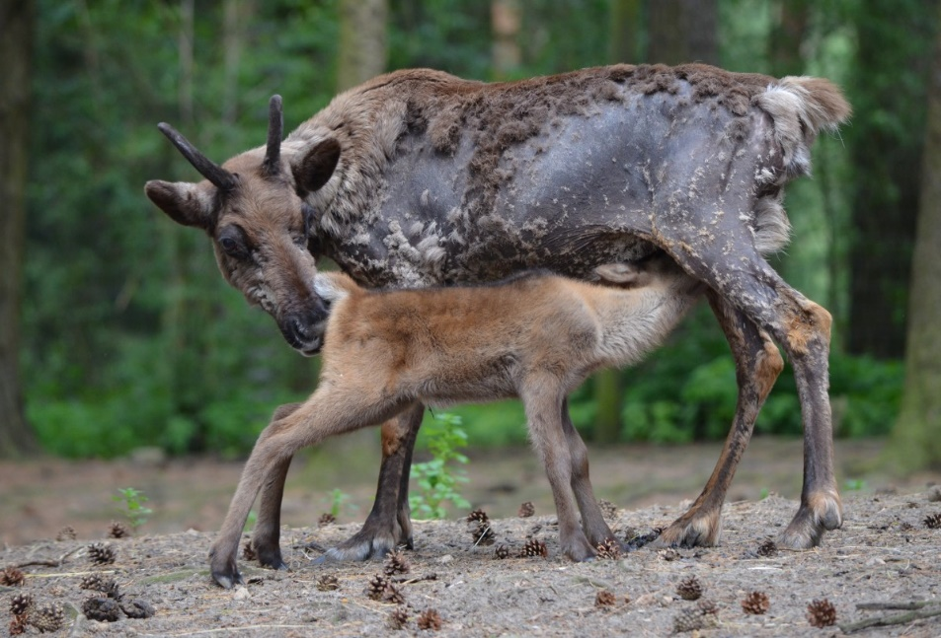
One Big Family!
Reindeer live in groups called herds. Large herds may contain thousands of reindeer!
Each herd is made up of male, female and baby reindeer.
A male reindeer is called a bull, a female is called a cow and a baby is called a calf.
“Herd of Caribou” by [United States Fish and Wildlife Service] is licensed under CC BY 2.0

Slide 13
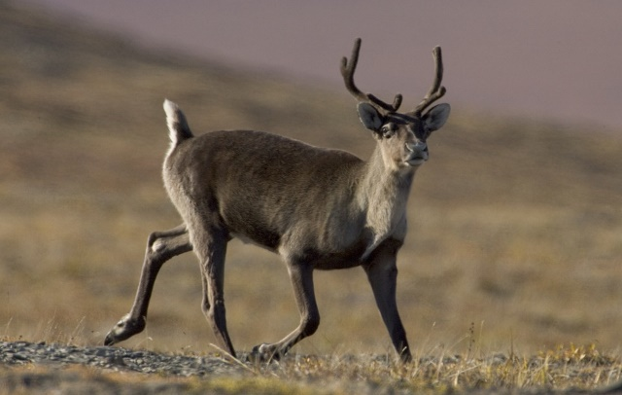
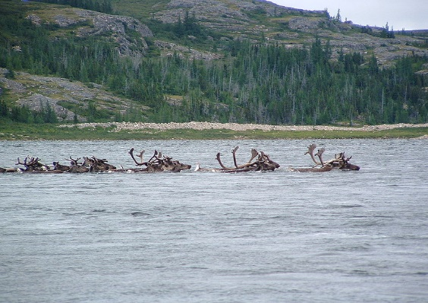
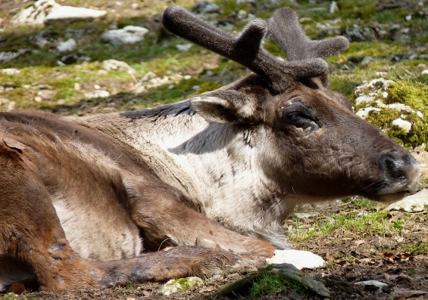
Did You Know?
Reindeer can run up to 50 miles per hour!
Reindeer are strong swimmers.
They have been known to walk more than 3000 miles in one year!
Wild reindeer are also known as caribou in North America.
A reindeer calf can walk about an hour after it is born.
A reindeer’s coat has two layers. This helps to keep them warm.
“Caribou crossing Leaf River” is licensed under CC BY 2.0

Slide 14
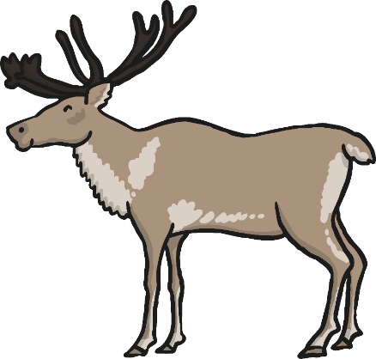
Glossary
mammal
adapted
insulator
unique
herd
climate
habitat
a warm-blooded animal that gives birth to live young
adjusted or made suitable to specific conditions
something which doesn’t allow heat or cold to pass through it
one of its kind; unlike anything else
a large group of animals
the weather conditions in a particular area
the natural home of an animal or plant
back

Slide 15
Glossary
mammal
adapted
insulator
unique
herd
climate
habitat
a warm-blooded animal that gives birth to live young
adjusted or made suitable to specific conditions
something which doesn’t allow heat or cold to pass through it
one of its kind; unlike anything else
a large group of animals
the weather conditions in a particular area
the natural home of an animal or plant
back

Slide 16
Glossary
mammal
adapted
insulator
unique
herd
climate
habitat
a warm-blooded animal that gives birth to live young
adjusted or made suitable to specific conditions
something which doesn’t allow heat or cold to pass through it
one of its kind; unlike anything else
a large group of animals
the weather conditions in a particular area
the natural home of an animal or plant
back

Slide 17
Glossary
mammal
adapted
insulator
unique
herd
climate
habitat
a warm-blooded animal that gives birth to live young
adjusted or made suitable to specific conditions
something which doesn’t allow heat or cold to pass through it
one of its kind; unlike anything else
a large group of animals
the weather conditions in a particular area
the natural home of an animal or plant
back

Slide 18
Glossary
mammal
adapted
insulator
unique
herd
climate
habitat
a warm-blooded animal that gives birth to live young
adjusted or made suitable to specific conditions
something which doesn’t allow heat or cold to pass through it
one of its kind; unlike anything else
a large group of animals
the weather conditions in a particular area
the natural home of an animal or plant
back

Slide 19
Glossary
mammal
adapted
insulator
unique
herd
climate
habitat
a warm-blooded animal that gives birth to live young
adjusted or made suitable to specific conditions
something which doesn’t allow heat or cold to pass through it
one of its kind; unlike anything else
a large group of animals
the weather conditions in a particular area
the natural home of an animal or plant
back

