Slide 1


Lesson 3
Step: Count money (notes and coins)

Slide 2
Fluency
Complete the number sentences.
10
70
a) £5 + £2 + £2 + £1 + 50p + 20p = £__________ and __________p
8
80
b) £1 + £5 + £2 + 20p + 50p + 10p = £__________ and __________p
9
65
c) £5 + £2 + £2 + 50p + 10p + 5p = £__________ and __________p
10
85
d) £5 + £5 + 20p + 50p + 10p + 5p = £__________ and __________p
12
26
e) £10 + £2 + 10p + 10p + 5p + 1p = £__________ and __________p

Slide 3
Fluency
Complete the number sentences.
32
1
a) £__________ and __________p = £10 + £10 + £5 + £5 + £2 + 1p
21
67
b) £__________ and __________p = £20 + £1 + 10p + 50p + 5p + 2p
30
55
c) £__________ and __________p = £20 + £10 + 50p + 5p
8
75
d) £__________ and __________p = £2 + £1 + £5 + 50p + 5p + 20p
22
77
e) £__________ and __________p = £20 + £2 + 50p + 20p + 5p + 2p

Slide 4
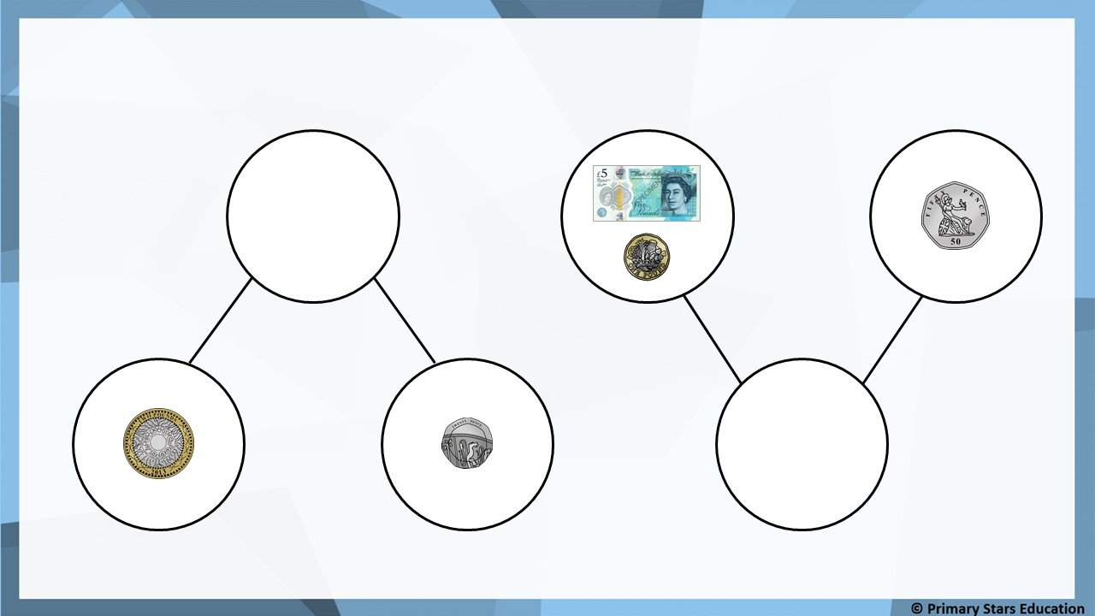
Fluency
Complete the part-whole models.
£2 and 20p
£6 and 50p

Slide 5
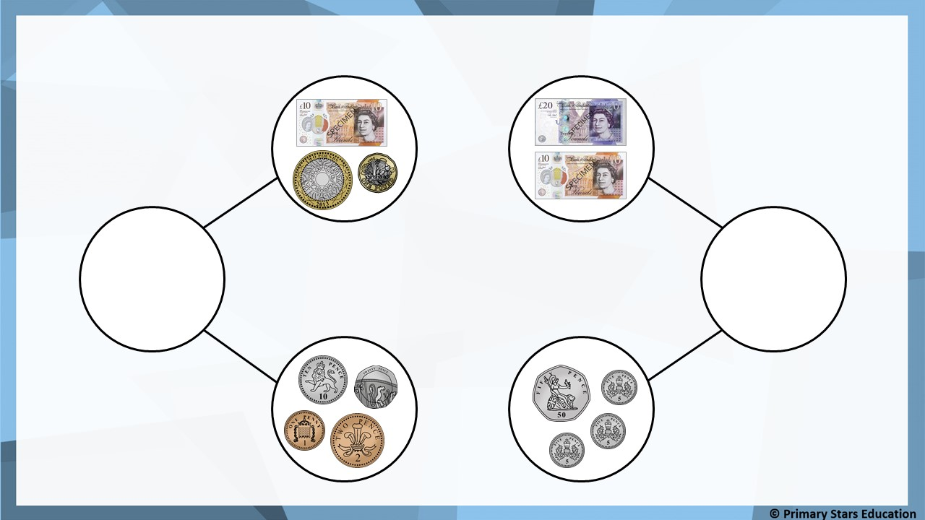
Fluency
Complete the part-whole models.
£13 and 33p
£30 and 65p

Slide 6
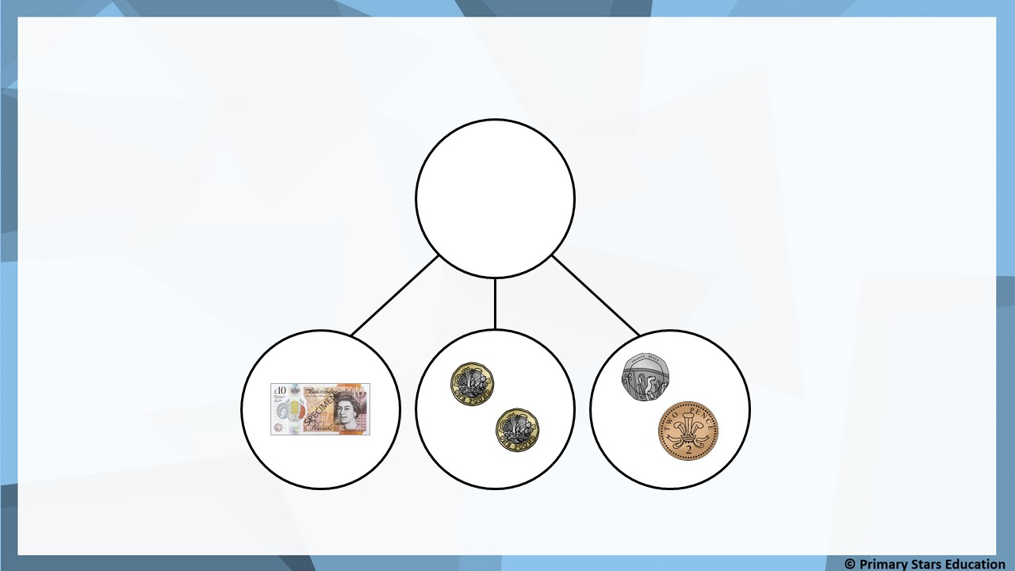
Fluency
Complete the part-whole model.
£12 and 22p

Slide 7
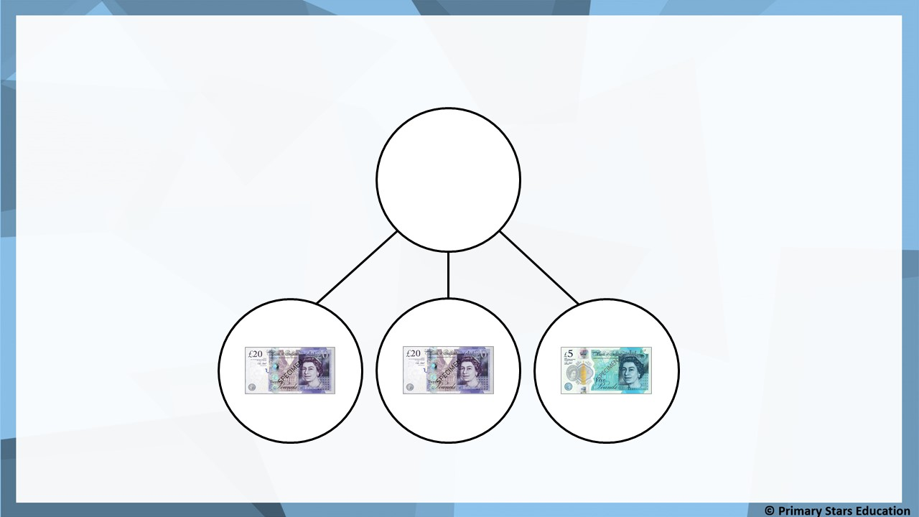
Fluency
Complete the part-whole model.
£45

Slide 8
Beth completed the number sentence:
Reasoning
2
£2 + £_______ + £2 + £1 + 50p + 10p + 1p = £10 and 61p
Is Beth correct? YES NO
Explain how you know.
Beth’s number sentence would total of £7 and 61p.
Beth should have written £5 to make the number sentence correct.

Slide 9
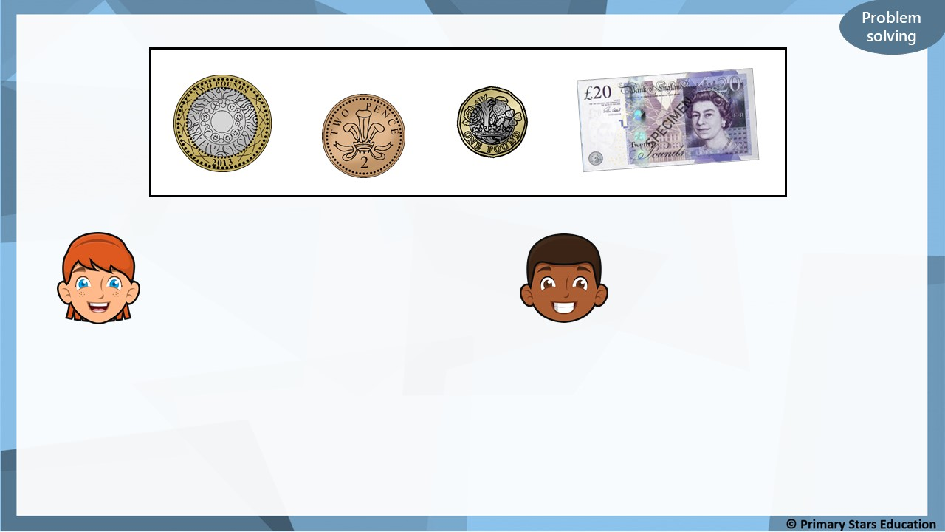
There is 25p.
There is £25.
Sue
Mo
Who is correct? Explain how you know.
Both are incorrect. The total is £23 and 2p.

Slide 10
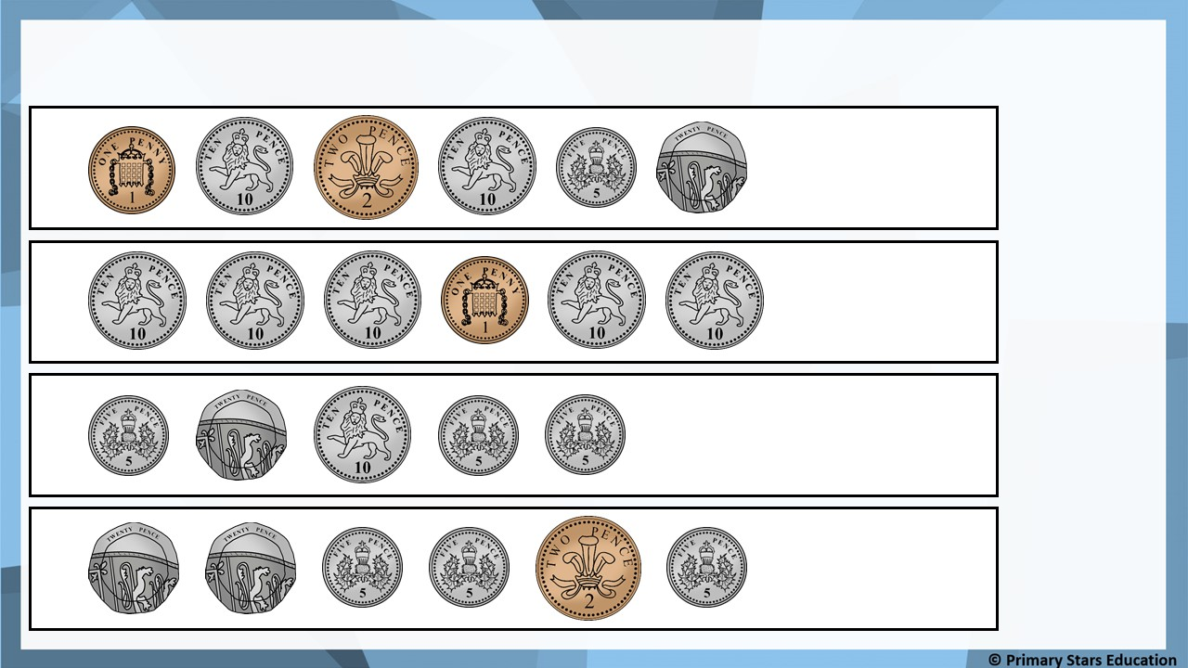
Problem solving
Put a tick (✓) next to the amounts that show more than 50p.
a)
b)
✓
c)
d)
✓

