Slide 1


Lesson 2
Step: Count money (pounds)

Slide 2

Fluency
£1

Slide 3

Fluency
£2

Slide 4
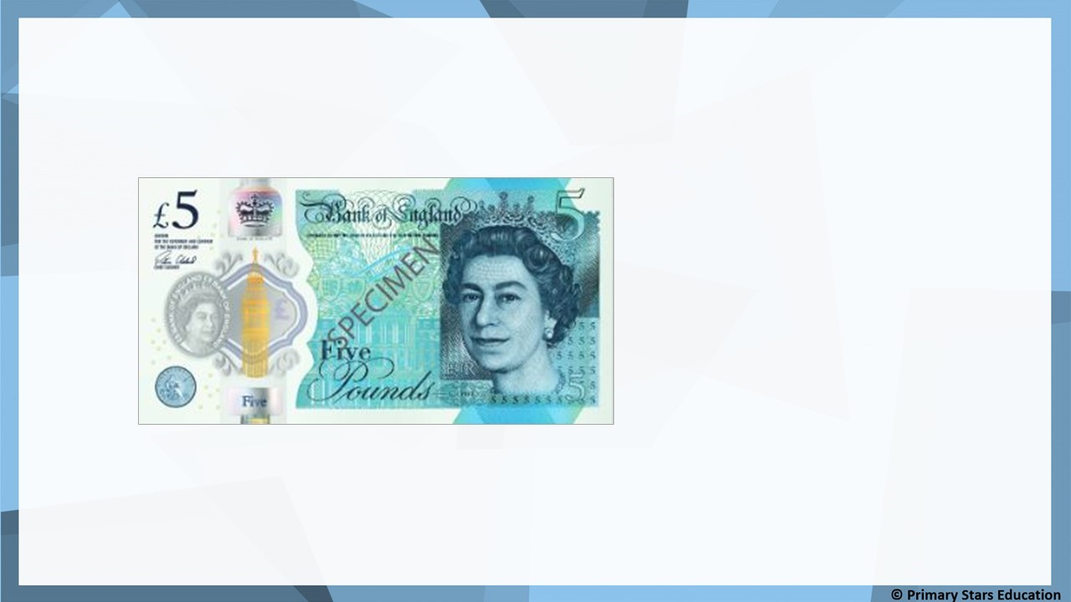
Fluency
£5

Slide 5
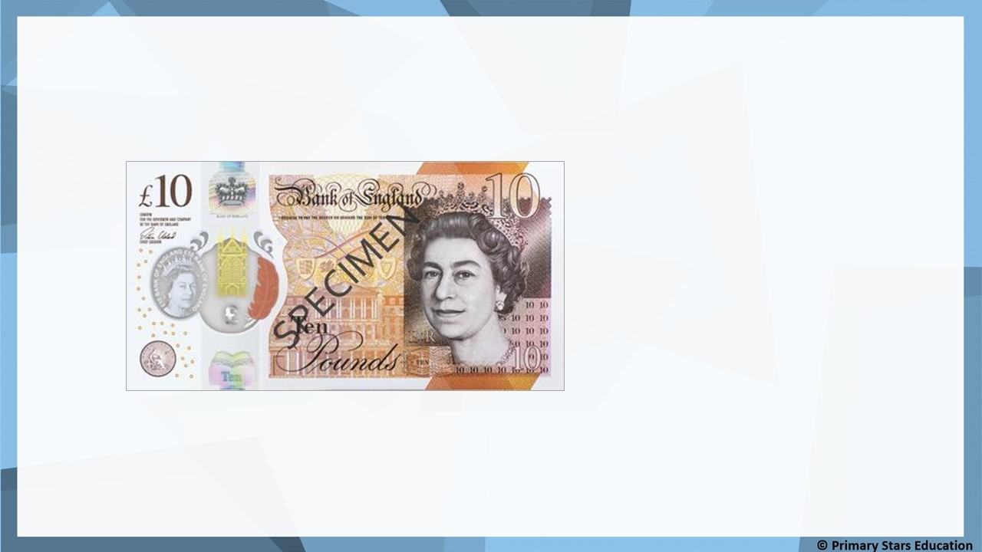
Fluency
£10

Slide 6
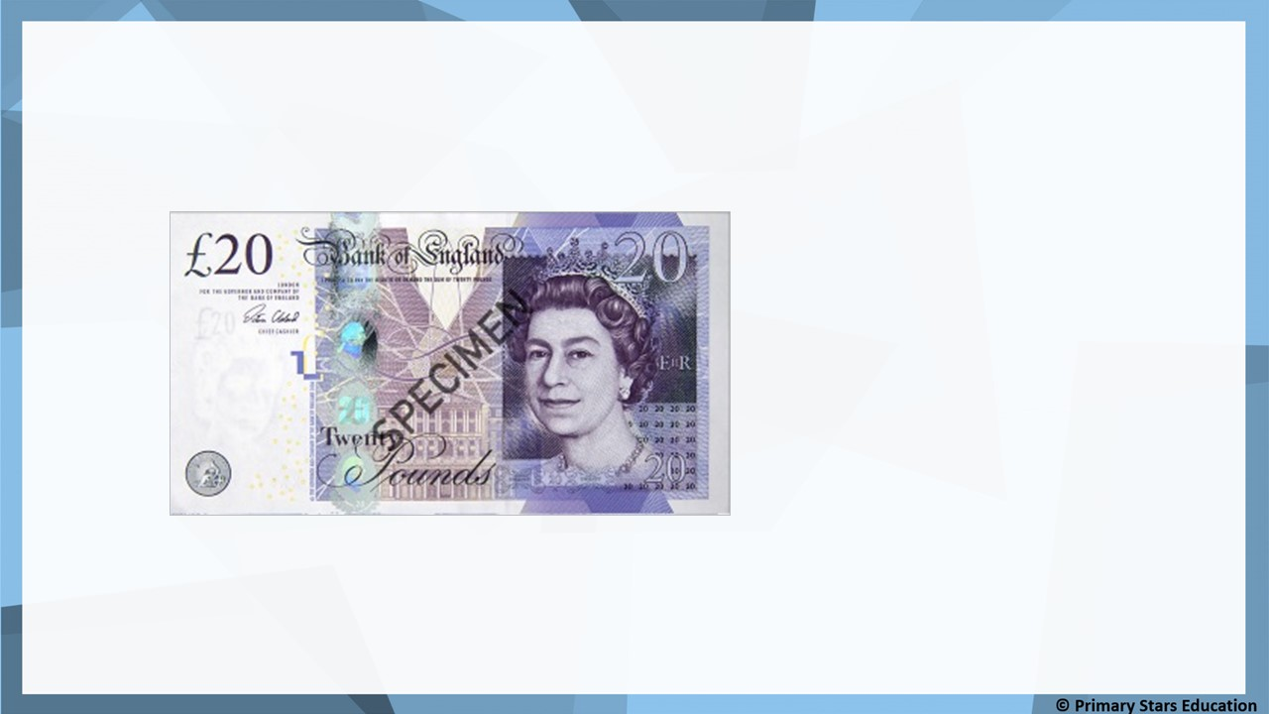
Fluency
£20

Slide 7
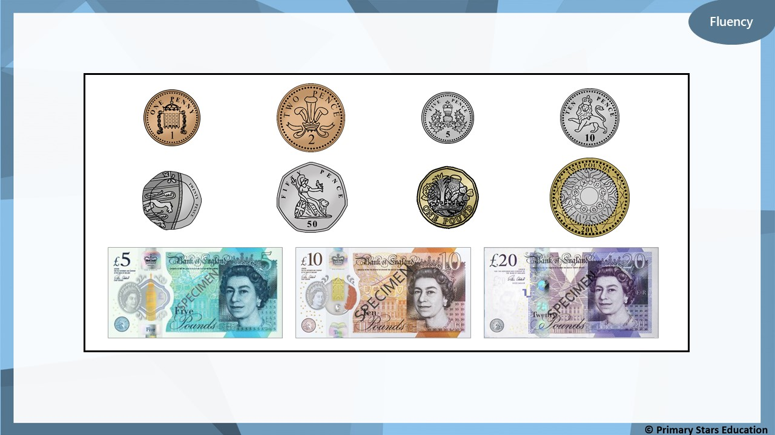
Look at the coins and notes below.
Can you describe them? What is the same? What is different?

Slide 8
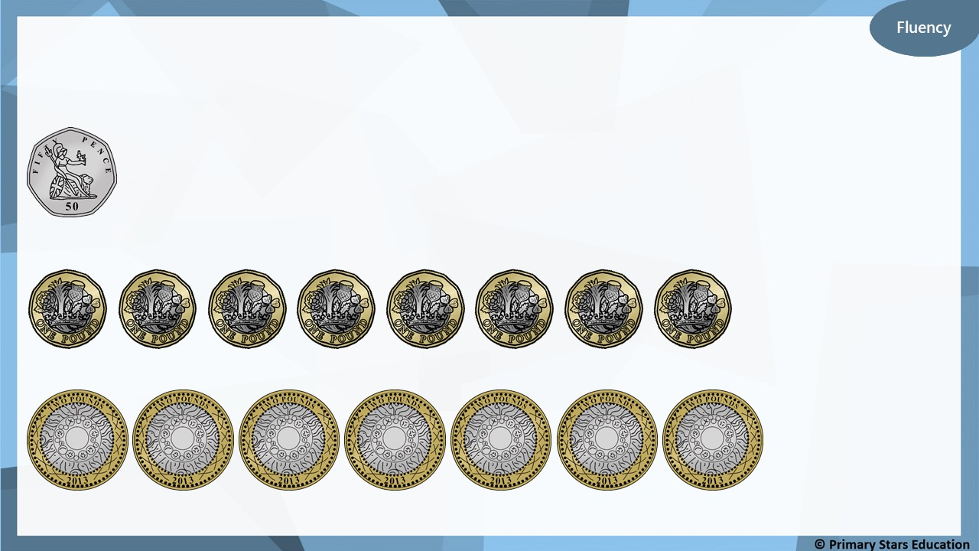
What amounts are shown?
50p
£8
£14

Slide 9
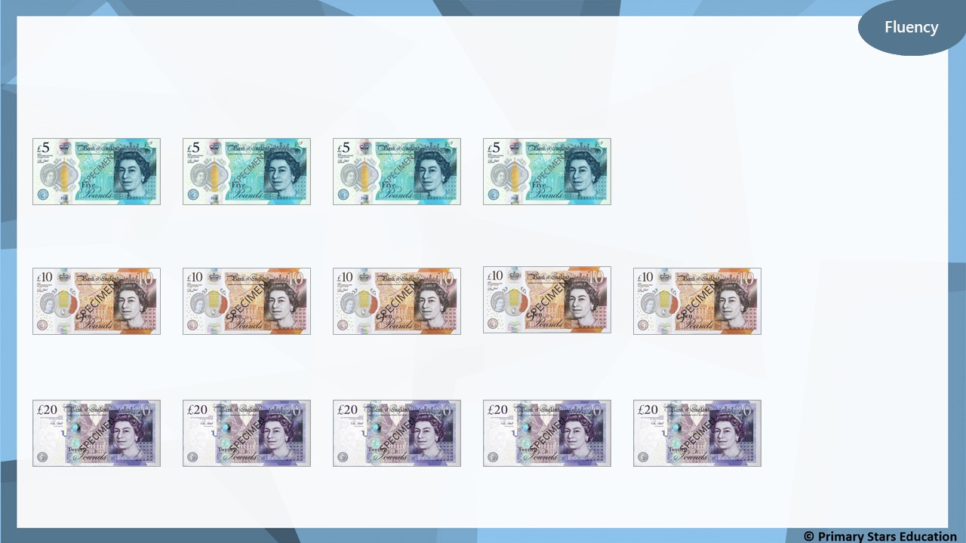
What amounts are shown?
£20
£50
£100

Slide 10
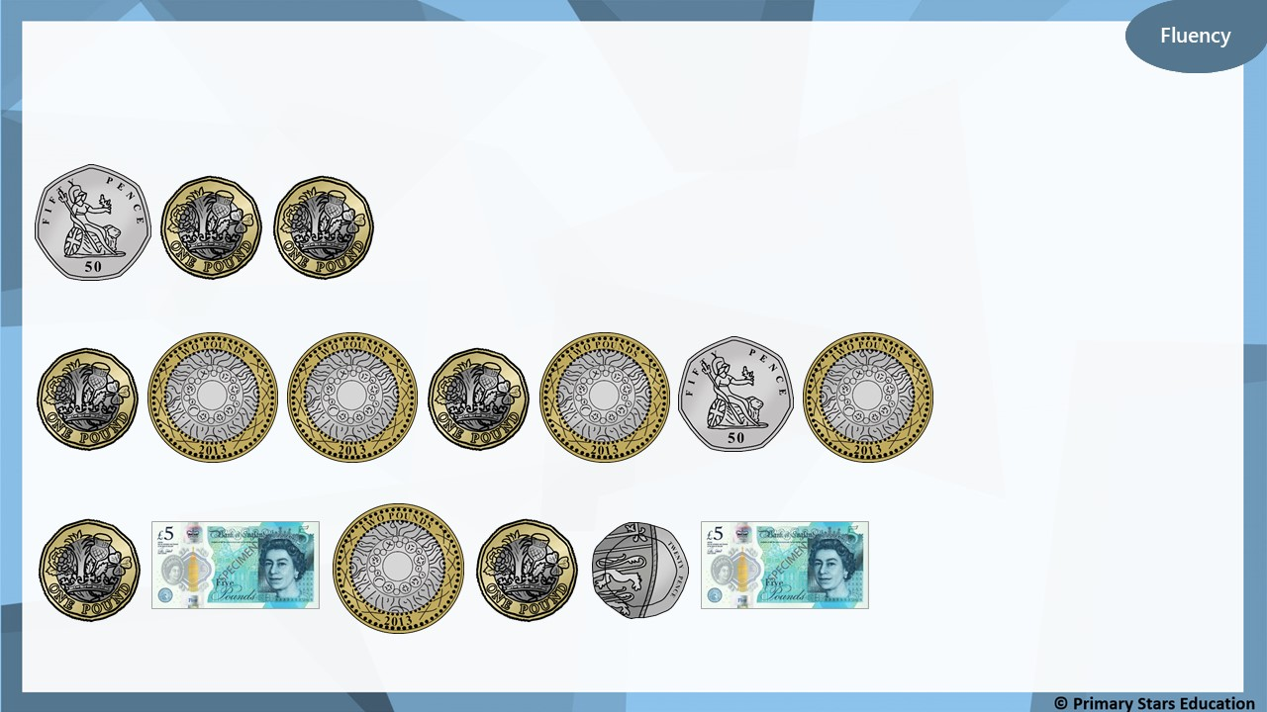
What amounts are shown?
£2 and 50p
£10 and 50p
£14 and 20p

Slide 11
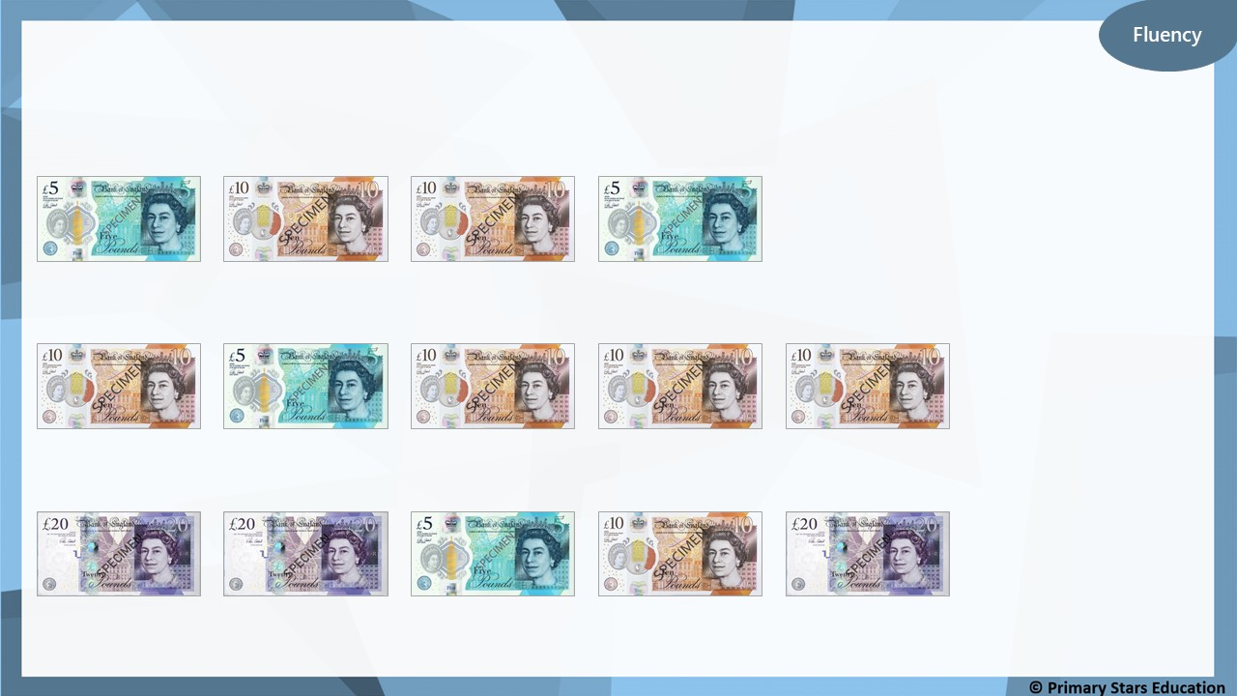
What amounts are shown?
£30
£45
£75

Slide 12
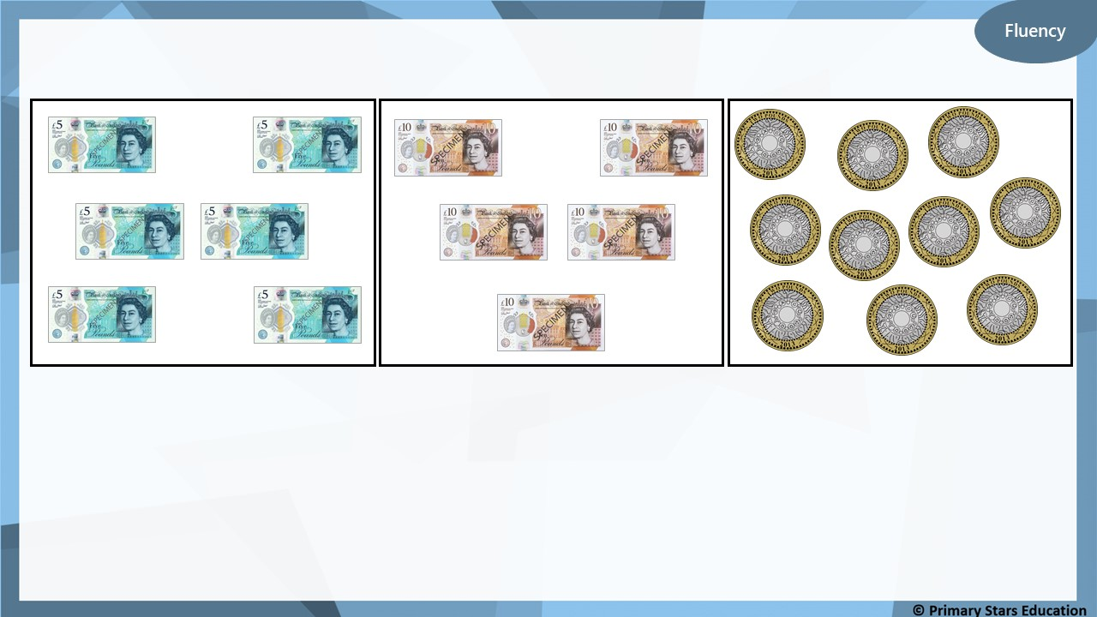
Match the money to the correct total.
£20
£30
£50

Slide 13
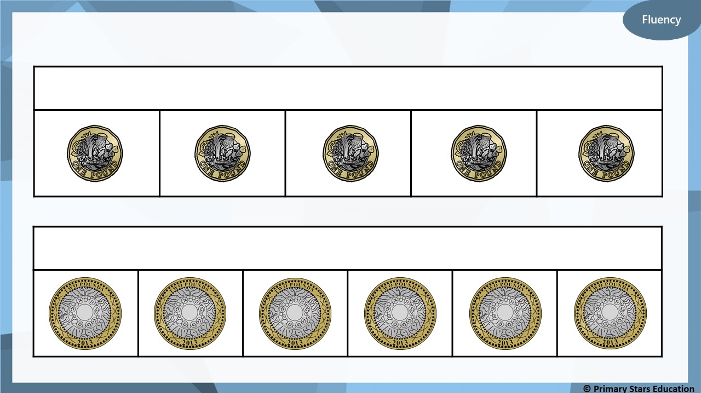
Complete the bar models.
£5
£12

Slide 14
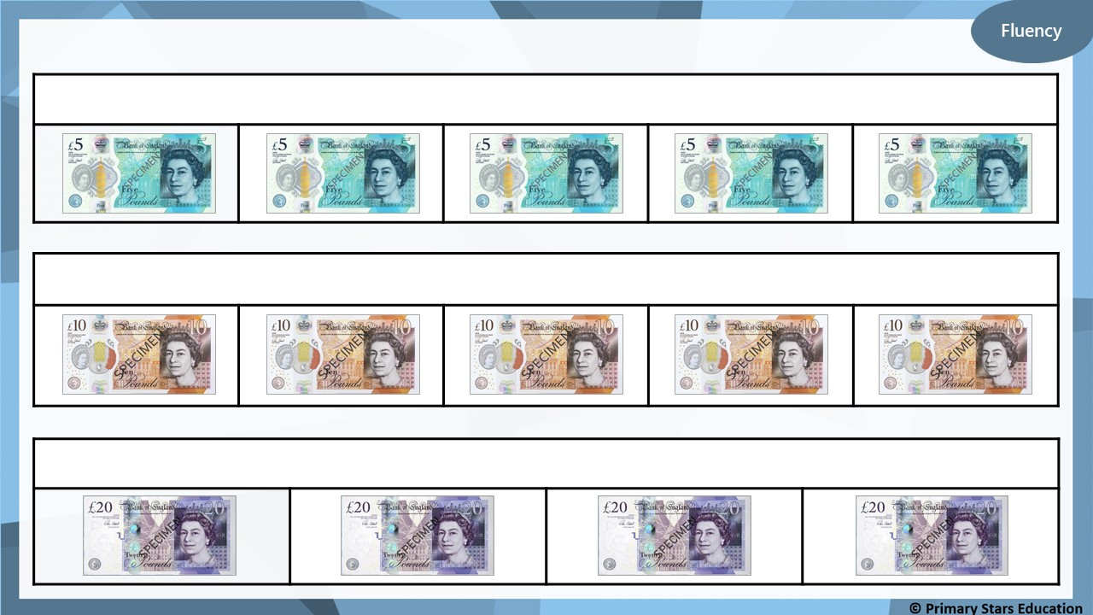
Complete the bar models.
£25
£50
£80

Slide 15
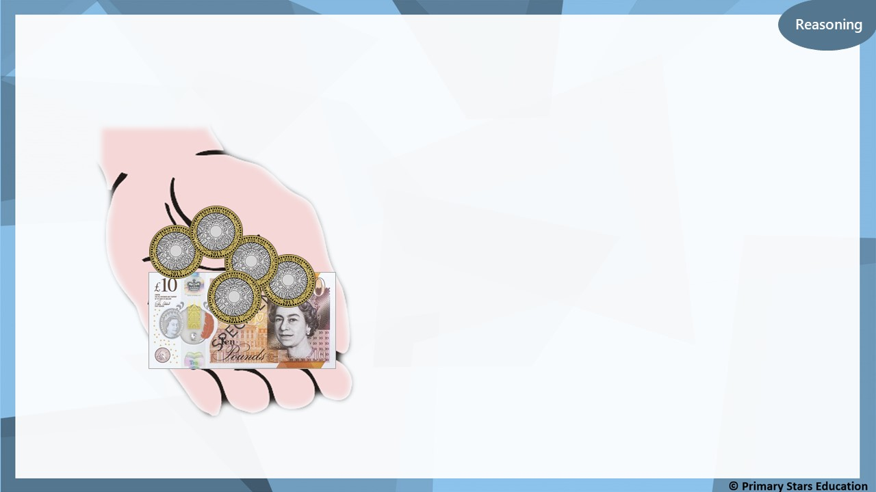
Che says he has £15.
Is Che correct?
Explain how you know.
No. Che has £20.
What mistake might Che have made?
Che may have mistaken the
£2 coins for £1 coins.

Slide 16
Problem solving
Identify the values below that can be made using only £5 notes.
£35
£80
£72
£4
£18
£65
£48
£100

