Slide 1


Lesson 5
Step: Make the same amount

Slide 2
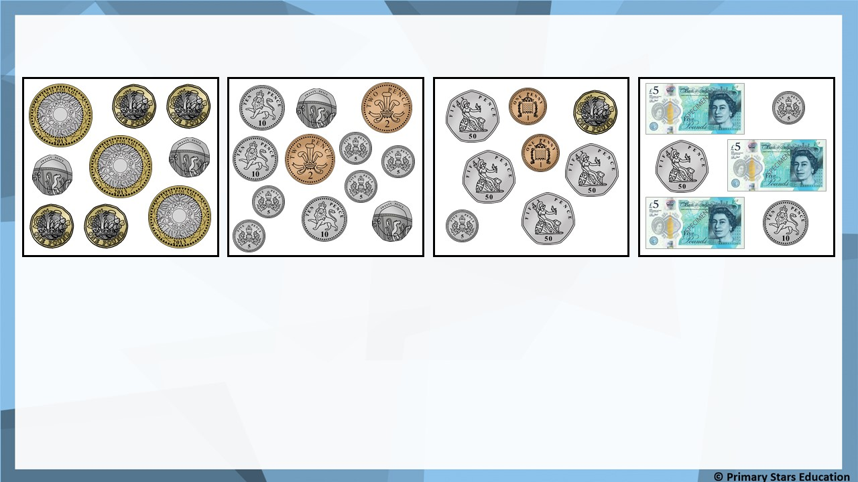
Fluency
Match the coins to the correct amount.
£3 and 7p
£10 and 40p
£15 and 65p
99p

Slide 3
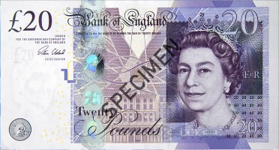
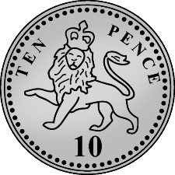
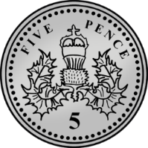
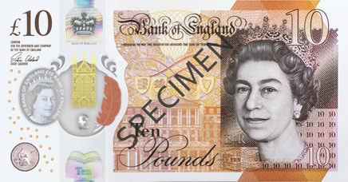

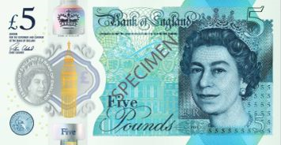
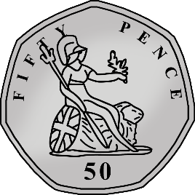
Fluency
Match the coins to the correct amount.
£50 and 50p
£20 and 77p
£45 and 8p
£30 and 35p

Slide 4
Fluency
Complete the part-whole models.
15p
£15
10p
5p
£5
£5
£5

Slide 5
Fluency
Complete the part-whole models.
40p
£40
20p
20p
£20
£10
£10

Slide 6
Fluency
Complete the part-whole models.
60p
£60
50p
10p
£20
£20
£20

Slide 7

You can make 10p in at least 5 different ways using coins.
Yes
Do you agree? __________
Explain why.
2p, 2p, 2p, 2p, 2p
2p, 2p, 2p, 2p, 1p, 1p
2p, 2p, 2p, 1p, 1p, 1p, 1p
2p, 2p, 1p, 1p, 1p, 1p, 1p, 1p
2p, 1p, 1p, 1p, 1p, 1p, 1p, 1p, 1p
1p, 1p, 1p, 1p, 1p, 1p, 1p, 1p, 1p, 1p

Slide 8
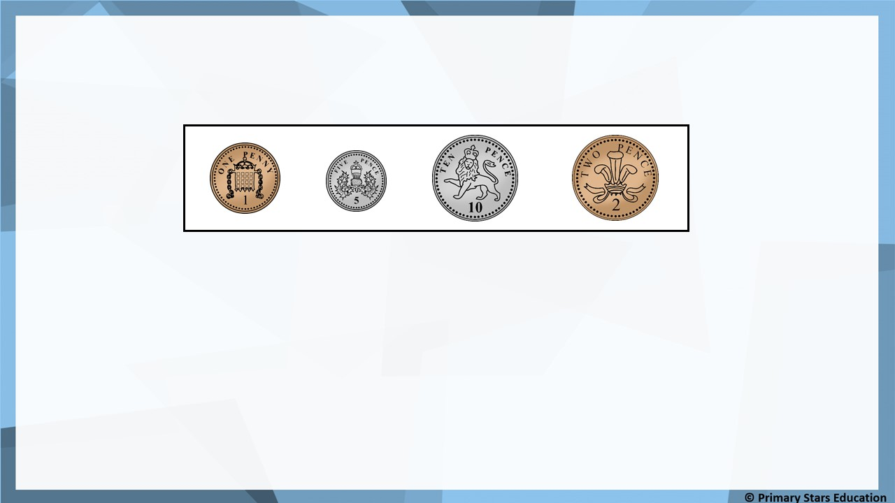
Problem solving
Make 30p three ways using the coins below.
You can each coin more than once.
Possible examples:
10p, 10p, 10p
10p, 10p, 5p, 5p
10p, 5p, 5p, 5p, 5p
5p, 5p, 5p, 5p, 5p, 5p
30 x 1p
15 x 2p

