Slide 1
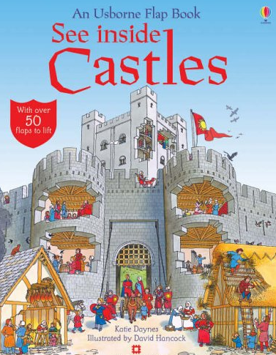
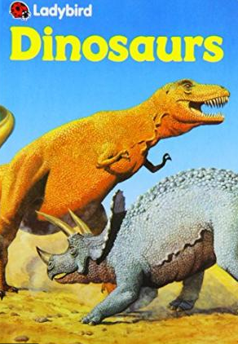

LO: To identify non-fiction books and their features.

Slide 2

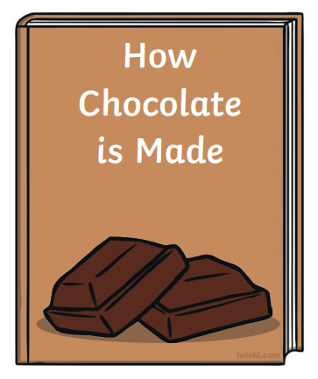
What is non-fiction?
A non-fiction book is one that tells you facts and information about the world around you. It can cover almost any topic from animals to sports.
Non-fiction books help us to learn about the topics we are interested in. Examples of non-fiction includes newspapers, magazines and reference books.

Slide 3

Text Features
Text features are included in nonfiction text to help the reader better understand the material.
There are many different types of text features that provide unique information to the reader, that can…
Tell or explain new information
Help the reader find information

Slide 4

Headings and Subheadings
A heading is included at the top of the text, to tell the reader what the entire text is about.
A subheading tells the reader what information they will find in the following paragraphs before the next subheading.

Slide 5
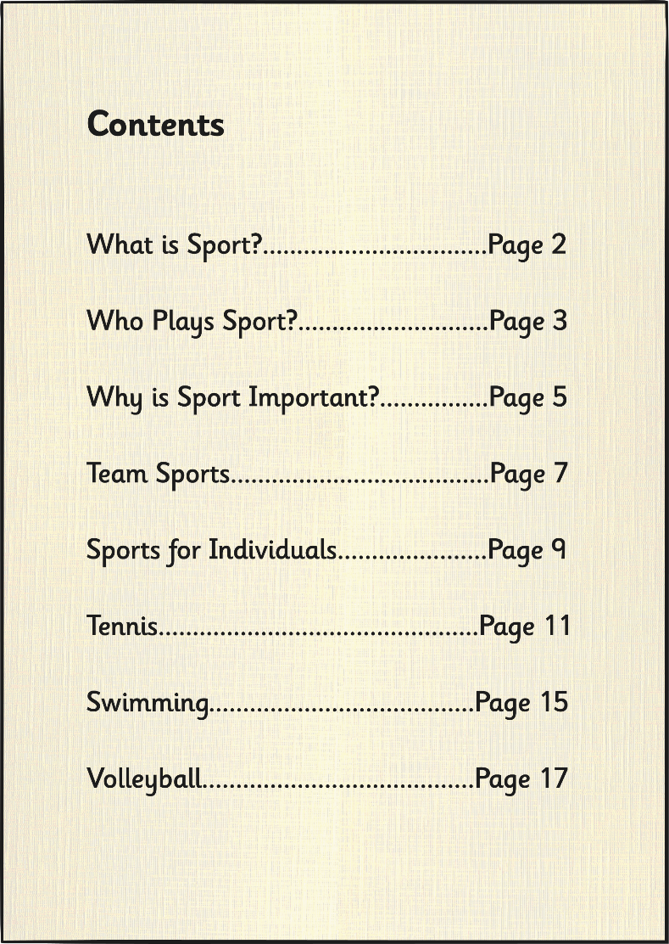
Table of Contents
A table of contents is often included at the very beginning of a book.
The table of contents shows a list of headings within the book, and the page number where you can look to find that heading.
The table of contents makes it easier for the reader to find specific information they are looking for.

Slide 6
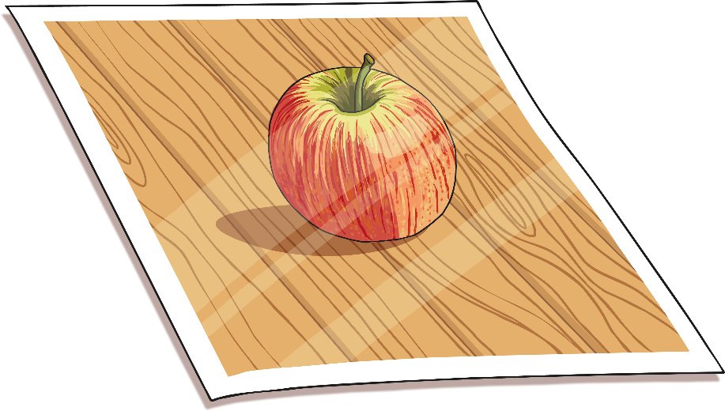
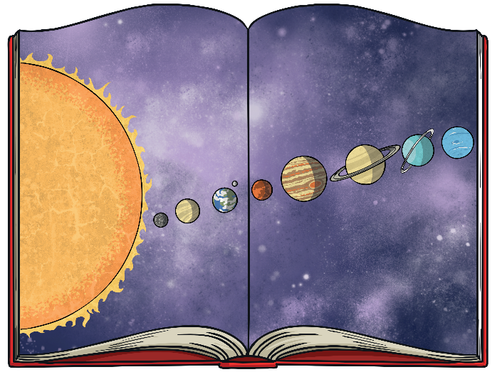
Photographs and Illustrations
Authors often choose to include photographs or illustrations to help the reader better understand the information.
A photograph may be an actual picture from an event in history or of a unique underwater creature.
An illustration may be a diagram that explains a complex body system or scientific process.

Slide 7
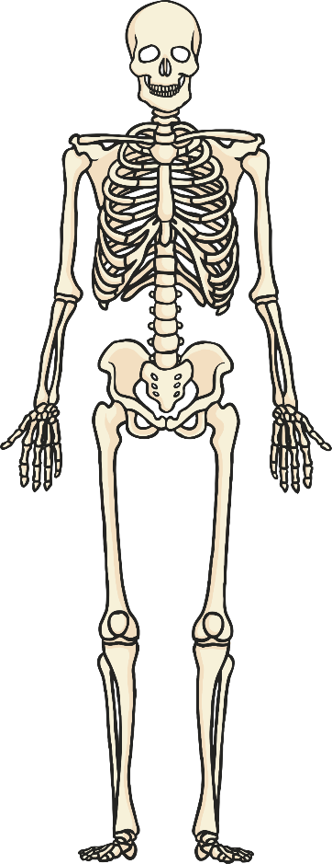
Captions and Labels
Skull
A caption briefly explains what a photograph or illustration is about. It is often a short phrase or sentence that is located directly next to or under the image.
A label points to a specific part of a photograph, illustration or diagram, and tells you the name of that part.
ribs
pelvis
femur
Skeletal system of a human

Slide 8

Bold Words and the Glossary
Throughout the text, an author may choose to make a word bold.
A bold word is often an important word to the subject of the text or a difficult word that the reader may not know.
If you see a bold word, there is a good change you can find the definition in the Glossary.

Slide 9
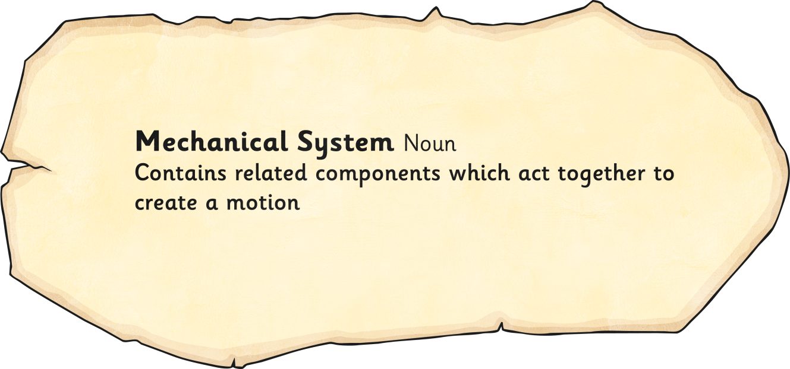
Glossary
A glossary is included at the end of a book.
Bold words throughout the text are listed in alphabetical order.
Next to each word is a definition of the word to help the reader better understand the information.

Slide 10
Success Criteria
Look carefully for each feature in the book.
Record the page number where you find each feature.
Write a sentence or caption to show what you have found.
Join your writing neatly.
Read and check your work.

