Slide 1

YEAR 2
Money
Recognising coins & notes
Count money: pence
Block 3

Slide 2


Lesson 1
LO: To count money (pence)

Slide 3

Fluency
1p

Slide 4
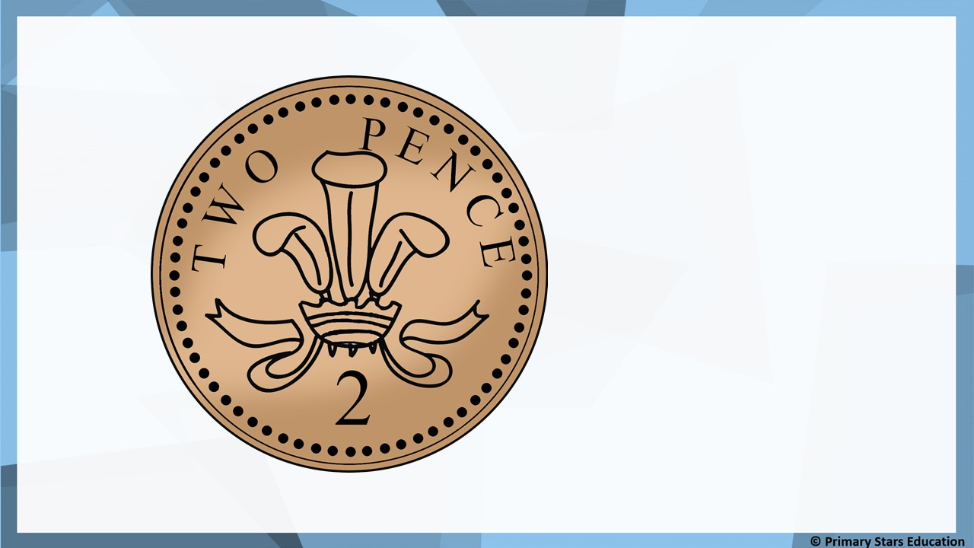
Fluency
2p

Slide 5

Fluency
5p

Slide 6

Fluency
10p

Slide 7

Fluency
20p

Slide 8

Fluency
50p

Slide 9
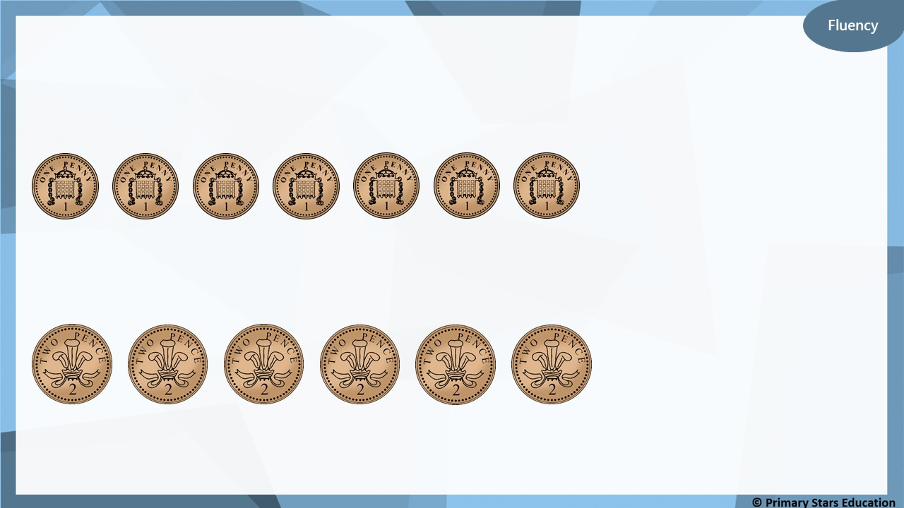
What amounts are shown?
7p
12p

Slide 10
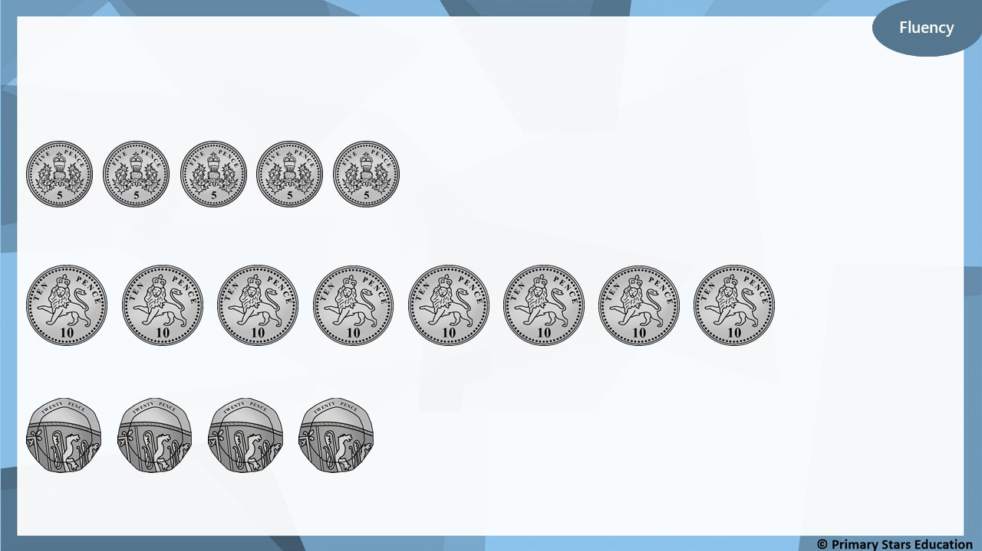
What amounts are shown?
25p
80p
80p

Slide 11
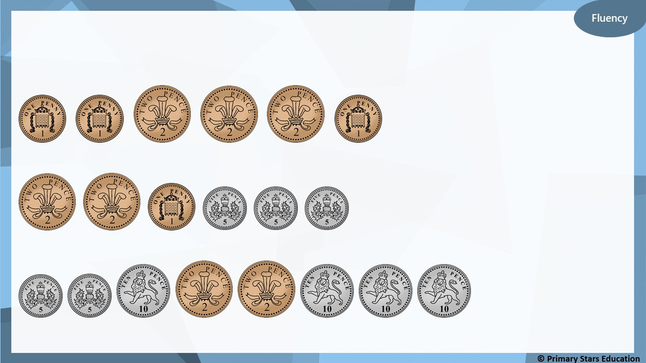
What amounts are shown?
9p
20p
54p

Slide 12
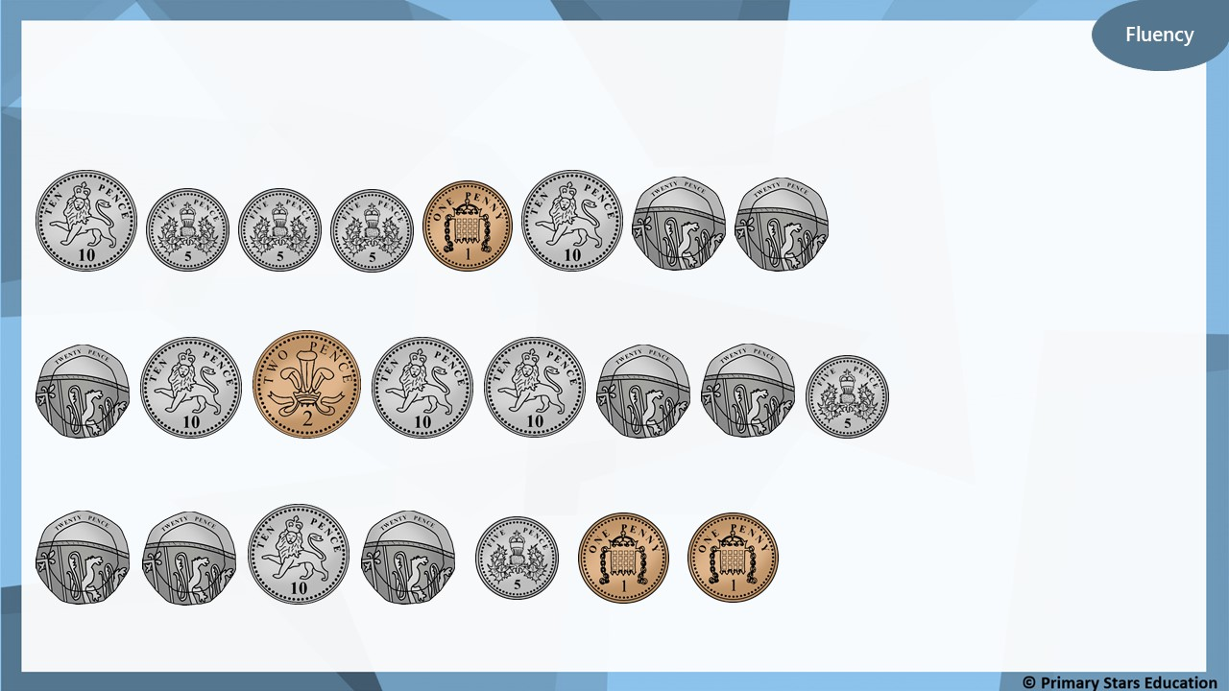
What amounts are shown?
76p
97p
77p

Slide 13
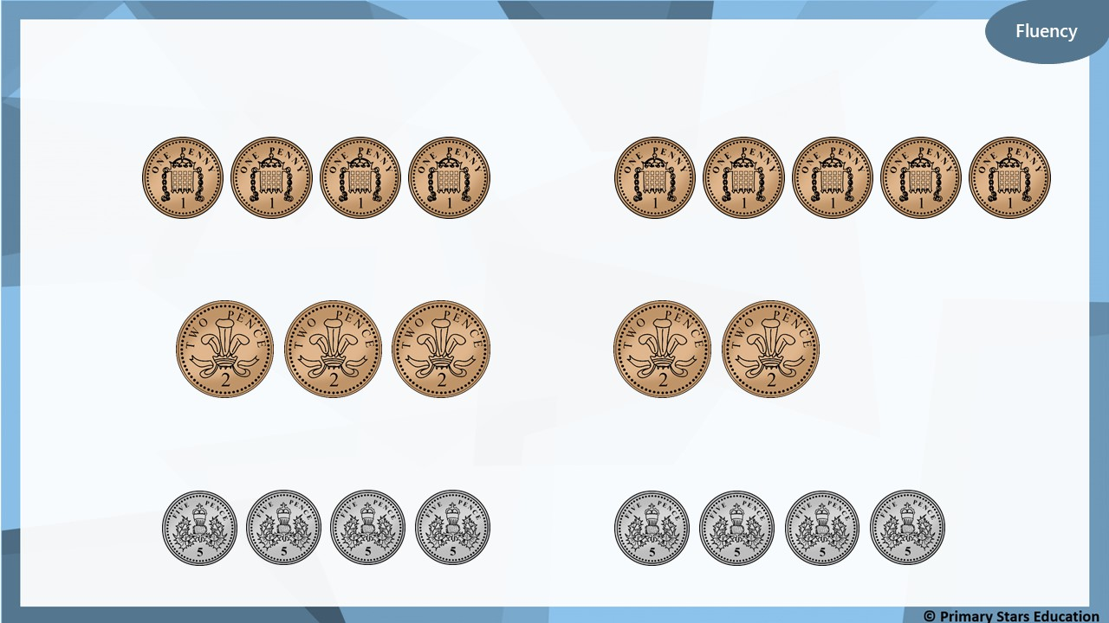
Use <, > or = to compare the money.
<
>
=

Slide 14
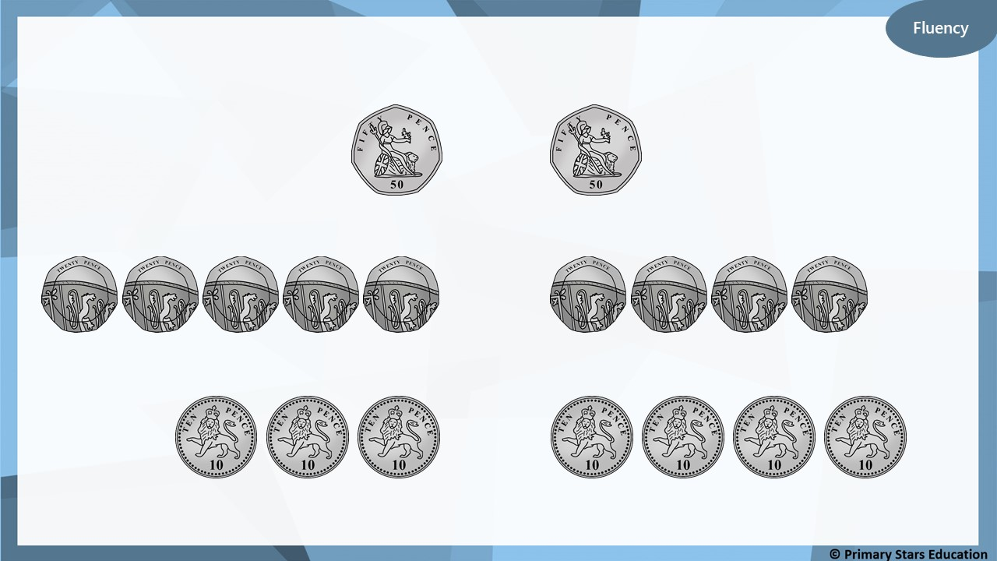
Use <, > or = to compare the money.
=
>
<

Slide 15
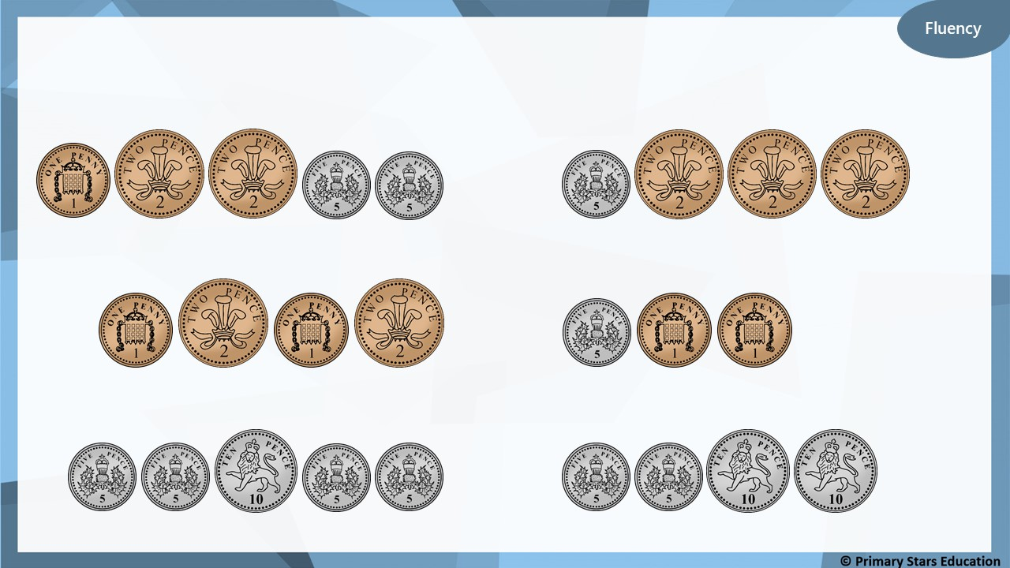
Use <, > or = to compare the money.
>
<
=

Slide 16
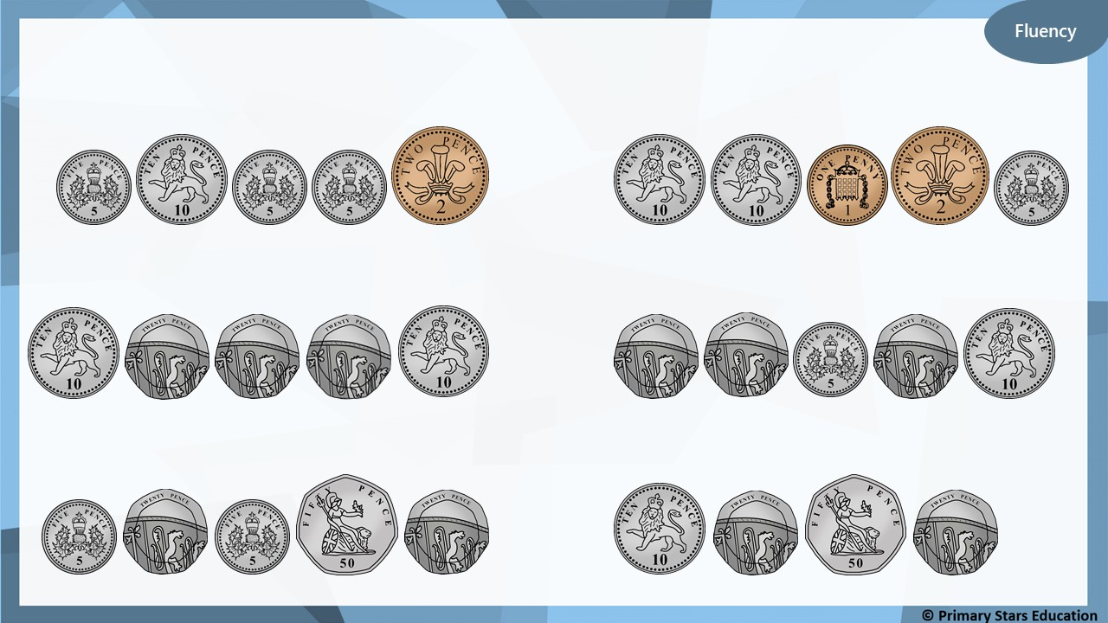
Use <, > or = to compare the money.
<
>
=

Slide 17
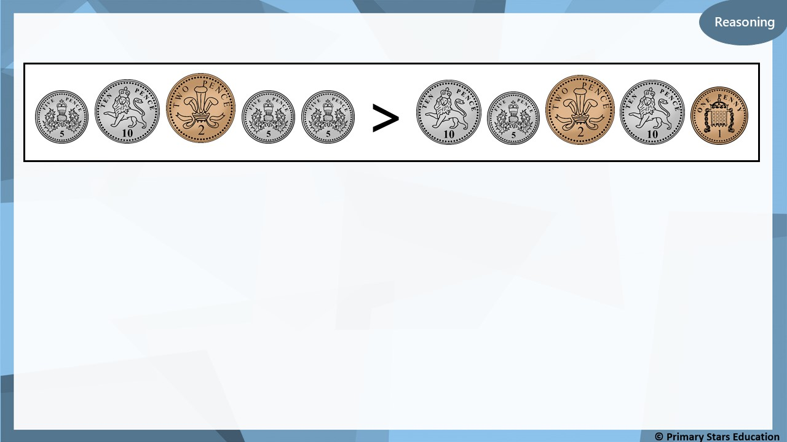
Is the statement above true or false?
Explain how you know.
False.
The left side shows 27p and the right side shows 28p.
27p is less than 28p so the sign should be less than (<).

Slide 18
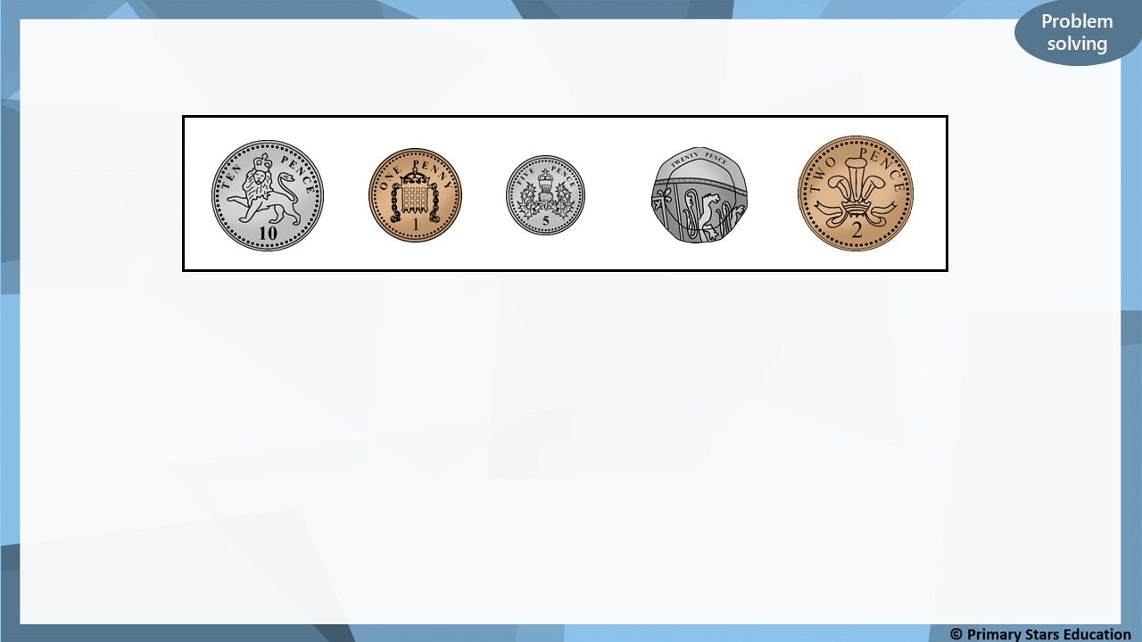
Kat selects four of these coins, using them only once.
18p
What is the lowest total Kat could make? __________
37p
What is the greatest total Kat could make? __________
38p
What total would all the coins make? __________

