Slide 1


Lesson 3
Step: Find the difference

Slide 2


Fluency
Calculate the difference.
10p
?
30p
20p
10p + ________ = 30p

Slide 3


Fluency
Calculate the difference.
35p
?
75p
40p
35p + ________ = 75p

Slide 4
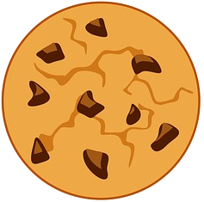

Fluency
Calculate the difference.
£1 and 25p
?
£1 and 50p
25p
£1 and 25p + ________ = £1 and 50p

Slide 5
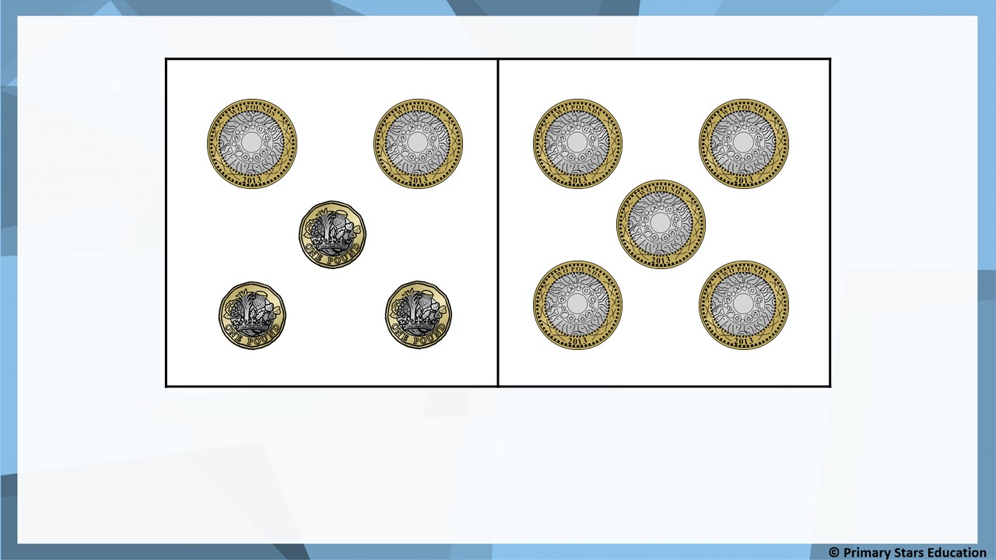
Fluency
Ben
Tam
£3
How many pounds less does Ben have? ______.

Slide 6
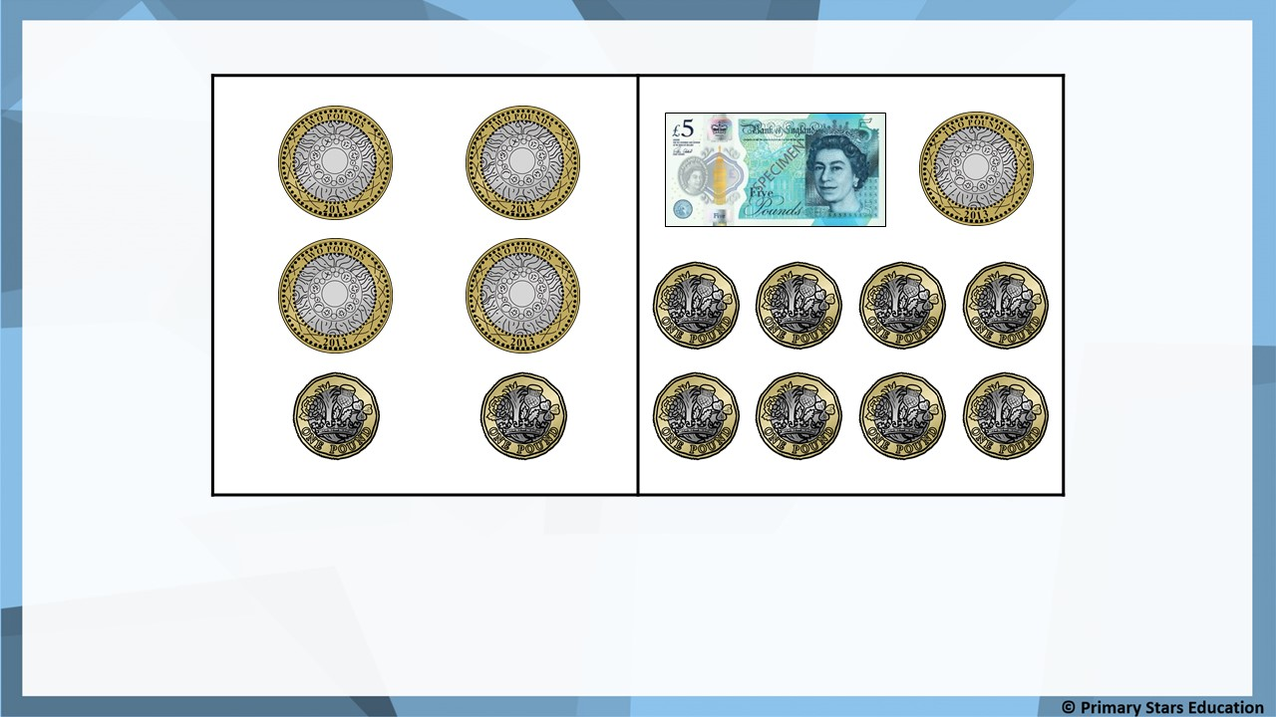
Fluency
Jack
Beth
£5
How many pounds more does Beth have? ______.

Slide 7
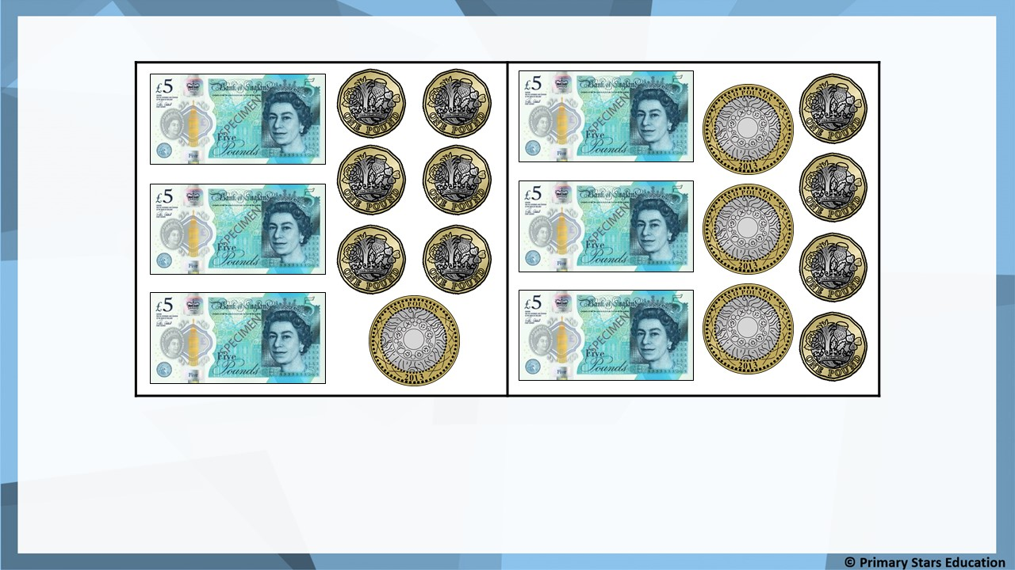
Fluency
Jack
Sue
£2
How many pounds less does Jack have? ______.

Slide 8
Fluency
a) Mo has £1 and 50p.
Asha has £1 and 65p.
How much more money does Asha have than Mo?
Asha has 15p more than Mo.
b) Rob has £1 and 75p.
Gina has £2 and 25p.
How much more money does Gina have than Rob?
Gina has 50p more than Rob.

Slide 9

I have
£1 and 40p.
I have
£1 and 20p.
Tam
Dom
Tam says she has 30p more than Dom.
Is Tam correct? How do you know?
No. Tam has 20p more than Dom.
£1 and 40p - £1 and 20p = 20p.

Slide 10

I have 10p.
I have 30p.
Sue
Che
Both children have a 10p coin. Che only has silver coins.
What other silver coins could Che have?
Any combination of silver coins to make 20p, for example:
4 x 5p 2 x 5p and 1 x 10p 2 x 10p 1 x 20p

