Slide 1


Slide 2

Rules for adding ed

Slide 3

Rules for adding ed

Slide 4

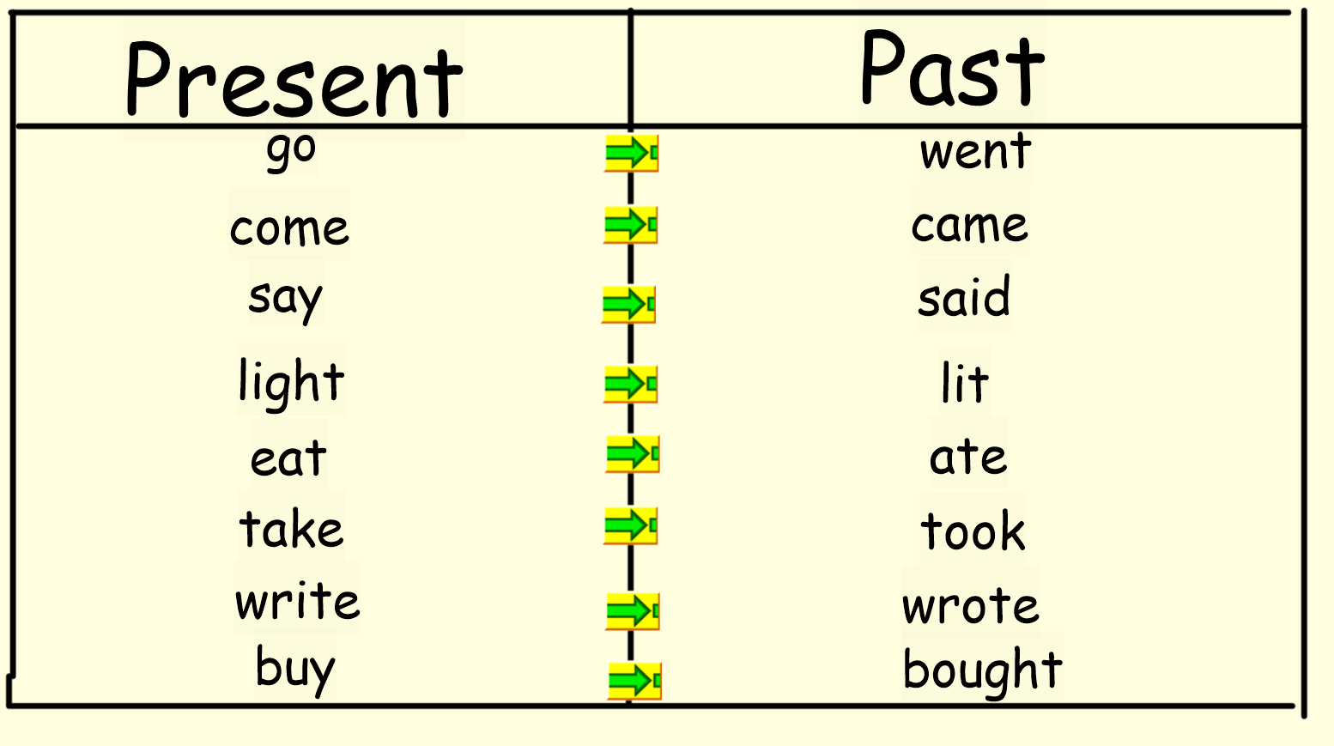

Slide 5



