Slide 1


Lesson 1
Step: Compare money

Slide 2
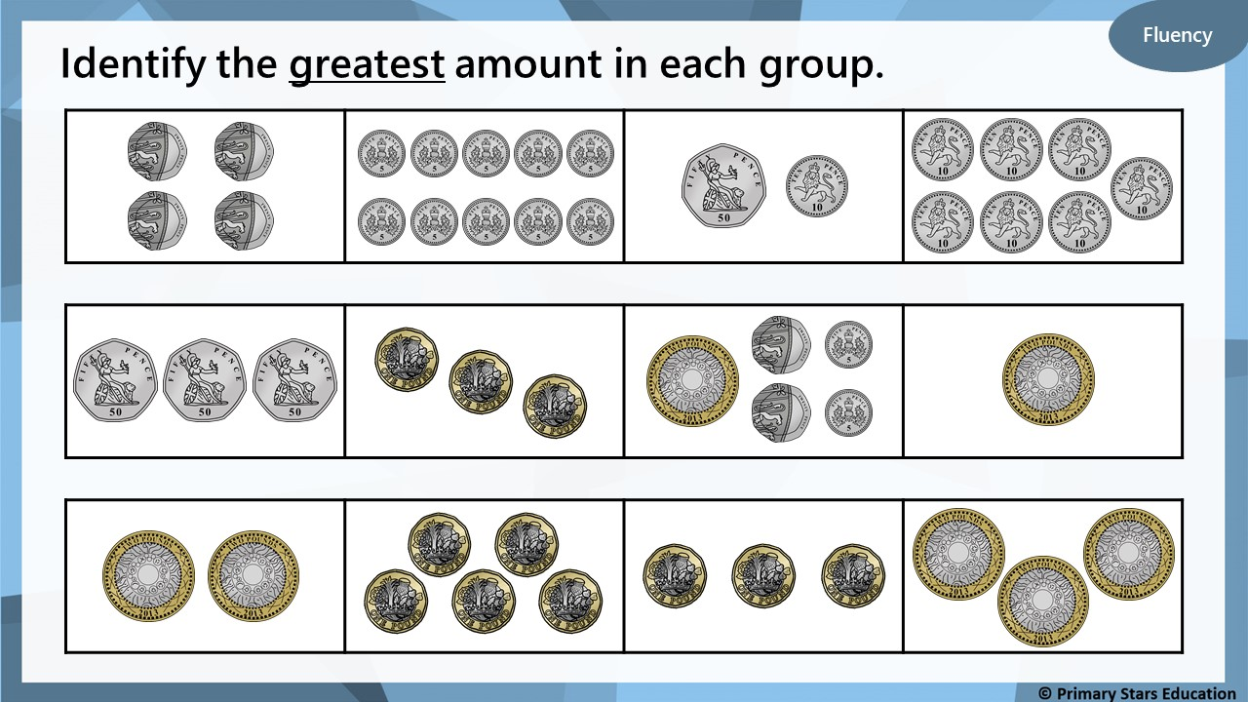

Slide 3
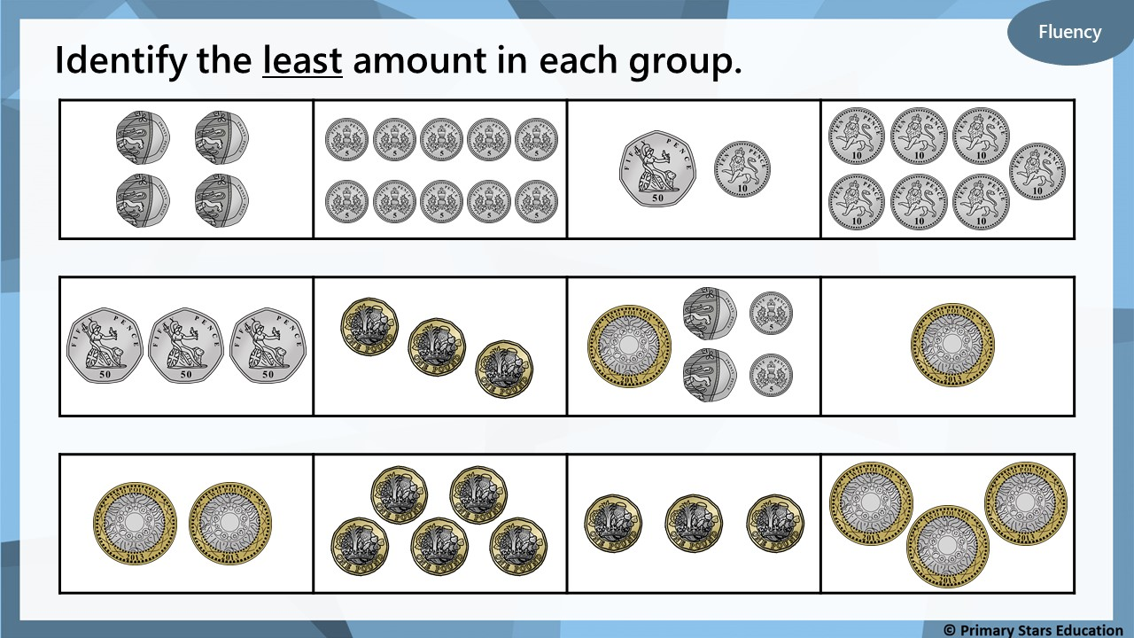

Slide 4
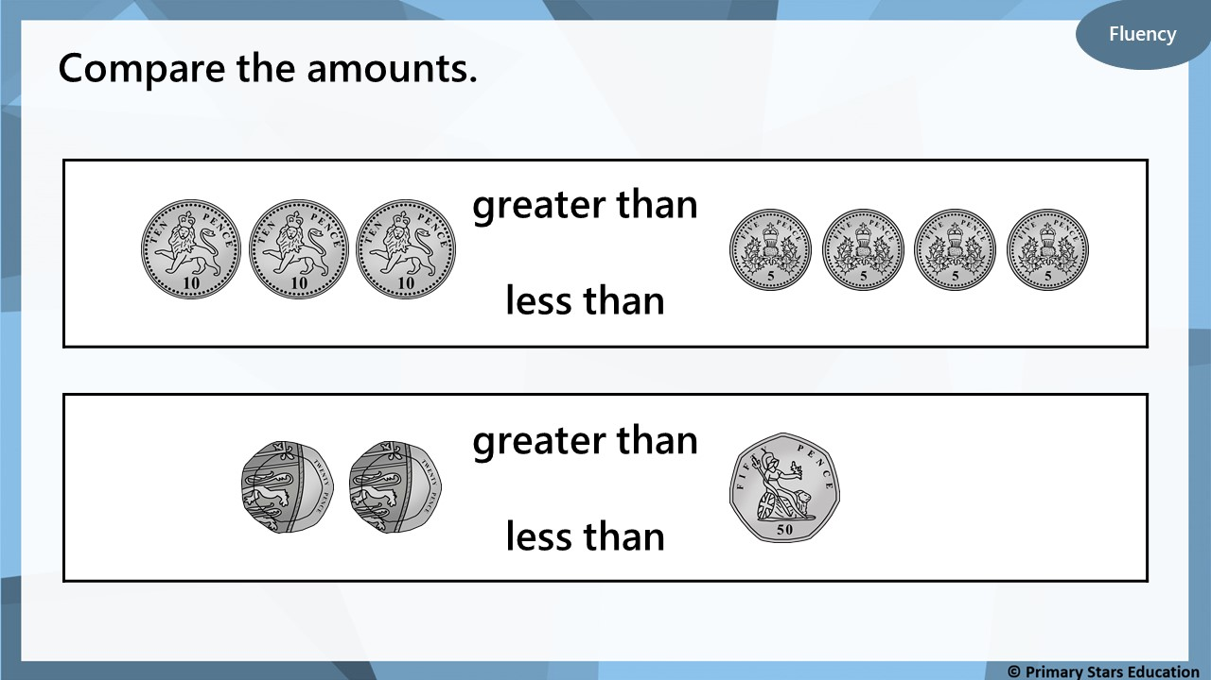

Slide 5
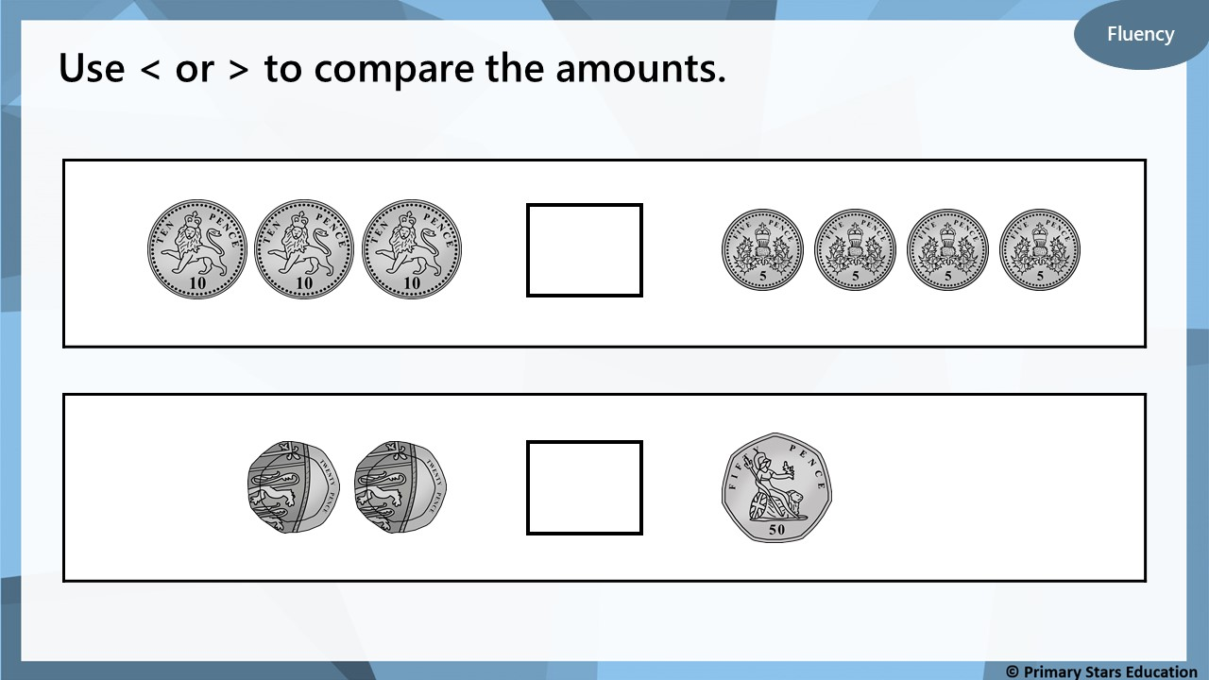
>
<

Slide 6
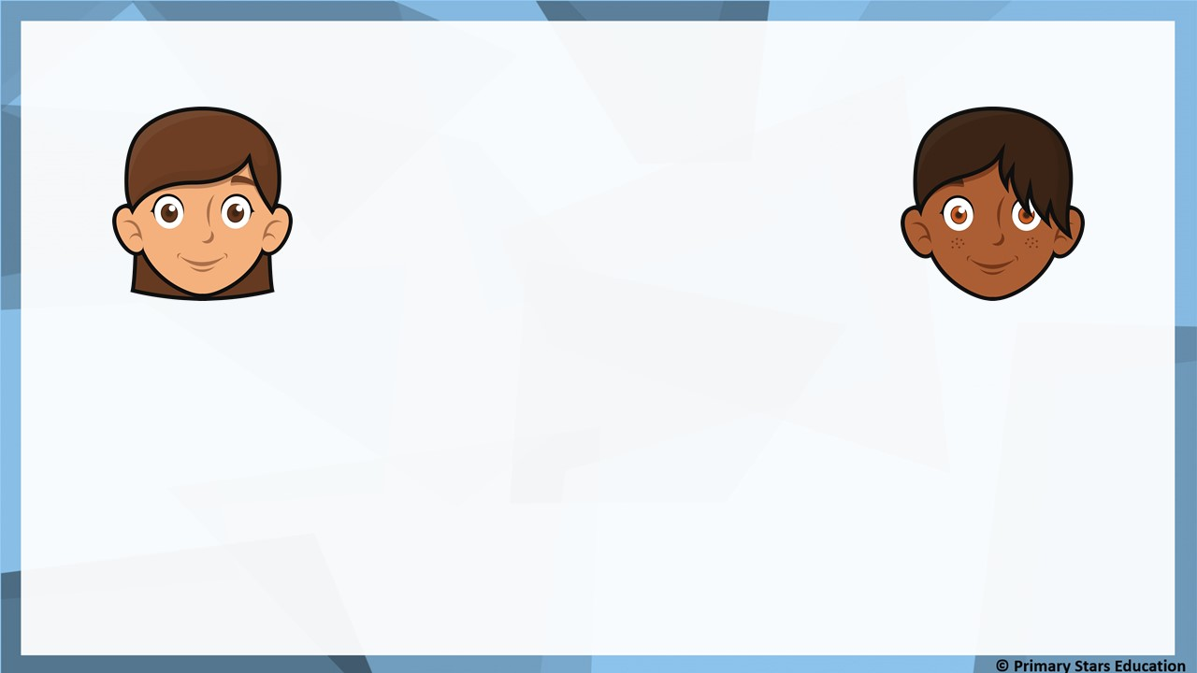
Reasoning
Who has the most and who has the least?
I have £10.
I have 10p.
Beth
Gina
How do you know?
Beth has the most and Gina has the least.
Beth’s amount is in pounds whereas Gina’s is in pence.
£10 is more than 10p.

Slide 7
Problem solving
Put coins in the boxes to show…
3 copper coins > 1 silver coin
>
How many different ways are there?

