Slide 1


Lesson 2
Step: Find the total

Slide 2
Fluency
Complete the table.
Pounds | Pence | Total
£1 | 10p | £________ and ________p
£2 | 35p | £________ and ________p
£________ | 75p | £2 and ________p
£________ | 50p | £3 and ________p
£4 | ________p | £________ and 5p
£5 | ________p | £________ and 60p
1
10
2
35
2
75
3
50
5
4
60
5

Slide 3


Fluency
Mo buys an apple and a banana.
30p
45p
0
75
How much does he spend? £________ and ________p

Slide 4


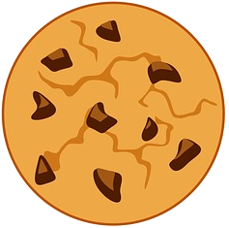
Fluency
Sue buys an doughnut, slice of cake and a cookie.
50p
80p
30p
1
60
How much does she spend? £________ and ________p

Slide 5
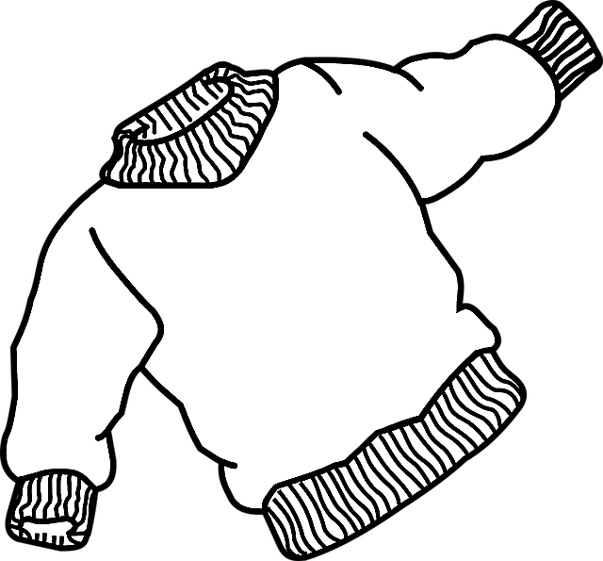

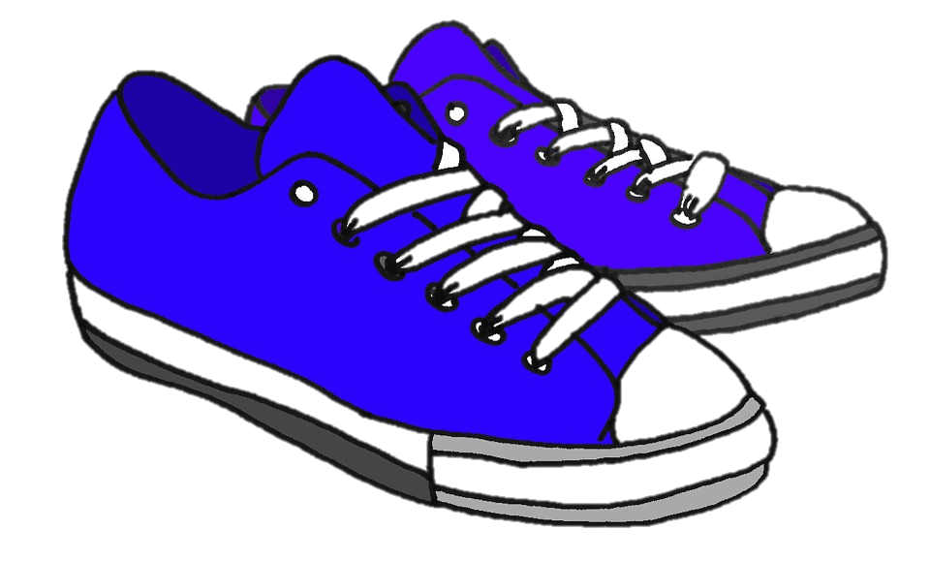
Fluency
Kat buys a shoes, a t-shirt and a jumper.
£10
£7
£5 and 75p
22
75
How much does she spend? £________ and ________p

Slide 6
Fluency
Complete the bar models.
10p | 5p | 5p
20p
£1 | £1 | 10p
£2 and 10p

Slide 7
Fluency
Complete the bar models.
£17
£2
£5
£10
£45
£15
£15
£15

Slide 8



Reasoning
What is the total of:
£1 and 50p
£1 and 25p
£2
a) Hat and the socks? £________ and ________p.
3
50
b) Gloves and the socks? £_______ and _______p.
2
75
c) The total of all the items is £5 and 75p. True or false?
False, the total of all the items is £4 and 75p.

Slide 9
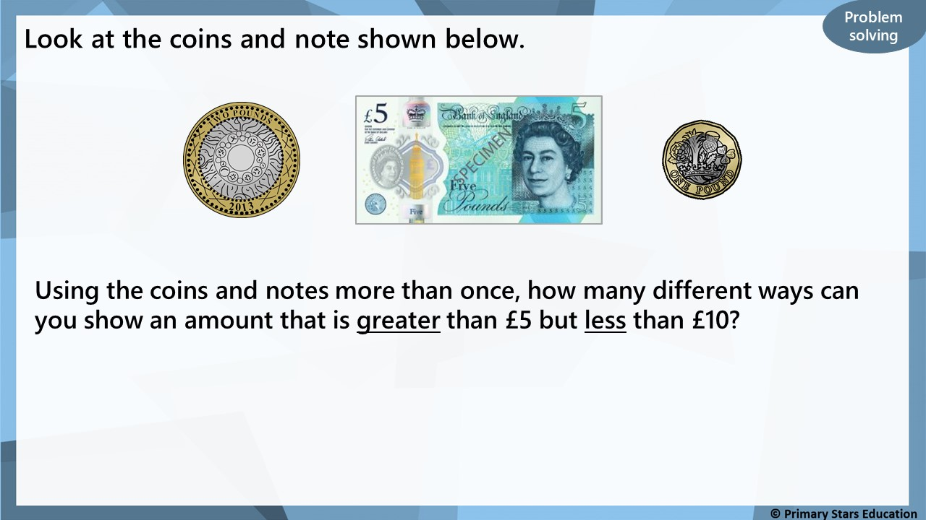
Any combinations of the above coins and note that amount to more than £5 but less than £10, for example:
£5, £2 = £7 OR £2, £2, £2 = £6 OR £1, £1, £1, £5 = £8

