Slide 1


Lesson 4
Step: Find change

Slide 2
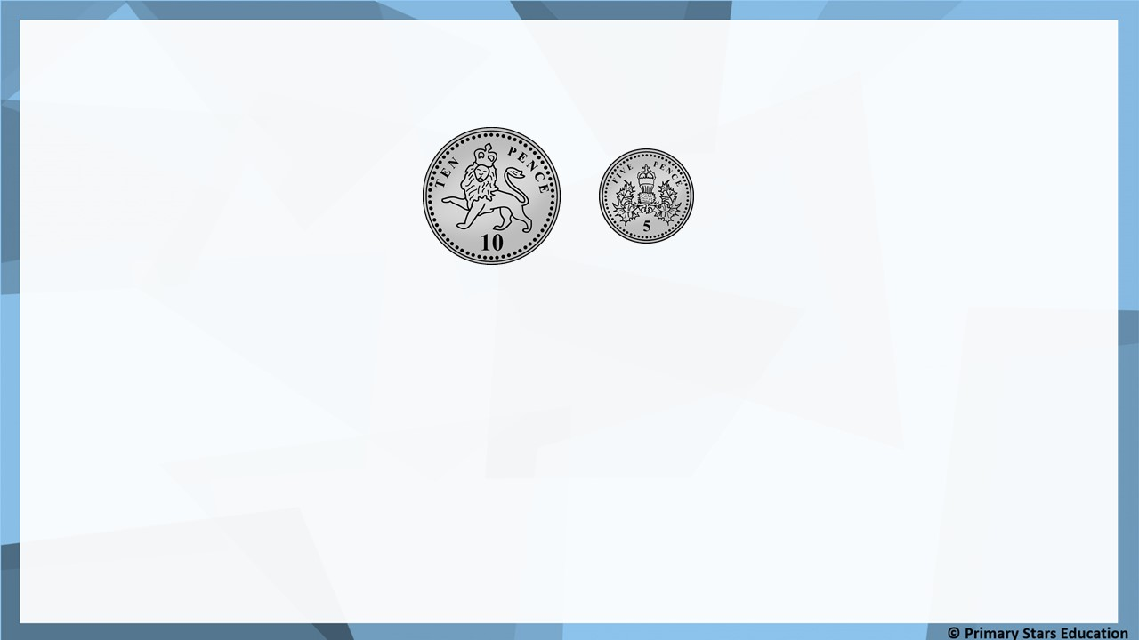
Fluency
Sue has these coins:
She spends 11p.
What money will she have left? _______
What coins could it be?
4p
2 x 2p OR 4 x 1p
or a combination of these coins.

Slide 3
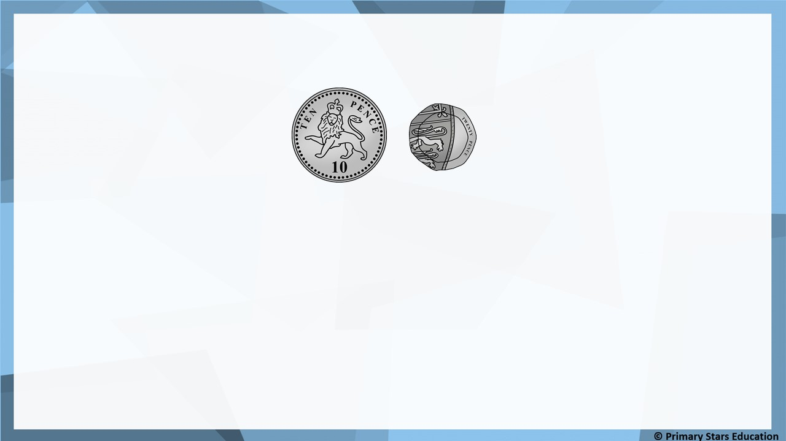
Fluency
Matt has these coins:
He spends 24p.
What money will he have left? _______
What coins could it be?
6p
5p, 1p OR 3 x 2p OR 6 x 1p
or a combination of these coins.

Slide 4
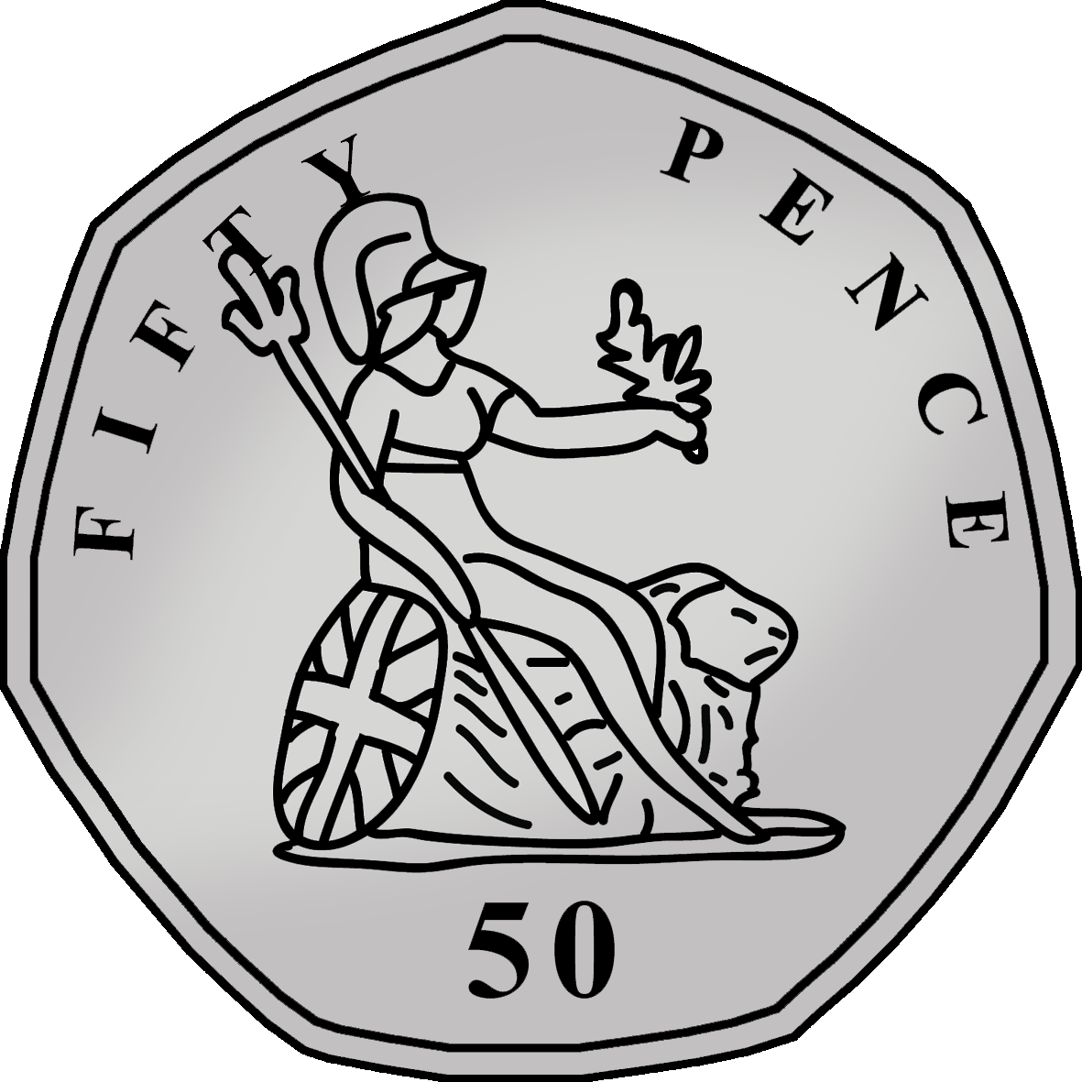
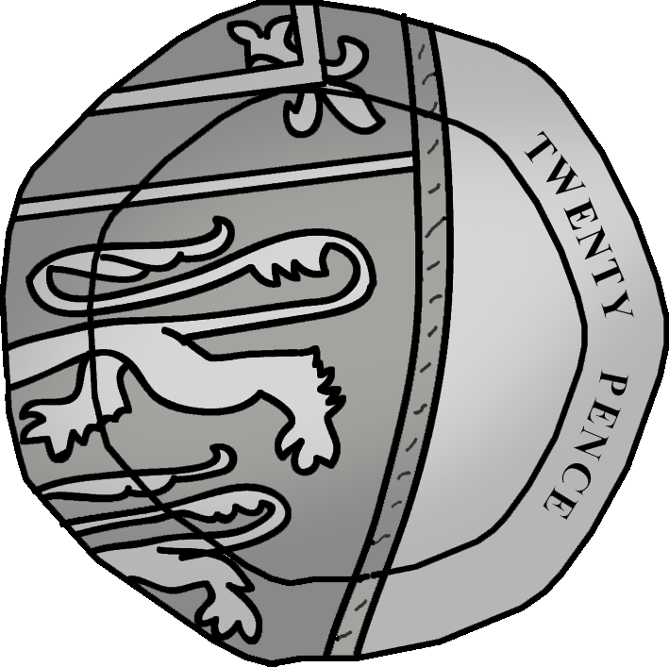
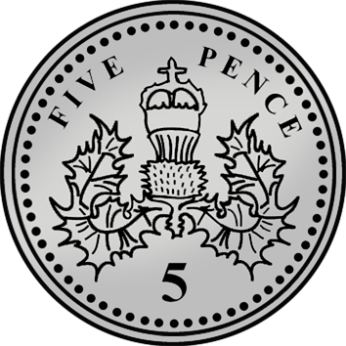
Fluency
Mo has these coins.
He spends 63p.
What money will he have left? _______
What coins could it be?
12p
10p, 2p OR 10p, 1p, 1p OR 2 x 5p, 2p OR 2 x 5p, 1p, 1p
OR 6 x 2p OR 12 x 1p or a combination of these coins.

Slide 5
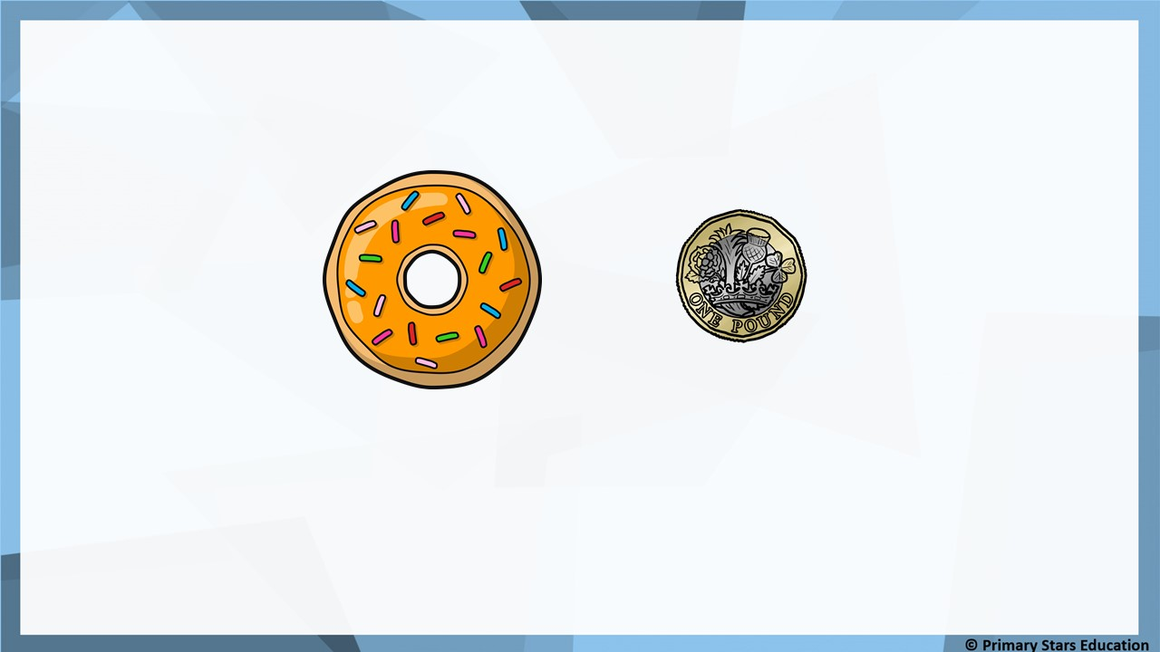
Fluency
Sue buys a doughnut using the coin shown.
Write the calculation to find the change.
59p
£1
59p
41p
_______ - _______ = _______

Slide 6


Fluency
Matt buys a slice of cake using the coin shown.
Write the calculation to find the change.
£1 and 30p
£2
£1 and 30p
70p
_______ - _____________ = _______

Slide 7
Fluency
1) Ben spends 7p in the shop.
He pays with a 10p coin.
How much change will he receive? ______________
3p
2) Jess spends 24p in the shop.
She pays with a 50p coin.
How much change will she receive? ______________
26p

Slide 8
Fluency
1) Mo spends 73p in the shop.
He pays with a £1 coin.
How much change will he receive? ______________
27p
2) Asha spends £1 and 45p in the shop.
She pays with a £2 coin.
How much change will she receive? ______________
55p

Slide 9

Reasoning
Dom says,
I spent 56p in the shop and paid with a £1 coin. I received 54p change.
Is Dom correct? Explain how you know.
No, Dom is not correct.
£1 – 56p = 44p change not 54p.

Slide 10
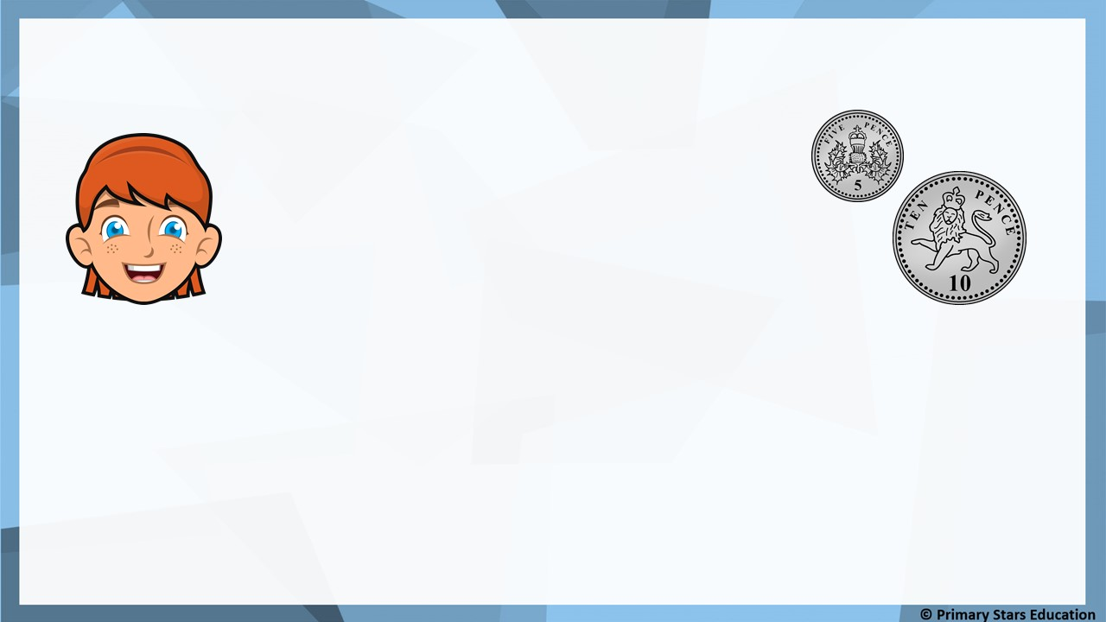
Problem solving
Sue says,
I paid for my shopping with one silver coin.
Here is my change.
What could Sue have paid with and how much would the item have been?
Sue could have paid with a 20p coin and the item would have cost 5p.
Sue could have paid with a 50p coin and the item would have cost 35p.

