Slide 1


Lesson 5
Step: Two-step problems

Slide 2
Problem solving
Gina has £2. She gets £1 more.
Complete the bar model and write a calculation to show her total.
£2 | £1
£3
£2
£1
£3
__________ + __________ = __________
She then spends 50p.
Complete the bar model and write a calculation to show what is left.
£3
50p
£3
50p
£2 and 50p
__________ - __________ = ______________
£2 and 50p

Slide 3
Problem solving
Kat has £4 and she gets £5 more.
Complete the bar model and write a calculation to show her total.
£4 | £5
£9
£4
£5
£9
__________ + __________ = __________
She then spends £6 .
Complete the bar model and write a calculation to show is left.
£9
£6
£9
£6
£3
__________ - __________ = ___________
£3

Slide 4
Problem solving
Mo has £25. He gets £20 more.
Complete the bar model and write a calculation to show his total.
£25 | £20
£45
£25
£20
£45
__________ + __________ = __________
He then spends £28.
Complete the bar model and write a calculation to show what is left.
£45
£28
£45
£28
£17
__________ - __________ = ___________
£17

Slide 5
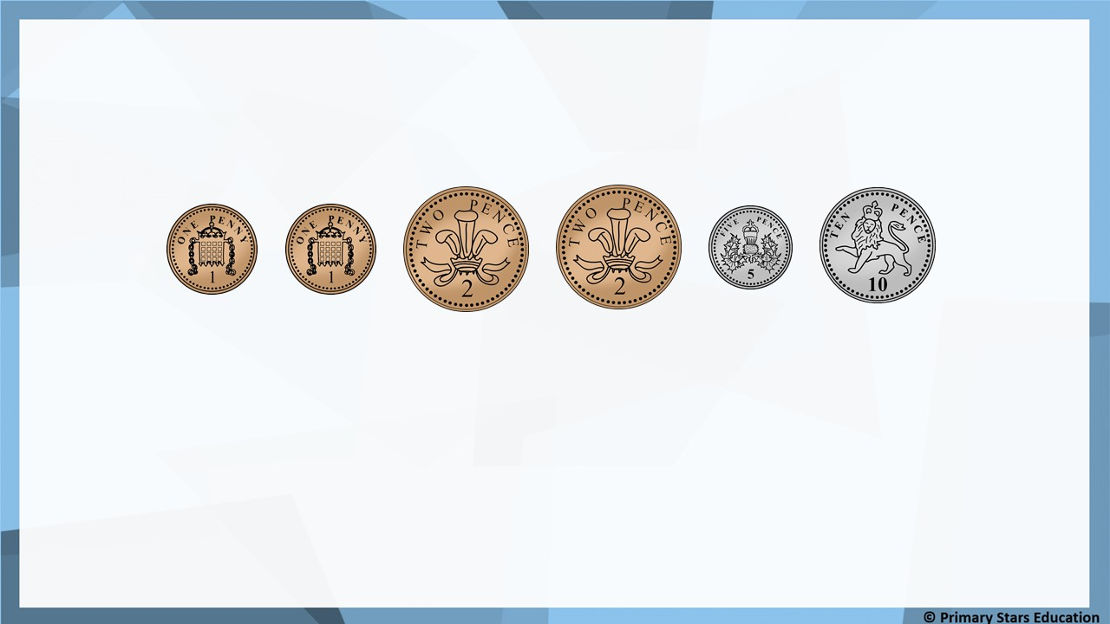
Problem solving
Che has these coins.
He spends 17p.
How much does he have left? _______
4p

Slide 6
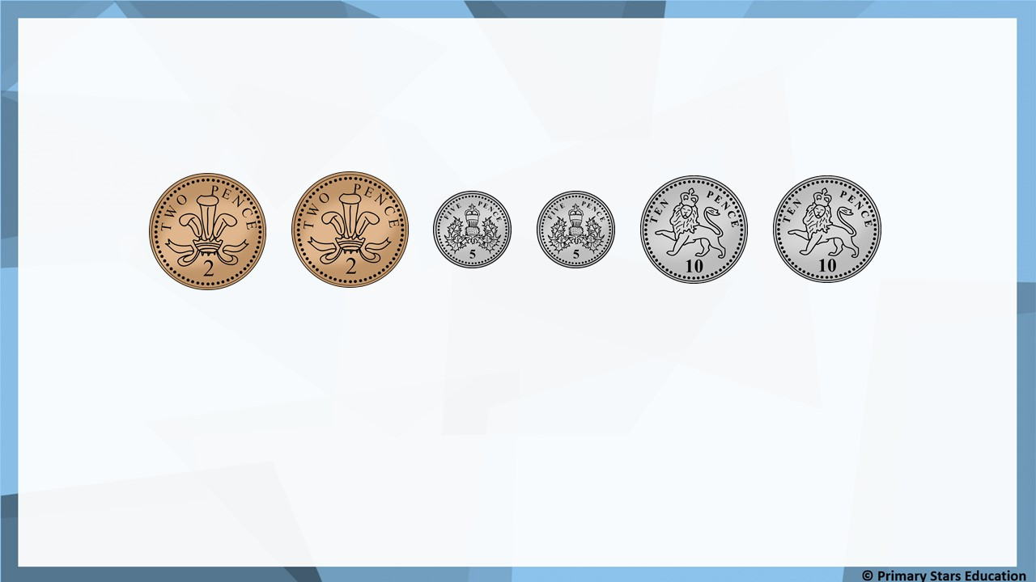
Problem solving
Matt has these coins.
He spends 25p.
How much does he have left? _______
9p

Slide 7
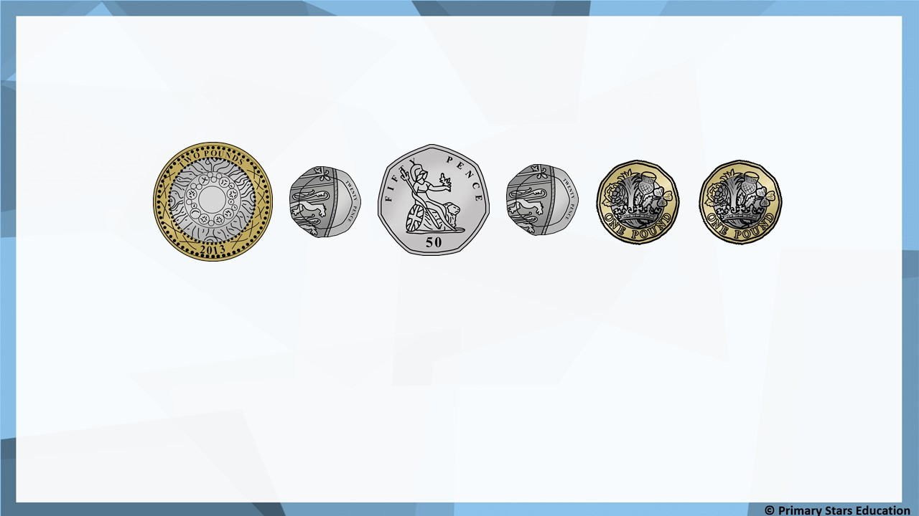
Problem solving
Gina has these coins.
She spends £3 and 90p.
How much does she have left? _______
£1

Slide 8
1) A scarf is £5 and a pair of gloves is £2 and 50p.
Ben buys one of each and pays with a £10 note.
How much change will he receive?_________________
Problem solving
£2 and 50p
2) A skirt is £17 and a jumper is £12.
Kat buys one of each and pays with a £50 note.
How much change will she receive?_________________
£21

Slide 9
1) A meal is £7 and 50p and a dessert is £4 and 50p.
Asha buys both and pays with a £20 note.
How much change will she receive?_________________
Problem solving
£8
2) A pair of jeans cost £23 and a shirt costs £15.
Jack buys both and pays with a £50 note.
How much change will he receive?_________________
£12

