Slide 1

L.O: To develop pleasure in reading and understanding poetry.

Slide 2
Listen to the poem carefully ready to complete the comprehension task.

Slide 3

I read a book this morning
With photos of the past;
Of memories when I was young,
And sounds that always last.

Slide 4
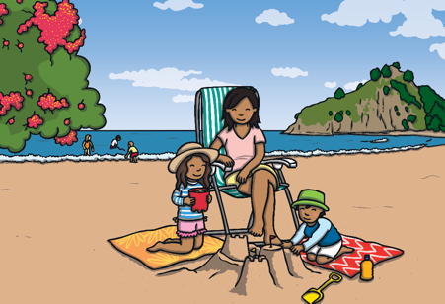

The pictures were of holidays,
The pictures were of me,
But the ones that I remembered best
Were right beside the sea.

Slide 5
The crying of the seagulls,
The laughter in the air,
The hum of all the people,
And the music of the fair.

Slide 6

The slurp of drippy ice cream,
The fizz of cola pop,
Applying sun cream to my back,
Slippy, slappy, slop.

Slide 7

The whooshing of the pebbles,
The crashing of the waves,
The gurgling and rushing
Of the water in the caves.

Slide 8


The sound of my legs splashing,
Swimming in the sea,
Dad is paddling to my left
And Mum is here with me.

Slide 9
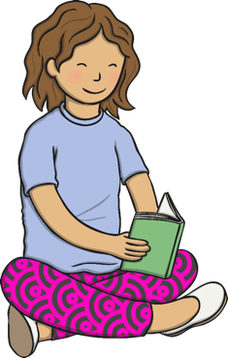
I read a book this morning,
The sounds, they always last.
It keeps them there, fresh like new,
Memories of my past.

Slide 10
What sound words did you hear?
The crying of the seagulls,
The laughter in the air,
The hum of all the people,
And the music of the fair.

Slide 11
Task – 1 Star

Slide 12
Task – 2 Star

