Slide 1

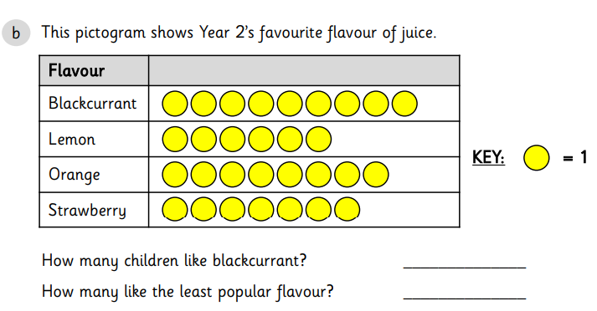

LO: To interpret and understand pictograms

Slide 2
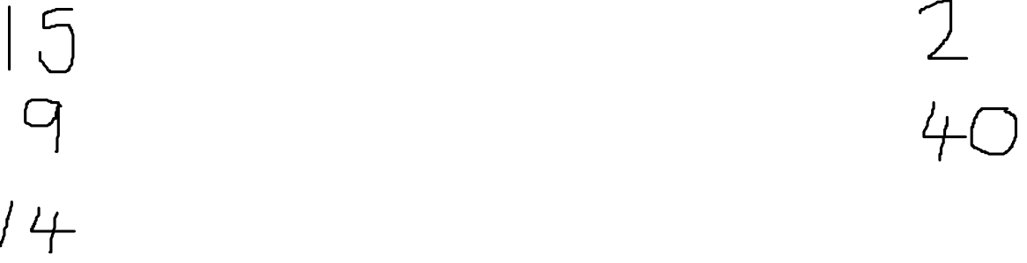
Fluency
Hair colour
Black
Brown
Blonde
Ginger
KEY: = 1
How many black? _______ How many ginger? _______
How many brown? _______ How many altogether? _______
How many blonde? _______

Slide 3
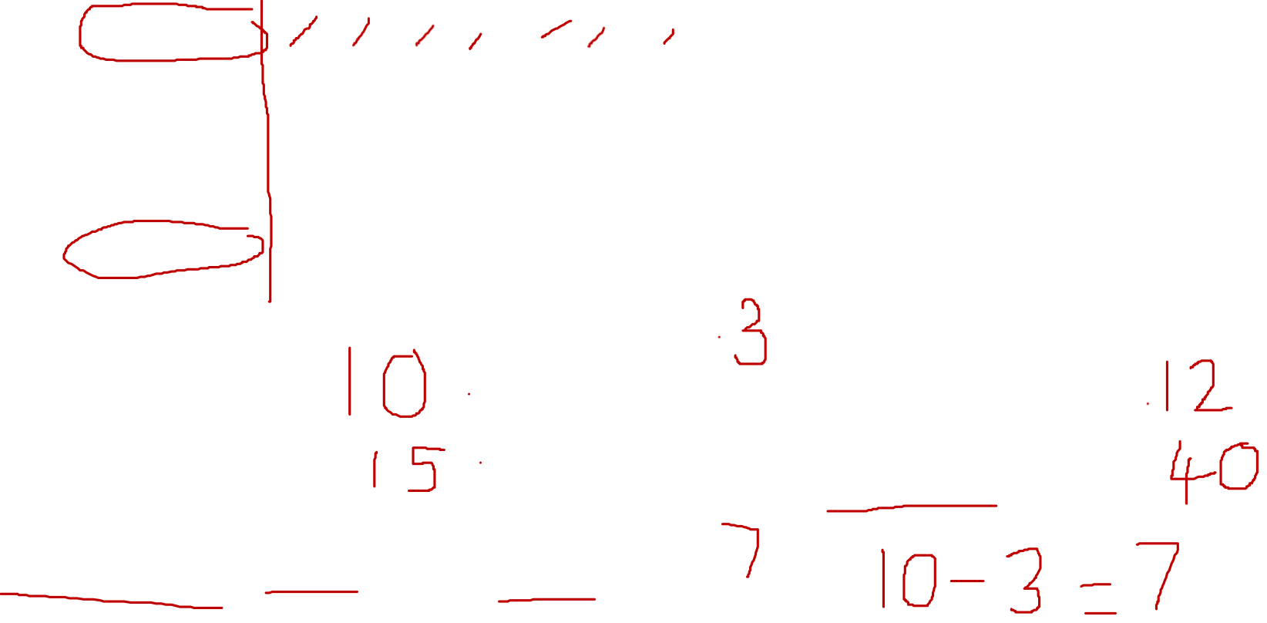
Fluency
Fruit
Apple
Banana
Orange
Grapes
KEY: = 1
How many apples? _______ How many oranges? _______
How many bananas? _______ How many altogether? _______
How many more apples than grapes? _______

Slide 4
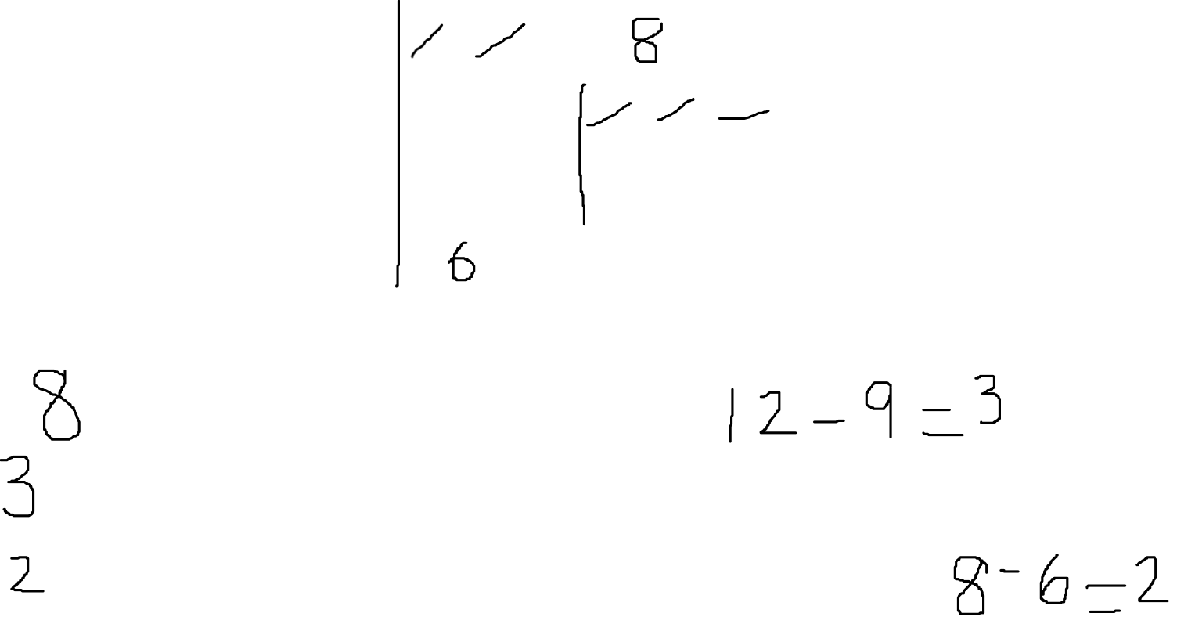
Fluency
Ice-cream
Vanilla
Chocolate
Strawberry
Mint
KEY: = _____
There are _______ people who like vanilla.
There are _______ more people who prefer chocolate to strawberry.
There are _______ less people who prefer mint to vanilla.

Slide 5
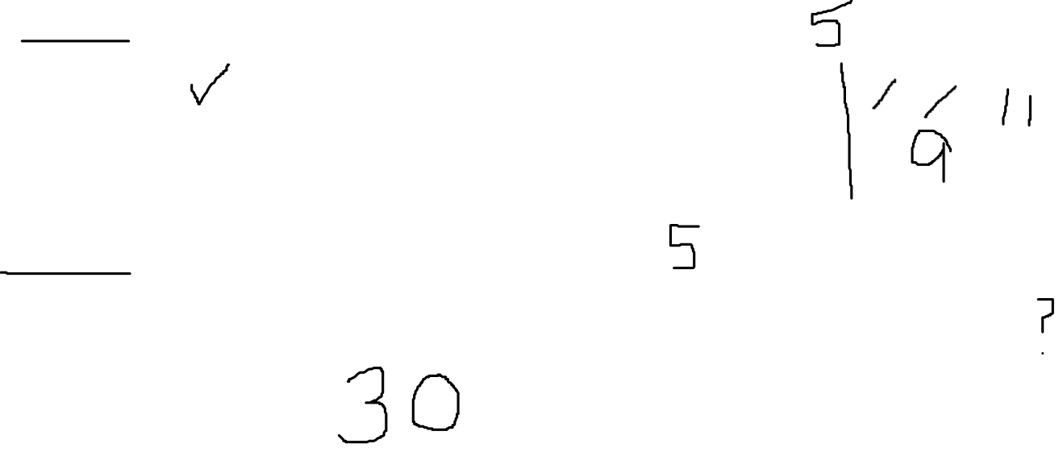
What does this pictogram show?
Mini-beasts
Worm
Ladybird
Centipede
Spider
KEY: = 1
Can you think of anything else it shows?

Slide 6
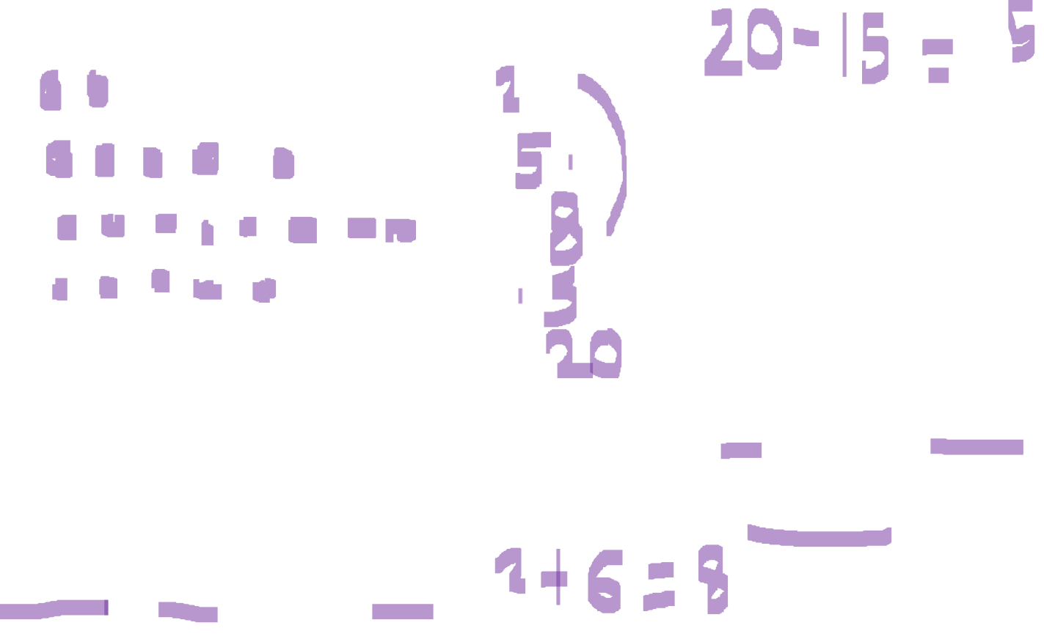
Problem solving
Complete the pictogram using the clues.
Trees
Oak
Ash
Birch
Fir
KEY: = 1
There are 5 ash. 4. There are 20 trees in total.
2. There are 2 oak. 5. How many fir trees? _______
3. There are 6 more birch than oak.

Slide 7
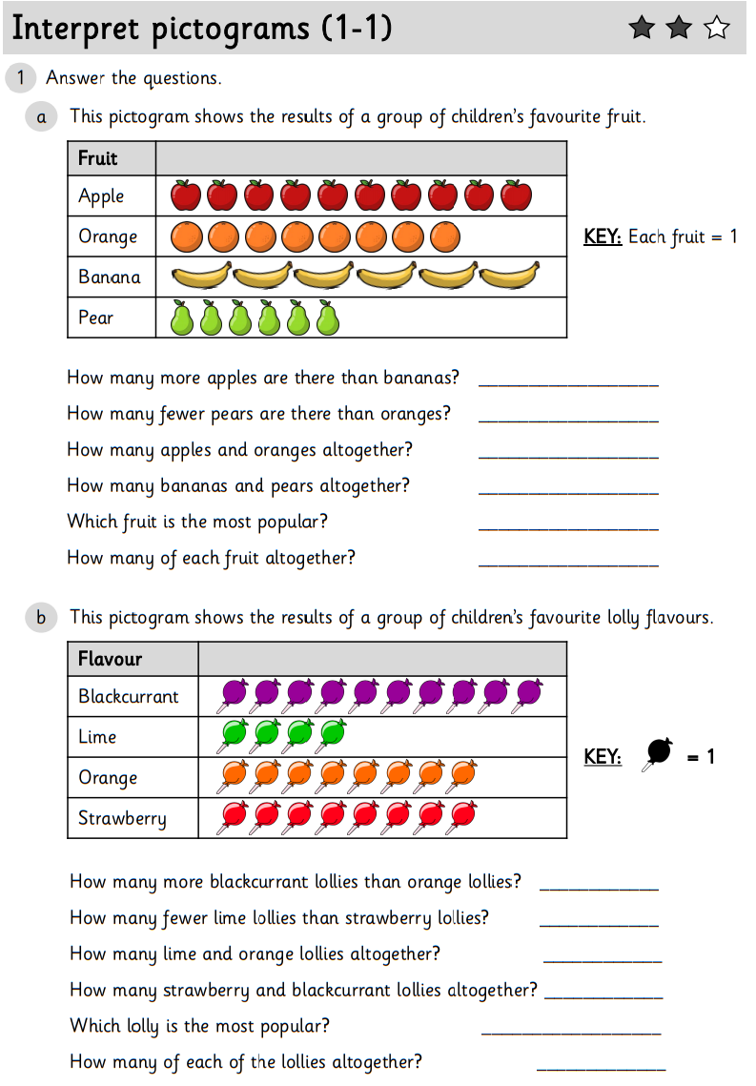
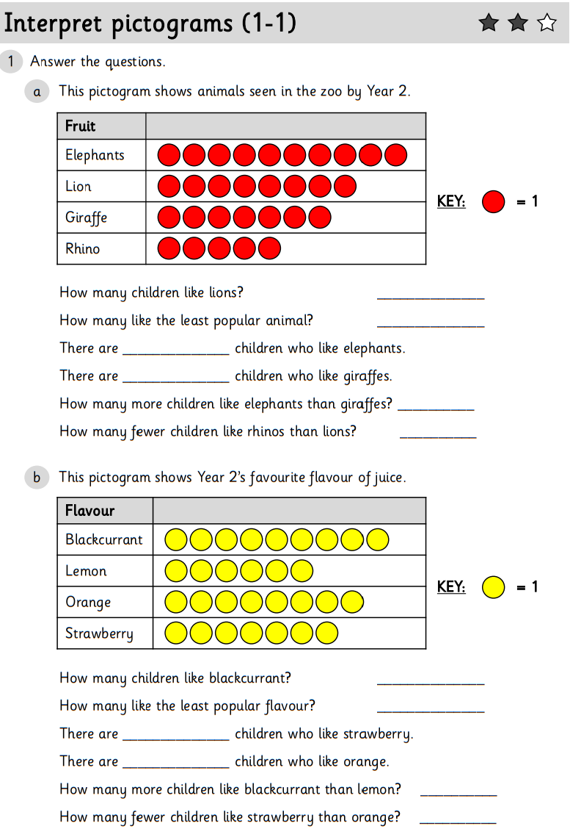
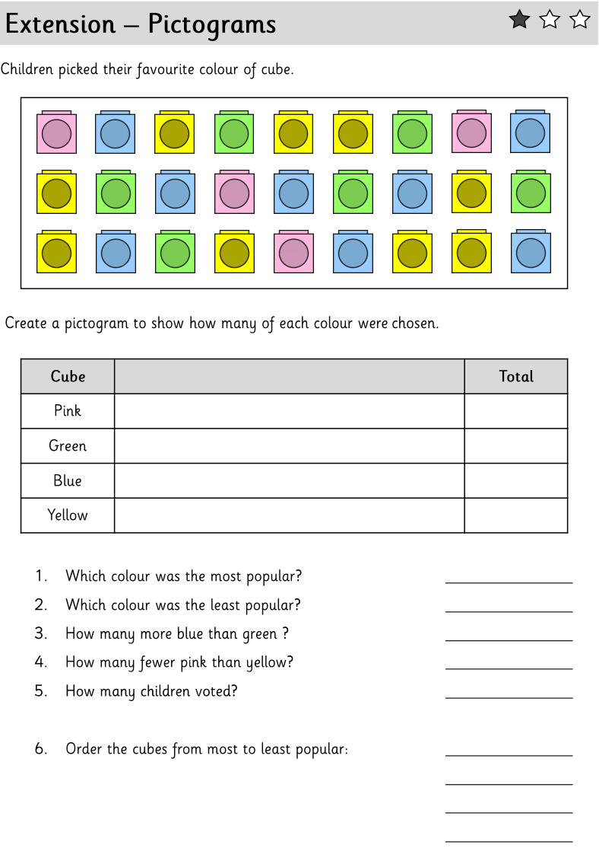
Now complete two 1, 2 or 3 Star worksheets. There is also an extra challenge in the folder.

