Slide 1


Slide 2
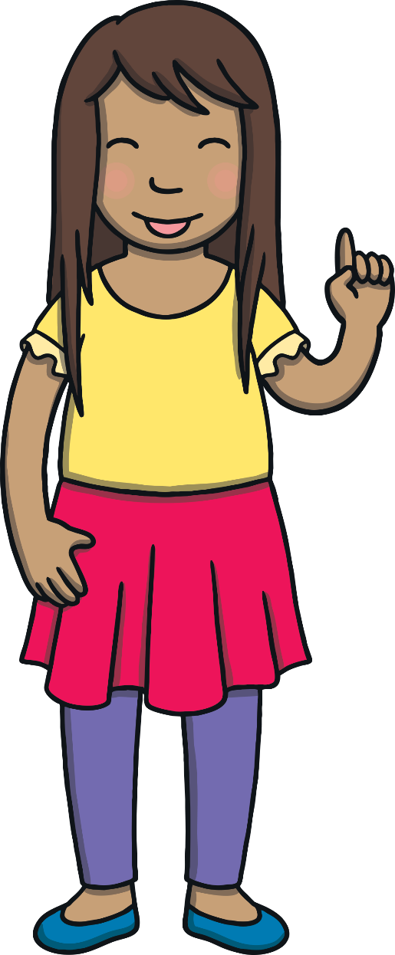
Revisit and Review
Let’s practise reading all of this week’s focus words.
nicest
sparkly
bravest
noisy
finest
slimy
largest
money
shiny
parents

Slide 3
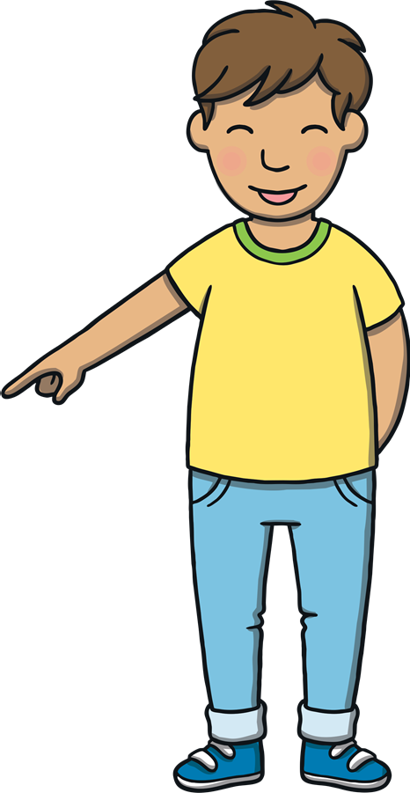

Teach
Now, let’s write them down.

Slide 4
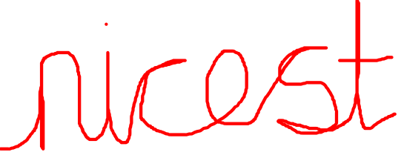
Teach
n
i
c
e
s
t

Slide 5
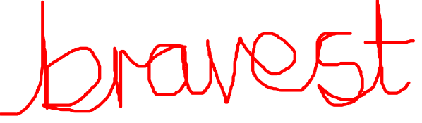
Teach
b
r
a
v
e
s
t

Slide 6
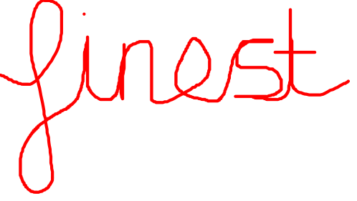
Teach
f
i
n
e
s
t

Slide 7
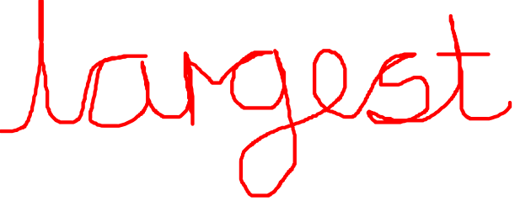
Teach
l
a
r
g
e
s
t

Slide 8
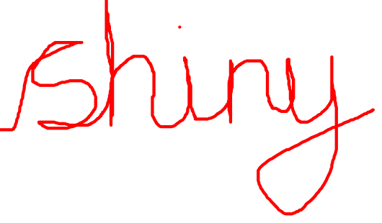
Teach
s
h
i
n
y

Slide 9
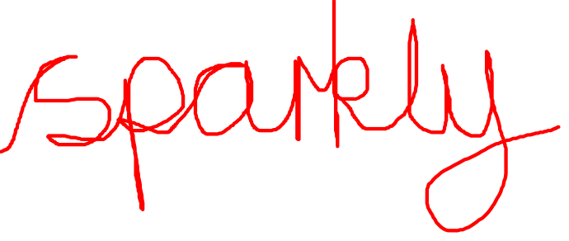
Teach
s
p
a
r
k
l
y

Slide 10
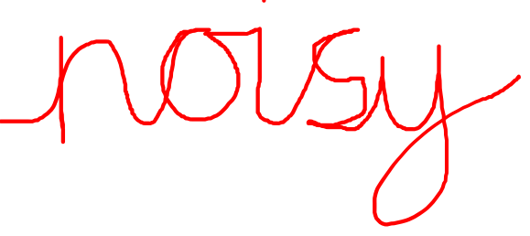
Teach
n
o
i
s
y

Slide 11
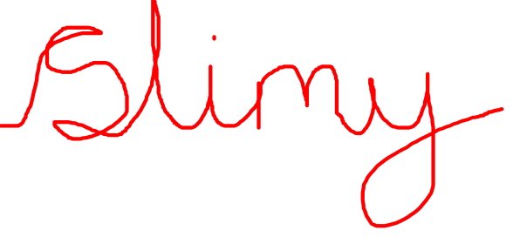
Teach
s
l
i
m
y

Slide 12
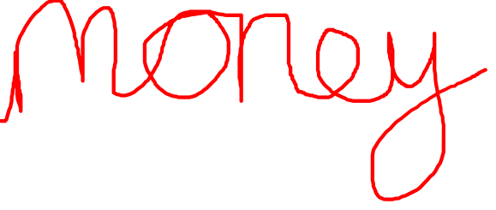
Teach
m
o
n
e
y

Slide 13
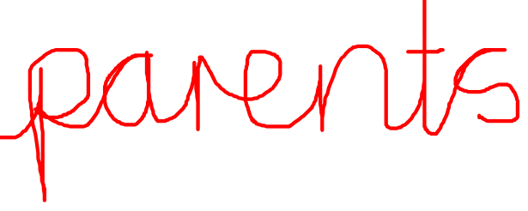
Teach
p
a
r
e
n
t
s

Slide 14
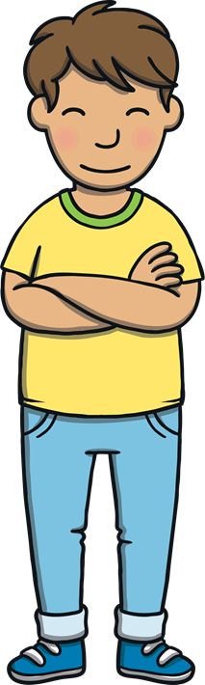
Teach
Today, we are learning to write sentences that contain
words with suffixes –est and –y added to words ending in ‘e’ with a consonant before it.

Slide 15
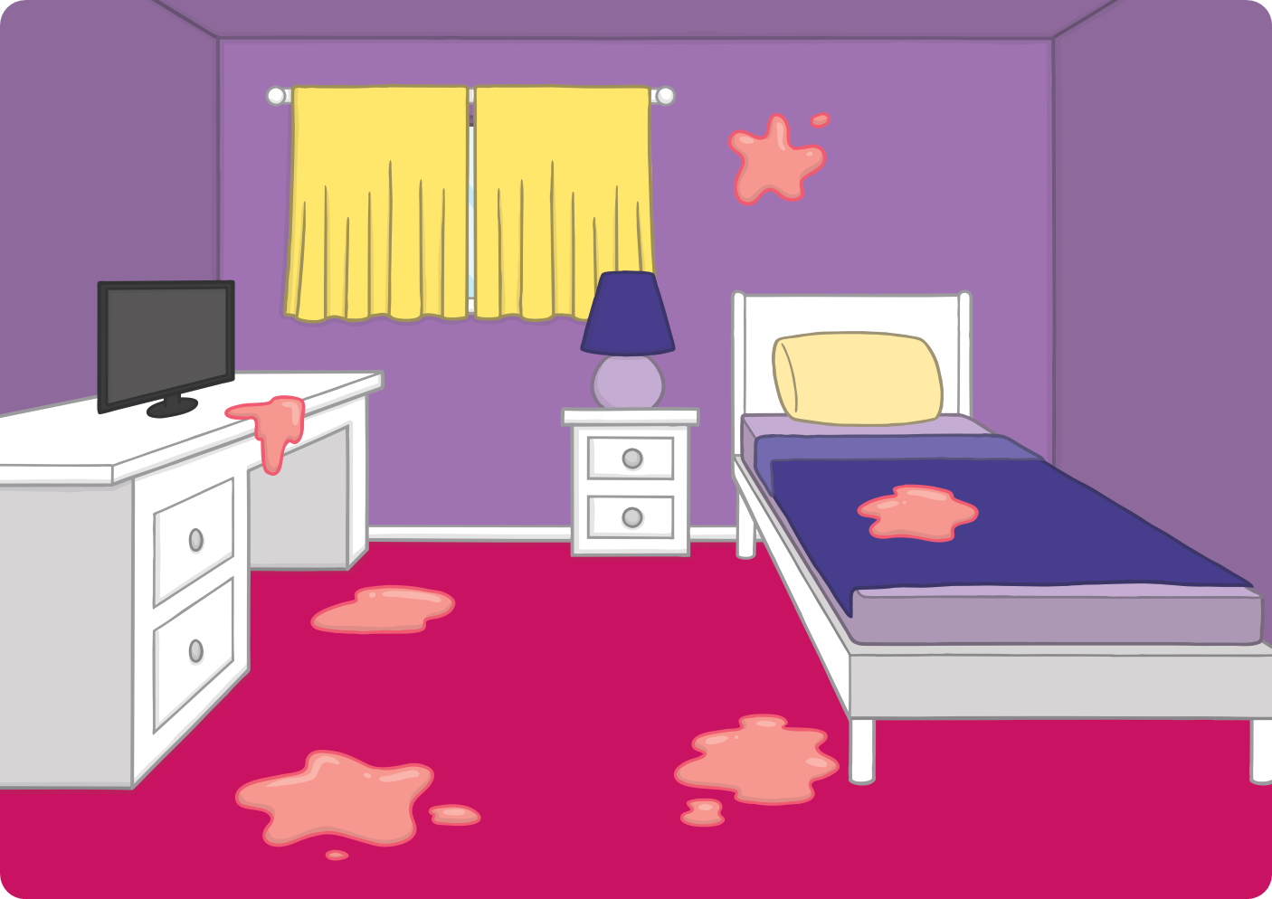
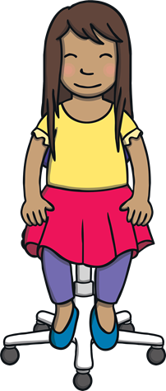
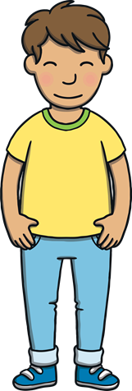
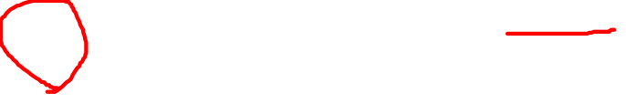
Teach
The familiar sight of Sam’s bedroom came back into view. “What an amazing adventure that was!” said Sam as she flopped on to her chair. “It was so lovely to see Jay again.”

Slide 16


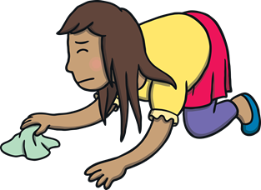
?
?
Teach
X
Why did Kit and Sam hurry to finish tidying up?
Mum was still downstairs tidying up. “Have you both finished up there?” she called.
“Oops!” said Kit and Sam. They hurried to finish tidying their rooms.
“Almost,” they called.

Slide 17
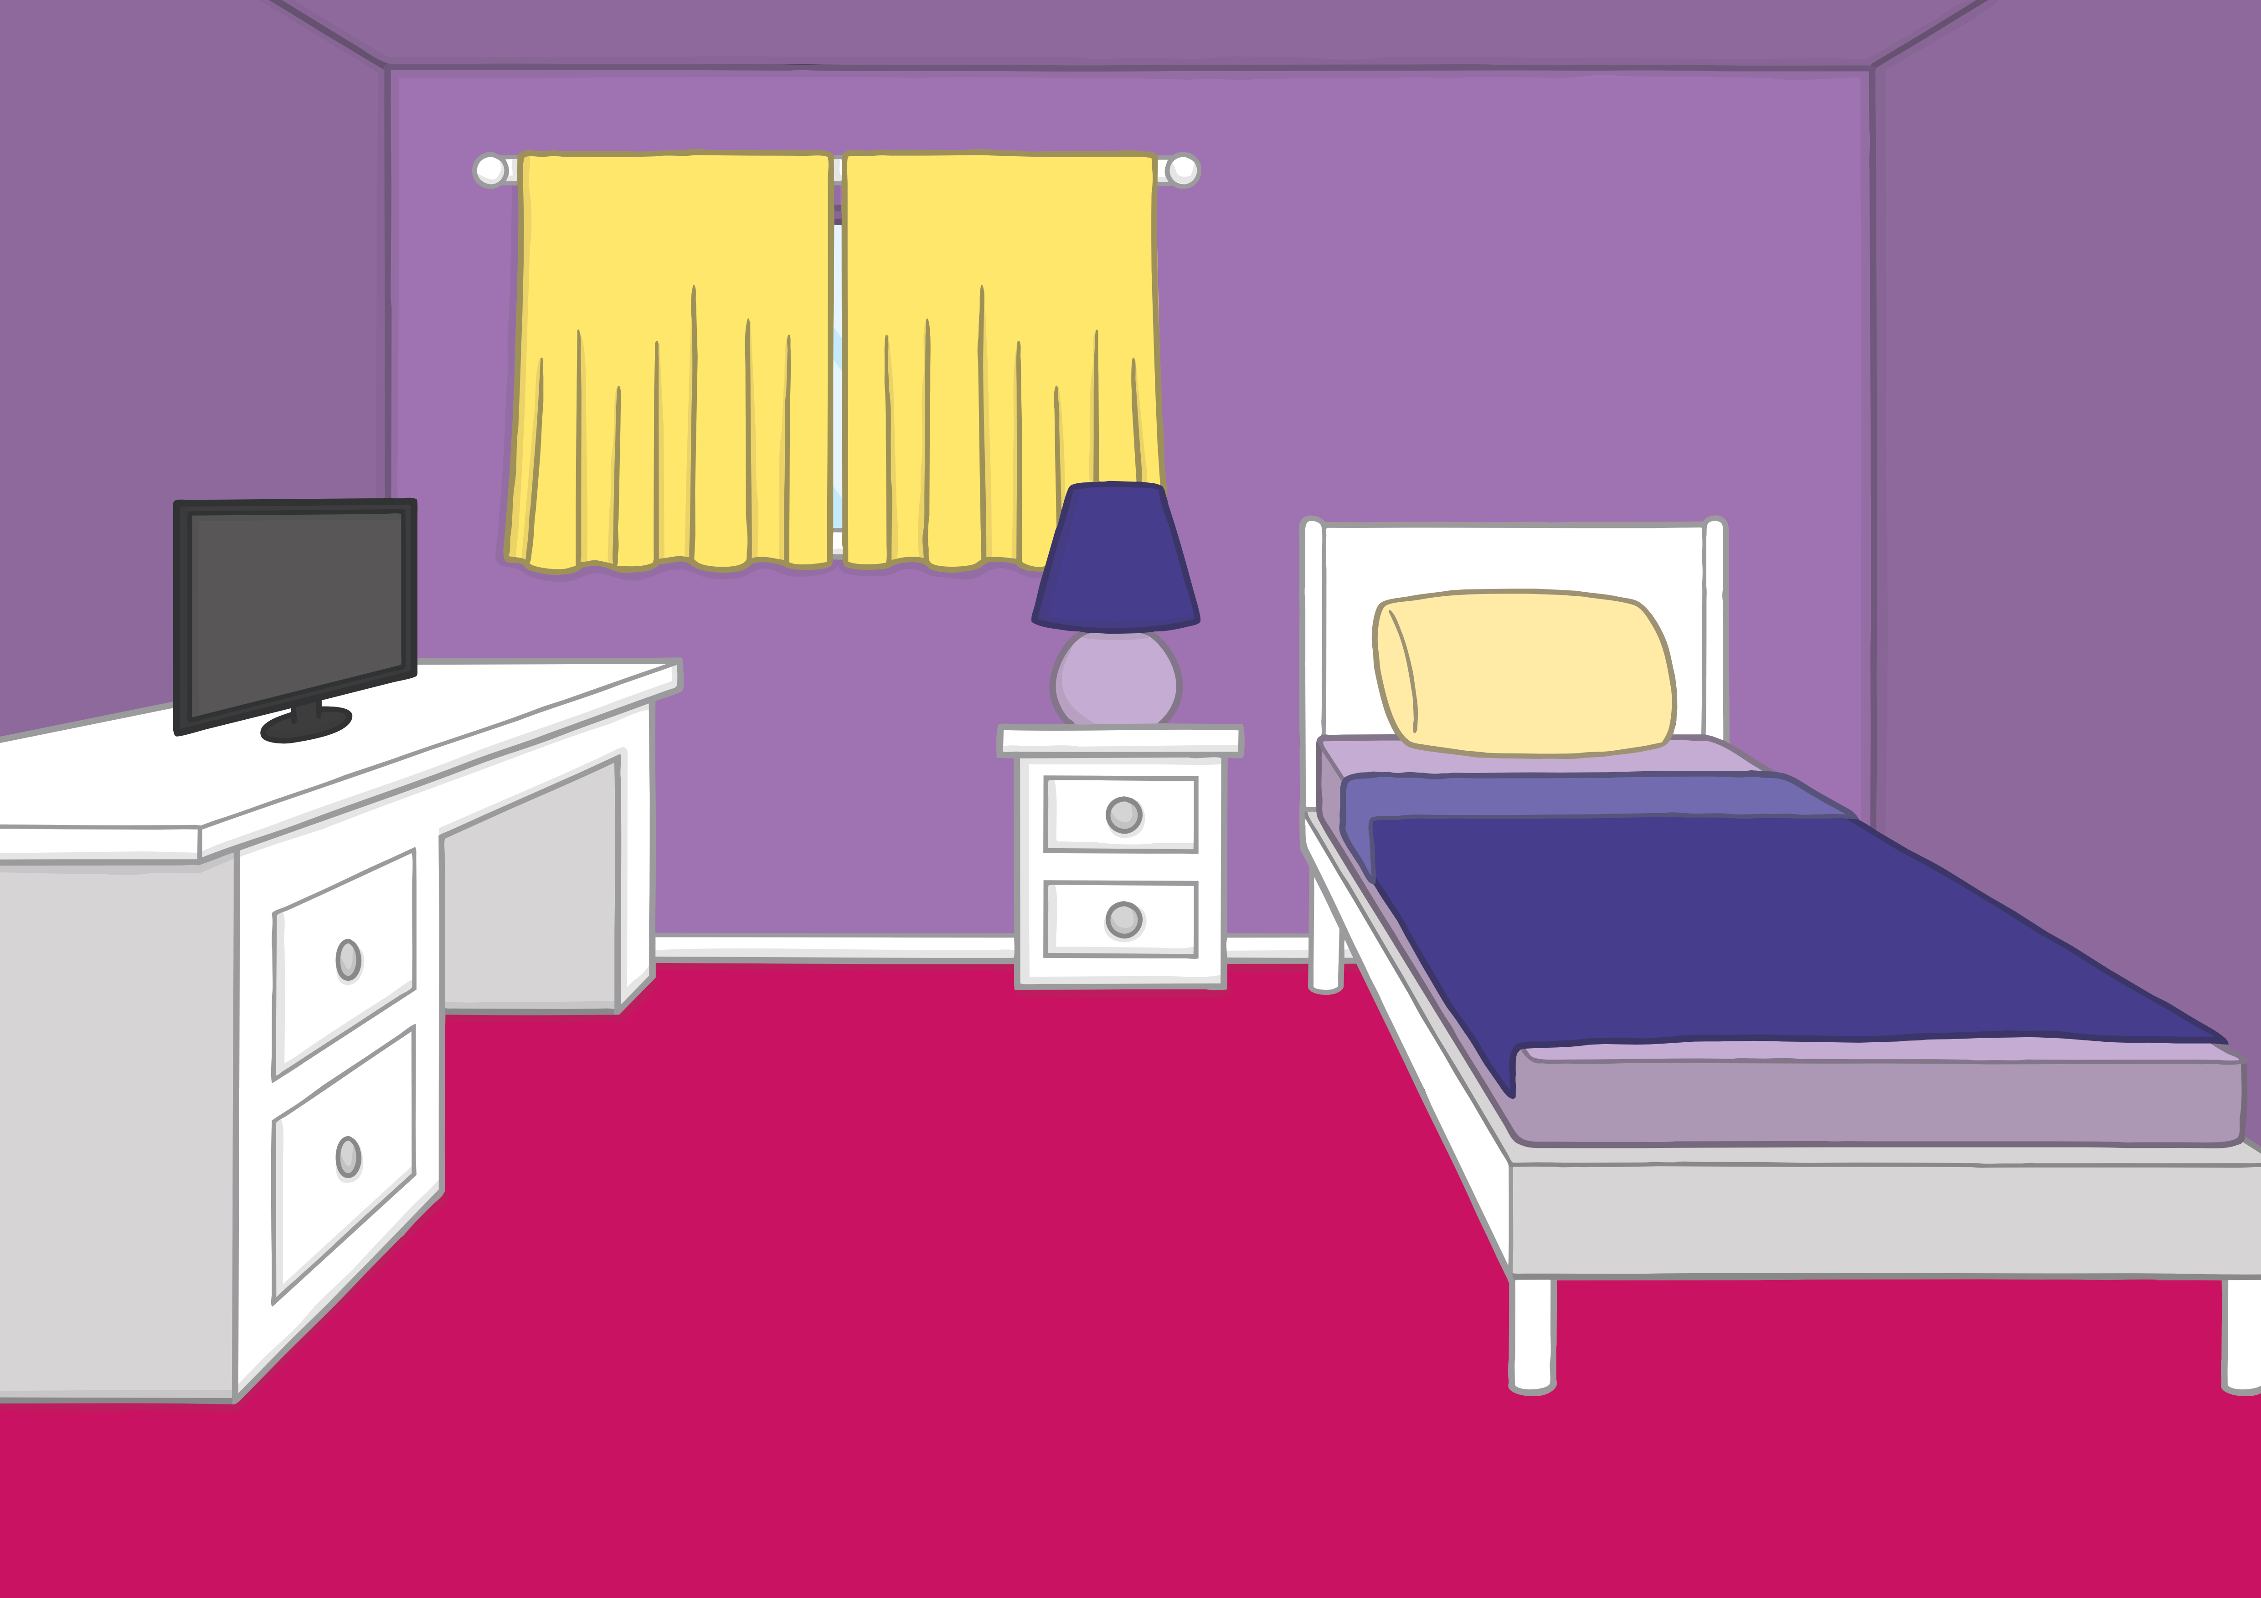

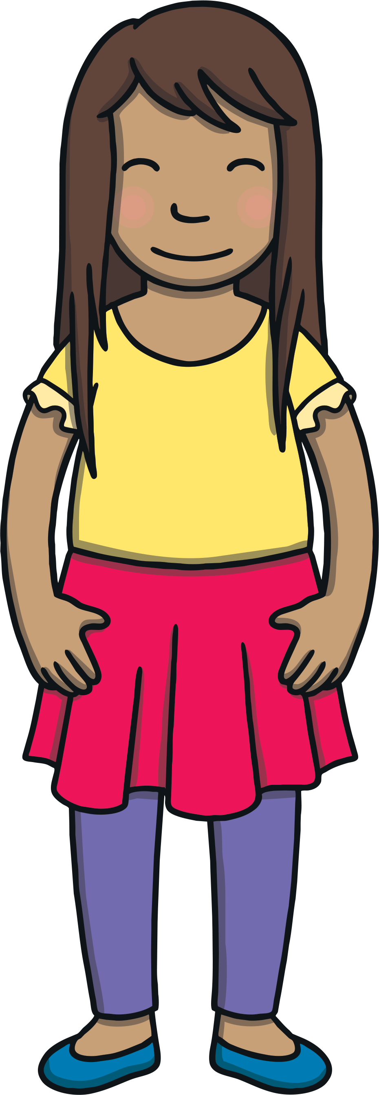
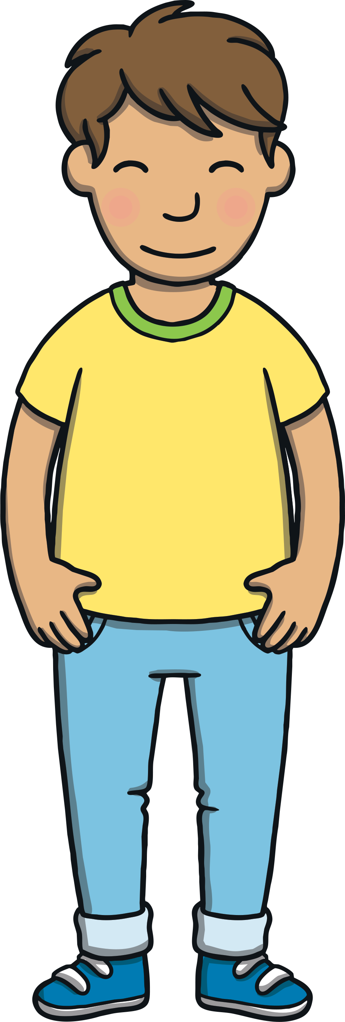
Teach
They tidied until their rooms were shiny and clean. Mum came to check. “Well done. It looks lovely up here,” she said, “but what’s this shiny, slimy stuff on the floor?” The slime had come from Jay’s planet on their shoes! Kit and Sam shrugged and rushed to clean it up.

Slide 18
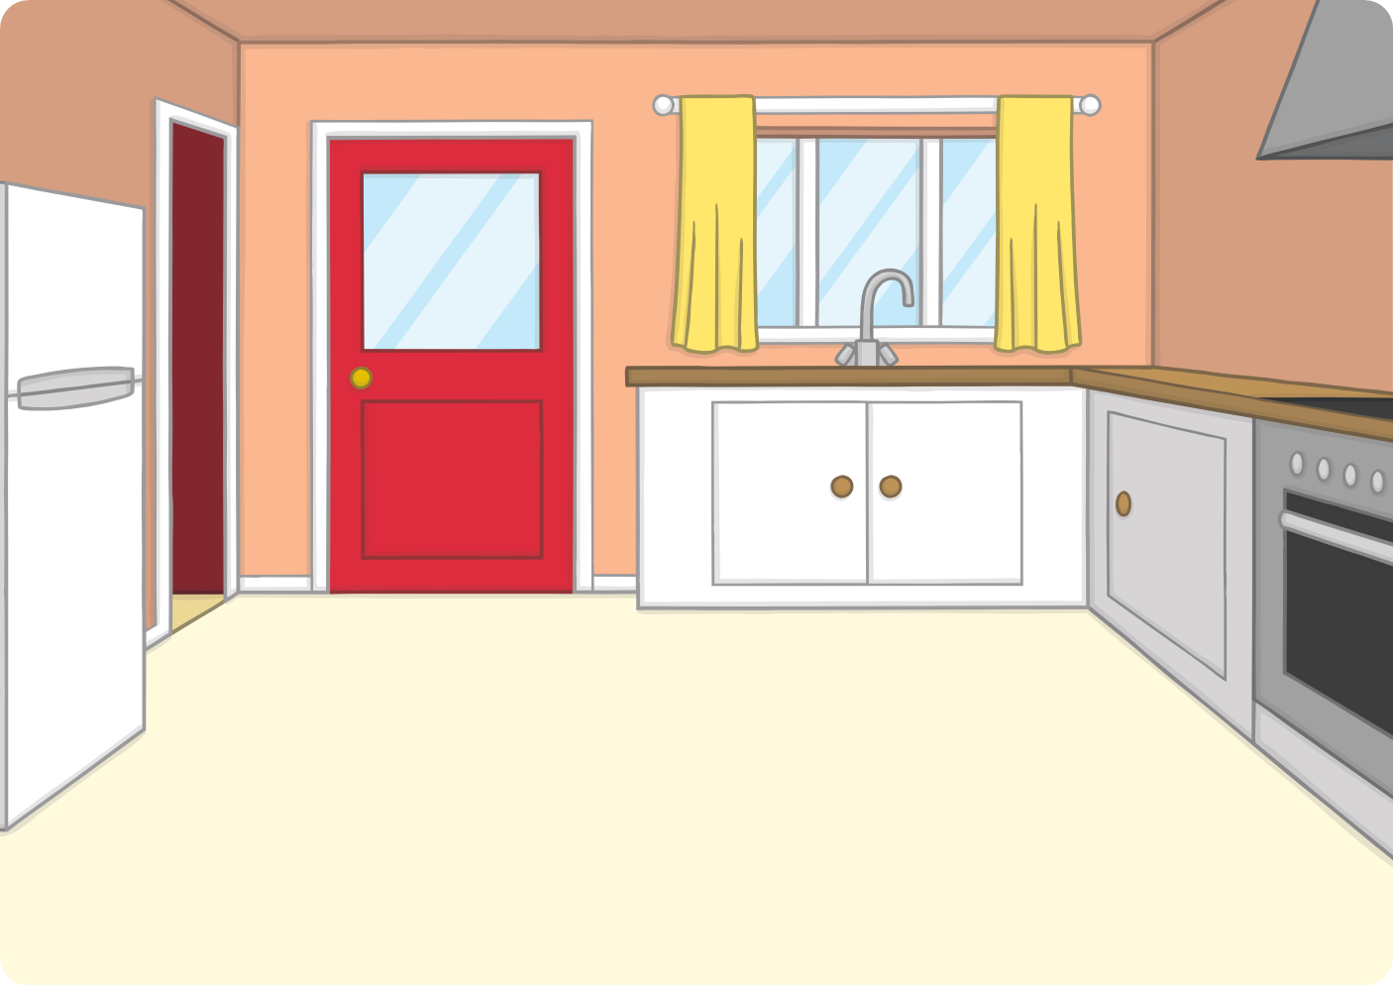
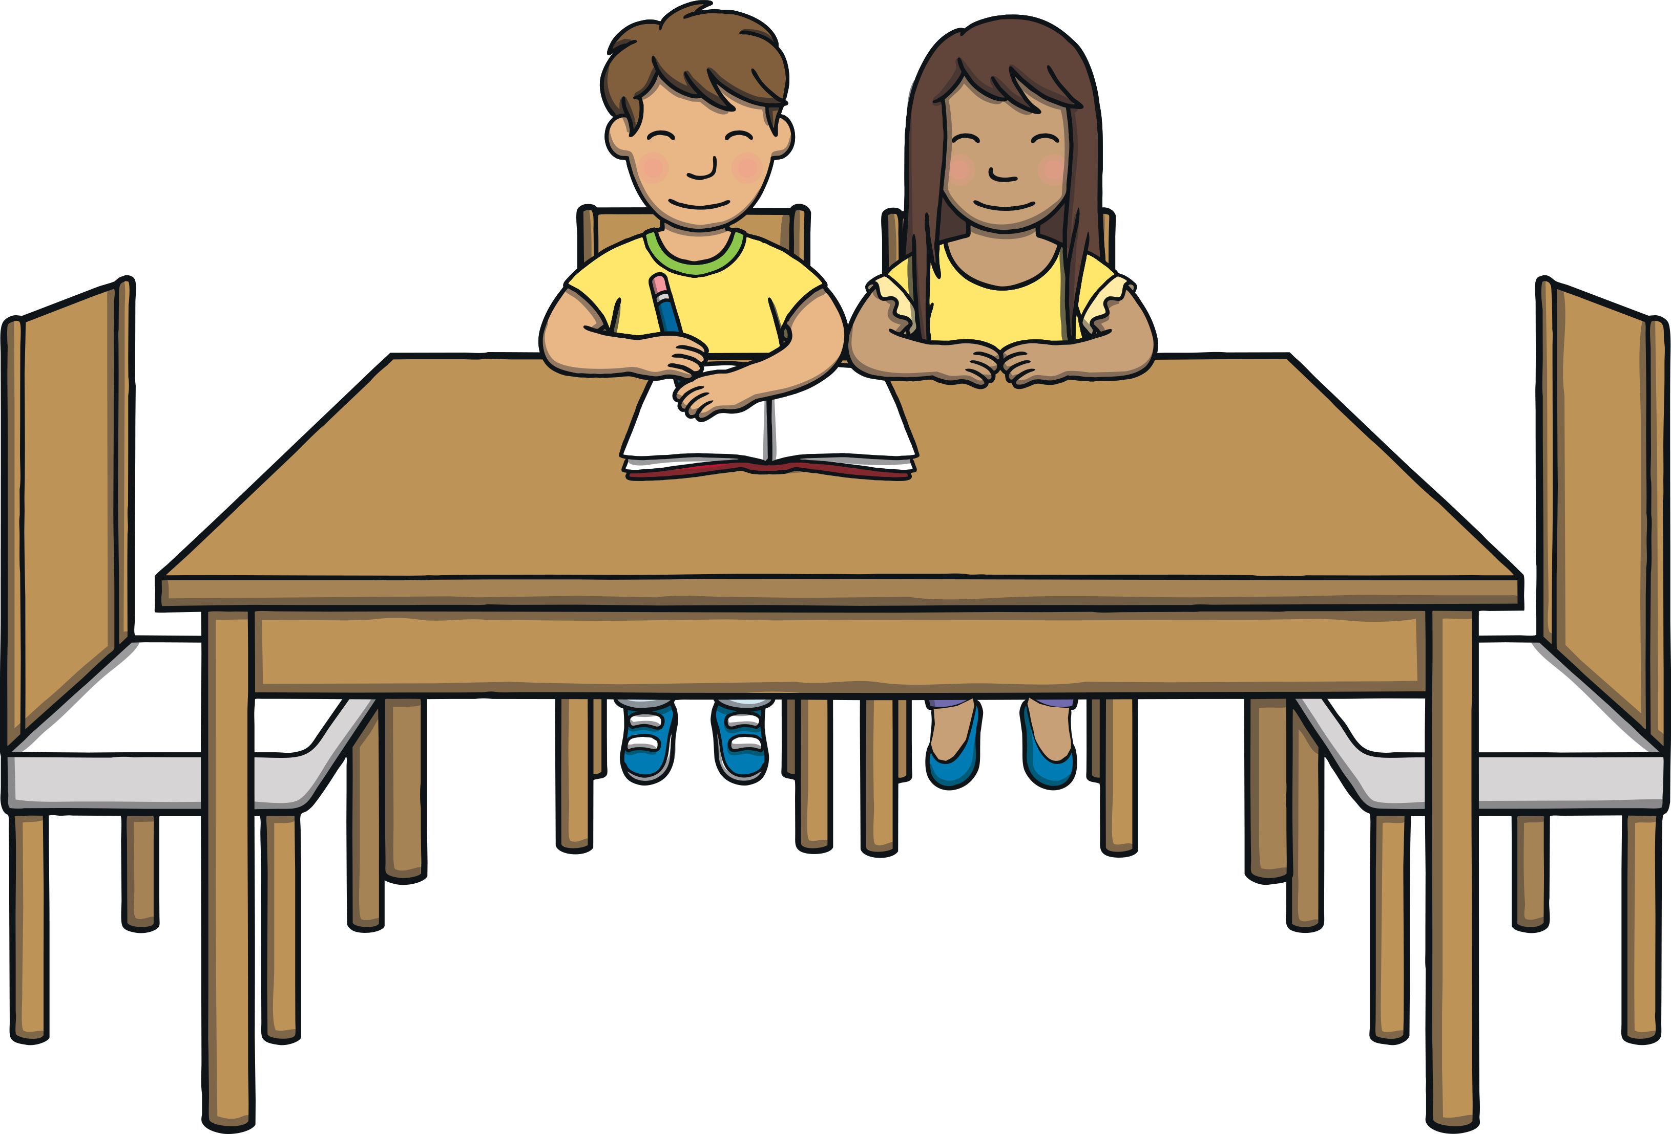
Apply
After they had cleaned up the slime, Kit and Sam decided to write a book about their adventure to Jay’s planet. “What a slimy adventure it turned out to be!” exclaimed Sam.

Slide 19
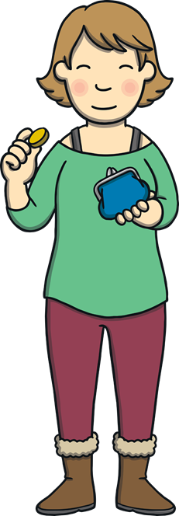
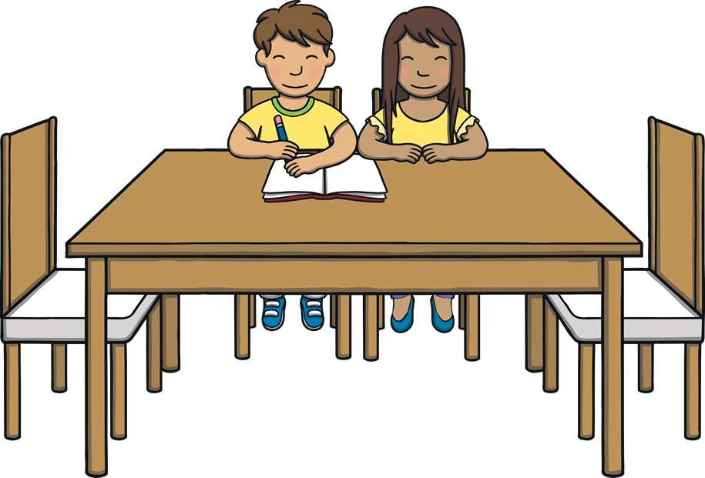
Apply
“Thank you for tidying up, you two. Here’s your pocket money,” said Mum, as she handed Kit and Sam some shiny coins.
“Thanks, Mum,” said Kit. “I know what I’m going to spend it on – the next ‘Jay the Alien’ book!”

Slide 20
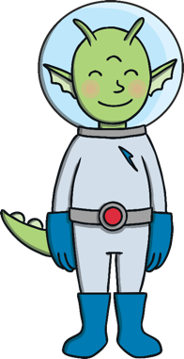
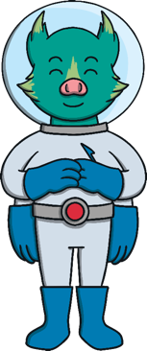
Write a statement or
exclamation sentence for each of the words we have learnt this week.
nicest bravest
largest shiny
sparkly noisy
slimy money
parents finest

Slide 21


