Slide 1


Slide 2

Revisit and Review
Let’s practise reading some of this week’s focus words.
parents
sparkly
bravest
largest
money
nicest
finest
shiny
slimy
noisy

Slide 3


Revisit and Review
Now, let’s write them down.
nicest

Slide 4
Revisit and Review
Now, let’s write them down.
bravest

Slide 5
Revisit and Review
Now, let’s write them down.
finest

Slide 6
Revisit and Review
Now, let’s write them down.
largest

Slide 7
Revisit and Review
Now, let’s write them down.
shiny

Slide 8
Revisit and Review
Now, let’s write them down.
sparkly

Slide 9
Revisit and Review
Now, let’s write them down.
noisy

Slide 10
Revisit and Review
Now, let’s write them down.
slimy

Slide 11
Revisit and Review
Now, let’s write them down.
money

Slide 12
Revisit and Review
Now, let’s write them down.
parents

Slide 13

Teach
Today, we are learning to write sentences that contain words with suffixes –est and –y added to words ending in e.
We are also learning to identify and use exclamations and statements.

Slide 14
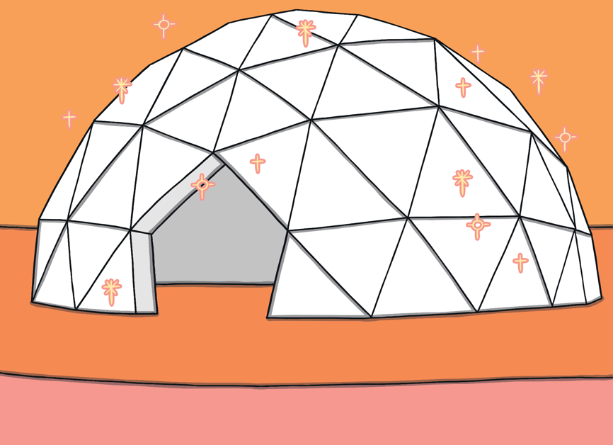
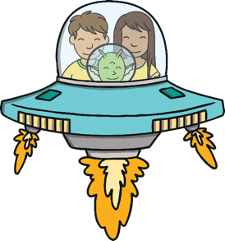
Teach
Kit and Sam were very excited. They were in Jay’s spaceship ready to take off for a tour around the planet. The engine was so noisy that they could barely hear each other talk! “Let’s go!” shouted Jay, as the spaceship gently manoeuvred up and over his house.

Slide 15
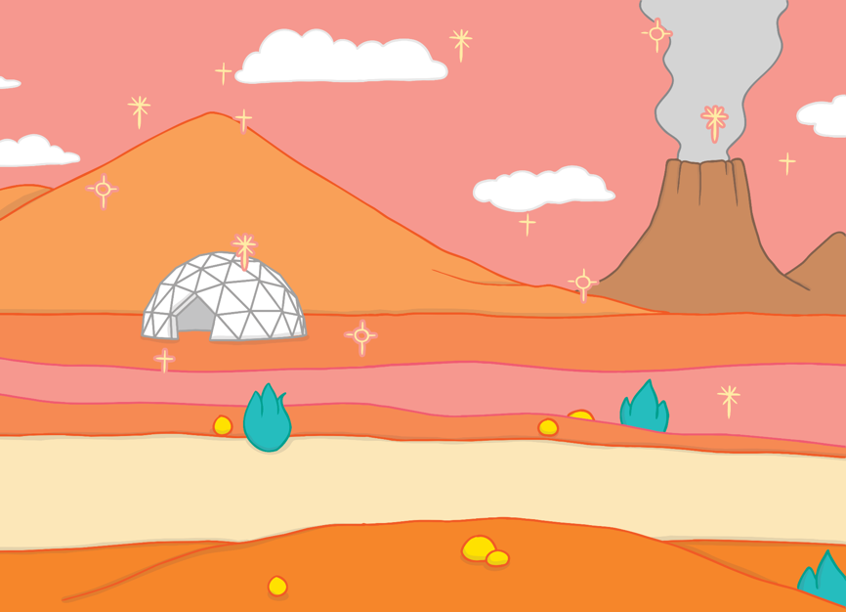

Teach
Kit and Sam couldn’t help but gasp in awe of Jay’s planet as they saw it from above. They zoomed over spiky rocks, sparkly slime and icy mountains. Sam nudged Kit and pointed at a smoky volcano in the distance. “What an amazing planet!” shouted Kit.

Slide 16
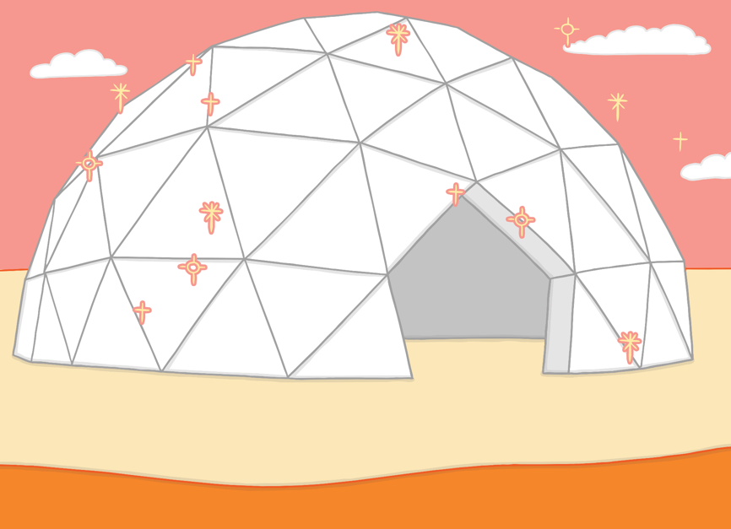






Teach
“Here we are!” shouted Jay, as he brought the spaceship into land and switched off the noisy engine. Kay was outside waiting for them. Jay introduced her to Kit and Sam, “This is my closest friend, Kay,” he said.

Slide 17


Teach
A statement is a type of sentence, which tells you something. It has a verb and ends with a full stop.
For example:
The girl was singing in the hall.
X
A statement usually has a subject before the verb.
Click me for Kit’s teaching tips!

Slide 18

Teach
An exclamation is another type of sentence. It must start with ‘what’ or ‘how’, have a verb and end with an exclamation mark.
For example:
What a mess we have made!

Slide 19
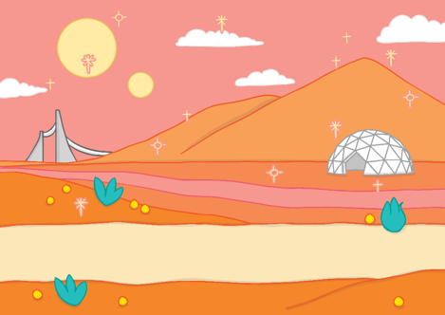

Teach
Let’s write an exclamation sentence using a word ending in e with –est or –y added for this picture.
What a shiny planet this is!
Show Suggestion

Slide 20

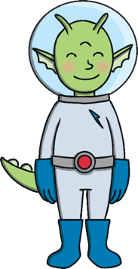
Sentence Sort
Practise
Can you sort the sentences by clicking the correct alien?

Slide 21

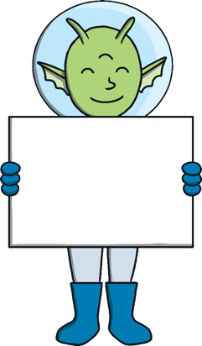
Practise
Exclamation
Statement
Try Again
What a sparkly planet you have!

Slide 22
Practise
Try Again
Exclamation
Statement
Kit and Sam went to visit the nicest alien they had ever met.

Slide 23
Practise
Exclamation
Statement
Try Again
How noisy the spaceship was!

Slide 24
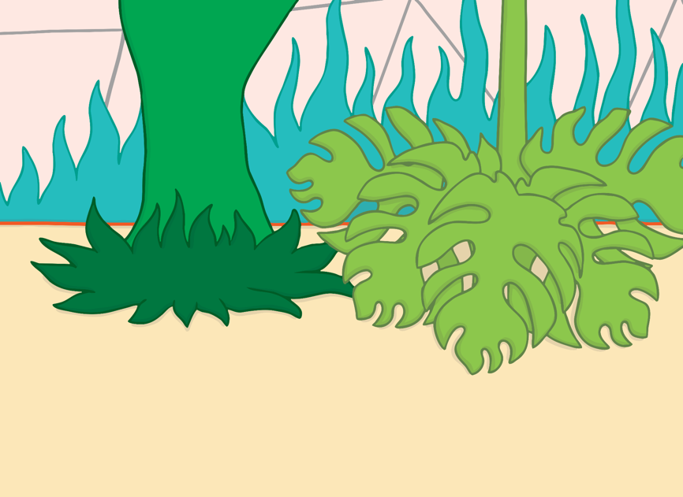
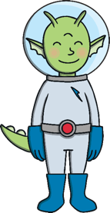



Apply
Kay gave Kit and Sam a tour around her home. “All of our planet was covered in these plants but it got too cold so we can only grow them in our homes now,” she told them.

Slide 25


Sentence Scribers
Apply
Listen to Sam talk about their visit to Jay’s planet and write down each sentence on a whiteboard or piece of paper.
X
Encourage children to listen out for any words ending in e that have had the –est or –y suffixes added.
Click me for Kit’s teaching tips!

Slide 26


Apply
Jay lives at the bottom of the largest hill.
What a shiny house he has!
1
2
Show
Show

Slide 27


Apply
“I’m afraid it’s time for us to go now,” said Sam. “Thank you so much for showing us around your amazing planet and beautiful homes!”
“It’s the least we could do for the nicest humans we have ever met,” smiled Jay.
Sam opened up her map, “Take us home!” she called.

Slide 28


Write 2 statement sentences and
2 exclamation sentences.
Use –est and –y words

