Slide 1
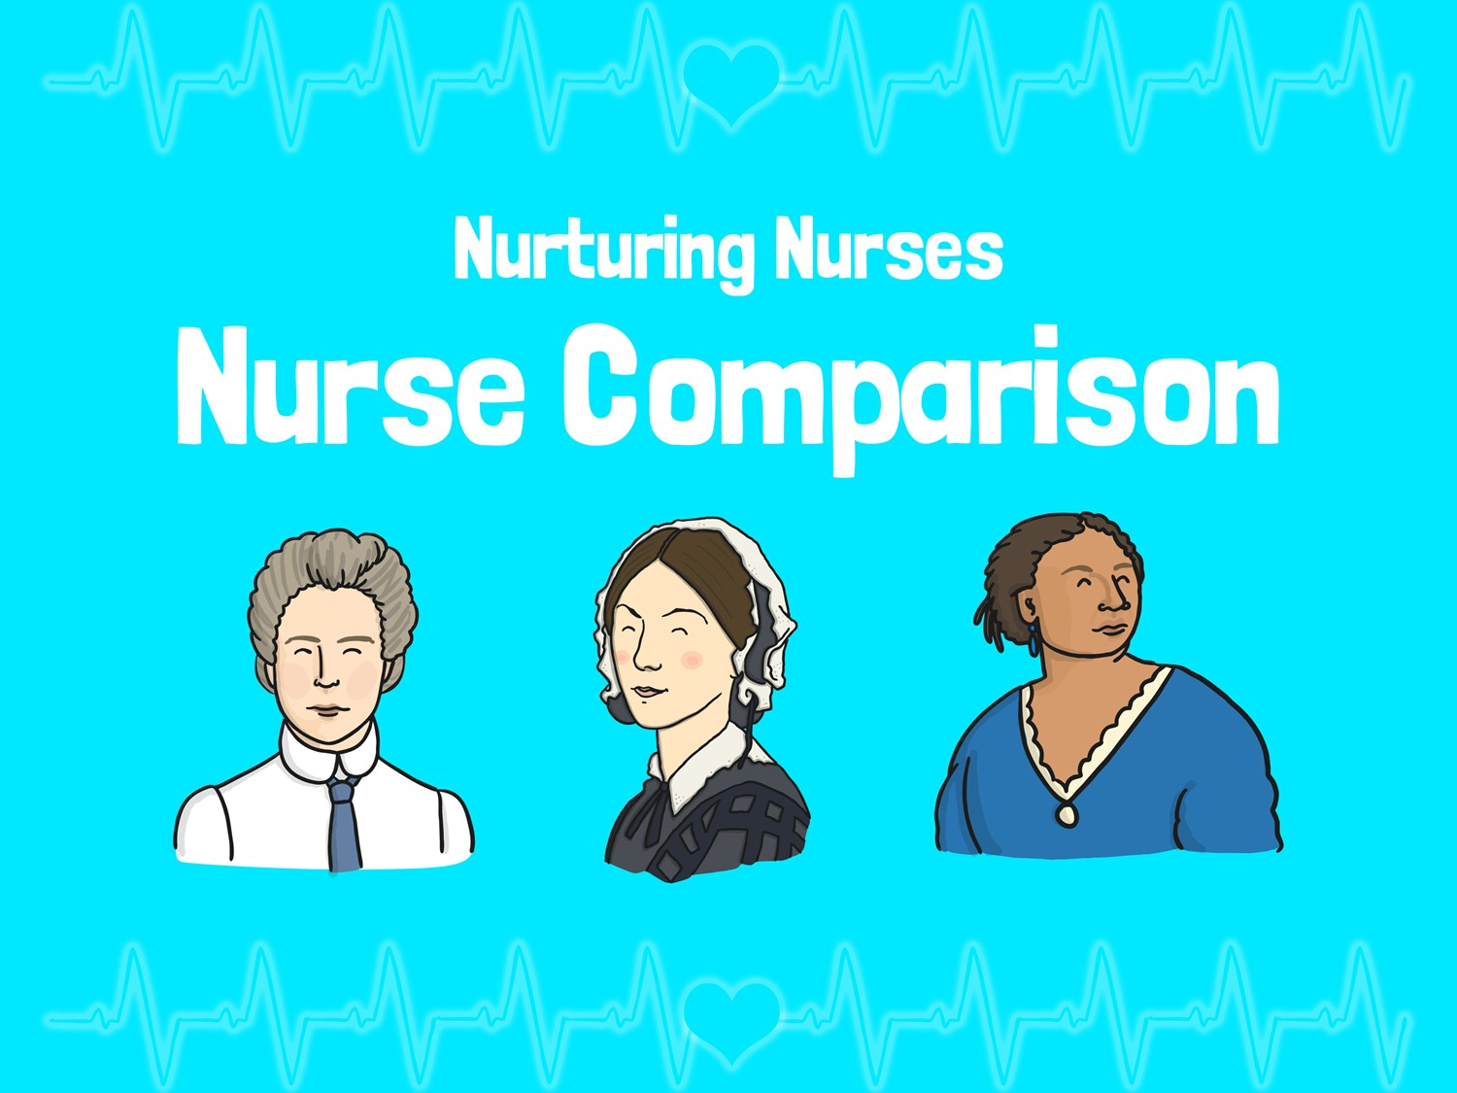


LO: To identify similarities and differences between the nurses we have studied

Slide 2
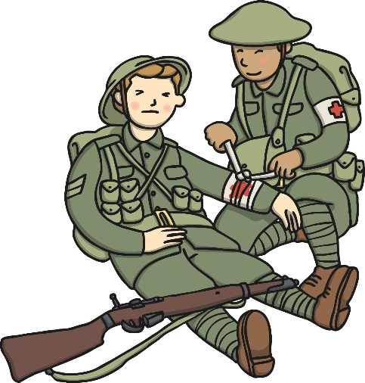
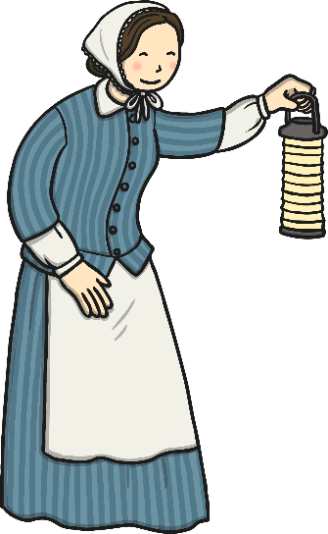
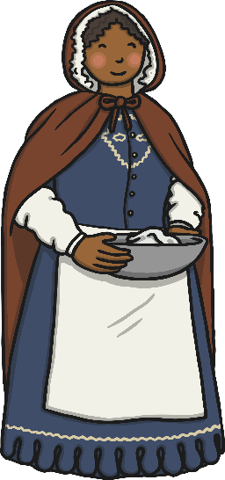
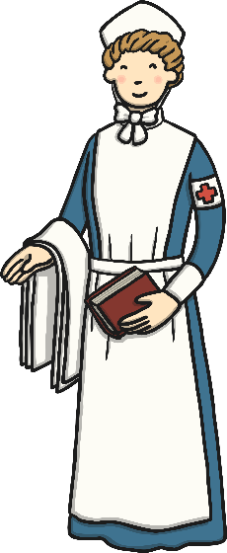
Similarities and Differences
Can you think of any similarities between Florence Nightingale, Mary Seacole and Edith Cavell?
Can you think of any differences?
They were all nurses who helped soldiers.
They were born in different countries: Florence – Italy
Mary – Jamaica
Edith - England

Slide 3
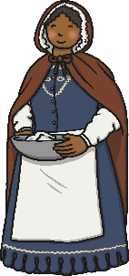
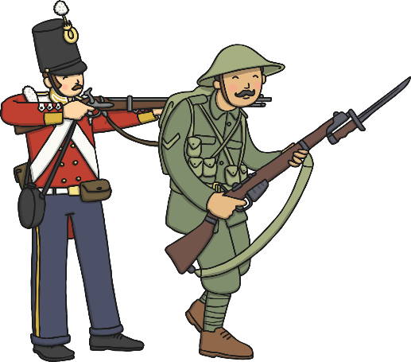
Similarities and Differences
Can you think of any similarities between Florence Nightingale, Mary Seacole and Edith Cavell?
Can you think of any differences?
They were all brave, kind and caring.
Two nursed in the Crimean War and one in World War One.

Slide 4
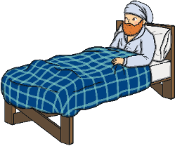
Similarities and Differences
Can you think of any similarities between Florence Nightingale, Mary Seacole and Edith Cavell?
Can you think of any differences?
They all worked incredibly hard and thought of others before themselves.
Mary paid for herself to travel and treat soldiers in the Crimean war.
Mary used herbal remedies to treat the injured soldiers.

Slide 5
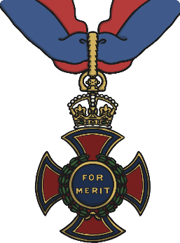
Similarities and Differences
Can you think of any similarities between Florence Nightingale, Mary Seacole and Edith Cavell?
Can you think of any differences?
They all received medals for the bravery they showed whilst treating soldiers at war.
Florence Nightingale played an important role in improving hospitals.
Edith helped soldiers escape to safety.

Slide 6
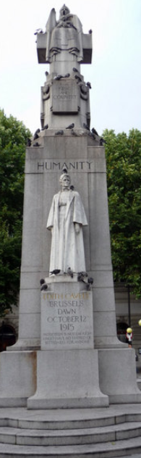
Similarities and Differences
Can you think of any similarities between Florence Nightingale, Mary Seacole and Edith Cavell?
Can you think of any differences?
They are all remembered for their achievements and each have a memorial statue in London.
Florence and Edith helped to train other nurses.
Florence and Mary wrote books about being a nurse.

Slide 7
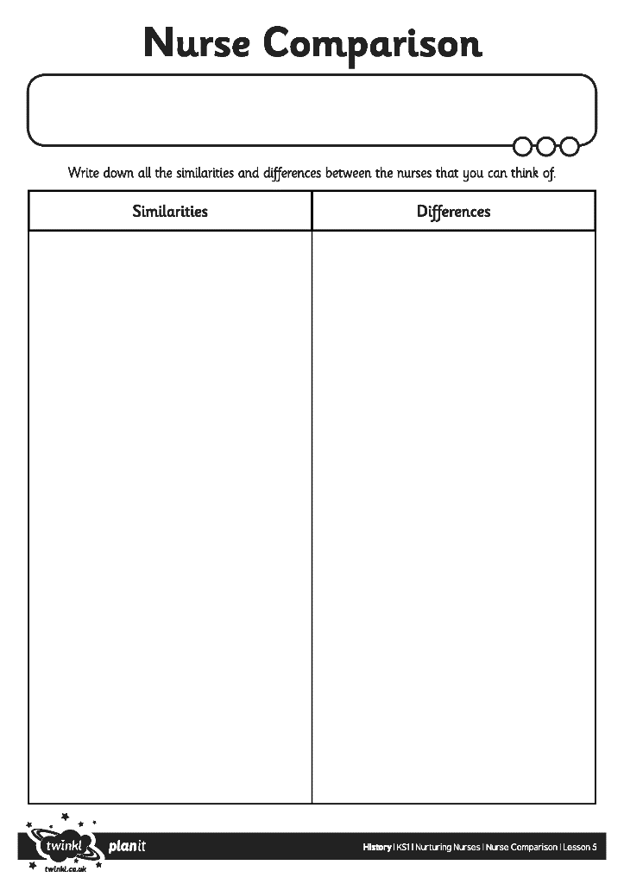



Nurse Comparison
For you activity today
we would like you to write
similarities and differences
between Florence Nightingale,
Mary Seacole and Edith Cavell.

Slide 8



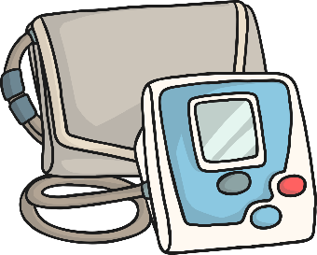



Nurses Today
How do Florence Nightingale, Mary Seacole and Edith Cavell compare with nurses today?
Where do nurses work today?
How do they help people?
Do nurses from the UK go to work in any other countries?
Are there any special hospitals for injured soldiers?
Where are they?

