Slide 1
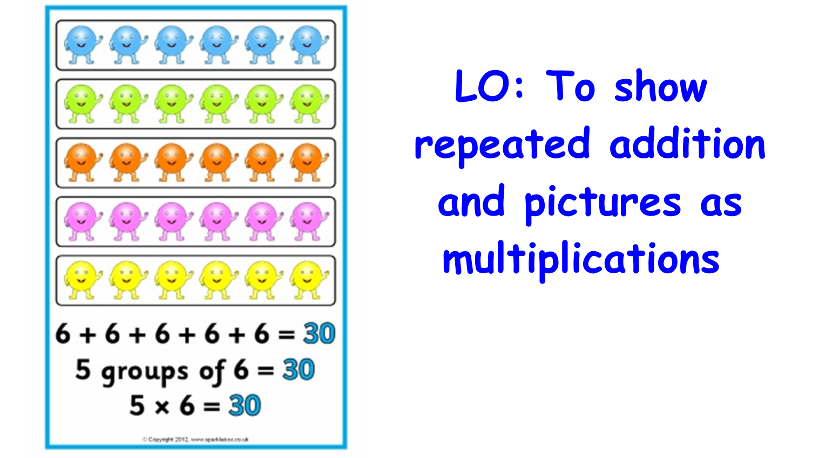

Slide 2
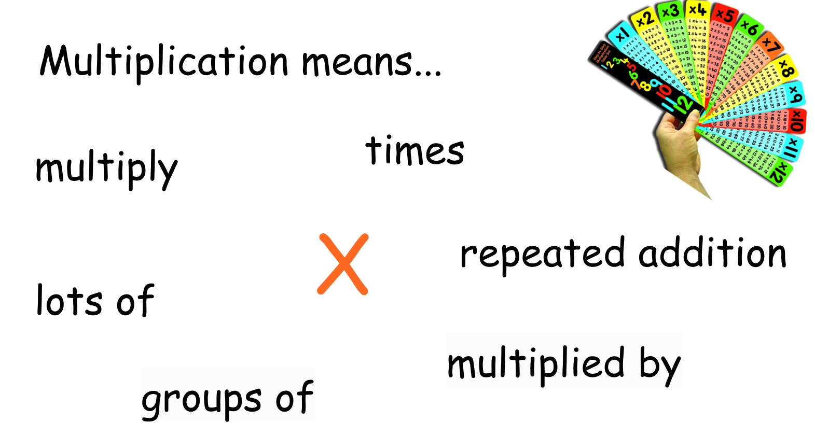

Slide 3
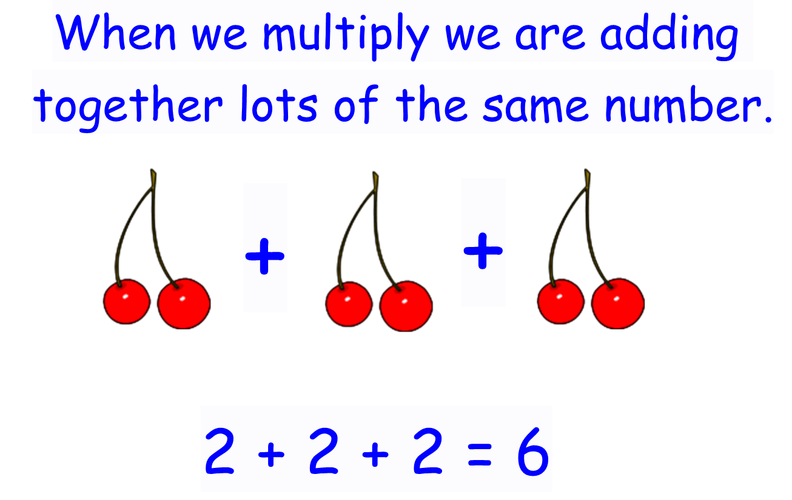

Slide 4
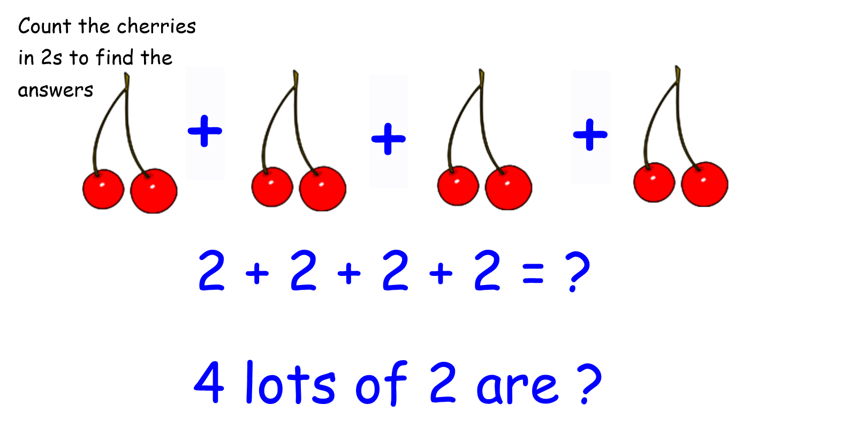

Slide 5
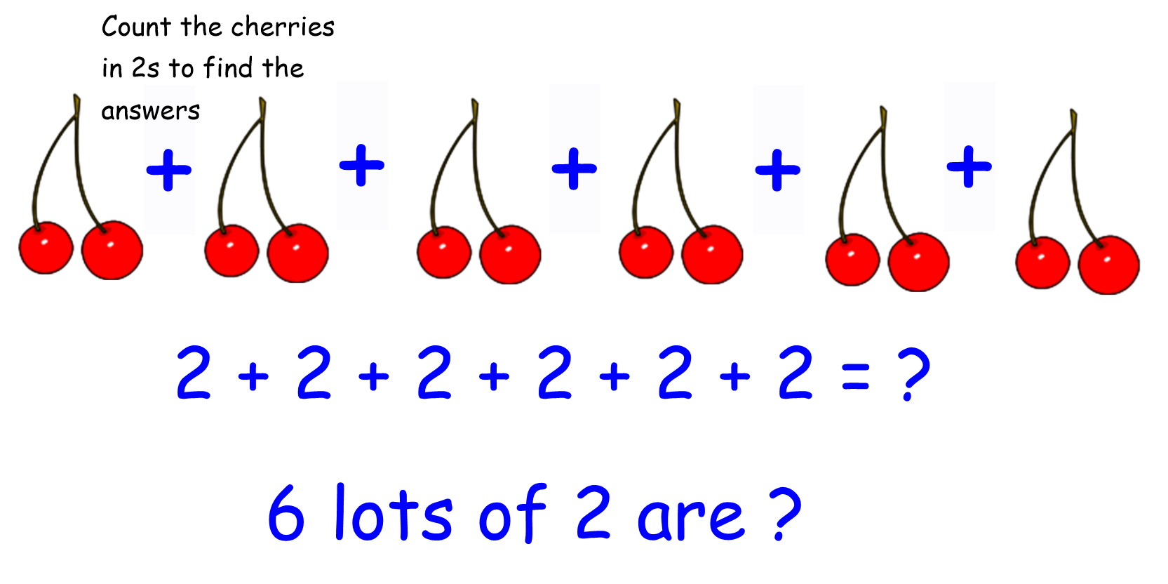

Slide 6
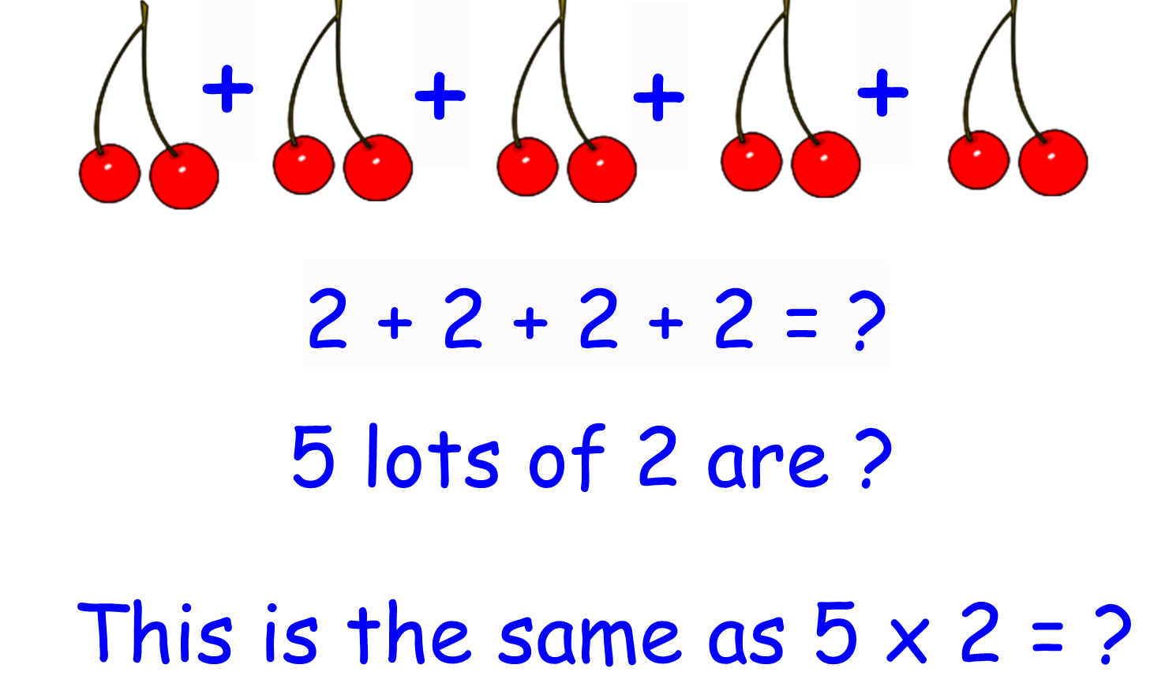

Slide 7
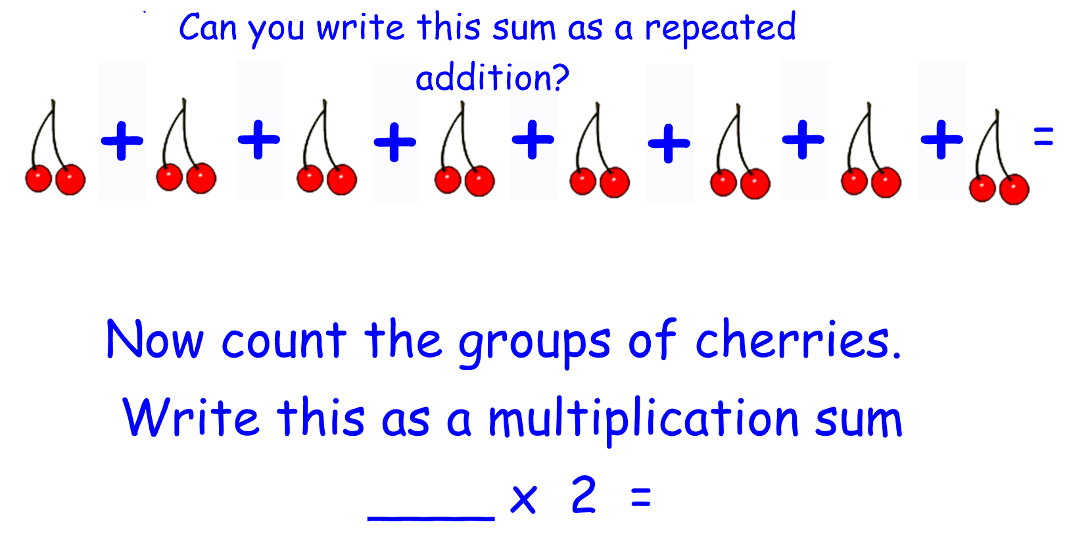

Slide 8
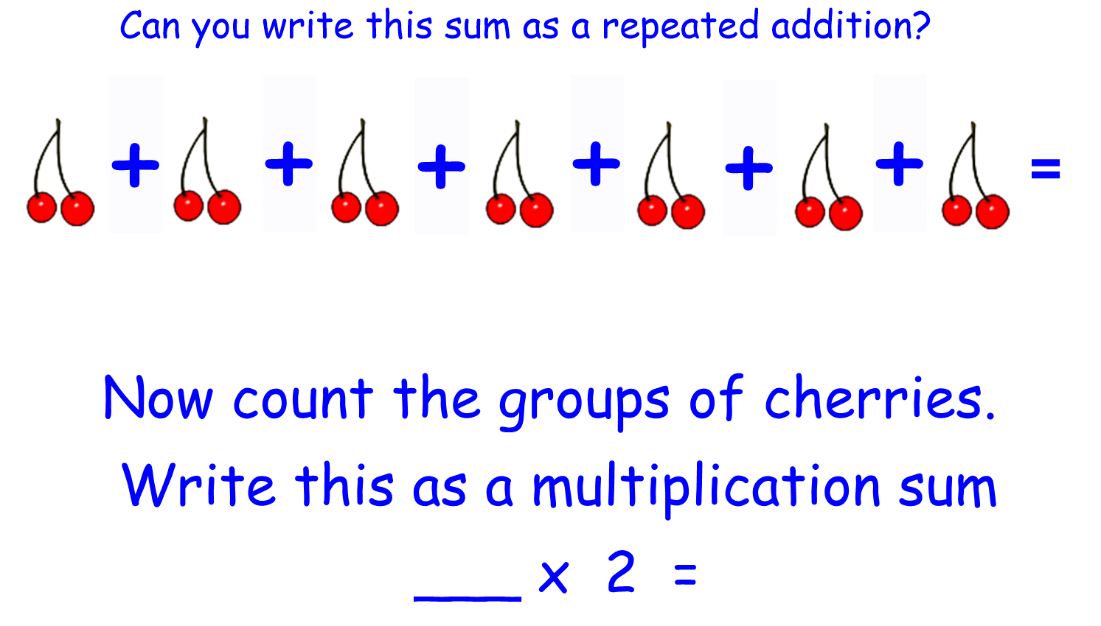

Slide 9
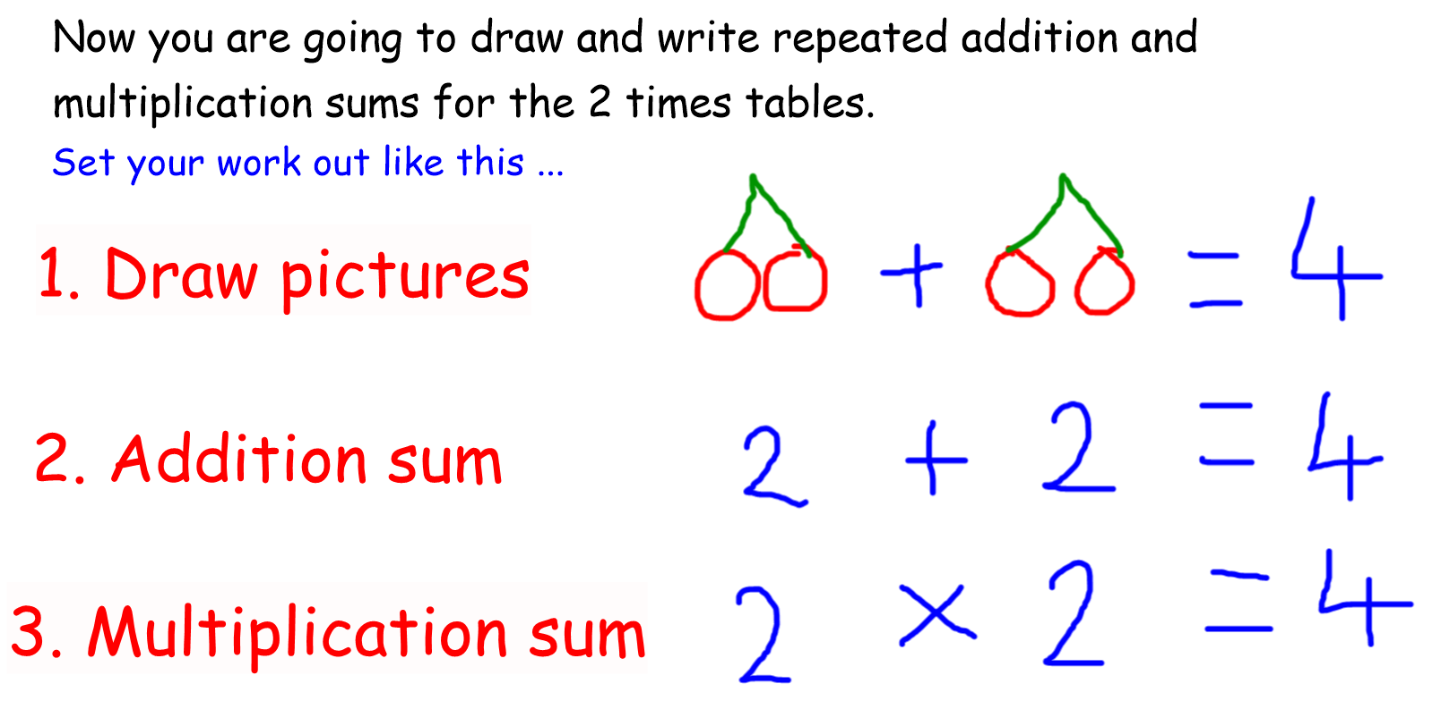

Slide 10
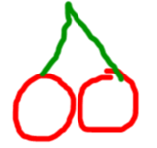
On your piece of paper start with 1 lot of 2 (cherries) and continue to at least 5 lots of 2 (cherries). If you can, carry on until you reach 12 lots of 2! Remember to write all of your answers.
= 2
2 = 2
1 x 2 = 2
+
=
2 + 2 =
2 x 2 =

