Slide 1
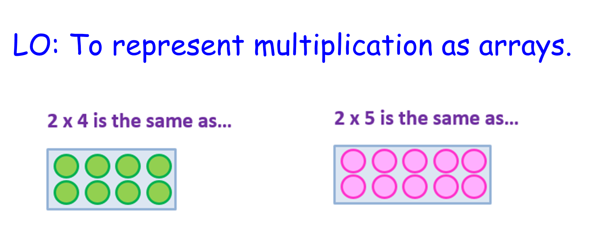


Slide 2
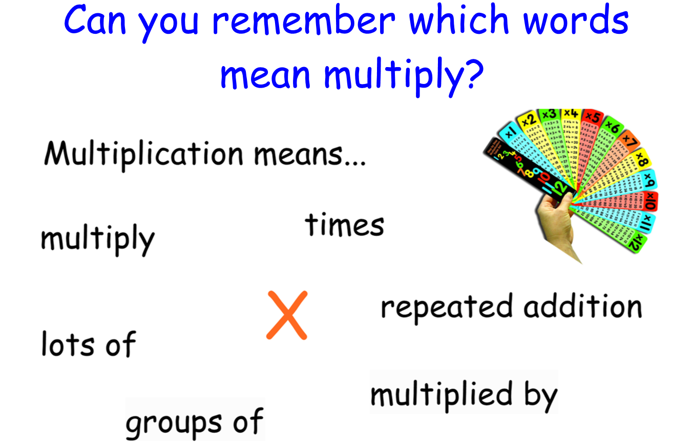

Slide 3
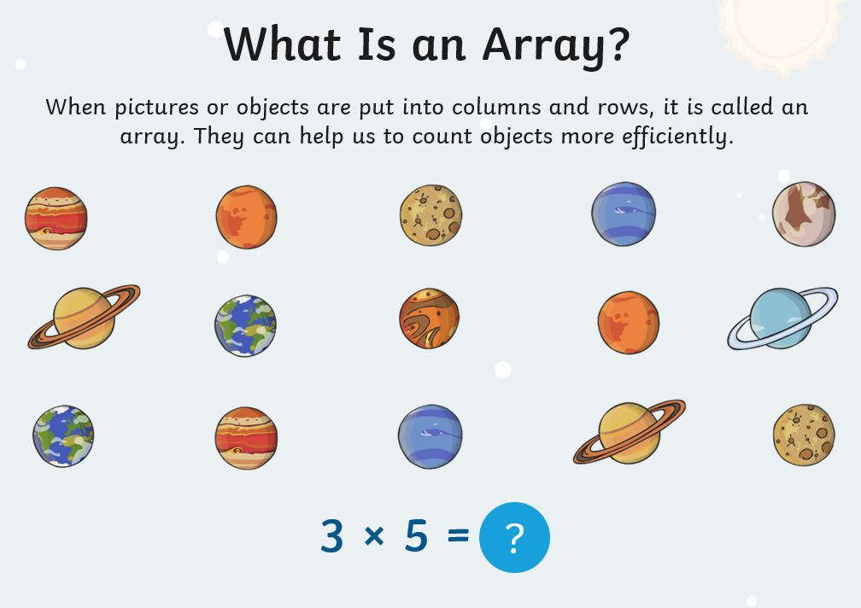

Slide 4
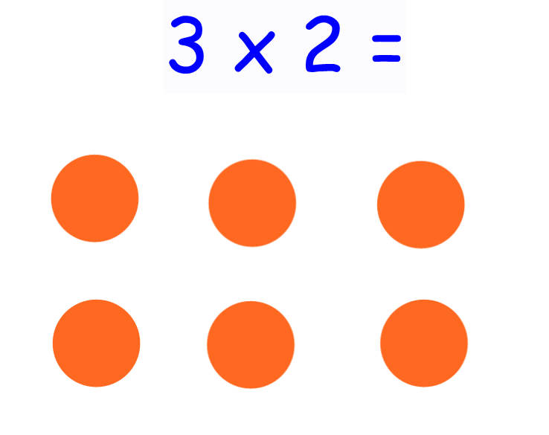
You can show an array by
drawing rows and columns of dots.
Here are 3 lots of 2:
Count 3 lots of 2 to
find the answer.

Slide 5
Here are 5 lots of 2:
5 x 2 =
Count 5 lots of 2 to
find the answer.

Slide 6
Here are 7 lots of 2:
7 x 2 =
Count 7 lots of 2 to
find the answer.

Slide 7
How many lots of 2 can you see?
4 x 2 =
Count 4 lots of 2 to
find the answer.

Slide 8
How many lots of 2 can you see?
6 x 2 =
Count in 2s to
find the answer.

Slide 9
How many lots of 2 can you see?
__ x 2 =
Count in 2s to
find the answer.

Slide 10
Can you draw your
own array patterns on a piece of paper for:
2 x 2 = (2 lots of 2)
10 x 2 = (10 lots of 2)

Slide 11

Did you get these answers?
2 x 2 = 4
10 x 2 = 20
Well done!

