Slide 1

I can talk about what rights are and identify rights that all
people share.

Slide 2

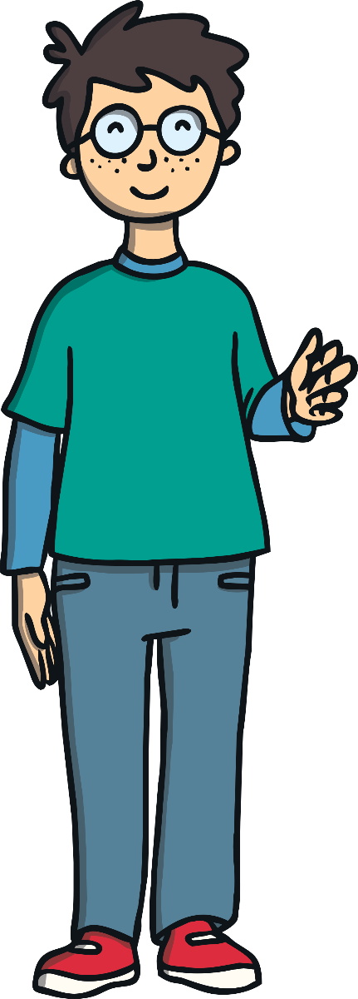
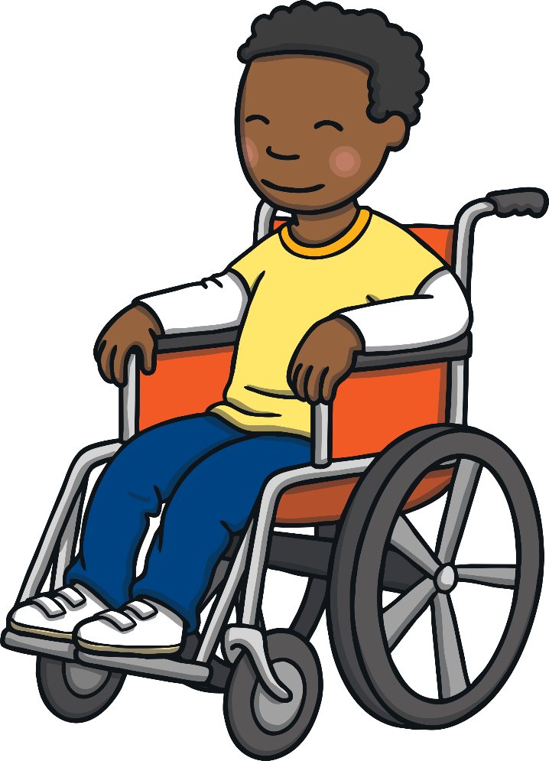
The Big Questions
What are rights and what rights do all
people share?
What special rights do children have?

Slide 3


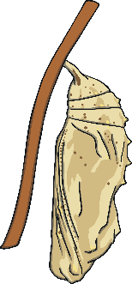

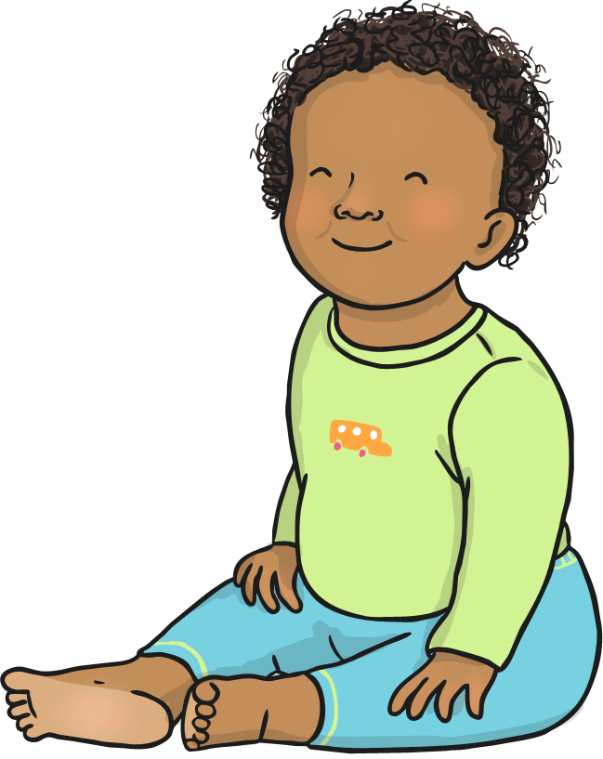
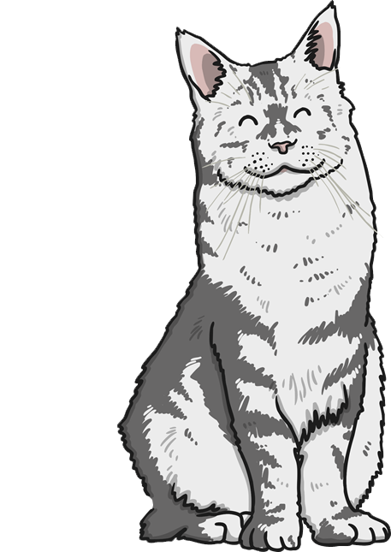
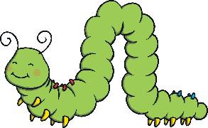


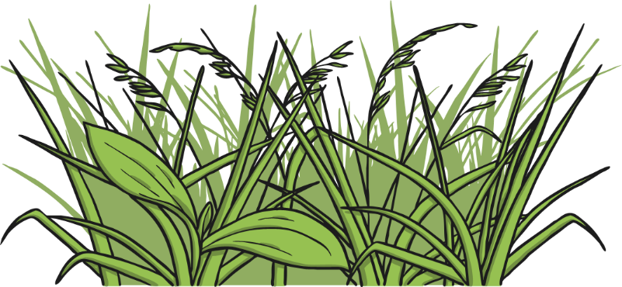
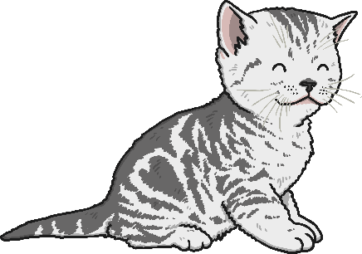
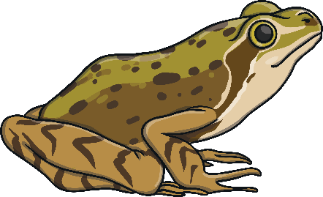
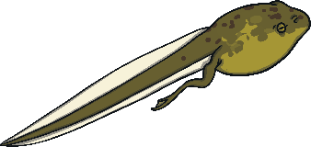


Human Needs
Living things all have basic needs. These are things that they need so they are able to grow and develop in a healthy way.
Plants need water, air, light and nutrients from the soil to grow and develop in a healthy way.
What do all humans need to grow and
develop in a healthy way?

Slide 4
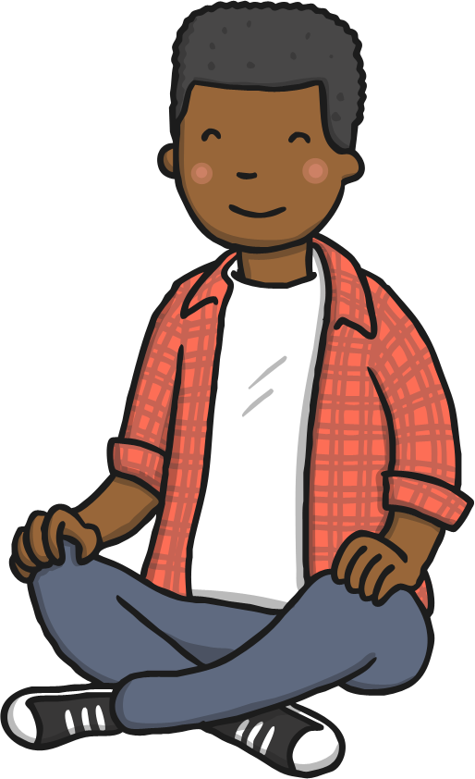
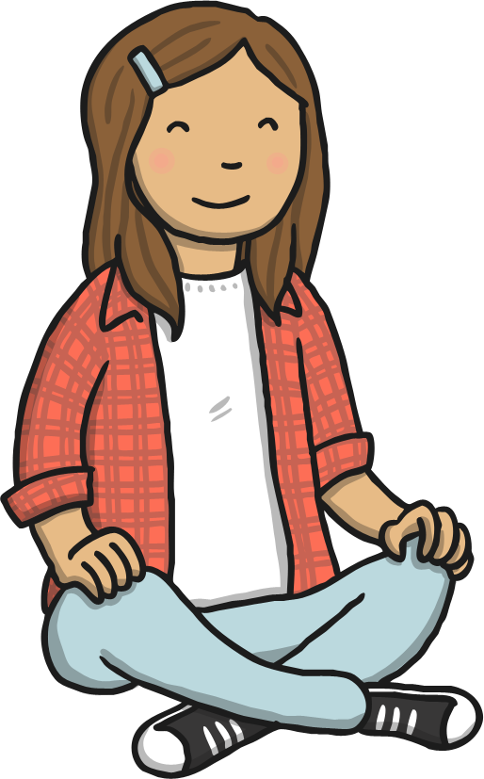
Human Needs
With your partner, think of three different things and be ready to share your thoughts with the class.

Slide 5

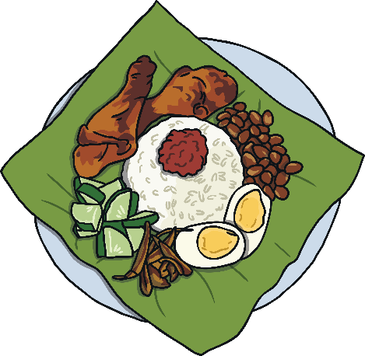
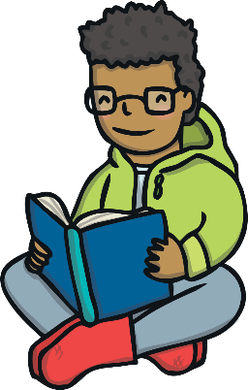
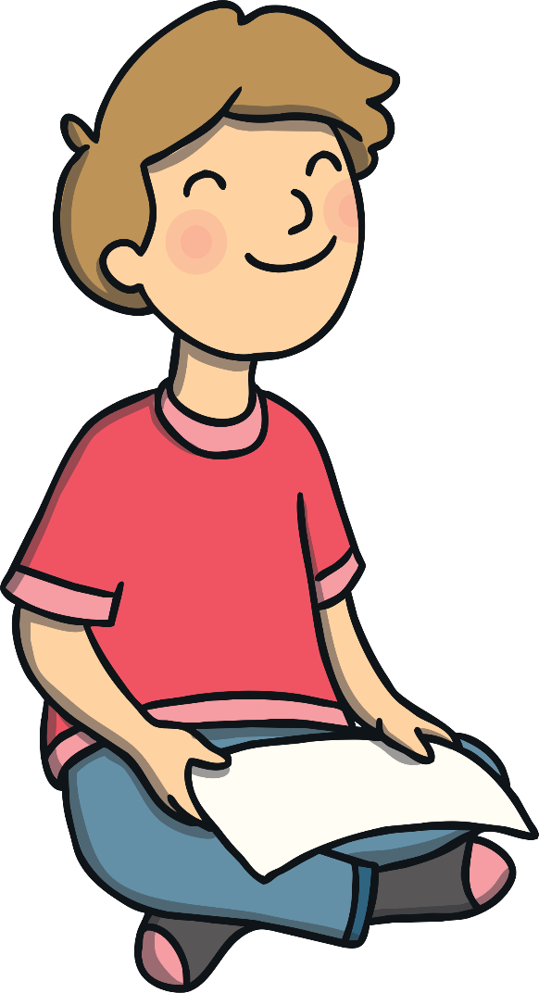
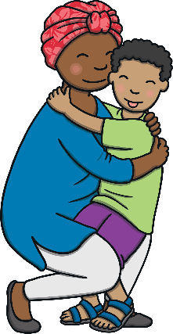
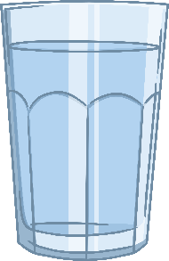

Human Needs
A need is something that humans must have to thrive. This means it is something that humans must have to grow and develop in a healthy way.
The basic needs of all humans throughout the are world are food, water, shelter, to be safe, feel happy and to have the opportunity to learn and develop.

Slide 6
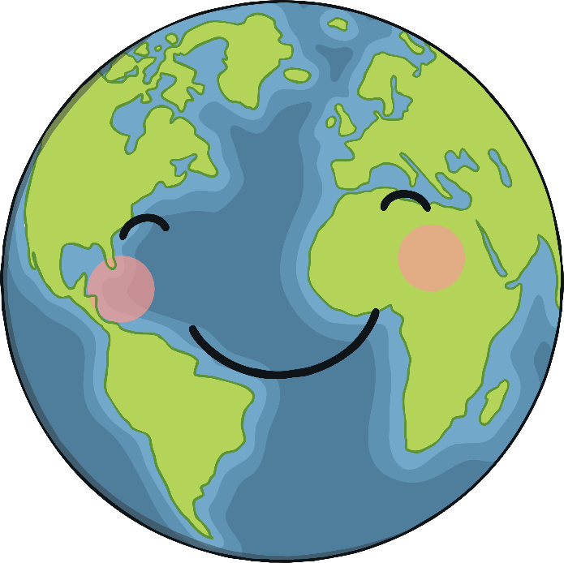
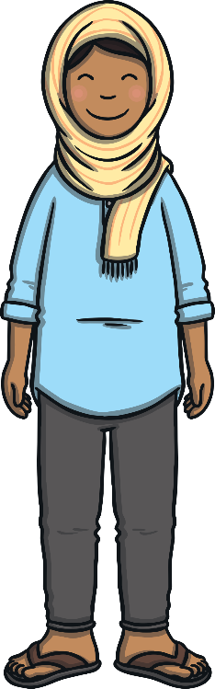
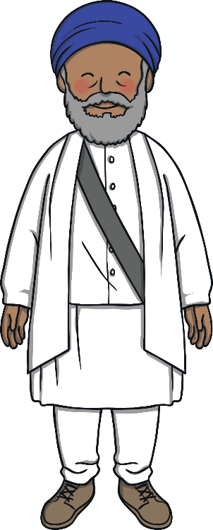
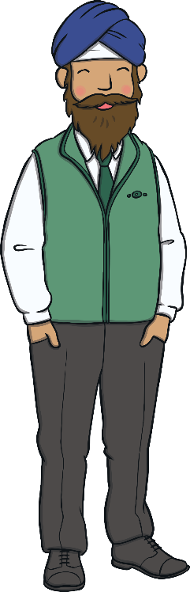
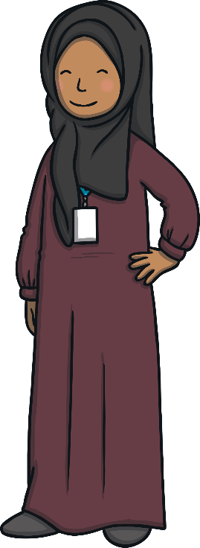
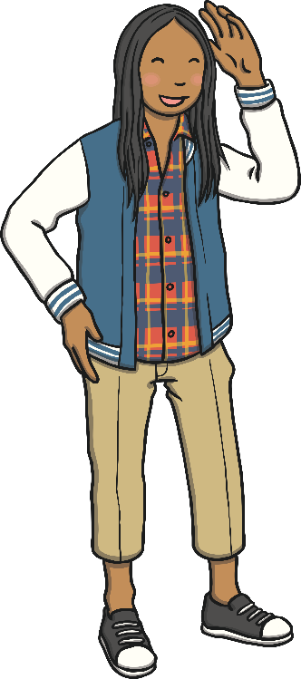
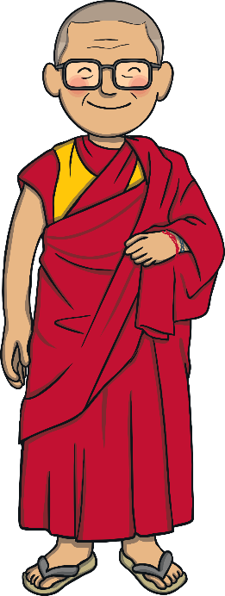
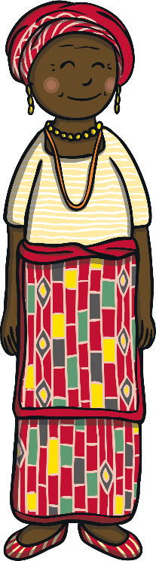
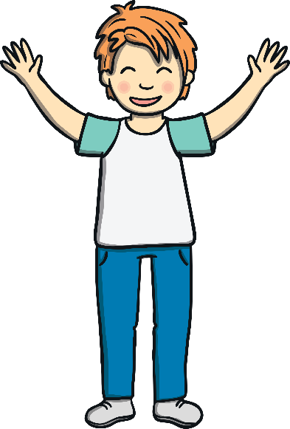
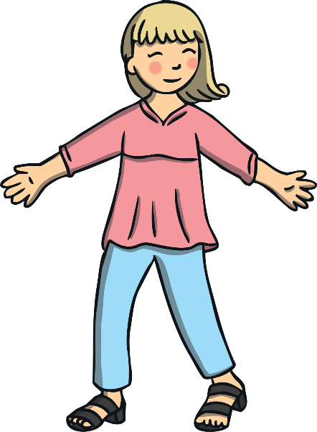
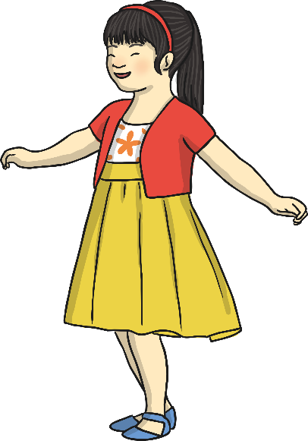
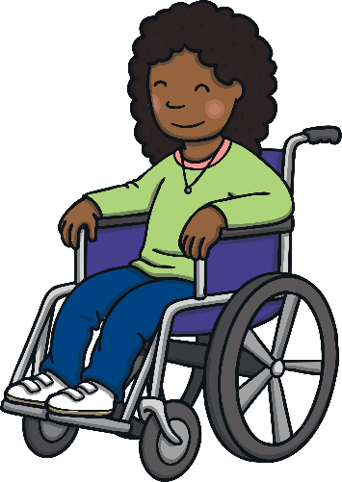
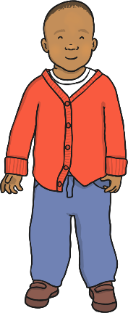
Human Needs
All humans, no matter where they are in the world, deserve to have their basic needs met. This is their right.
All humans, no matter where they are in the world, are important and special.

Slide 7
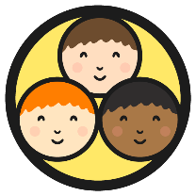
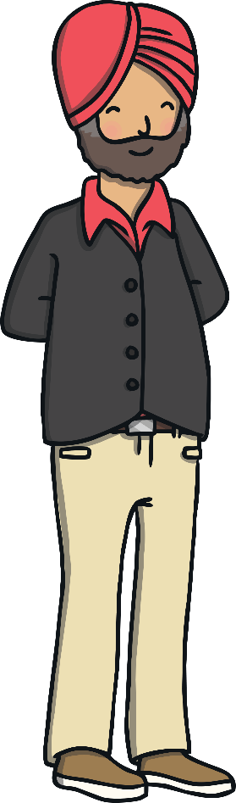
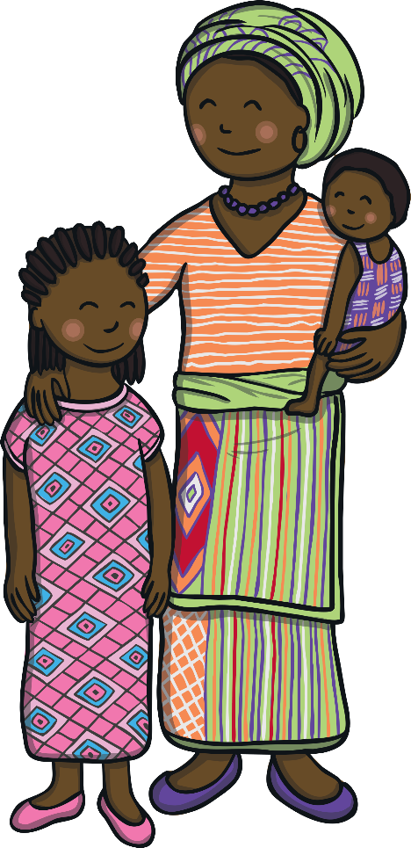
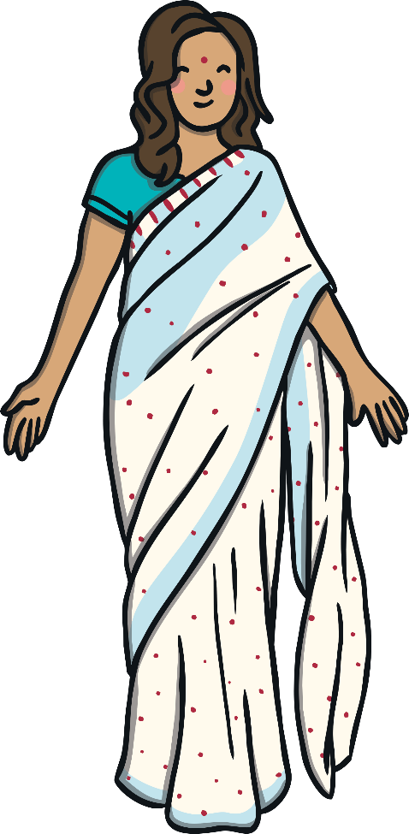
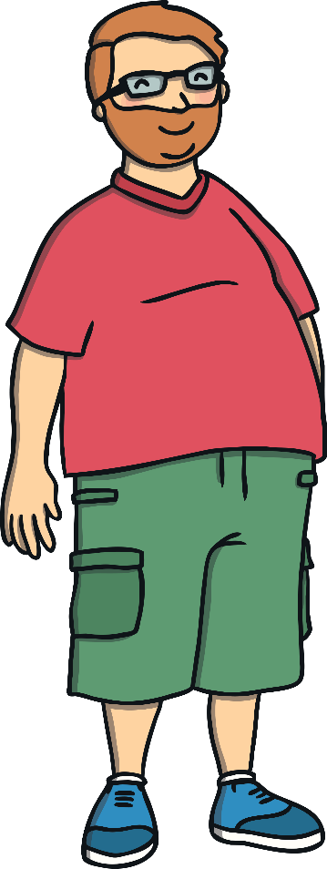
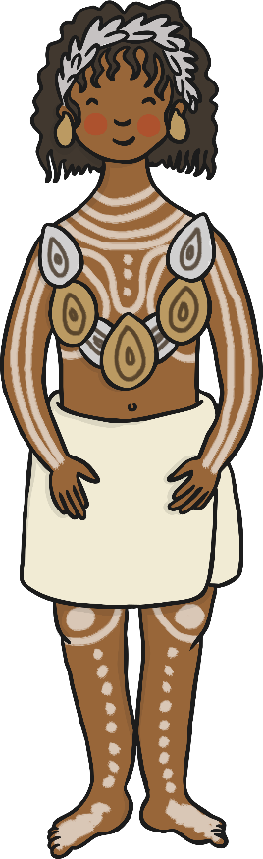
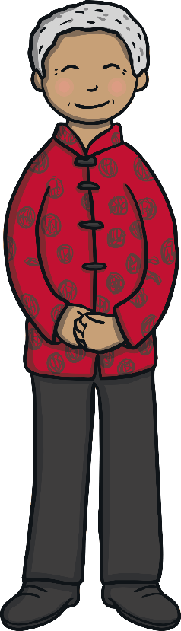
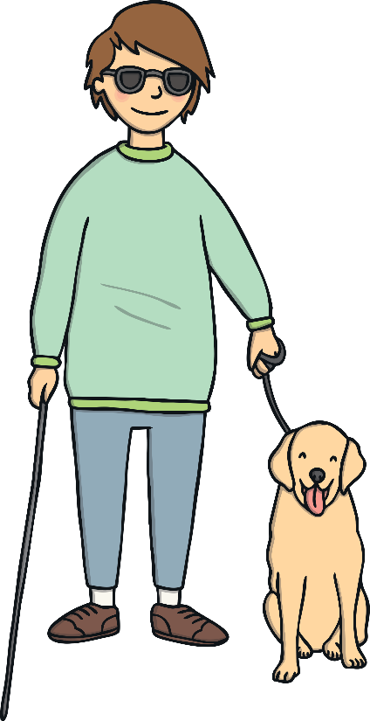
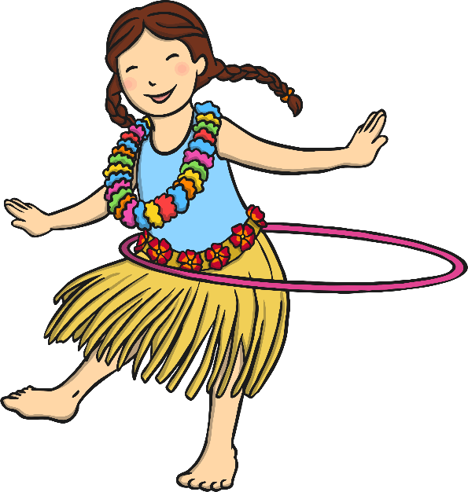
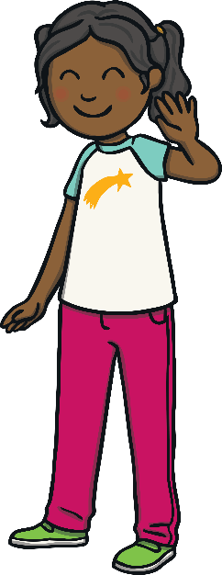
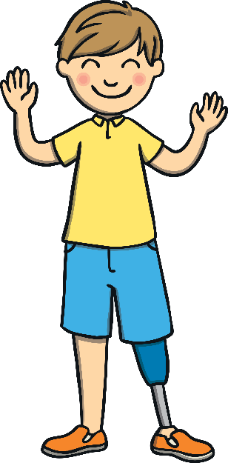
Human Rights
Human beings are all different. This makes the world an exciting and wonderful place to live!
A right is something that every person should have because they are a human being.

Slide 8
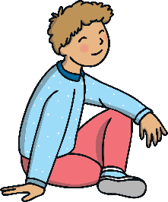
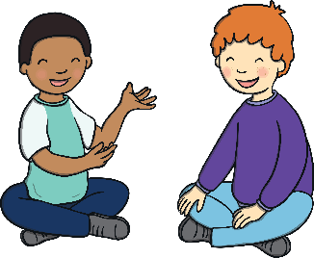
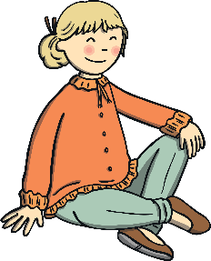
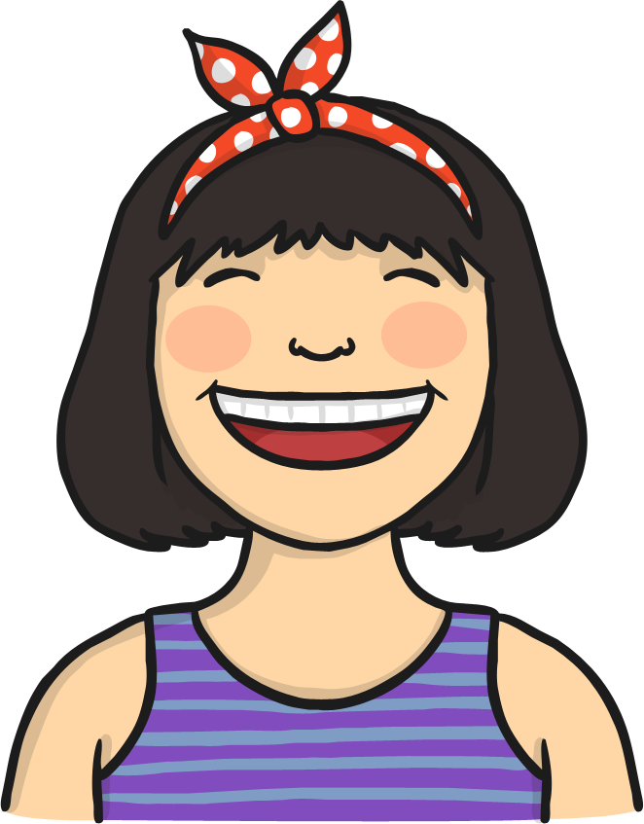
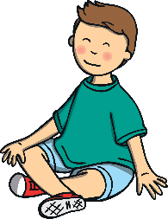

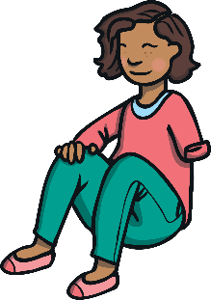
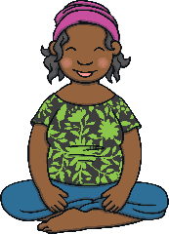
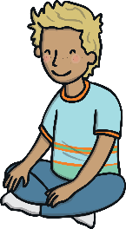
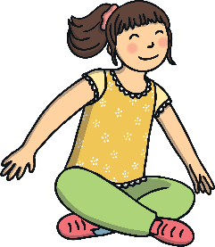





Human Rights
Human rights help make the world a better place. They help people to be treated fairly and to have what they need to be happy and healthy.
All people, no matter who they are or where they are in the world, have the same human rights.
Human rights show that every person in the whole world is important.

Slide 9









Children’s Rights
Children have their own special rights.
All children, no matter where they are in the world, have the same rights.
Children have the right:
to have the things they need to be safe and comfortable at home;
to have an education;
to be protected;
to have access to doctors and medicine;
to be heard and taken seriously.

Slide 10

Children’s Rights
The rights of all children, no matter where they are in the world, should be respected by all people.
This means that all people should take the rights of children seriously and treat them with importance.
It also means that children should respect the rights of each other.
Respecting the rights of others can help them to feel safe and happy.
Let’s be a rights respecting class!
Consolidating
Reflecting

Slide 11



My Rights
Draw a picture to go with each of the rights on your sheet. These pictures should show what your rights are, as a child.

Slide 12









How Do I Feel?
Sometimes, people don’t have their human rights met. This can make their lives hard.
This is sad, but the good thing is that there are a lot of people working very hard to change this.
Can you think of a time when someone might not have their human rights met?
How does this make you feel?
We can also do our bit by making sure we treat all people with kindness and respect.

Slide 13












Protecting Our Rights
All people are equally important. Let’s celebrate people everywhere and respect their human rights!

Slide 14
The Big Questions
What are rights and what rights do all people share?
What have you
learnt today?
How will it help you in your daily life?
What special rights do children have?

