Slide 1


Lesson 1 – Phonics

Slide 2
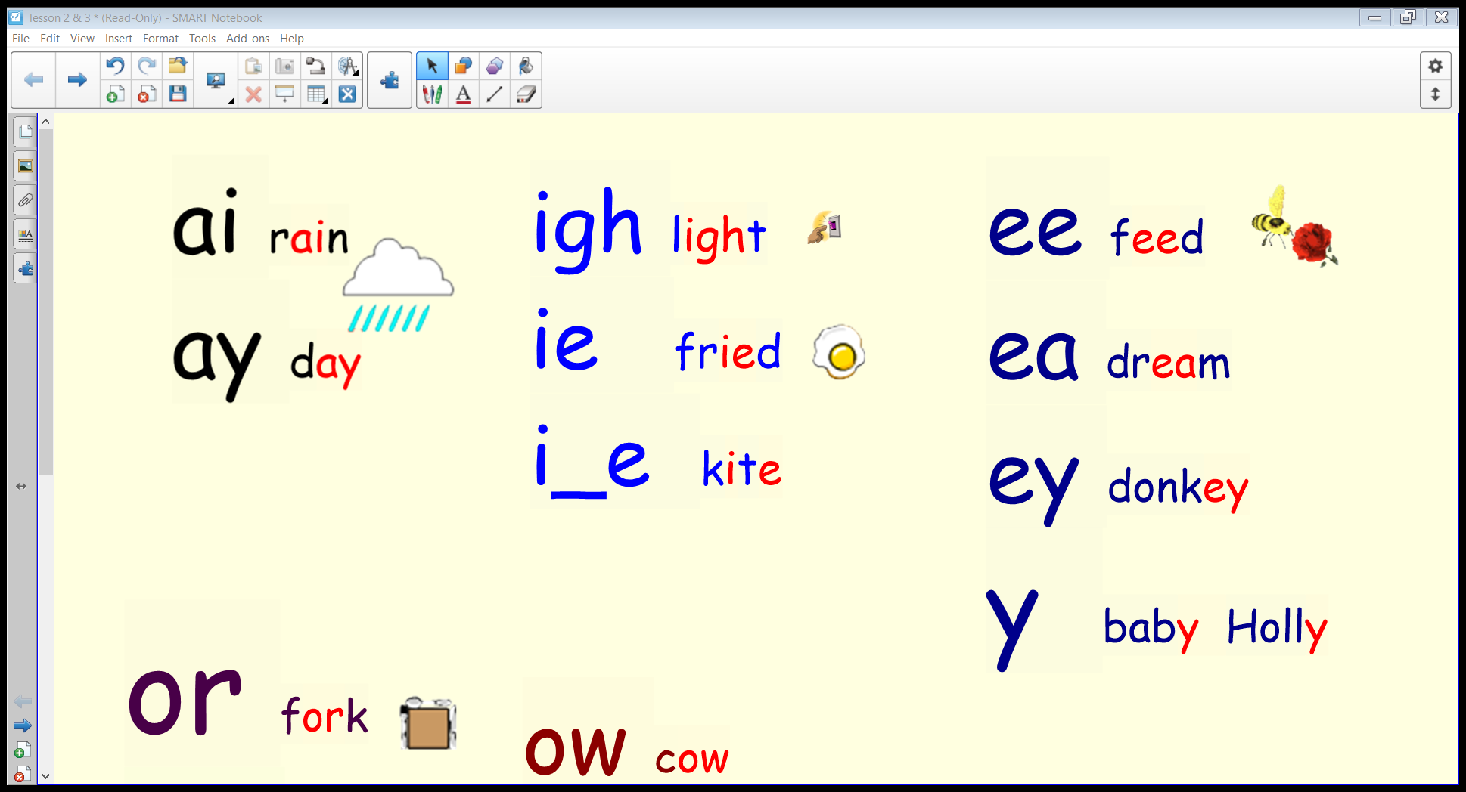
Let’s read…

Slide 3
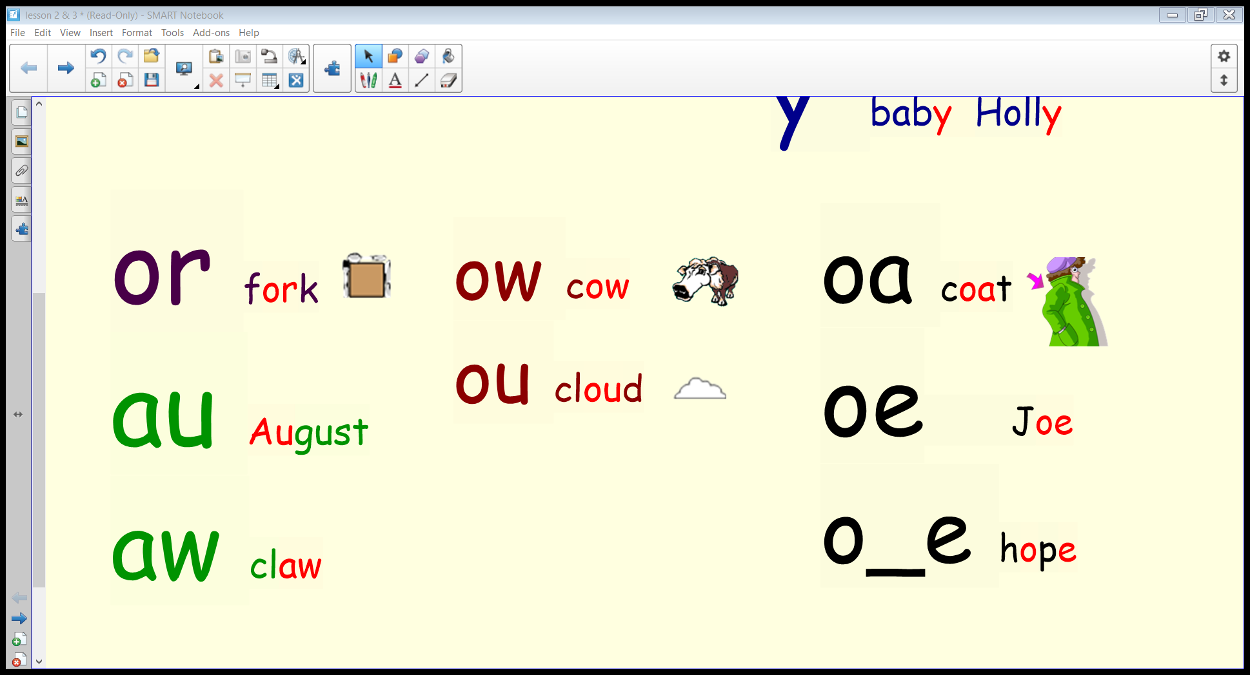
Let’s read…

Slide 4
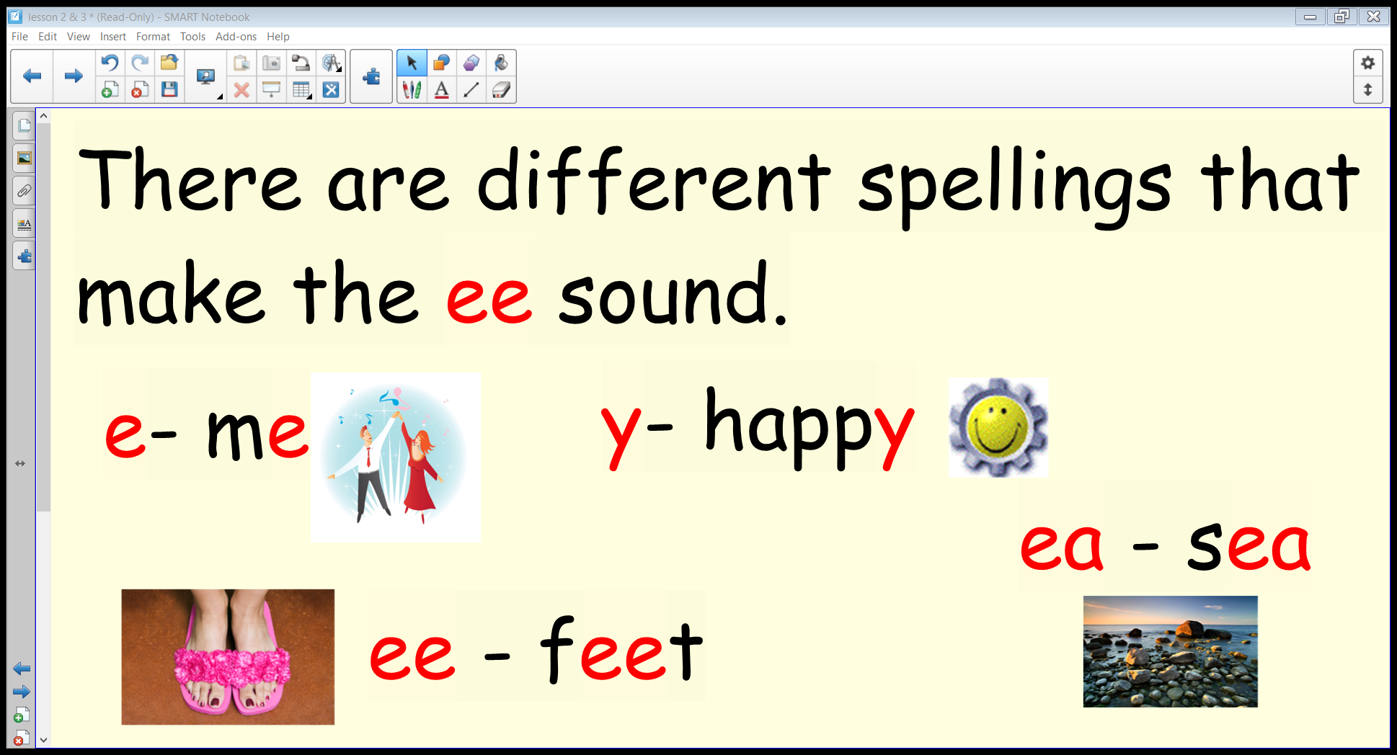

Slide 5
Can you think of any other words with ‘ee’, ‘ea’, ‘y’ or ‘e’?
ee ea y e

