Slide 1
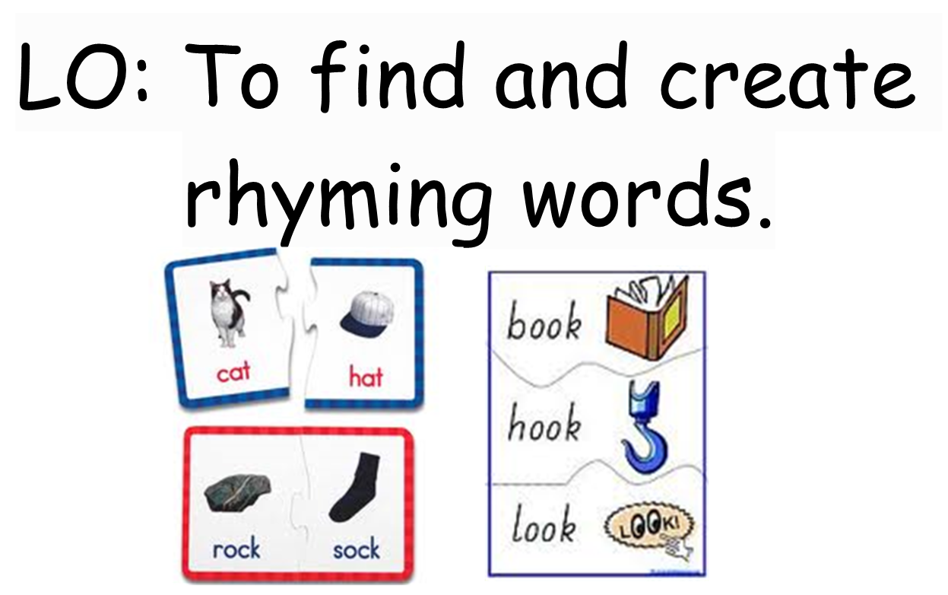
Lesson 1 – English

Slide 2
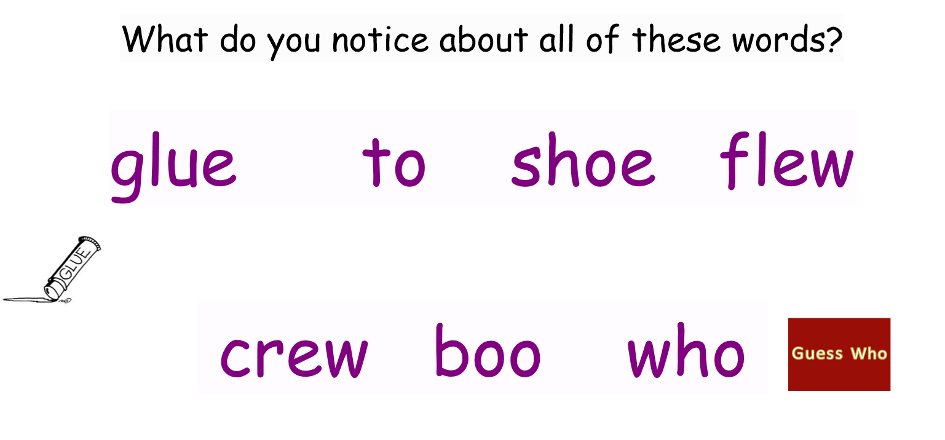
Let’s rhyme!

Slide 3

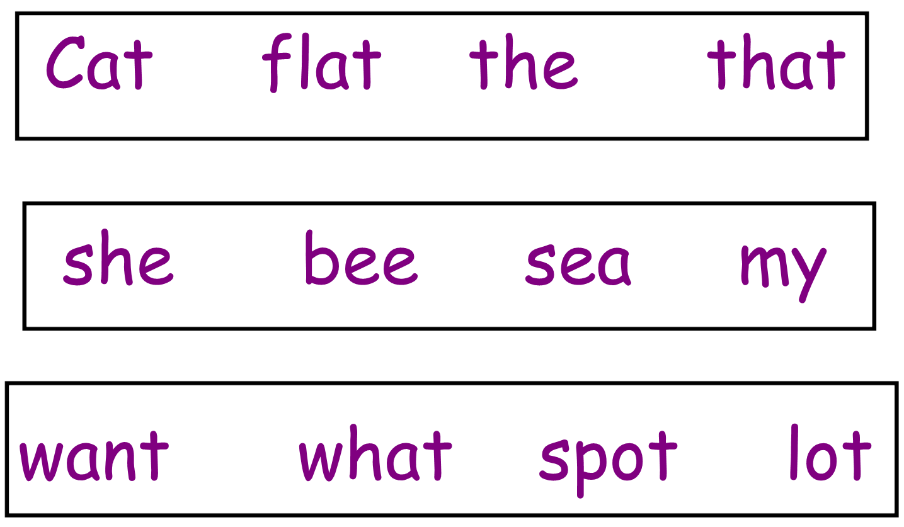

Slide 4
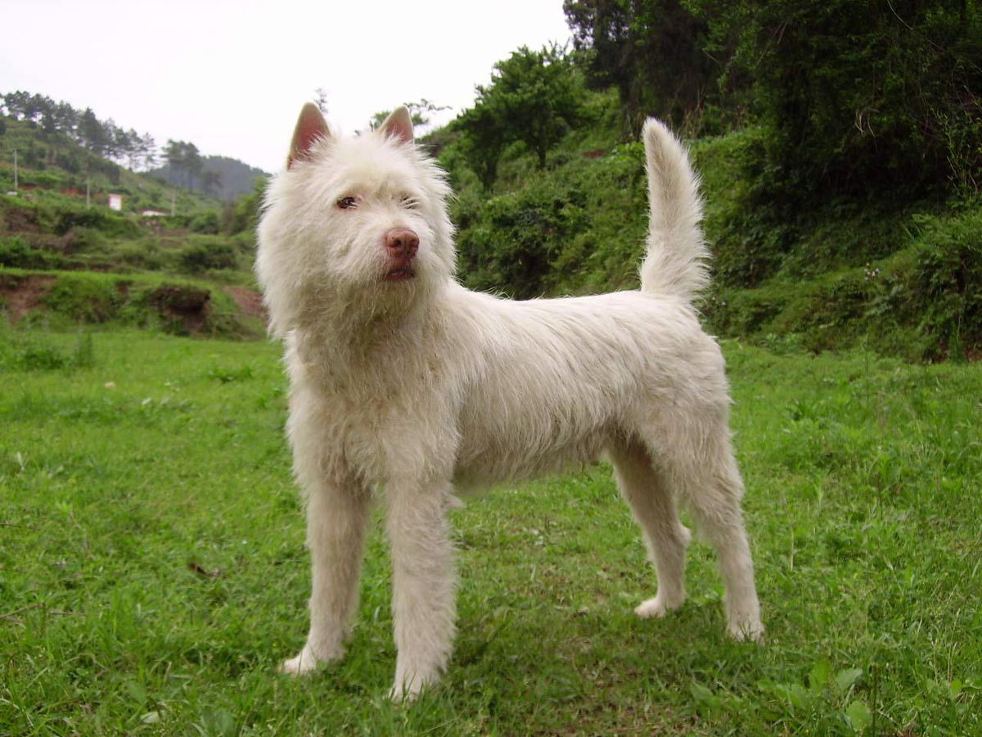
Think of some words that rhyme with dog.

Slide 5

Think of some words that rhyme with cap.

Slide 6
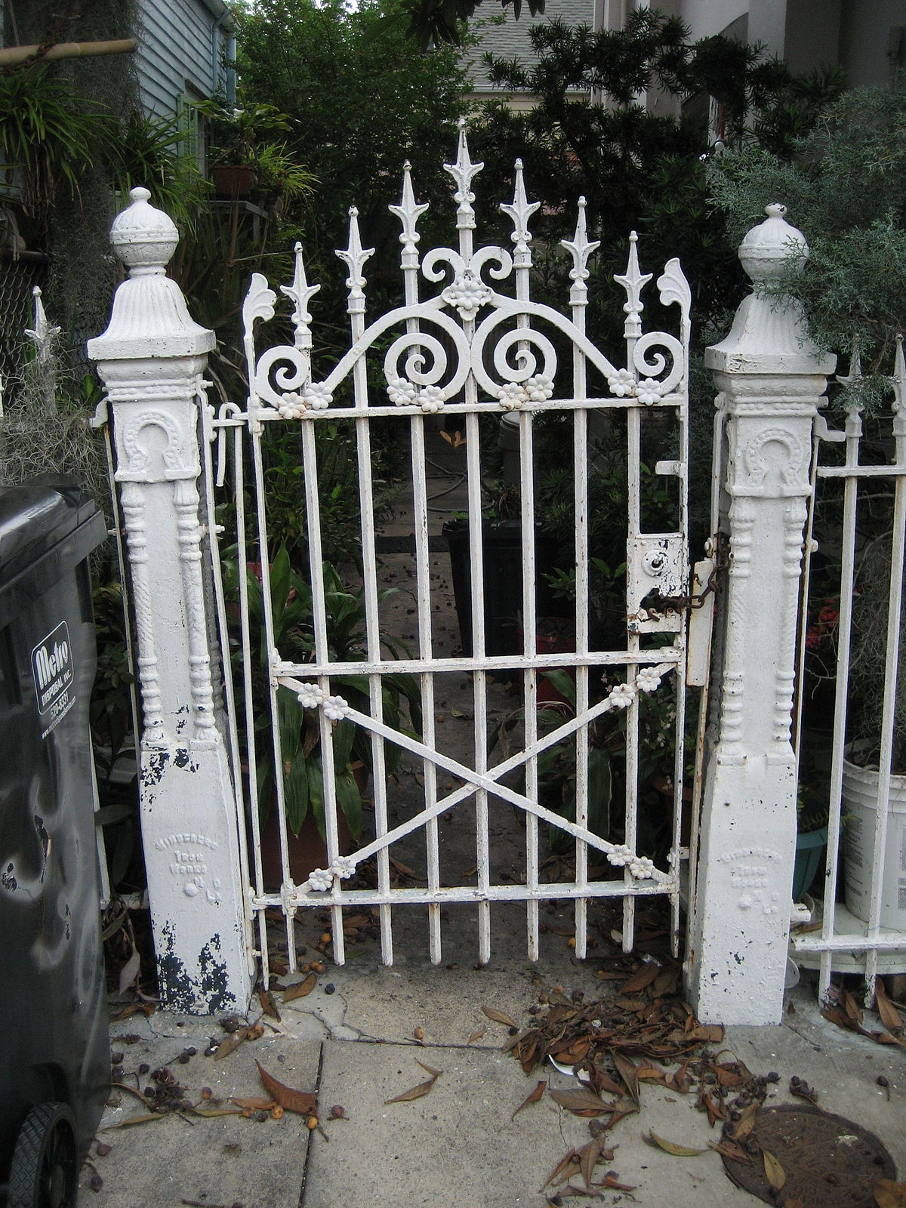
Think of some words that rhyme with gate.

Slide 7
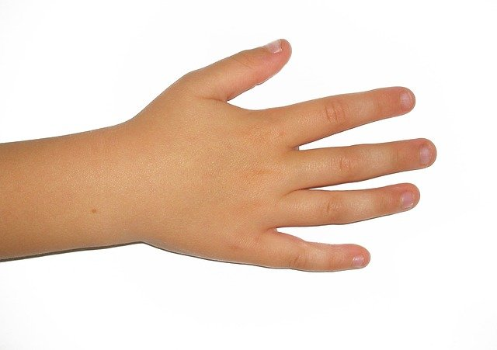
Think of some words that rhyme with hand.

