Slide 1
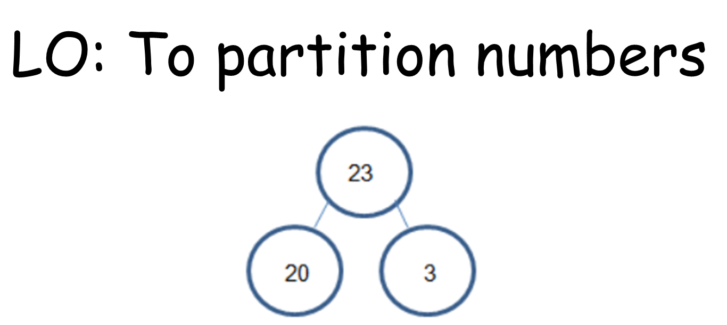
Lesson 1 – Maths

Slide 2
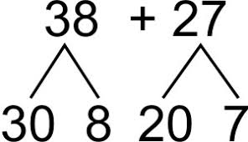
Let’s learn about partitioning!
https://www.bbc.co.uk/bitesize/topics/z69k7ty/articles/zyk8pbk

Slide 3
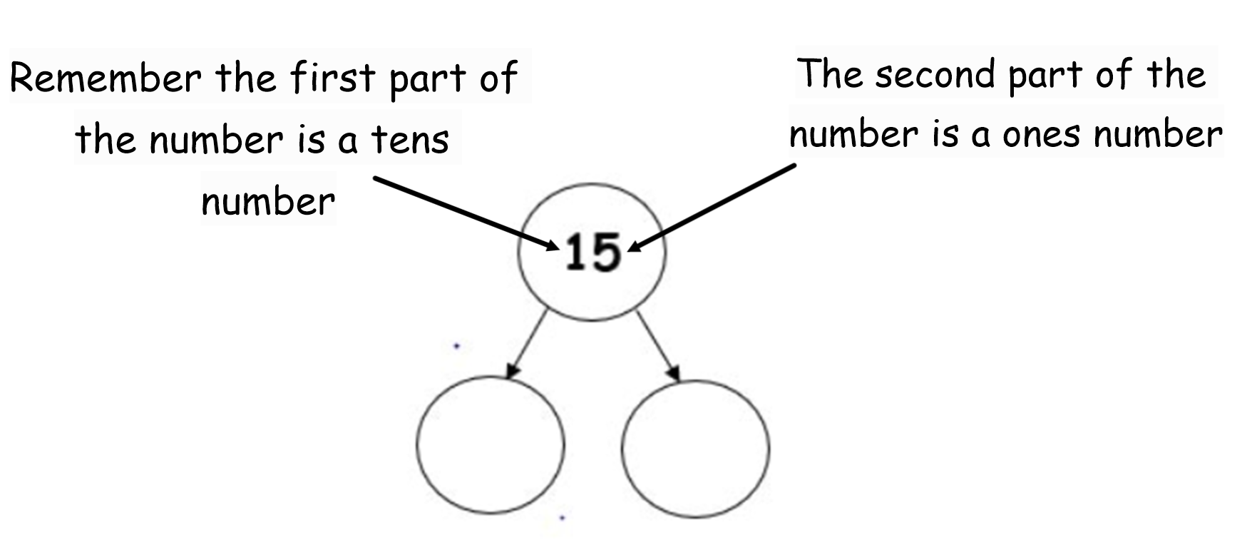

Slide 4
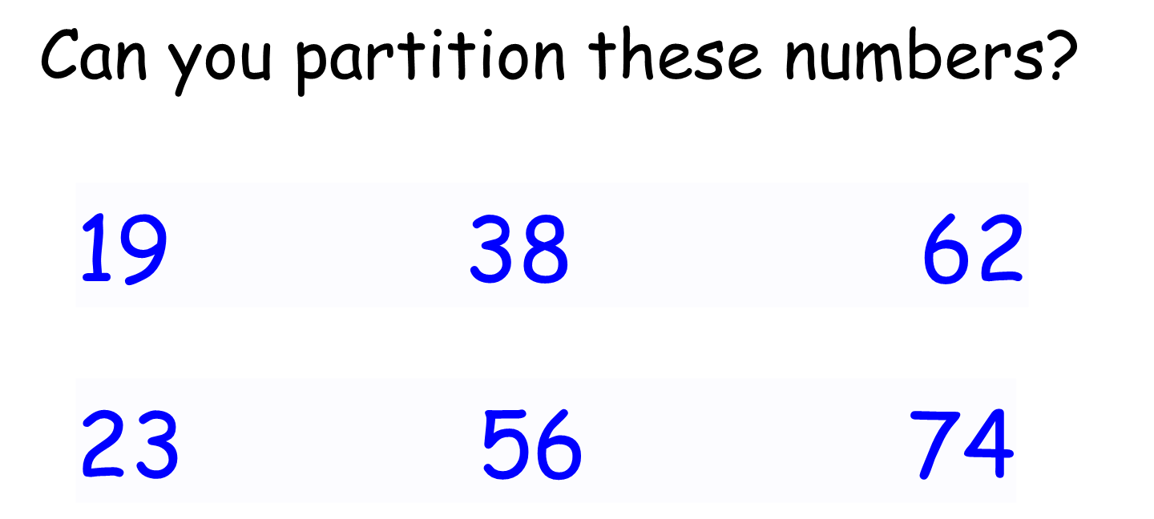

Slide 5


